Slide 1

Hierarchical DNA Memory based on Nested PCR
Satoshi Kashiwamura, Masahito Yamamoto, Atsushi Kameda,
Toshikazu Shiba, Azuma Ohuchi

Slide 2
Introduction
Nested Primer Molecular Memory
Data structure of NPMM
Addressing of the data
Merits of NPMM
NPMM design
strategy of primer design
Experiments
dissussion

Slide 3
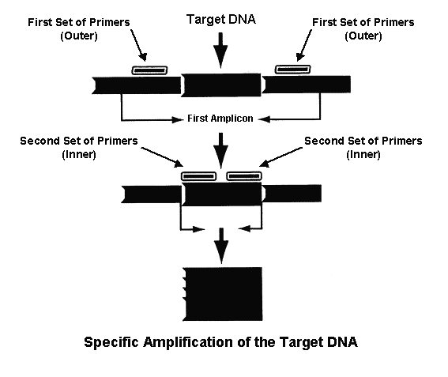
Nested PCR

Slide 4
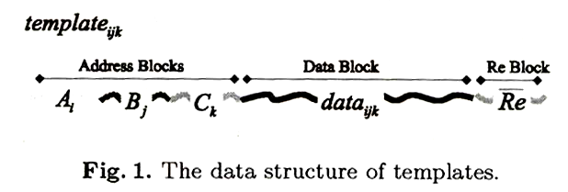
Data structure of NPMM
3 Address block : Ai / Bj / Ck I,j,k ∈ { 0,1,2 }
Re : reverse primer (common primer)
Example data ₁₀₁ = A1 , B0 , C1

Slide 5
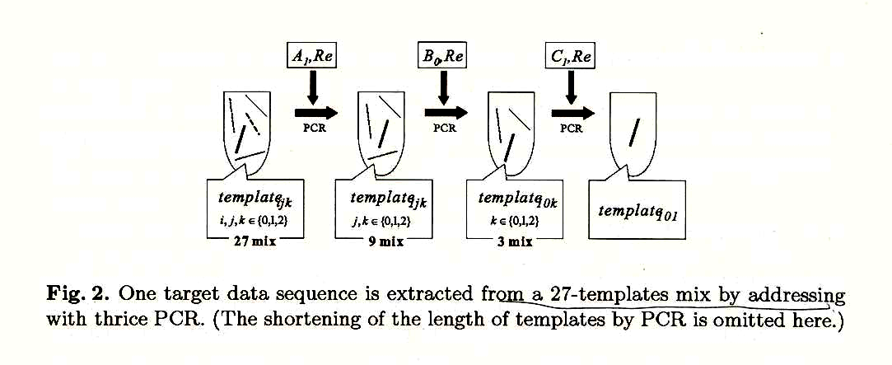
Addressing of the data
Select a p ∈ P and then perform PCR to NPMM with p and Re
Select another p’∈ P, then perform PCR to the diluted solution after previous PCR.
Repeat process 2 for an appropriate number of times

Slide 6
Merits of NPMM
The level of data security :
it is impossible to read data without primers
each primer works as a keys
each key is independent of other keys
A large capacity with a high reaction specificity :
M (bit) = 2 * Data(bp) * Primer block
M : the memory capacity of NPMM
Data : the length of the sequence in the data block
Block : the number of address blocks
Primer : the number of primers in each address block

Slide 7
NPMM design
Size of NPMM :
data sequence : 20bp
primers : all 15bp
template : 80bp ( 15 + 15 + 15 + 20 + 15 )
Several regards
GC content
hamming distance
3’ end complementary
Fitness = GC weight * GC value +
H weight * H value +
E weight * E value

Slide 8
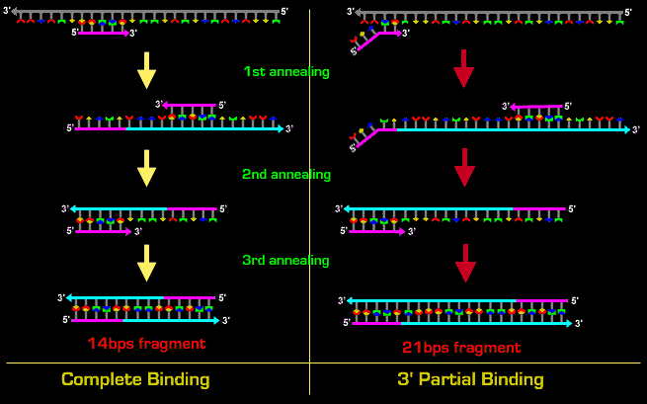

Slide 9
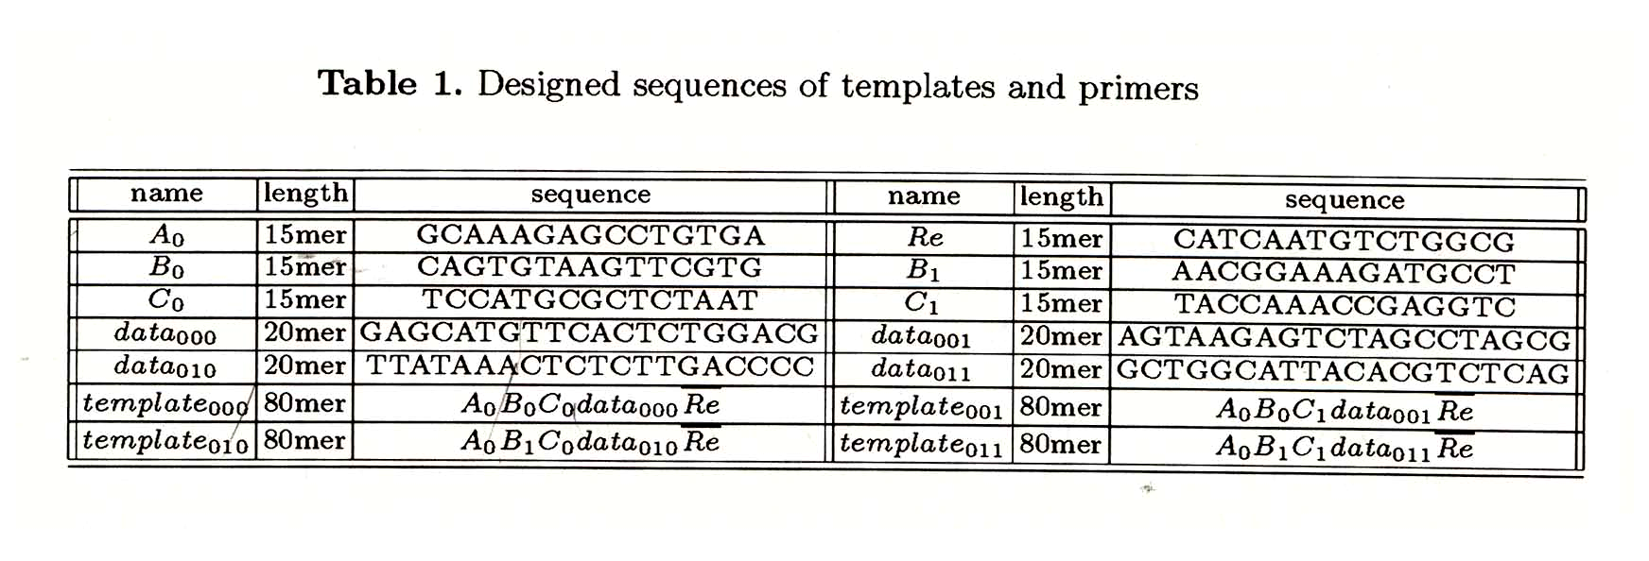
Experiments
expected result
data 000 = [ Bo , Co ]
data 001 = [ Bo, C1 ]
data 010 = [ B1 , Co ]
data 011 = [ B1 , C1 ]

Slide 10

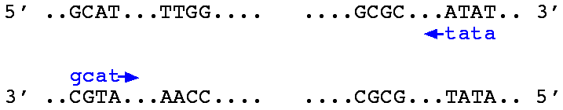

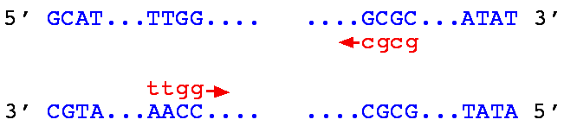

Amplify the target sequence
using Bo or B1 / Re
perform 23 cycle
denature 94C for 10sec
anneal 50C for 30 sec
extension 72C for 5 sec
using Co or C1 / Re
same condition

Slide 11
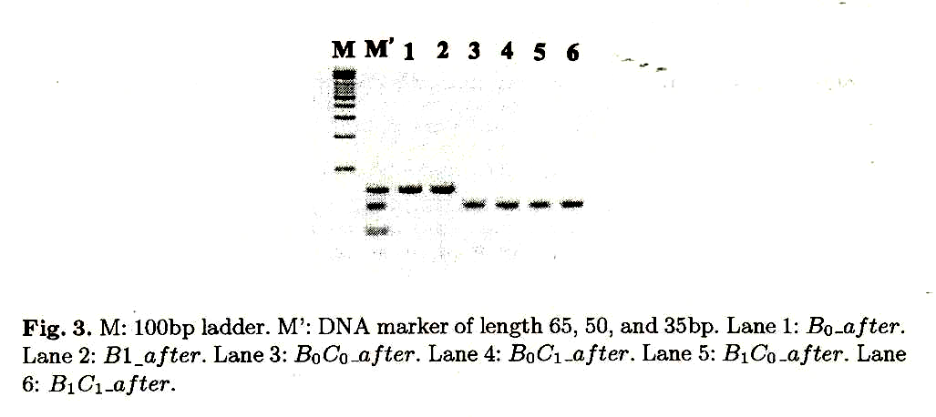
Result 1
Run 10% poly acrylamide gel

Slide 12
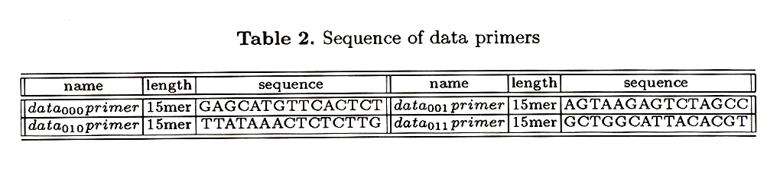
Detection of amplified sequence
15 mer
Bo
Co
Data ooo
Re
5’ end
50bp is too short to sequencing ---- need another PCR for detection

Slide 13
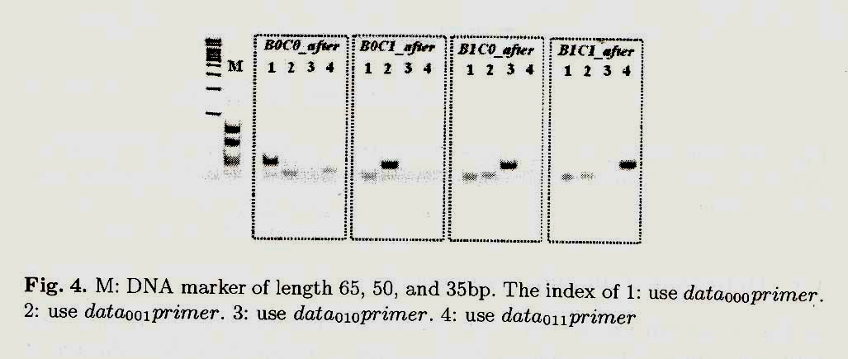
Result 2
using data 000 / data 001 data 010 / data 011 primers
perform 25 cycle using same condition
10% Poly acrylamide gel

Slide 14
Amplify using concatenation primer
2nd
1st / 2nd
1st
Bo
Co
Data ooo
Re
whether we can extract the target data by once PCR.
Anneal 50 C or 58 C or 74 C for 30 sec
PCR to NPMM using B0 C0
Detection of the sequence amplified with B0 C0

Slide 15
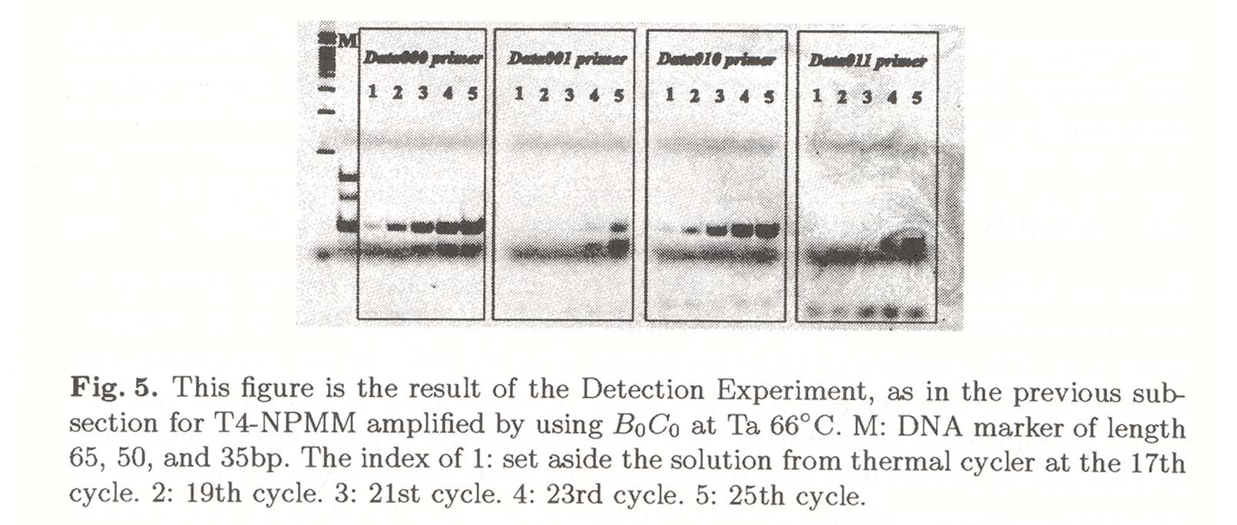
Result 3
using data 000 / data 001 data 010 / data 011 primers
10% Poly acrylamide gel

Slide 16
Discussion
Proposed a DNA memory with
A high capacuity / high data security / high specificity ..
Future work
Scaling up of NPMM
Design strategy for set of primers without dependence on the data sequence

