Slide 1
Universal Biochip Readout of Directed Hamiltonian Path Problems
C. L. T. Clelland, C. Bancroft and D. H. Wood
Preliminary Proceedings of the Eighth International Meeting on DNA Based Computers, pp. 301-310, June 2002
Cho, Dong-Yeon

Slide 2
Introduction
A Readout by Biochip
  Directed Hamiltonian problem
  An important difficulty
    All paths become superimposed upon one another.
A Universal Readout for DNA-encoded Graphs
  We have designed a readout procedure using innovative multiple labeling that is based upon a universal biochip.
  Efficient algorithms for computational determination of multiple solutions from our partial view readouts are under development.

Slide 3
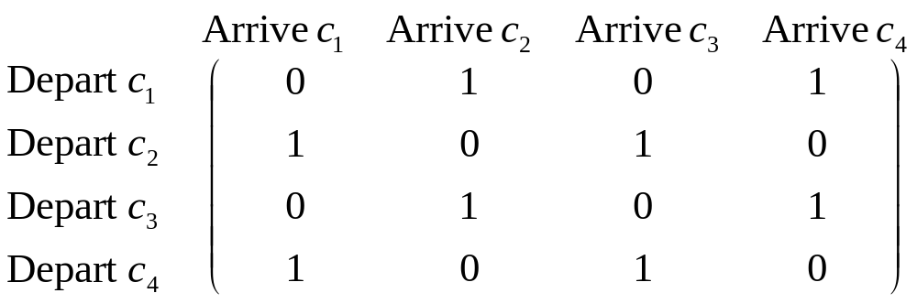
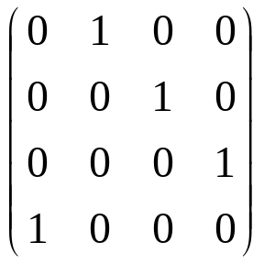
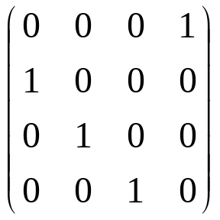
Graphs and Their Representations
Adjacency Matrix of a Graph
  n × n matrix of 0s and 1s
  There is no general method for recovering the individual graphs from the superposition.

Slide 4
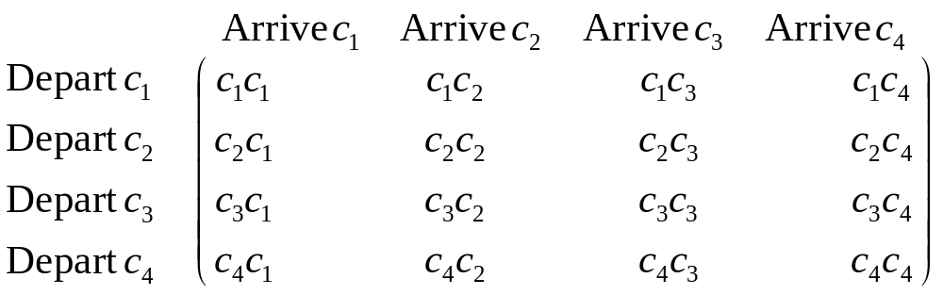
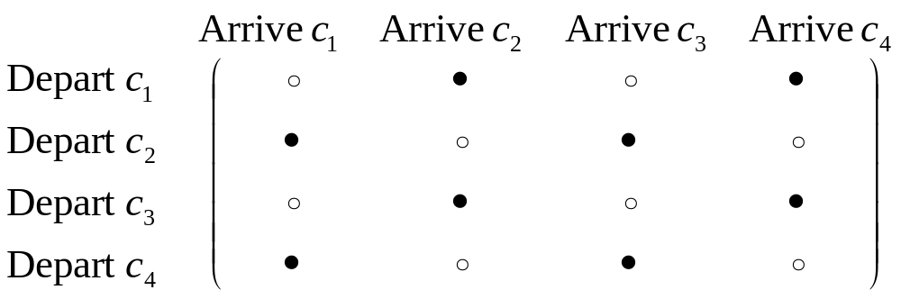
Design of the Universal Graph Readout Biochip
DNA sequences
  DNA sequence are designated c₁, c₂, …, c_{n}.
Appearance of Biochip Readout

Slide 5
Quantum Dot Barcodes for Optical Readout
Fluorescent Quantum Dots (Q-dots)
  When hit by a beam of light, Q-dot electrons emit light at a predetermined wavelength directly related to the size of the Q-dot.
Q-dot Barcodes
  Q-dots can be integrated into microbeads.
  “A realistic scheme” could use 5-6 colors with 6 intensity levels (0, 1, …, 5), yielding approximately 10,000 to 40,000 distinguishable barcodes.

Slide 6
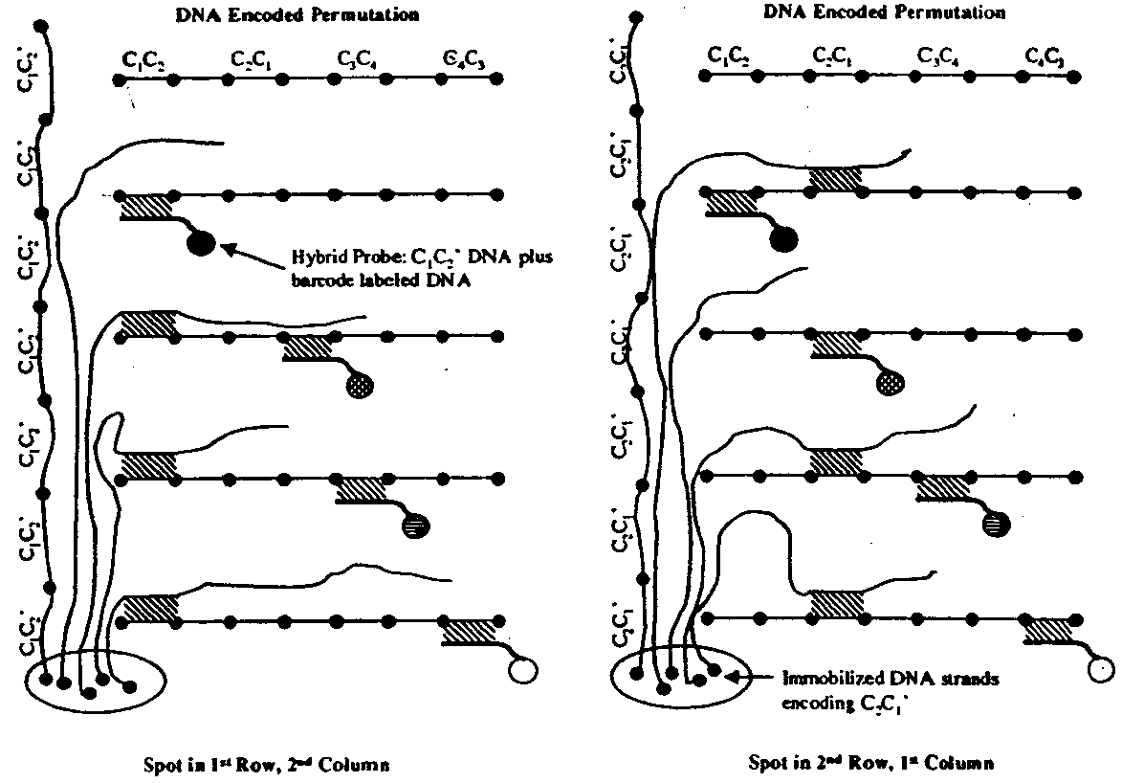
Graph Readout Using the Universal Biochip
n² Different Labels

Slide 7
Conclusion
A Novel Technique for the Readout of Multiple HPs
  Quantum-dot barcodes
  Biochip hybridization
  More efficient computer algorithms are under development for processing our biochip readouts to completely resolve superpositions of arbitrary collections of permutation graphs.

