Slide 1
Designs for Autonomous Unidirectional Walking DNA Devices
P.Yin, A. J. Turberfield, J. H. Reif
DNA10
Summarized by Ki-Roo Shin

Slide 2
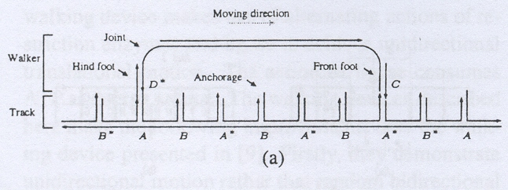
Old Design

Slide 3
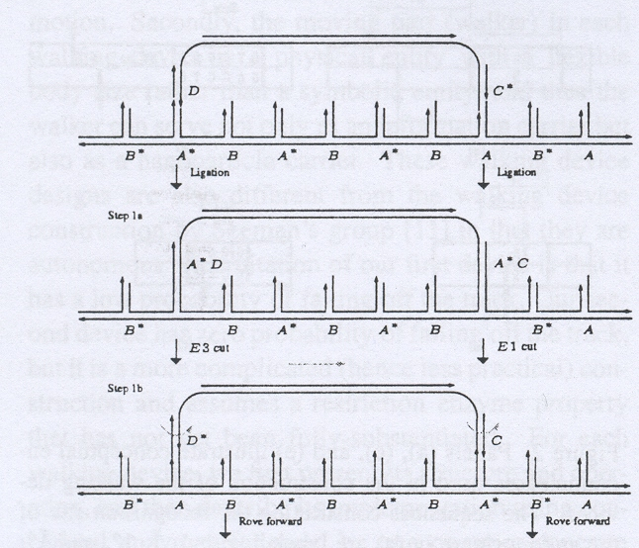

Slide 4
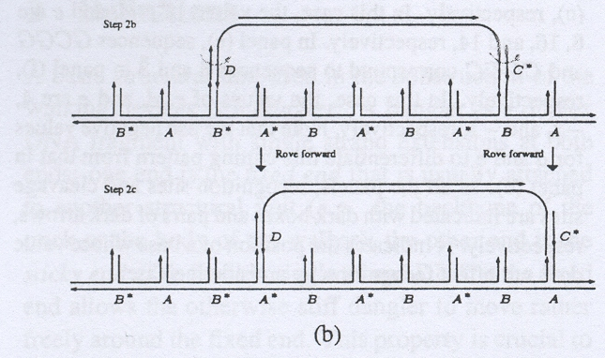

Slide 5
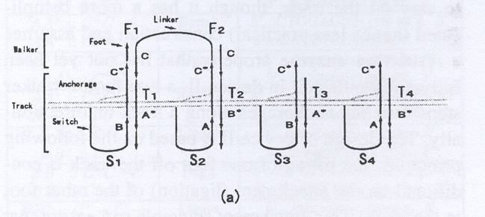
New Design

Slide 6
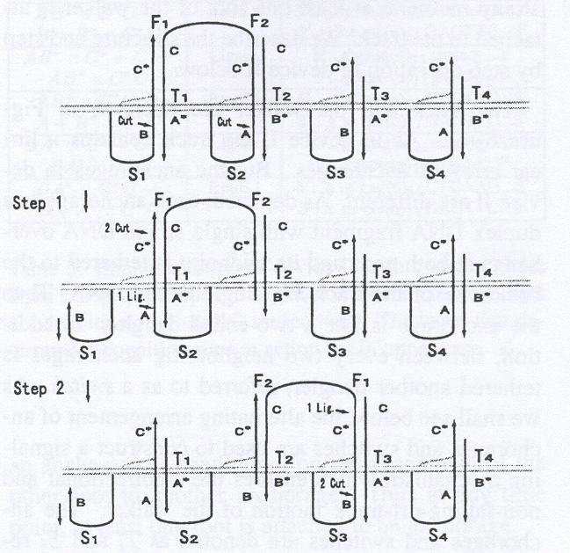

Slide 7
