Slide 1

TileSoft: Sequence Optimization Software
for Designing DNA Secondary Structures
P. Yin*, B. Guo*, C. Belmore*, W. Palmeri*, E. Winfree†,
T. H. LaBean* and J. H. Reif*
Summarized by HaYoung Jang

Slide 2
Abstract
DNA is a crucial construction material for molecular scale objects with nano-scale features. Diverse synthetic DNA objects hold great potential for applications such as nano-fabrication, nano-robotics, nano-computing, and nano-electronics. The construction of DNA objects is generally carried out via self-assembly. During self-assembly, DNA strands are guided by their sequence information into secondary structures to maximize Watson-Crick pairing of their bases and thus minimize the free energy of the resultant structures. A crucial computational problem in constructing DNA objects is the design of DNA sequences that can correctly assemble into desired DNA secondary structures. However, existing software packages only provide unintuitive text-line interfaces and generally require the user to step through the entire sequence selection process, which could be time-consuming and tedious. In contrast, TileSoft described here deliver the following features:
  Its graphical user interface renders the molecular architect the ability to define DNA secondary structure and accompanying designing constraints directly on the interface as well as the ability to view the optimized sequence information pictorially.
  Its fully automatic optimization module, which uses an evolutionary algorithm built on top of DNADesign by E. Winfree, relieves the user of the drudgery of manually dictating the sequence selection process, and its evolutionary algorithm produces satisfactory results efficiently.
  Its graphical user interface and its optimization module are smoothly integrated from user's perspective, while they are at the same time well separated in terms of software architecture, making each amenable to future improvements without negatively affecting the other.

Slide 3
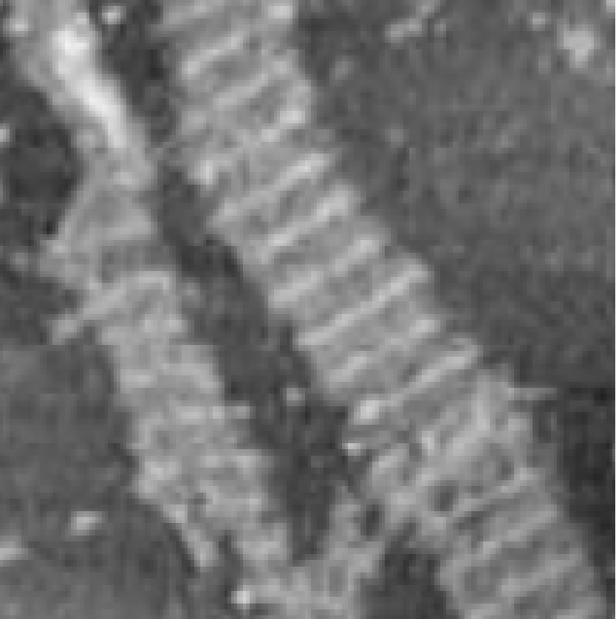
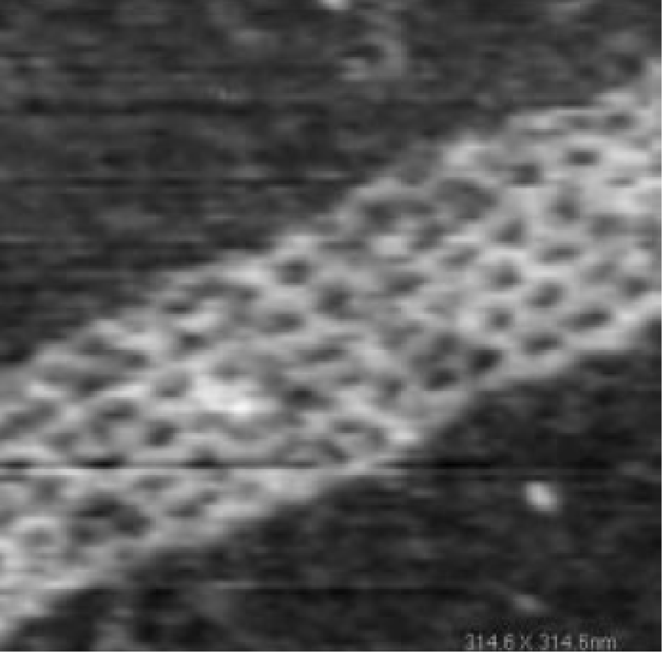
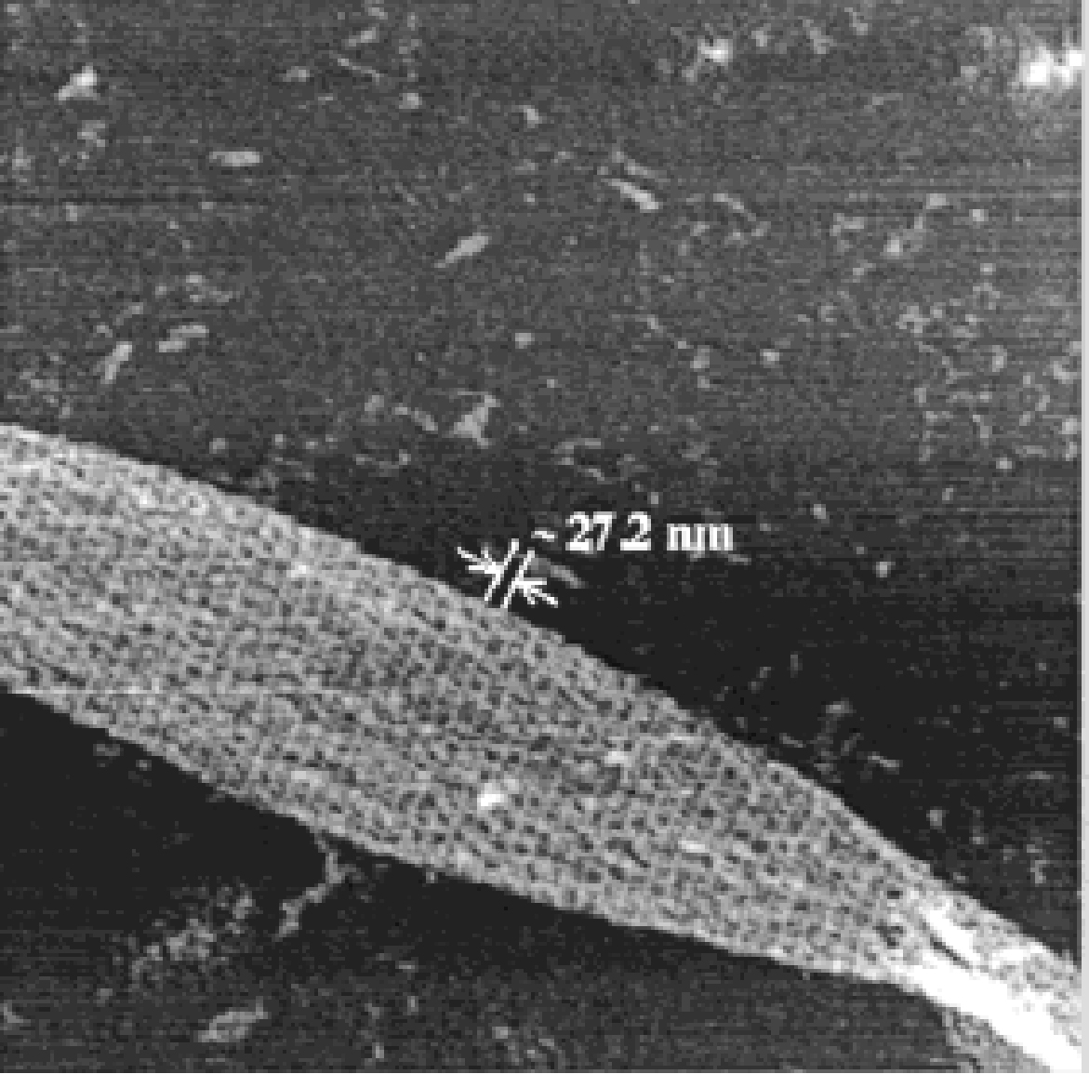
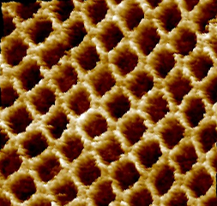
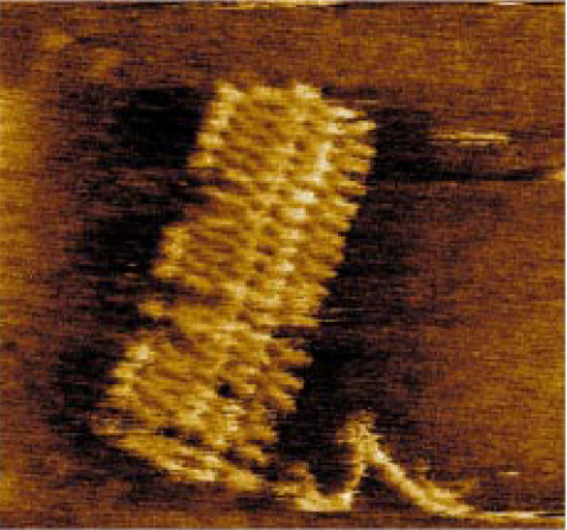
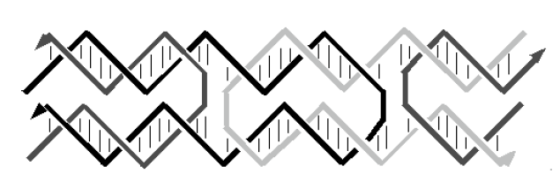
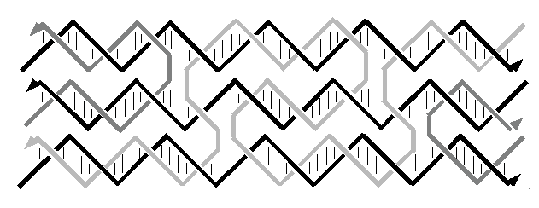
Motivation: Designing DNA tiles
DX lattice
Rhombus lattice
TX lattice
4x 4 lattice
Barcode lattice
DNA as nano-construction material
Self-assembly as bottom-up nano-construction method
DNA lattices made of DNA tiles, i.e. smaller DNA secondary nanostructure units
Design process:
  Template design
  Sequence selection (optimization)
DX tiles
TX tiles

Slide 4
Prior work v.s. TileSoft
DNA word design software:
  Produce a pool of DNA sequences such that each sequence is of maximal difference from others
Sequin:
  Generate DNA sequences that uniquely assemble into desired secondary structures
  Text line interface for inputting template and displaying optimized sequences
  Sequence optimization process only semi-automated
TileSoft: Available at http://www.cs.duke.edu/~py/dnaTileSoft/.
  Generate DNA sequences that uniquely assemble into desired secondary structures
  Graphical interface for inputting template and displaying optimized structure (GUI Module)
  Sequence optimization process fully automated (Optimization Module)
  GUI Module and Optimization Module smoothly integrated for end users, yet well separated in software architecture

Slide 5
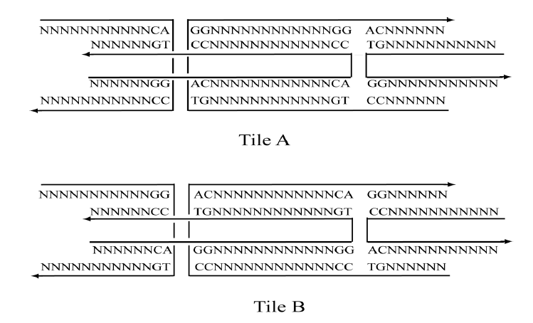
Tile Set Design Procedure
Topological structure of each single tile
Constraints on the DNA sequences:
  The complementary of pairing sticky ends
  The specific enzyme recognition sites
  The specification of the base composition of the junctions

Slide 6
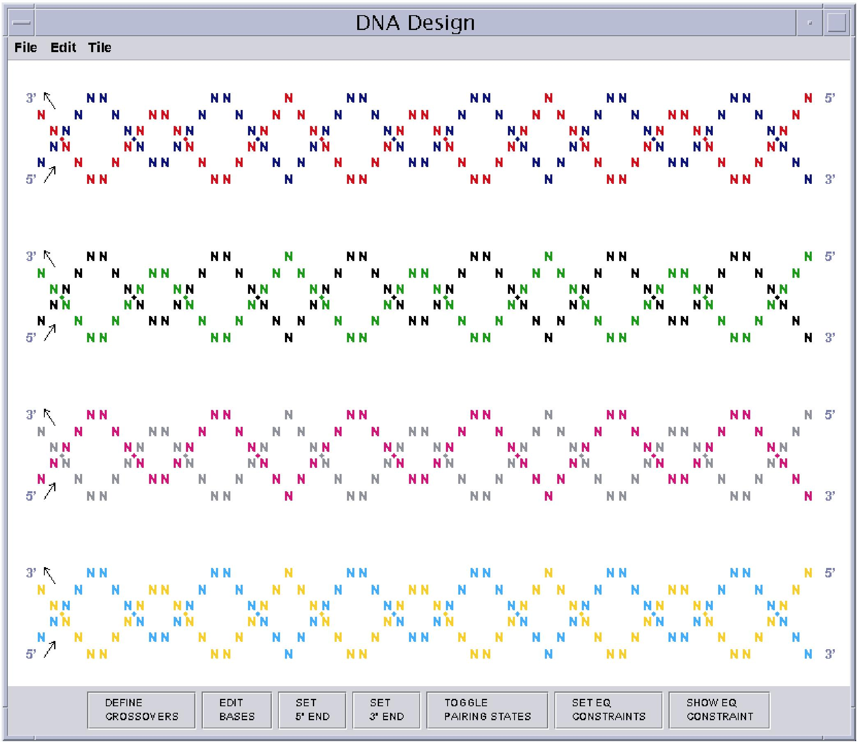
GUI: Default window

Slide 7
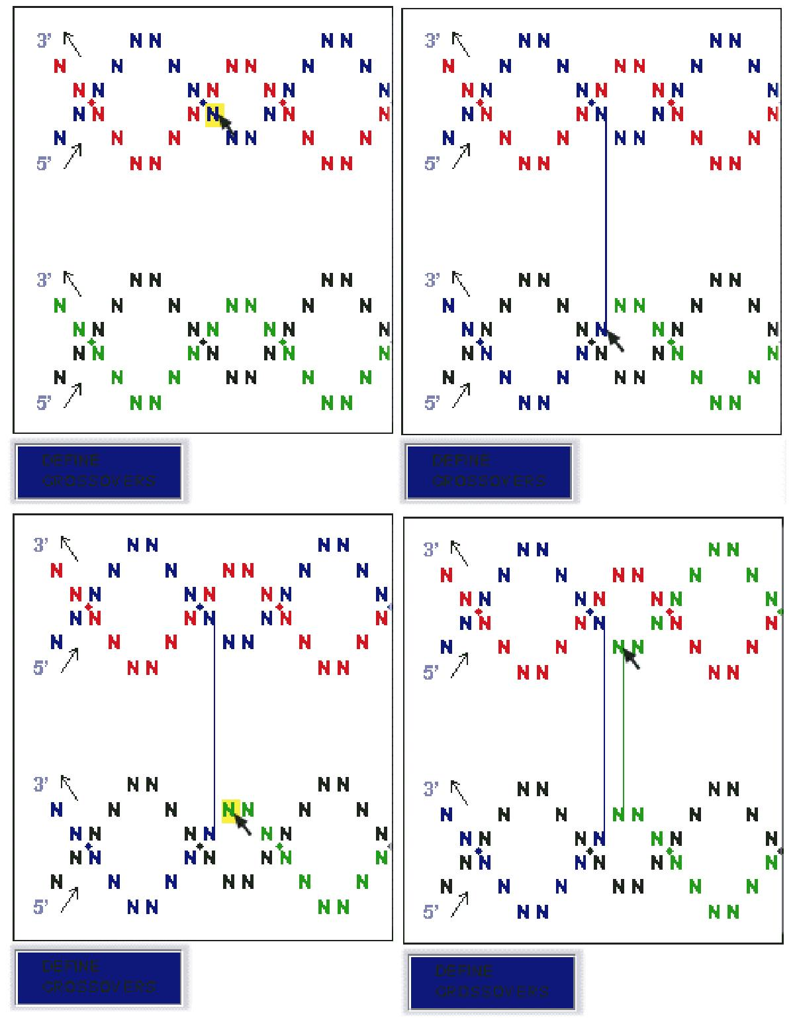
GUI: Define Crossover
The user can define crossovers between helices, by clicking sequentially the two bases to be connected in 5' to 3' order.

Slide 8
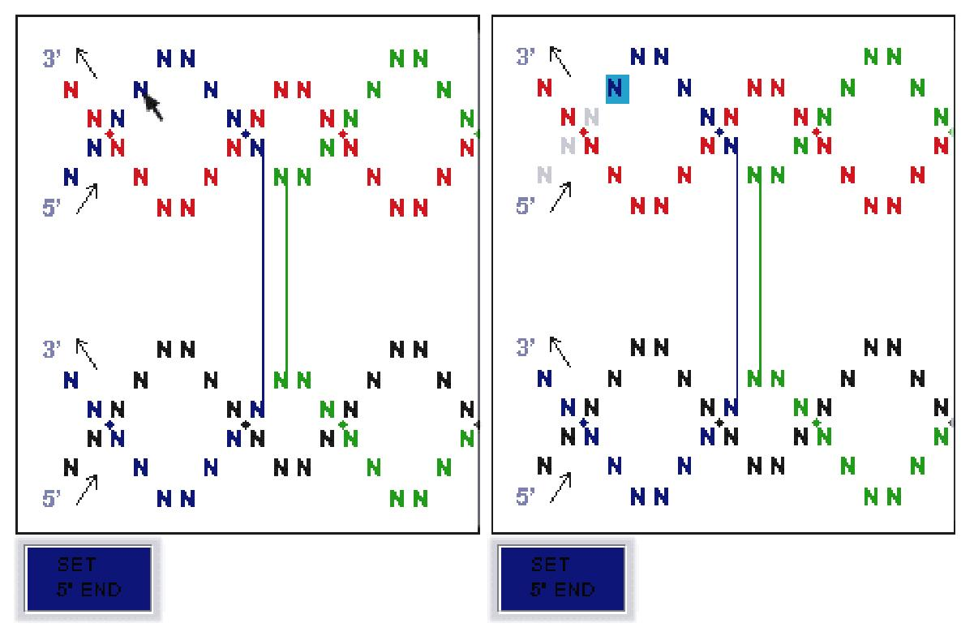
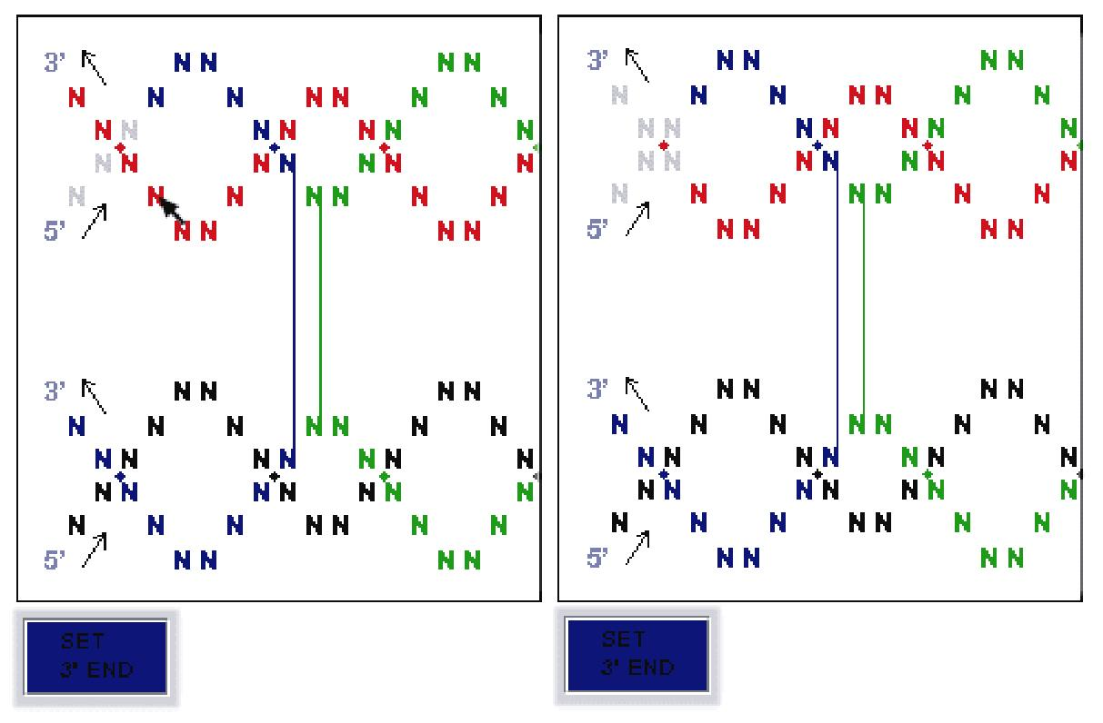
GUI: Set 5’ end; set 3’ end
Set 5’ end
Set 3’ end
By setting the 5' end and 3' end of a DNA strand, the user specifies the length of the strand, and the unused segment of the strand is deleted automatically (showed in color gray).

Slide 9
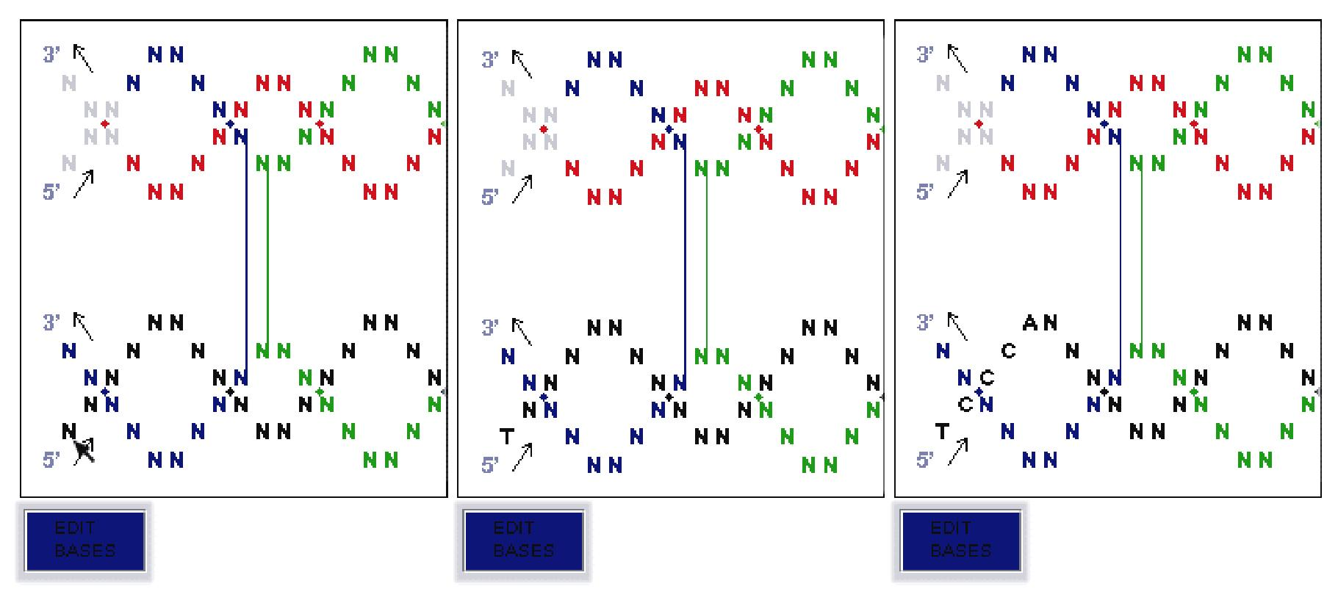
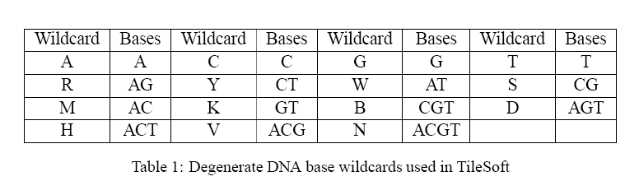
GUI: Edit base
The user can directly input the base values for a strand by typing; Typing more than one character edits consecutive bases in the 5' to 3' direction along the strand

Slide 10
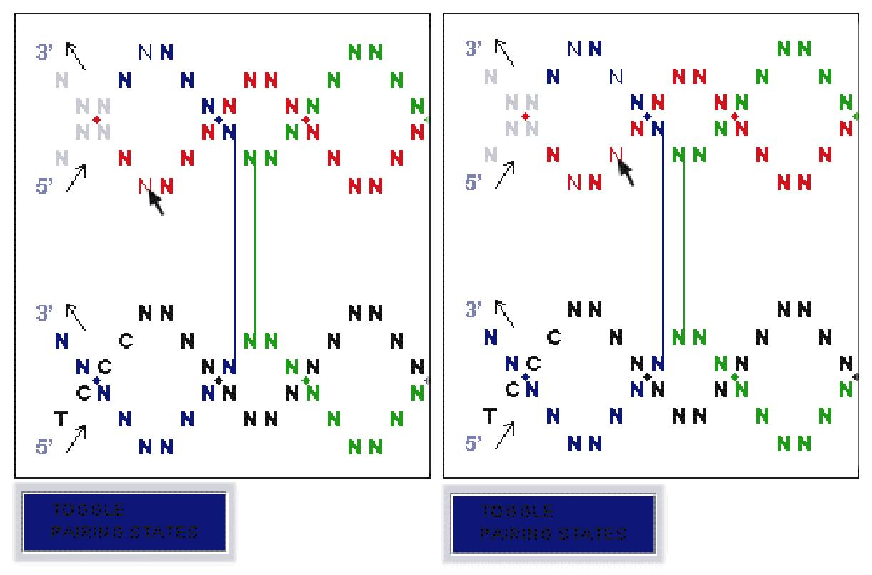
GUI: Set non-Waston-Crick base pairing
The user can define the subsequences that are not required to be Watson-Crick base paired by clicking on the starting and ending bases of the subsequences.

Slide 11
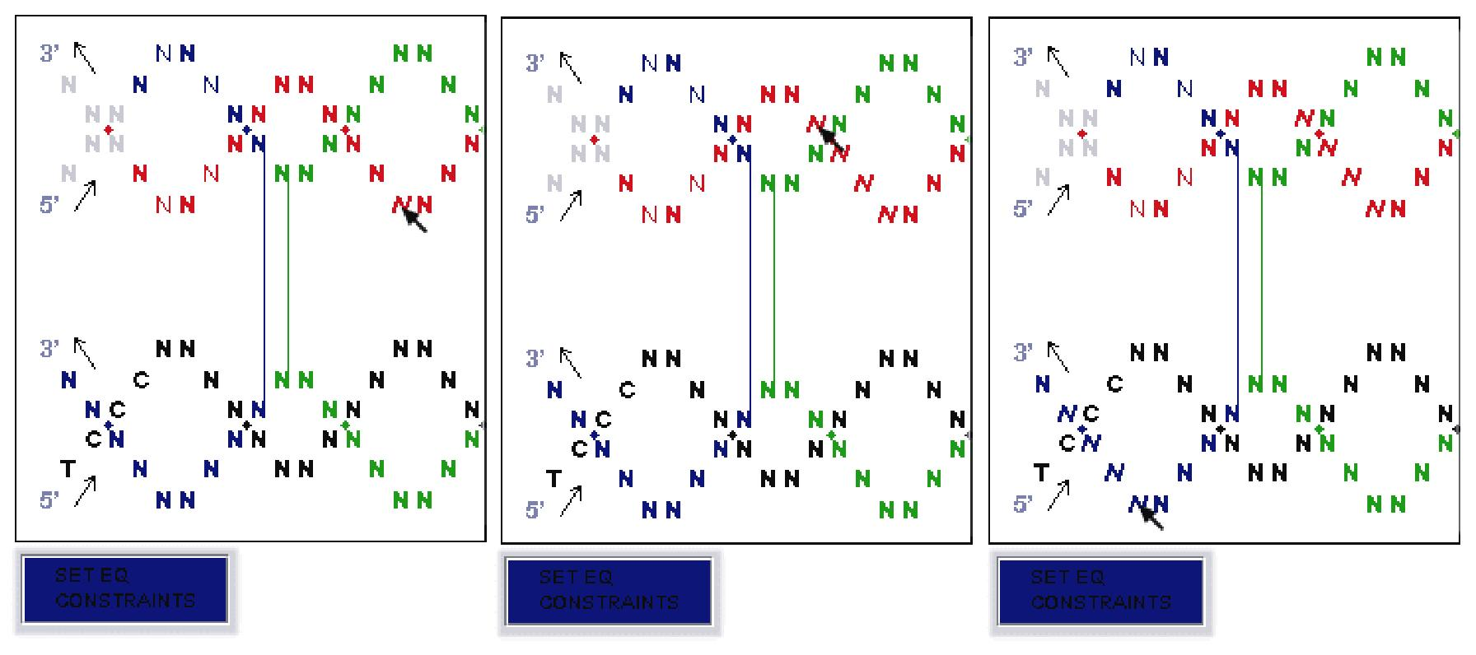
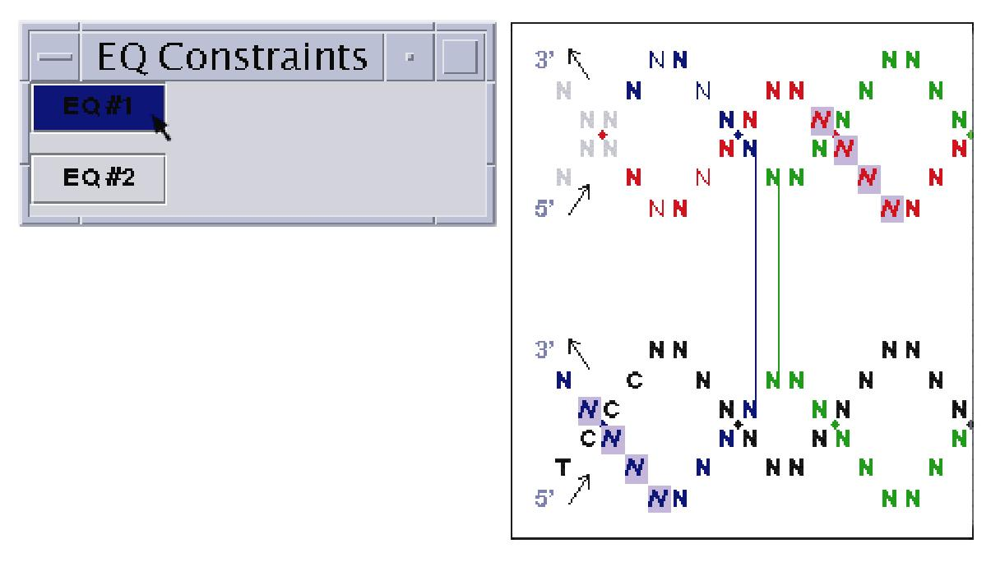
GUI: Set and show EQ constraint
Set EQ constraint
Show EQ constraint
Set EQ constraint: Clicking on two bases in one strand defines the starting and ending points of the first sub-sequence, and a click on another base delineates the second sub-sequence with the same length and direction as the first one.
Show EQ Constraint: A small window is brought up that contains multiple buttons, with each representing a set of equal sub-sequences. When one of these buttons is clicked, the corresponding sub-sequences will be highlighted in purple.

Slide 12
Optimization module
The optimization module is developed based on DNADesign by E. Winfree.
The optimization module enhances DNADesign employs an evolutionary algorithm to find the best solution to the optimization objective function.
Evolutionary algorithm:
  An evolutionary algorithm maintains a population of DNA sequences, which are generated randomly during initialization. During selection, the fittest DNA sequences are chosen for reproduction, based on their score according to the objective function. These individuals are used to generate new individuals via mutations and crossovers, and the newly produced individuals are reinserted into the population. The process is repeated until meeting some termination condition.
Objective function as in DNADesign:
  The objective function consists of two weighted factors, the count of unwanted complementary sequences spurious matches (as the sequence-symmetry minimization algorithm used in Sequin) and the count of to-be-avoided sub-sequences, e.g. long AT runs.

Slide 13
Future work
GUI:
  Geometrically more flexible structures
  Make the number of helices and number of bases per helix user specifiable
Optimization:
  Multiple parallel traces of optimization process with different starting points
  A pre-optimized library
  Incorporate parameters such as hybridization temperature and software modules such as BIND
  A new heuristic that performs optimization based on existing pre-optimized duplex libraries
Other:
  Curvature analyzer (S. H. Park, Duke Physics )
  Make the software more robust

