Slide 1
Biomolecular Computation in Virtual Test Tubes
7th International Meeting on DNA Based Computers, p75-83, June 10-13, 2001
Max Garzon, Chris Oehmen
Summarized by Dong-min, Kim

Slide 2
Introduction (1)
Biomolecular Computing (BMC) aims:
  To capture the advantages of biological molecules.
  Either through new experiments of biotechnology
  Or through theoretical results, such as universality and complexity.
But, we must address the fact:
  Biomolecular protocols in use are too unreliable, inefficient, unscalable, and expensive

Slide 3
Introduction (2)
An alternative approach is:
  To introduce an analog of biomolecules in electronics and computational algorithms that parallel their biological counterparts.
Experimental results show that:
  Molecular computing can be implemented much more efficiently in silico than the corresponding experiments in vitro.

Slide 4
Introduction (3)
Assume that:
  BMC has the competitive advantage in their massive parallelism.
Thus, the computation type of BMC is:
  asynchronous, massively parallel, and determined by both local and global properties of the processor molecules.

Slide 5
Virtual Test Tubes
Edna is a piece of software.
Edna simulates:
  the hybridization actually happen in a test tube,
  All random brownian motion of strands,
  Chains of complex molecular interactions.
  The tube conditions in a realistic way, such as temperature, salinity, covalent bonds, etc
Edna exhibit:
  Ready programmability, robustness, high degree of reliability

Slide 6
EdnaCo’s Architecture
EdnaCo is a distributed environment for simulating BMC
The computational framework of EdnaCo
  Distributed over several processing nodes
  Joined transparently
  Each node simulates a single tube fragment
  Node table tracks the movement of strands
  Two modes of hybridization (stacking energy, h-distance)

Slide 7
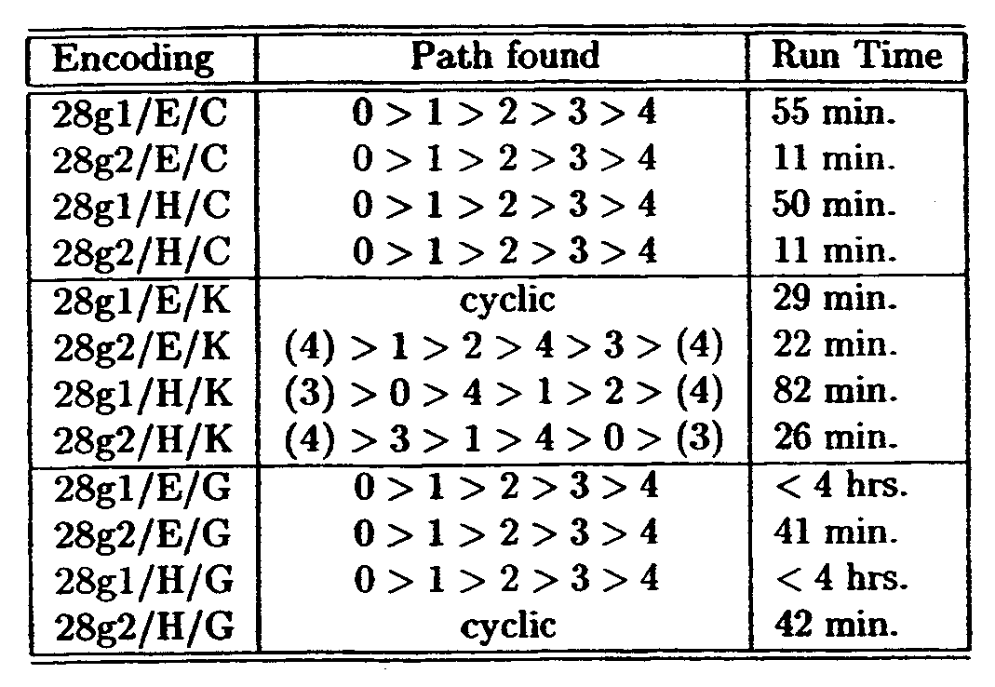
Experimental Results (1)
Scaling up Adleman’s Experiment
  Reproduce adleman’s result with electronic version
  E (stacking energy),
  H (h-distance)
  “Path” refers to the witness
  path actually formed
  C (cyclic graph),
  K (complete graph),
  G (5 vertices and 7 edges
  0->1, 0->3, 1->2,1->4, 2->3, 3->2, 3->4)
  Successful to scale up to about 15 vertices (25 edges)

Slide 8
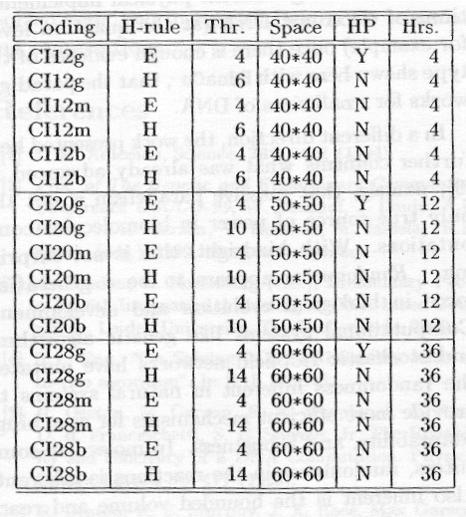
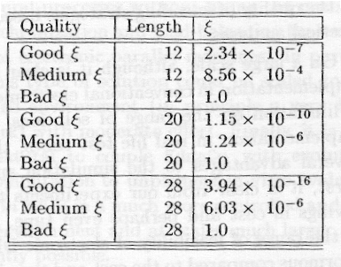
Experimental Results (2)
Evaluation of CI encodings
  Computational incoherence based on statistical mechanics

Slide 9
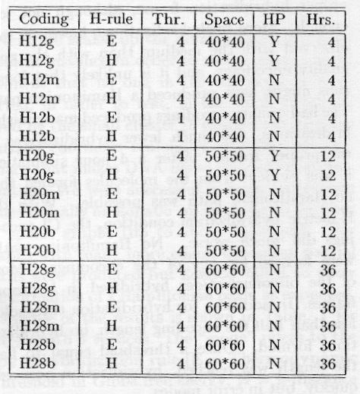
Experimental Results (3)
Evaluation of h-metric Encodings
  Hybridization likelihood that extends Hamming distance
  The minimum of all
  Hamming distance
  obtained by successively
  shifting and lining up
  the WC-complement
  of two sequence

Slide 10
Conclusions and Future Work
Electronic DNA is capable of solving in practice Adleman’s experiment in silico for fairly large problem size
Several advantages of the simulation approach
  Save costs and time
  Electronic DNA give reliability, control, scalability and programmability
Randomness is another source of power in BMC
BMC can exploit the inherent parallelism over the problems of synchronization and load-balancing

