Slide 1
DNA Computing in Microreactors
Danny van Noort, Frank-Ulich Gast and John S. McCaskill
Biomolecular Information Processing, GMD, Germany
Lee Ji Youn

Slide 2
Introduction
대상문제 : combinatorial optimization problems
  ⇒ maximum clique, 3-SAT
장점 : generically programmable
Key words
  programmability
  integration of biochemical processing protocols
  photochemical and microsystem techniques
  STM : a magnetically switchable selective transfer module
  basic sequence-specific DNA filtering operation

Slide 3
Benchmark problem
Maximal clique problem
  : finding the largest subset of fully interconnected nodes in the given graph
  : devided into two stages
    1. select from all node subsets, those corresponding to cliques in the graph
    2. find the largest such element
Algorithm
  : consisting of a series of selection steps containing three parallel selection decisions
  : performed with a network of O(N ²) STMs

Slide 4
MCP
Basic algorithm
  for each node i (i ≥ 1) in the graph ratain only subsets either not containing node i or having only other nodes j such that the edges (i,j) are in the graph
    ⇒ This can be implemented in two nested loops (over i and j), each step involving two selectors in parallel
  third selector : allow the selector sequences to be fixed independently of the graph instance

Slide 5
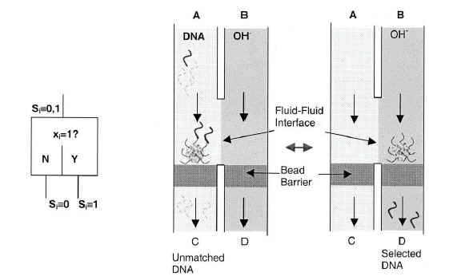

Slide 6
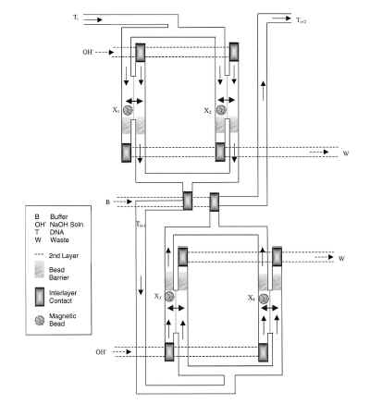
(x₁∨ x₂ )∧(x₃∨ x₄ )

Slide 7
The key problems with STM
1. Non-specific binding of DNA to the beads
2. Avoiding extensive dilution of the transferred DNA
3. Reliable magnetic transfer of the beads in the face of surface adhesion forces
4. Regulating the position of the two fluid contact surface

Slide 8
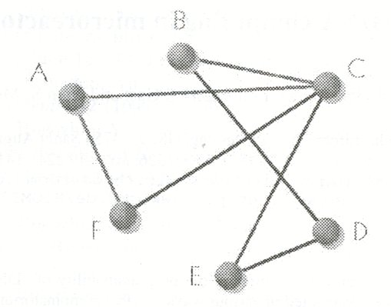
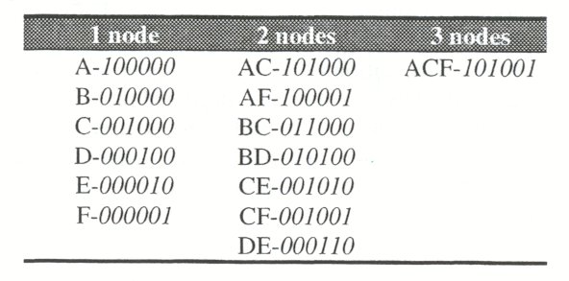
Maximal clique
  ACF ⇒ 101001
All possible cliques

Slide 9
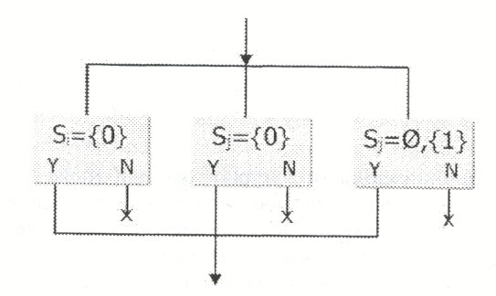
Three selection modules in parallel
  absence of i
  absence of j
  presence of edge (i,j)
Positive selection

Slide 10
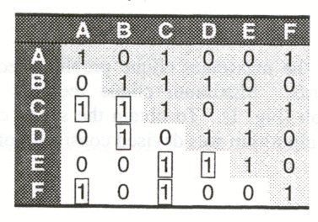
Connectivity matrix
1
N(N-1)
2

Slide 11
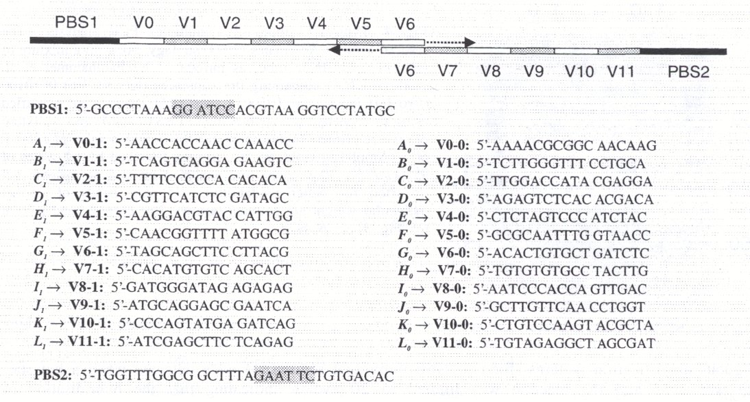
DNA library
BamHI
EcoRI

Slide 12
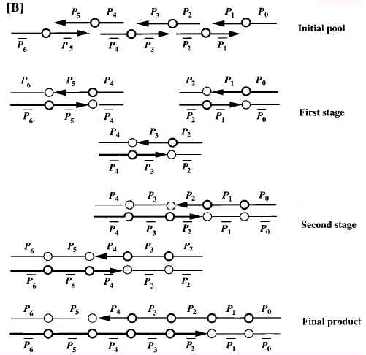
POA (parallel overlap assembly)
  : with 12 oligonucleotides
P_{i}V_{i}P_{i+1} for even i
P_{i+1} V_{i} P_{i} for odd i
P₀V₀P₁ P₂V₂P₃ P₄V₄P₅
P₂V₁P₁ P₄V₃P₃ P₆V₅P₅
PCR with P₀ and P₆
as primers (lane2 in fig3)

Slide 13
16 nt
  : identical G+C content (50%)
    ⇒ to obtain comparable melting points
  : long enough to ensure specific hybridization
  : short enough to minimize secondary structure

Slide 14
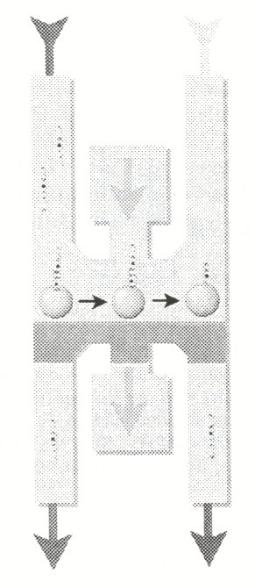
Channel A
- DNA template
inlet
Channel C
- dehybridization
(NaOH)
bead barrier
Channel B
- rinse-off

Slide 15
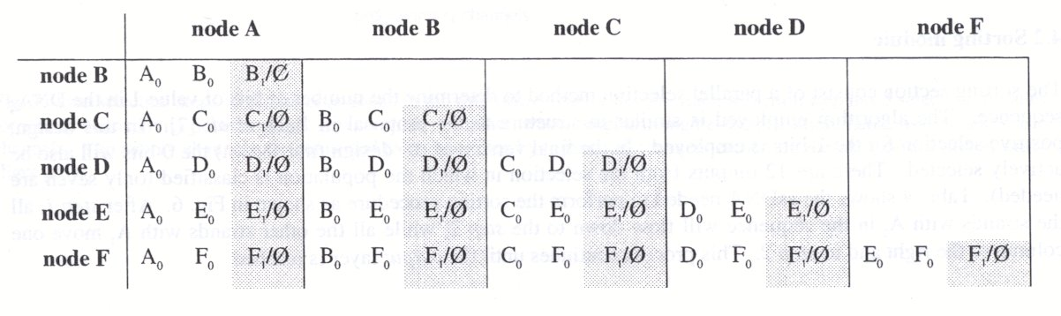
All necessary selection steps
  The shaded area is programmable and is determined by the edges between node i and j

Slide 16
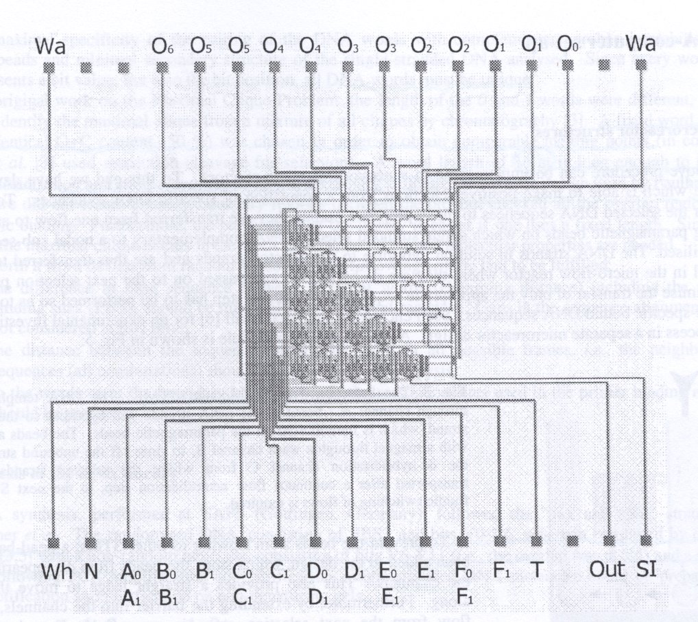
waste
output
sorting
module
input
wash
inlet
inlet
template
sorting
module
output
ssDNAs programming inlets

Slide 17
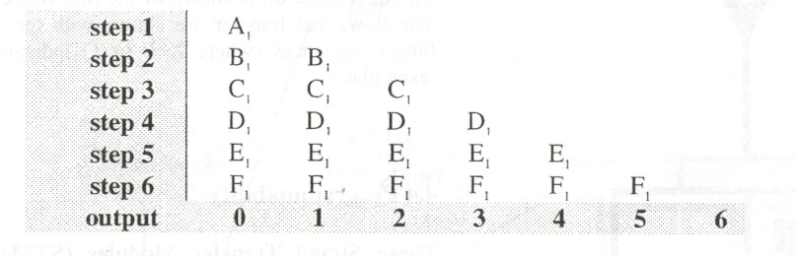

Slide 18
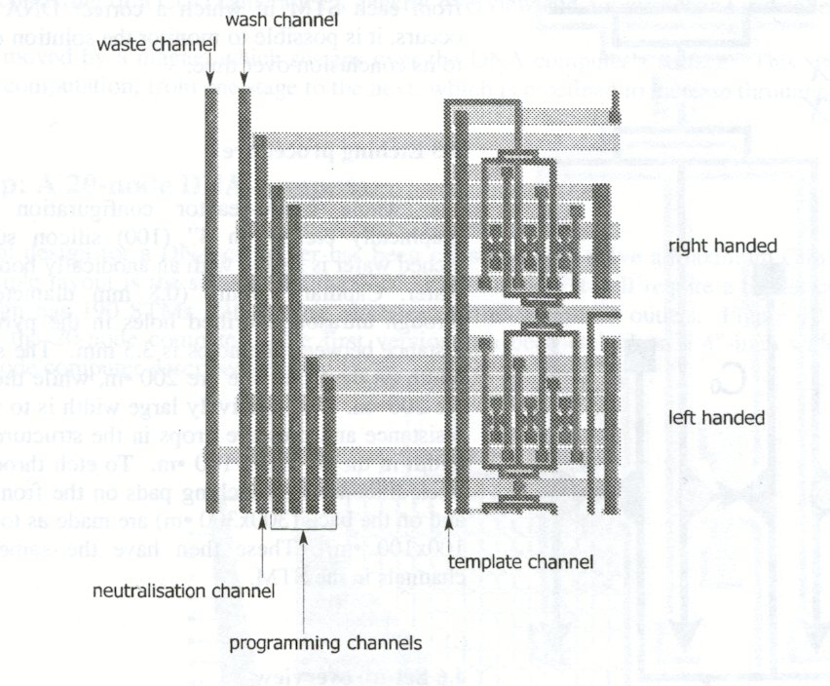
3 selection modules for a connectivity decision (dark grey)
supply channels (light grey)

Slide 19
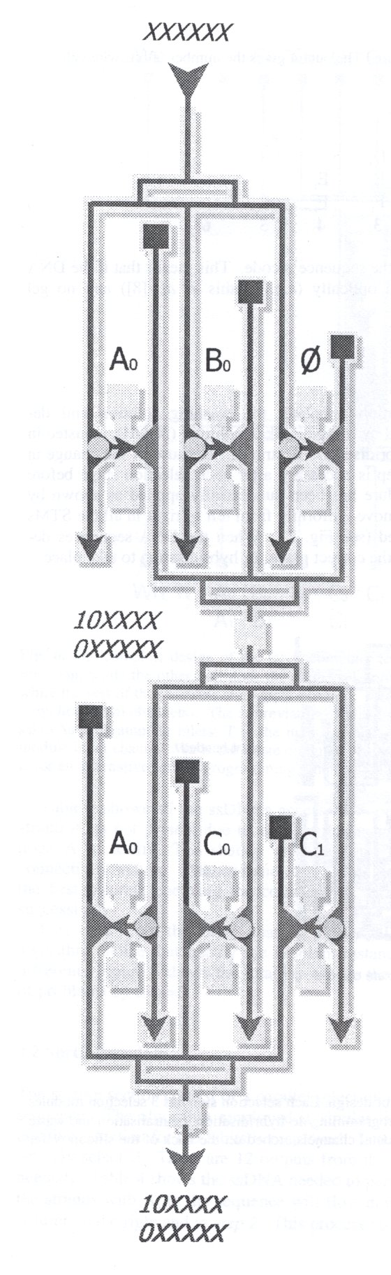

Slide 20
Programmability
Paralle
Tm
Experiment
Complicated or not?

