Slide 1
Being Bayesian about Network Structure
Nir Friedman & Daphne Koller

Slide 2
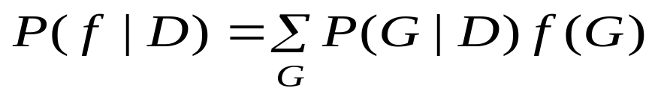
Introduction
Goal
Features of Structure
Family
edge

Slide 3
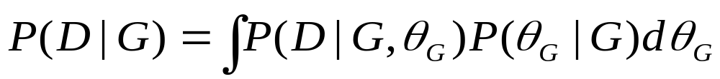
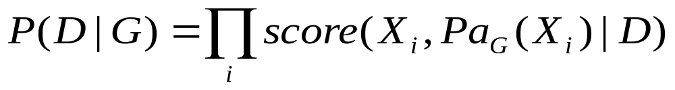


Bayesian learning
  The form of the Posterior probability

Slide 4
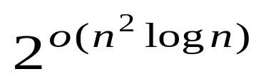


Bayesian model averaging
Computation time ~
If we take a boung k on the number of parents per node ~
  It is feasible only for tiny domains(4~5 nodes)
One of the approximation solution
High scoring structures

Slide 5
How can we construct g ?
Simplest & commom approach
  Use Model selection to pick a single high-scoring structure and then use that as our approximation
Search method(greedy hill-climbing)
Occam’s window(Madigan & Raftery)
  Rejects models whose posterior probability is very low, as well as complex models whose probability is not substantially better than a simpler model
MCMC (Madigan & York)

Slide 6

  We define a stationary distribution of Markov Chain is the posterior distribution . We then generates a set of possible structures by doing a random walk in this Markov chain.
    It is not clear how rapidly this type of chain mixes for large domains

Slide 7


Closed form for known ordering
Idea
  Rather than perform model averaging over the spaces of all structures, we restrict attention to structures that are consistent with some known total ordering

Slide 8




Probabilities of features

Slide 9


MCMC methods
The basic algorithm

Slide 10

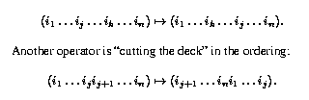

Slide 11




Computational tricks
  Before any MCMC step, for each potential parent ,we compute the score of the single edge, we then select the nodes for which this score was highest.
  We precompute the score for some number of the highest-scoring families and then sorted in decreasing order
  We prune the exhaustive enumeration of families by ignoring families that augment low-scoring families with low-scoring edges

Slide 12


Experimental Results
The comparison of structure-MCMC and ordering-MCMC
  Data ~ synthetic data generated from the Alarm BN(37 nodes)
  Setting
    K (max. number of parents in a family) = 3
    = 20
    = 4000

Slide 13
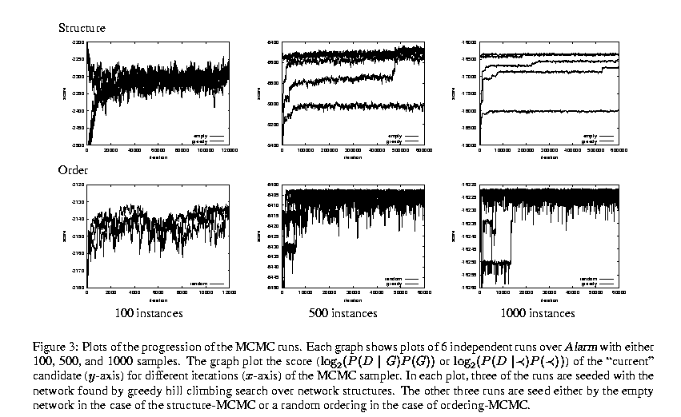

Slide 14
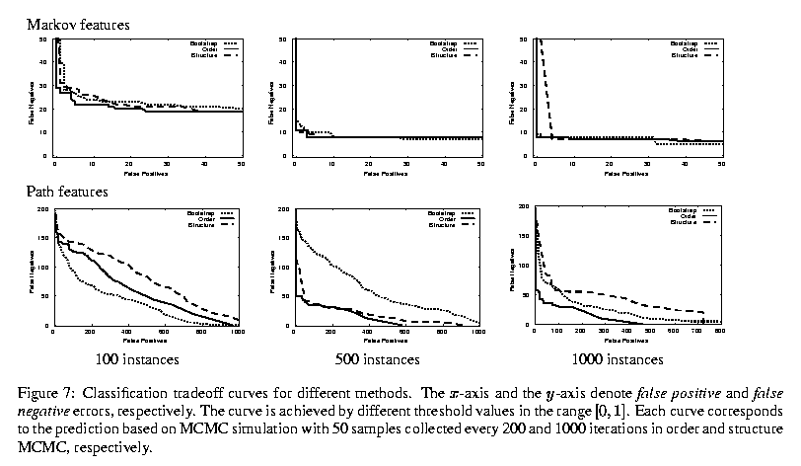

Slide 15
Discussion and future work
We have shown that the resulting Markov chain mixes substantially faster than MCMC over structures, and therefore gives robust high-quality estimates in the probability of these features
This approach can be extended to deal with data sets where some of data is missing, by extending the MCCM over orderings with MCMC over missing values allowing us to average over both
This will be good for applying in biology domain

