Slide 1
Dependency Networks for Inference, Collaborative filtering, and Data Visualization
Heckerman et al.
Microsoft Research
J. of Machine Learning Research 1, 2000

Slide 2

Contents
Introduction
Dependency Networks
Probabilistic Inference
Collaborative Filtering
Experimental Results

Slide 3
Introduction
  Representation of dependency network:
  Collection of regressions or classifications among
  variables using the machinery of Gibbs sampling.
  A cyclic graph.
    Advantages: computationally efficient algorithm,
    useful for encoding and displaying predictive relationships,
    useful for the task of predicting preferences (collaborative
    filtering), useful for answering probabilistic queries.
    Disadvantages: not useful for encoding casual
    relationships, difficult to construct using knowledge based
    approach.

Slide 4
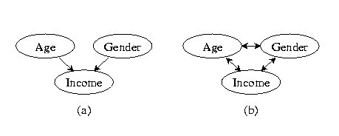
Dependency Networks
  Bayesian network and Dependency network.
  A consistent dependency network for X: (G, P)
  Each local distribution can be obtained from the joint distribution p(x).
  Cf. Markov network: (U, Φ)
  P: a set of conditional probability distributions.(easier to interpret than potentials)
  Φ: a set of potential functions.
  Markov network (undirected graphical model) and consistent dependency network have the same representation power.

Slide 5
Probabilistic Inference
  Probabilistic Inference: Given a graphical model for X = (Y , Z) where Y is a set of target variables and Z is a set of input variables, what is p(y|z) or p(x) (a density estimation)?
  Given a consistent dependency network for X, a probabilistic inference can be done by converting it to a Markov network, triangulating then applying
  one of the standard algorithms like junction tree algorithm.
  Here Gibbs algorithm is considered for recovering
  the joint distribution p(x) of X.

Slide 6
Probabilistic Inference
  Calculation of p(x):
    Ordered Gibbs Sampler:
      Initialize each variable
      Resample each X_{i} by p(x_{i} | x \ x_{i}) in an order X₁, … , X_{n} .
    An ordered Gibbs sampler recovers the joint distribution
    for X.
  Calculation of p(y|z)
  Naïve approach: Use Gibbs sampler directly, only samples for Z=z to compute. If either p(y|z) or p(z) is small, many iterations are required

Slide 7
Probabilistic Inference
  Calculation of p(y|z)
    For small p(z): Modified ordered Gibbs sampler. (fix Z=z in the ordered Gibbs sampling.)
    For small p(y|z): Y contains many variables.
  Use dependency network to avoid some Gibbs sampling.
  Eg.) [X₁ X₂ ←→ X₃ ] : X₁ can be determined with no Gibbs sampling.(Cf. Step 7 in Algorithm 1),
  X₂ , X₃ can be determined by modified Gibbs samplers each with target x₂ , x₃ each.

Slide 8
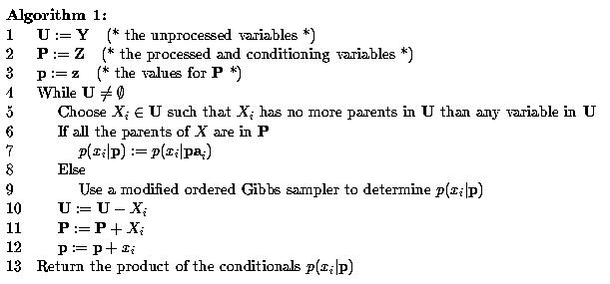
Probabilistic Inference

Slide 9
Dependency Network
  Extension of consistent dependency networks:
    For computational concerns, independently estimate each
    local distribution using a classification algorithm.(Feature
    selection in the classification process also governs the structure of the dependency network).
    Drawbacks: structural inconsistency due to heuristic search and finite data effects. ( x → y , not vice versa)
    Large sample size will overcome this inconsistency.
    The ordered Gibbs sampler yields a joint distribution for the domain whether the local distributions are consistent or not.(ordered pseudo Gibbs sampler)

Slide 10
Dependency Network
  Conditions for consistency:
  A minimal consistent dependency network for a positive distribution p(x) must be bi-directional.
  (a consistent dependency network is minimal if for every node and parent, the node is not independent to one of its parent given the remaining parents)
  Decision Trees for local probability:
  X_{i} : target variable, X \ X_{i} : input variables
  parameter prior: uniform, structure prior: k^{f} (f is # free par.)
  Use Bayesian score to learn the tree structure.

Slide 11
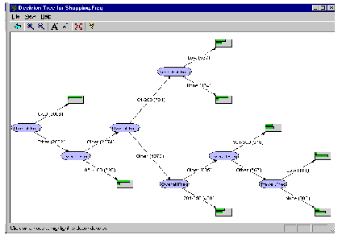
Dependency Network
  Decision Trees for local probability (cont`d):
    Start from a single root node.
    Each leaf node is a binary split of some input variable
    until no further increase of score.

Slide 12
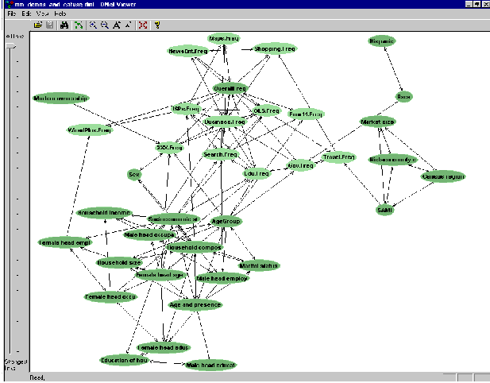
Dependency Network

Slide 13
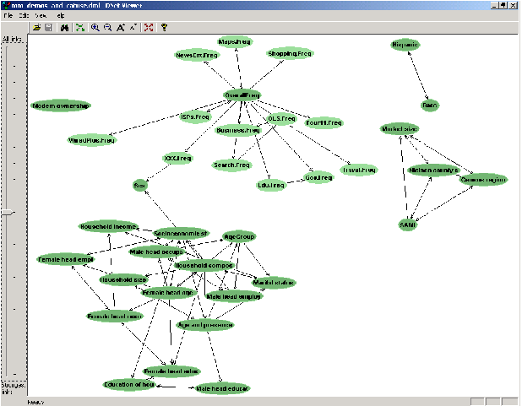
Dependency Network

Slide 14
Collaborative Filtering
  Preference prediction based on the history.
  Prediction of what products a person will buy knowing the items already purchased
  Express each item as a binary variable (Breece et al. (1998))
    Use this data set of learnings to learn a BN for the joint distribution of these variables
    Given a new user’s preference x , use a Bayesian network to estimate p(x_{i} =1 | x \ x_{i} =0) for each product X_{i} not purchased yet.
    Return a list of recommended items ranked by these estimates
    This method outperforms memory-based and cluster-based methods. (Breece)
    In this paper, p(x_{i} =1 | x \ x_{i} =0) ≅ p(x_{i} =1 | Pa_{i})
    ( a direct lookup in a dependency network)

Slide 15
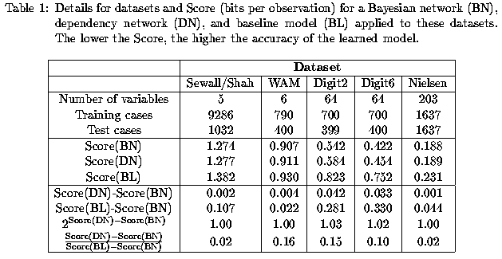
Experimental Results
Accuracy evaluation :
Score (x₁ ,…, x₁ | model) = - [∑ log p(x_{i} | mpdel)] / [nN]
(Average # of bits needed to encode the obs. of var. in the test set)
: measures how well the dependency network predicts an entire case.

Slide 16
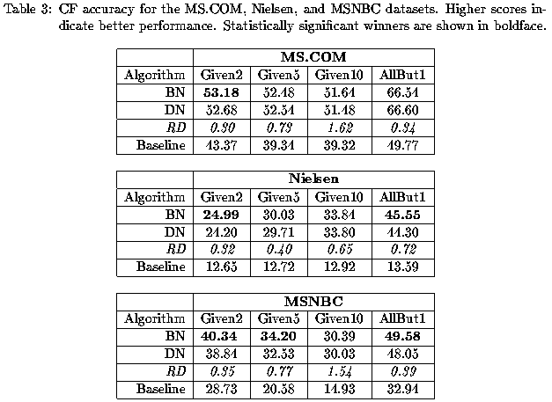
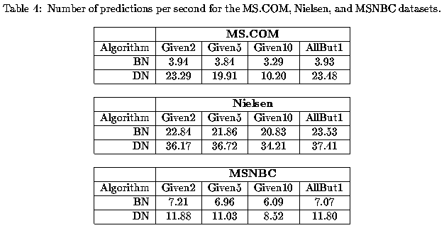


Criteria of a user’s expected utility for a list of recommendation.
(P(k) : A probability a user will examine the k-th item on a recommendation list.)

Slide 17
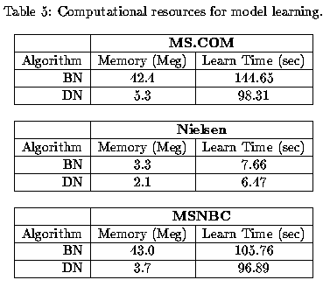

Slide 18
  Data sets:
    Sewall/Shah: college plans of high school seniors
    WAM: women’s preference for a career in Math.
    Digits: images of handwritten digits
    Nielson: 5 or more watch of TV shows
    MS.COM: visit of a cite for users of MS.com
    MSNBC: visitors of MSNBC for reading the most popular 1001 stories on the cite.

