Slide 1
Introduction to Inference for Bayesian Netoworks
Robert Cowell

Slide 2
2. Basic axioms of probability
Probability theory = inductive logic
  system of reasoning under uncertainty
probability
  numerical measure of the degree of consistent belief in proposition
Axioms
  P(A) = 1 iff A is certain
  P(A or B) = P(A) + P(B) A, B are mutually exclusive
Conditional probability
  P(A=a | B=b) = x
  Bayesian network과 밀접한 관계
Product rule
  P(A and B) = P(A|B) P(B)

Slide 3

3. Bayes’ theorem
P(A,B) = P(A|B) P(B) = P(B|A) P(A)
Bayes’ theorem
General principles of Bayesian network
  model representation for joint distribution of a set of variables in terms of conditional/prior probabilities
  data -> inference
    marginal probability 계산
    arrow를 반대로 하는 것과 같다

Slide 4

4. Simple inference problem
Problem I
  model: X → Y
  given: P(X), P(Y|X)
  observe: Y=y
  problem: P(X|Y=y)

Slide 5

4. Simple inference problem
Problem II
  model: Z ← X → Y
  given: P(X), P(Y|X), P(Z|X)
  observe: Y=y
  problem: P(Z|Y=y)
  P(X,Y,Z) = P(Y|X) P(Z|X) P(X)
  brute force method
    P(X,Y,Z)
    P(Y) --> P(Y=y)
    P(Z,Y) --> P(Z, Y=y)

Slide 6

4. Simple inference problem
  Factorization 이용

Slide 7

4. Simple inference problem
Problem III
  model: ZX - X - XY
  given: P(Z,X), P(X), P(Y,X)
  problem: P(Z|Y=y)
  calculation steps: message 이용

Slide 8

5. Conditional independence
P(X,Y,Z)=P(Y|X) P(Z|X) P(X)
Conditional independence
  P(Y|Z,X=x) = P(Y|X=x)
  P(Z|Y,X=x) = P(Z|X=x)

Slide 9


5. Conditional independence
Factorization of joint probability
Z is conditionally independent of Y given X

Slide 10

5. Conditional independence
General factorization property
Z ← X ← Y
  P(X,Y,Z) = P(Z|X,Y) P(X,Y)
  = P(Z|X,Y) P(X|Y) P(Y)
  = P(Z|X) P(X|Y) P(Y)
Features of Bayesian networks
  conditional independence의 이용:
    simplify the general factorization formula for the joint probability
  factorization: DAG로 표현됨

Slide 11

6. General specification in DAGs
Bayesian network = DAG
  structure: set of conditional independence properties that can be found using d-separation property
  각 node에는 P(X|pa(x))의 conditional probability distribution이 주어짐
Recursive factorization according to DAG
  equivalent to the general factorization
  conditional property를 이용하여 각 term을 단순화

Slide 12
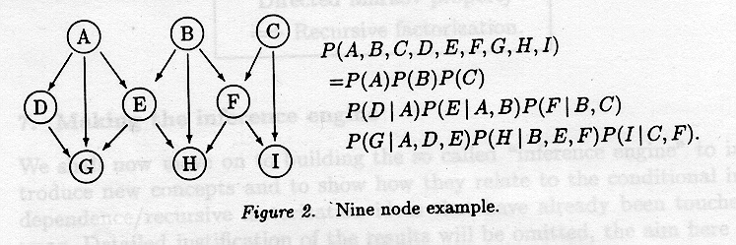
6. General specification in DAGs
Example
  Topological ordering of nodes in DAG: parents nodes precede
  Finding algorithm: checking acyclic graph
    graph, empty list
    delete node which does not have any parents
    add it to the end of the list

Slide 13

6. General specification in DAGs
Directed Markov Property
  non-descendent는 X에 관계가 없다
  Steps for making recursive factorization
    topological ordering (B, A, E, D, G, C, F, I, H)
    general factorization

Slide 14


6. General specification in DAGs
    Directed markov property
    => P(A|B) --> P(A)

Slide 15
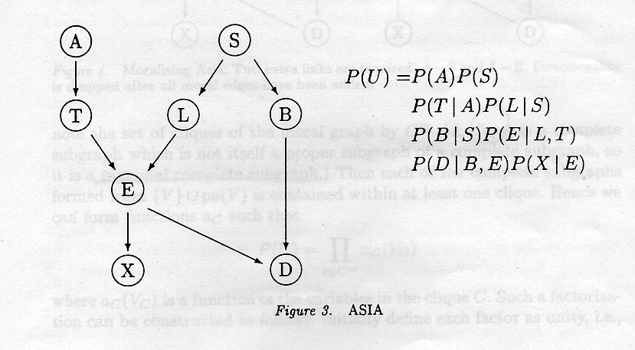
7. Making the inference engine
ASIA
  변수 명시
  dependency 정의
  각 node에 conditional probability 할당

Slide 16

7.2 Constructing the inference engine
Representation of the joint density in terms of a factorization
motivation
  model을 이용하여 data를 관찰했을 때 marginal distribution을 계산
  full distribution 이용: computationally difficult

Slide 17
7.2 Constructing the inference engine
calculation을 쉽게하는 p(U)의 representation을 발견하는 5 단계
= compiling the model
= constructing the inference engine from the model specification
1. Marrying parents
2. Moral graph (direction 제거)
3. Triangulate the moral graph
4. Identify cliques
5. Join cliques --> junction tree

Slide 18

7.2 Constructing the inference engine
a(X,pa(X)) = P(V|pa(V))
  a: potential = function of V and its parents
After 1, 2 steps
  original graph는 moral graph에서 complete subgraph를 형성
  original factorization P(U)는 moral graph G^{m} 에서 동등한 factorization으로 변환됨 = distribution is graphical on the undirected graph G^{m}

Slide 19
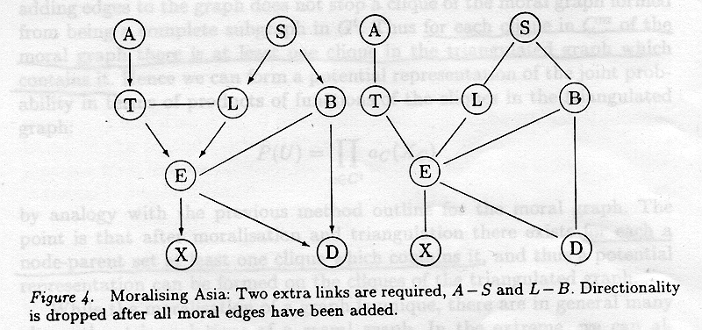
7.2 Constructing the inference engine

Slide 20

7.2 Constructing the inference engine
set of cliques: C^{m}
  factorization steps
  1. Define each factor as unity a_{c}(V_{c})=1
  2. For P(V|pa(V)), find clique that contains the complete subgraph of {V} ∪ pa(V)
  3. Multiply conditional distribution into the function of that clique --> new function
  result: potential representation of the joint distribution in terms of functions on the cliques of the moral C^{m}

Slide 21


8. Aside: Markov properties on ancestral sets
Ancestral sets = node + set of ancestors
S separates sets A and B
  every path between a ∈ A and b ∈ B passes through some node of S
Lemma 1
  A and B are separated by S in moral graph of the smallest ancestral set containing A∪ B ∪ S
Lemma 2
  A, B, S: disjoint subsets of directed, acyclic graph G
  S d-separates A from B iff S separates A from B in

Slide 22
8. Aside: Markov properties on ancestral sets
Checking conditional independence
  d-separation property
  smallest ancestral sets of the moral graphs
Ancestral set을 찾는 algorithm
  G, Y⊆ U
  child가 없는 node제거
  더 이상 지울 node가 없을때 --> subgraph가 minimal ancestral set

Slide 23

9. Making the junction tree
C에 있는 각 clique를 포함하는 triangulated graph 상의 clique가 있다.
After moralization/triangulation
  a node-parent set에 대해 적어도 하나의 clique가 존재
  represent joint distribution
  product of functions of the cliques in the triangulated graph
  작은 clique을 갖는 triangulated graph: computational advantage

Slide 24
9. Making the junction tree
Junction tree
  triangulated graph에서의 clique들을 결합하여 만든다.
  Running intersection property
  V가 2개의 clique에 포함되면 이 2개의 clique을 연결하는 경로상의 모든 clique에 포함된다.
  Separator: 두 clique을 연결하는 edge
  captures many of the conditional independence properties
  retains conditional independence between cliques given separators between them: local computation이 가능하다

Slide 25
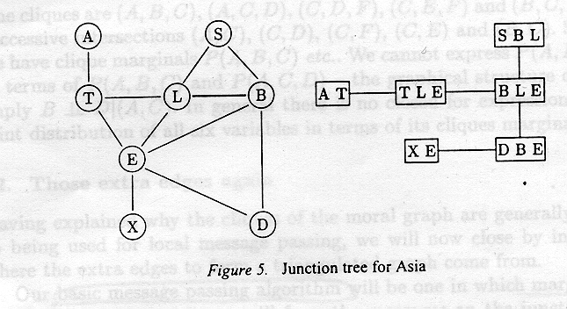
9. Making the junction tree

Slide 26

10. Inference on the junction tree
Potential representation of the joint probability using functions defined on the cliques
generalized potential representation
  include functions on separators

Slide 27



10. Inference on the junction tree
Marginal representation
clique marginal representation

