Slide 1
Introduction to Monte Carlo Methods
D.J.C. Mackay

Slide 2
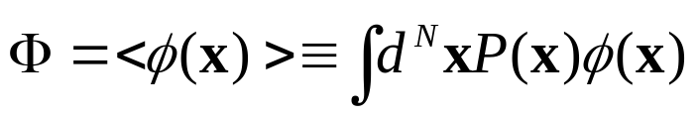
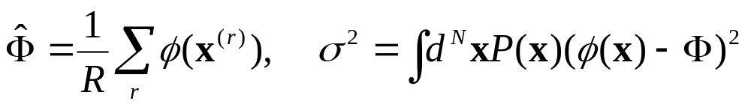
1. The problems to be solved
The aim of Monte Carlo methods
  Problem 1: generating samples from {x^{(r)}}_{r=1}^{R} a given target density P(x).
  Problem 2: estimating expectations of functions
The accuracy of Monte Carlo estimate is independent of the dimensionality of the space sampled.
  The estimate of Φ will be decreased as σ²/R.
  Only a few independent R samples are sufficient.

Slide 3
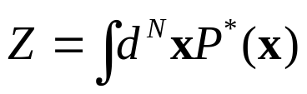
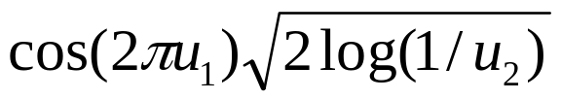
1.1 Why is sampling from P(x) Hard?
Assumption: P(x) can be evaluated.
  Function P*(x) can be evaluated, where P(x)=P*(x)/Z.
But why can problem1 be easily solved?
  Normalizing term Z
  Even if knowing Z sampling is still challenging in high-dim.
    Visiting every location in x can not be possible.
  In Gaussian, a sample can be generated by

Slide 4
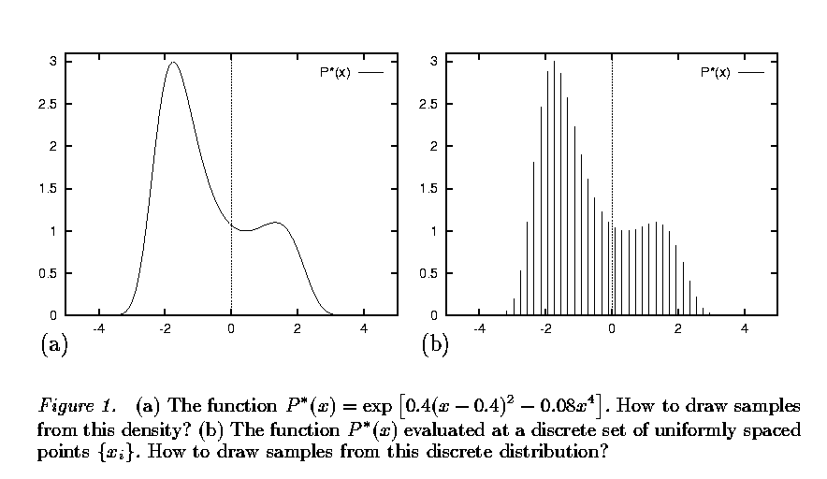
  If 50 discretized point, and dim is 1000 then 50¹⁰⁰⁰ evaluation of P*(x) will be need.

Slide 5
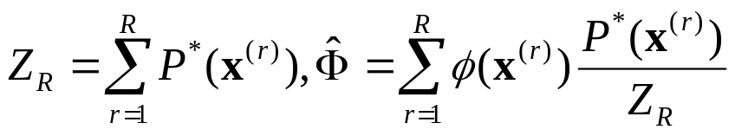
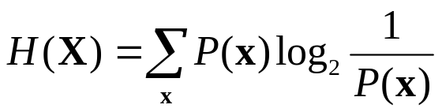
1.2 Uniform Sampling
Solve problem 2 by drawing random samples uniformly from the state space and evaluating P*(x).
  Typical set T, whose volume is |T|≈2^{H(X)}
    Shannon-Gibbs entropy
    Uniform sampling has meaning only when many samples hit the typical set.
    In Ising model, R_{min} ≈ 2^{N-H}.
    Our concern is when temperature is intermediate, specially N/2.
    If N = 1000, about 10¹⁵⁰ samples is needed.

Slide 6
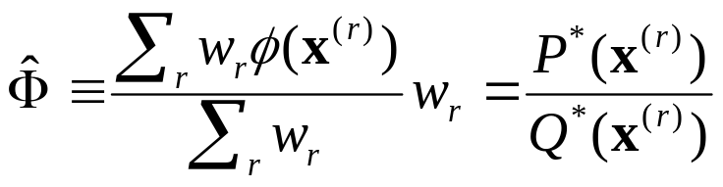
2. Importance Sampling
Not a Problem 1, but a Problem 2.
  Generalization of the uniform sampling method.
P(x) is too complicated for us to be able to sample from it directly.
  Introducing a simpler density Q(x) where Q(x) = Q*(x)/Z_{Q}.
  Over-represented, under-represented.
    Introducing weights
    If Q(x) is non-zero for all x where P(x) is non-zero, the estimate of Φ converges to Φ.
    Practically, it is hard to estimate how reliable the estimator.

Slide 7
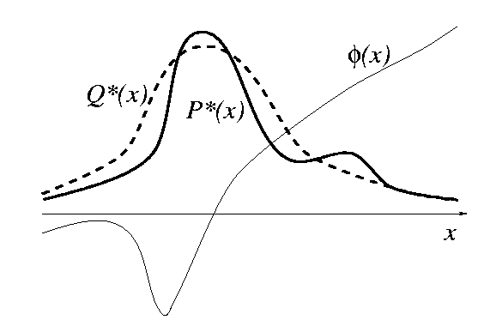

Slide 8
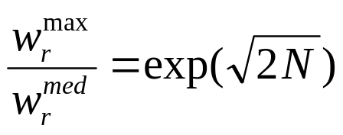
2.2 Importance Sampling in High Dimensions
Suffering from two difficulties
  1. Need for samples that lie in the typical set of P. Long time unless Q is a good approximation of P.
  2. Weights associated with those samples are likely to vary by large factors.

Slide 9
3. Rejection Sampling
Assumption
  one-dim. Density P(x)=P*(x)/Z, proposal density Q(x),
  for all x, cQ*(x)>P*(x)
Methods
  1. Generate two random numbers.
    x from Q(x)
    u from uniformly distributed in interval [0, cQ*(x)]
  2. Accept or reject the sample x.
    reject if u > P*(x)
    accept otherwise
    Acceptance means adding x to samples {x^{(r)}}
  This procedure generate samples from P(x).

Slide 10
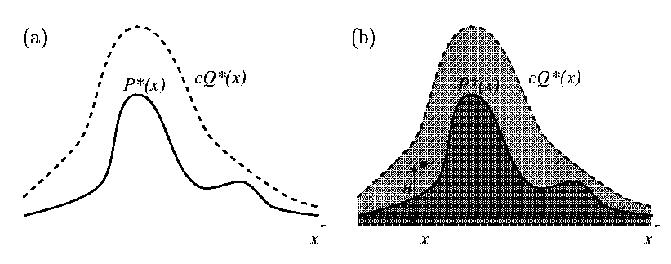

Slide 11
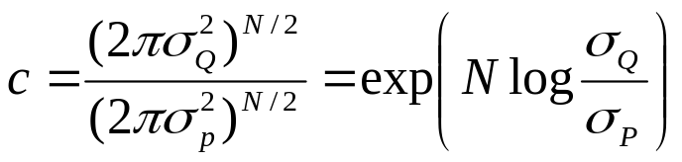
3.1 Rejection Sampling in High Dimension
Finding appropriate c is difficult.
  High dimension forces c to be so huge that acceptances will be very rare.
Example
  pair of N-dimensional normal distribution.
  c must be
  If N=1000, σ_{Q}/ σ_{P}=1.01 then c≈20,000. And acceptance ratio is 1/c = 1/20,000

Slide 12
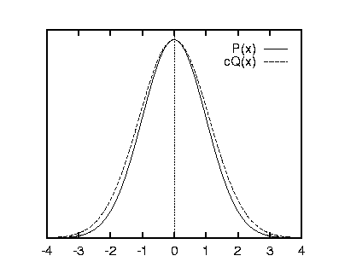

Slide 13
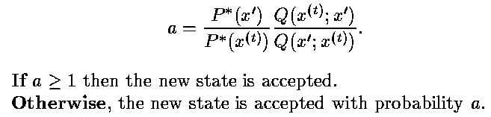
4. The Metropolis method
Metropolis algorithm make use of a proposal density Q which depends on the current state x^{(t)}.
  Proposal density Q(x) similar to P(x) is not so easy to be composed.
Methods
  If accepted x^{(t+1)}=x′, if rejected x^{(t+1)}=x^{(t)}.
  Differs from rejection sampling.

Slide 14
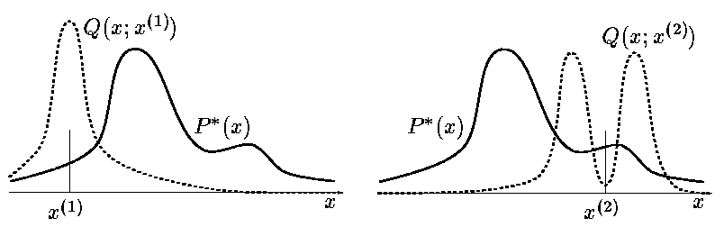
  Metropolis’s T iterations does not produce T independent samples from P. They are correlated.
  As t→∞, the probability distribution of x^{(t)} tends to P(x)=P*(x)/Z.
  It is MCMC.
    x^{(t)} are correlated.
    Rejection sampling is not MCMC, because x^{(r)} are independent samples from the desired distribution.

Slide 15
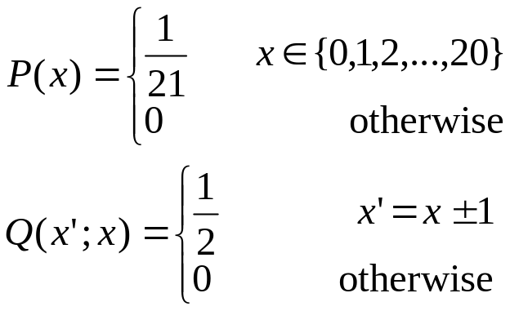
4.1. Demonstration of the Metropolis Method
Length scale ε relative short to the length scale L.
  disadvantage: random walk which takes a long time to get anywhere.
Lower bound on number of iterations of a Metropolis method.
  Must run for at least T≈(L/ ε)² iterations to obtain an independent sample.
Examples

Slide 16
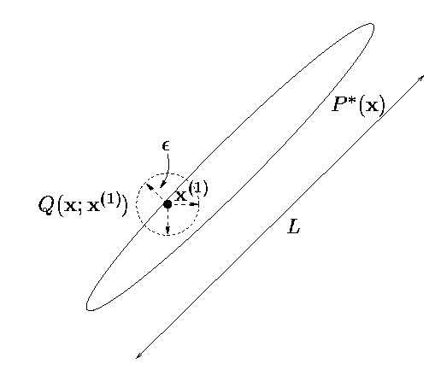

Slide 17
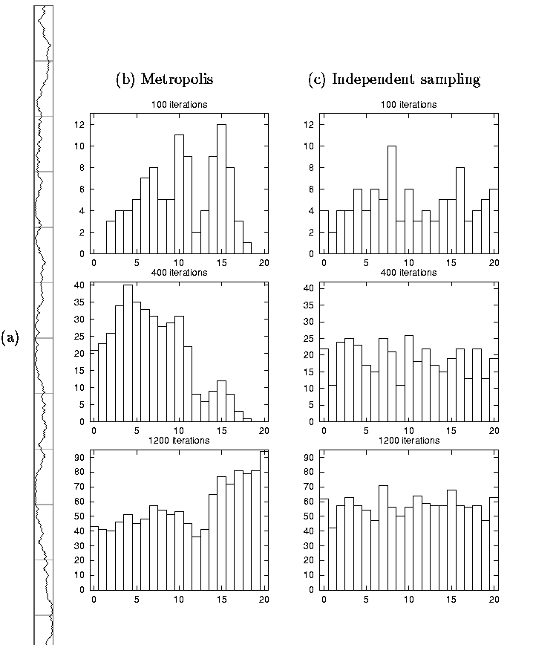

Slide 18
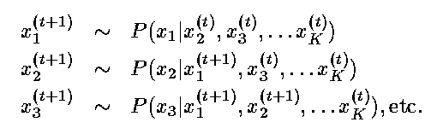
5. Gibbs Sampling
Methods
  Gibbs sampling can be viewed as a Metropolis method which has the property that every proposal is always accepted.

Slide 19
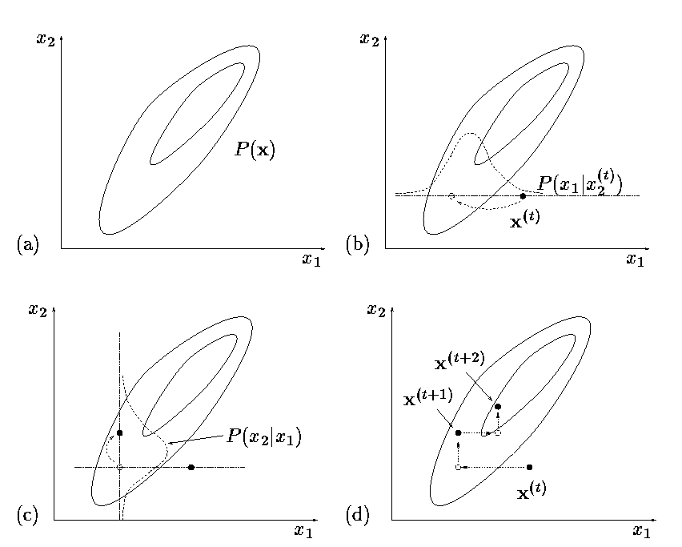

Slide 20
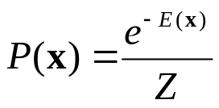

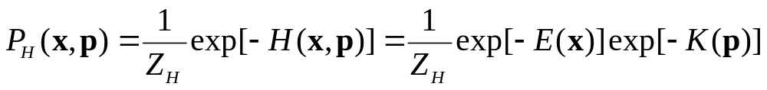
7.1. Speeding up Monte Carlo Methods
7.1.1 Reducing random walk behavior in Metropolis methods.
  Hybrid Monte Carlo: continuous state spaces which makes use of gradient information to reduce random walk behavior.
    If gradient is available, there is no reason to use random walk.
    Hamiltonian dynamics
      momentum variable p.
      K(p)=p^{T}p/2. (kinetic energy)
    sampling from Joint density

Slide 21
    If the simulation of the Hamiltonian dynamics is numerically perfect then the proposals are accepted every time.
    H(x,p) is a constant of the motion and a is equal to one.
    If the simulation is imperfect, then rejection is made using the change of H(x,p).

Slide 22
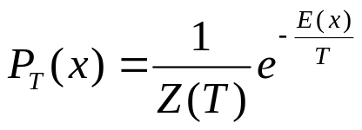
7.1.2. Overrelaxation
  reducing random walk behavior in Gibbs sampling.
  In Gibbs sampling, if variables are strongly correlated, lengthy random walks are leaded.
7.1.3. Simulated annealing
  when large temperature, the system can make transition which would be improbable at temperature 1.
  This can reduces the chance of the simulation’s becoming stuck in an unrepresentative probability island.
    Usually T is gradually decreased to 1.
    But T can be updated using Metropolis fashion as a random variable.

Slide 23
7.2 Can the normalizing constant be evaluated?
Active research area.
Maybe the best way of dealing with Z, is to find a solution to one’s task that does not require that Z be evaluated.

Slide 24
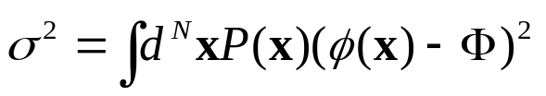
7.5. How many samples are needed?
The variance of estimator Φ depends only on the number of independent samples R and
There is little point in knowing Φ to a precision finer than about σ/3.
Then, R=12 is sufficient.

Slide 25
7.7. Philosophy
Monte Carlo methods are all non-Bayesian.
  In Monte Carlo, computer experiments are used to calculate the estimators Φ of quantities of interest.
  Bayesian approach use the experiments results to infer the properties of the P(x) and generate predictive distribution for quantities of interest such as Φ.
    It only depends on the computed values P*(x^{(r)}) at the points {x^{(r)}}.

Slide 26
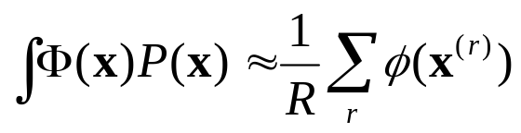
8. Summary
  Monte Carlo methods are a powerful tool that allow one to implement any probability distribution that can be expressed in the form P(x)=P*(x)/Z.
  Monte Carlo methods can answer virtually any query related to P(x) by putting the query in the form

