Slide 1
Dynamics of Training
NIPS'1996 Volume 9, pp141-147
Noh, Yung-kyun
Mar. 11, 2003

Slide 2
Introduction(1/3)
Training guided by empirical risk minimization does not always minimize the expected risk. Namely overfitting
A new description which is directly dependent on the actual traing steps.
We will examine empirical risk and expected risk as functions of the traing time.
Restrict ourselves to a quite simple neural network model.

Slide 3

Introduction(2/3)
Single layer perceptron with N-dim.
Examples
Nonlinear output function

Slide 4





Introduction(3/3)
Learning by examples attempts to minimize this.
We are interested in this.(generalization error or expected risk)
  R, Q : order parameters

Slide 5



Dynamical approach(1/5)
Dynamics
Weights w.r.t. input data
Dynamics of

Slide 6





Dynamical approach(2/5)
: P/N
: trace. Expressed as Integration over eigenvalues
When < 1
When > 1

Slide 7
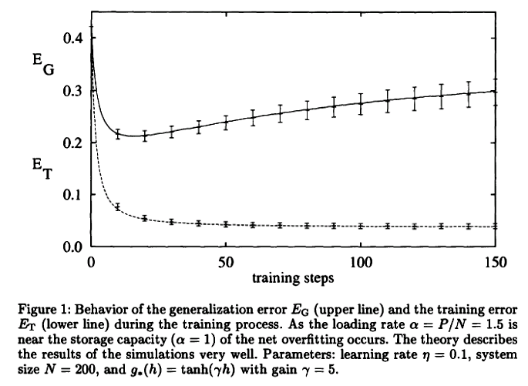
Dynamical approach(3/5)

Slide 8
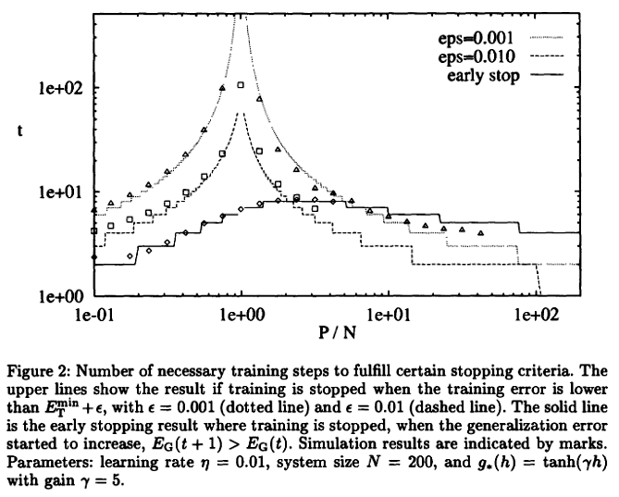
Dynamical approach(4/5)

Slide 9
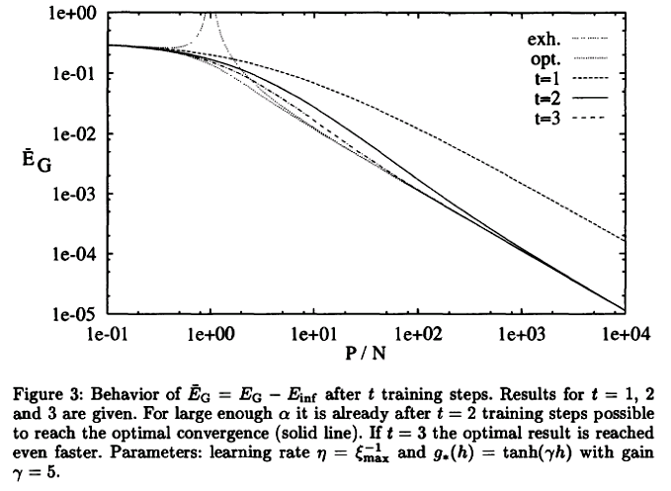
Dynamical approach(5/5)

Slide 10
Conclusion
The behavior of the learning and the training error during the whole training process.
How good this theory describes errors and actual number of training steps.
With sufficiently large , two batch training steps are necessary to reach the optimal convergence rate.
Thermodynamic description of the training process can be added.
This method could be extened towards other, more realistic models.

