Slide 1
A Computationally Efficient Evolutionary Algorithm for Real-Parameter Optimization
K. Deb, A. Anand, and D. Joshi
Evolutionary Computation,
vol. 10, no. 4, pp. 371-395, Winter 2002.
Cho, Dong-Yeon

Slide 2
Abstract
A Number of Real-Parameter GA
  Recombination operator
    Using probability distributions around the parent solutions to create offspring
G3 Model with the PCX Operator
  The proposed approach is found to consistently and reliably perform better than all other methods used in the study.

Slide 3
EAs for Real-Parameter Optimization
Three Different Approaches
  Self-adaptive evolution strategies
  Differential evolution
  Real-parameter genetic algorithms
    Recombination operators
EA Models
  Selection and variation
  Variation and selection

Slide 4
Real-Parameter GAs (1/3)
Variation Operator
  Population mean should remain the same before and after the variation operator.
    Variation operators usually do not use any fitness function information explicitly.
    Mean-centric vs. parent-centric
  Variation of the intramember distances must increase due to the application of the variation operator.
    Selection operator have a tendency to reduce the population variance.

Slide 5
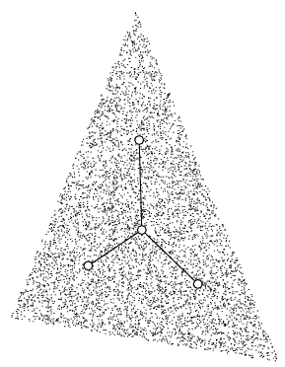
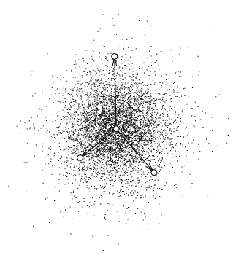
Real-Parameter GAs (2/3)
SPX vs. UNDX
Simplex Crossover
Unimodal Normal Distribution Crossover

Slide 6
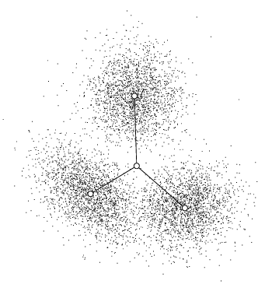
Real-Parameter GAs (3/3)
UNDX vs. PCX
Unimodal Normal Distribution Crossover
Parent Centric Recombination

Slide 7
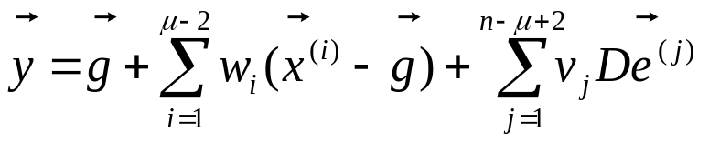
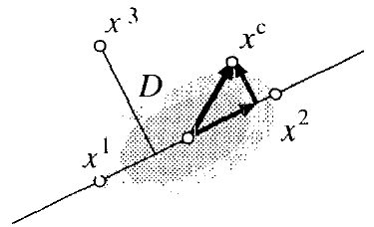





Mean-Centric Recombination
UNDX
    : μ randomly chosen parents
    : mean of (μ-1) parents
    D: length of orthogonal to all , i=1,…,μ-1
    : orthonormal bases of the subspace orthogonal to the subspace spanned by , i=1,…,μ-1
    n: size of the variable vector
    w_{i} ~ N(0, σ_{ζ}²), v_{j} ~ N(0, σ_{η}²)
  Each offspring is created around the mean vector.

Slide 8
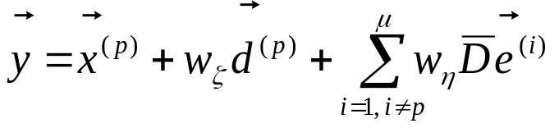






Parent-Centric Recombination
PCX
    : one parent, : mean of μ parents
    : average of the perpendicular distance D_{i} from (μ -1) parents to the line
    : orthonormal bases that span the subspace perpendicular to
    w_{ζ} ~ N(0, σ_{ζ}²), w_{η} ~ N(0, σ_{η}²)
  The probability of creating an offspring closer to the parent is higher.

Slide 9
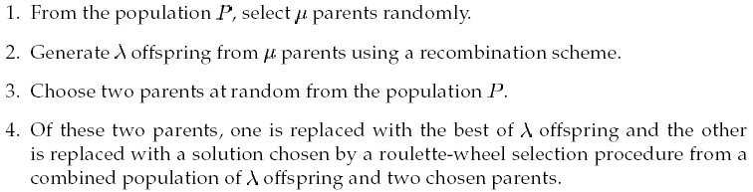
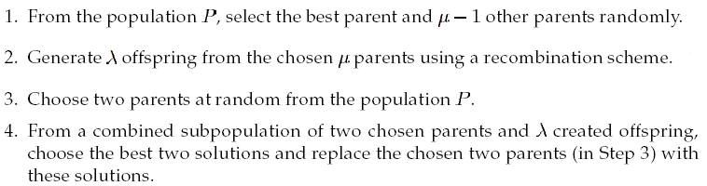
Evolutionary Algorithm Models
Minimal Generation Gap (MGG) Model
Generalized Generation Gap (G3) Model

Slide 10
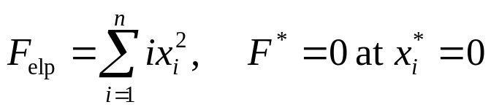
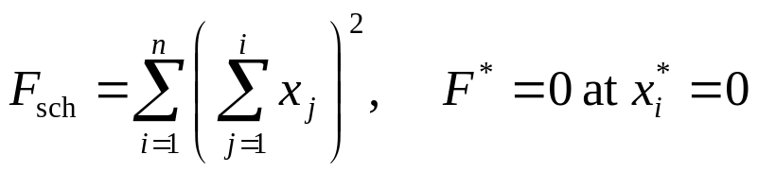
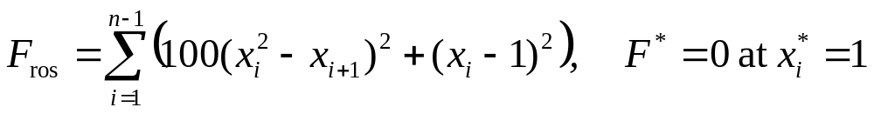

Three Standard Test Problems
Ellipsoidal
Schwefel
Generalized Rosenbrock

Slide 11
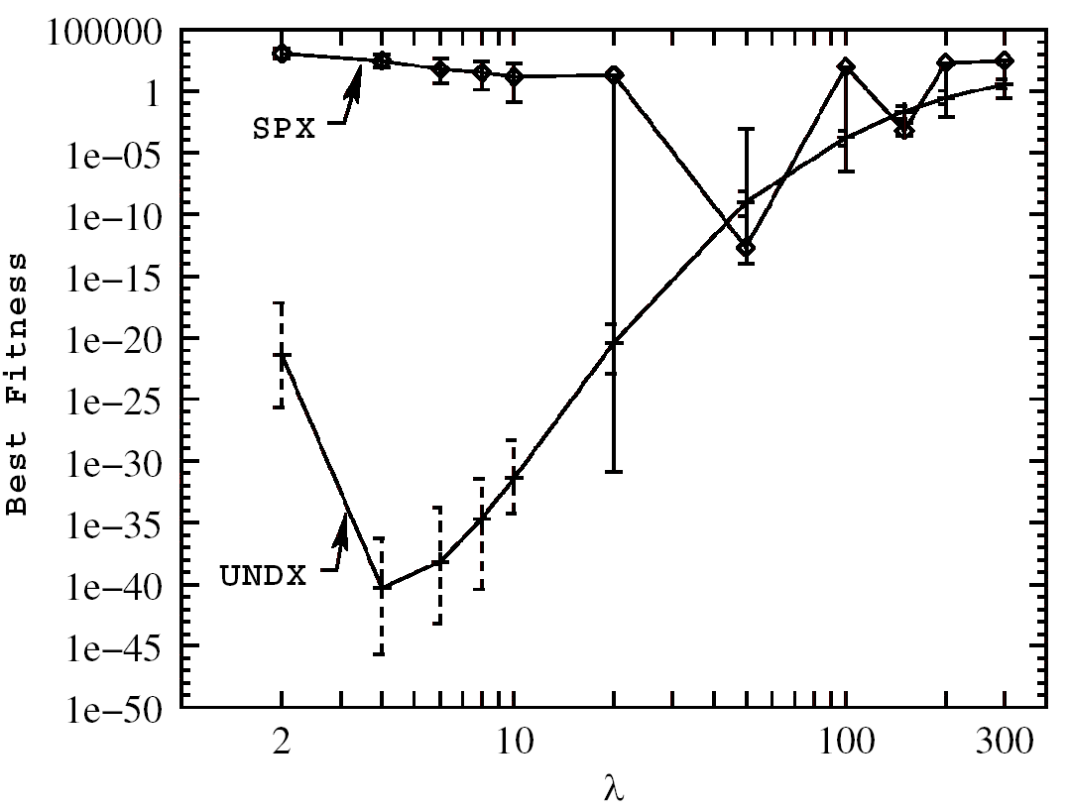
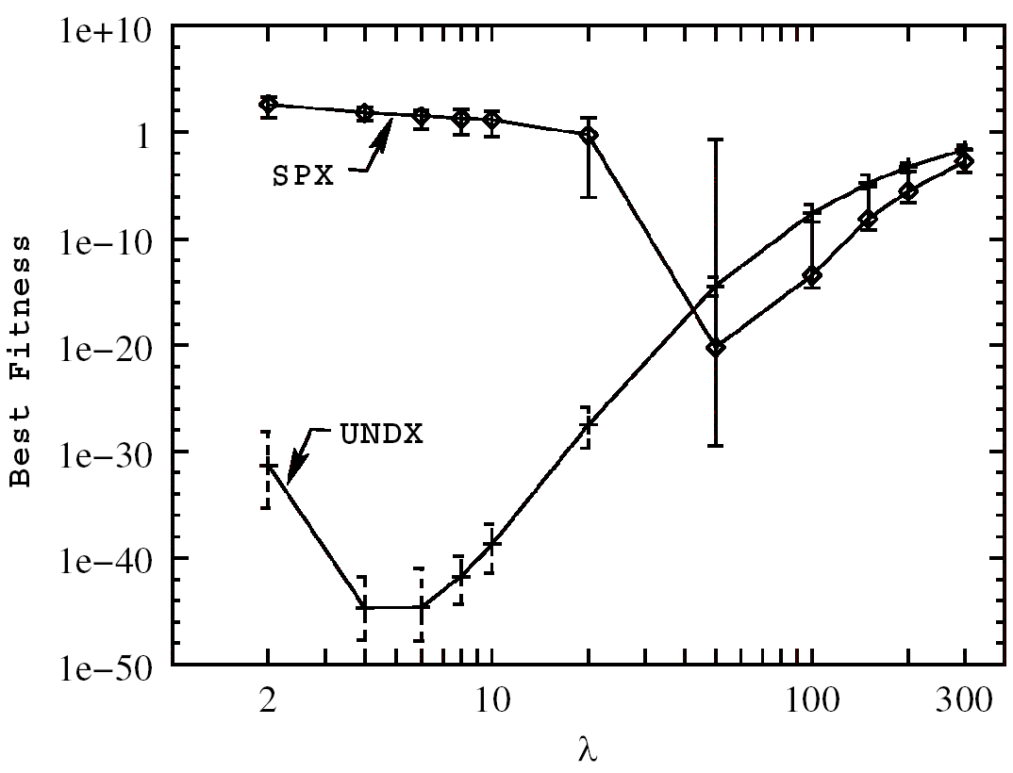
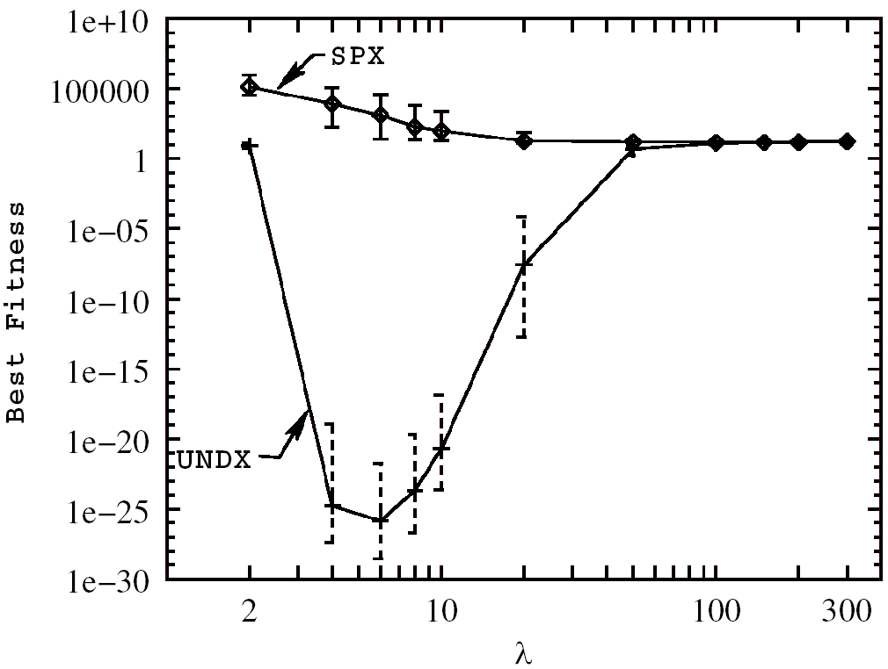
Experiments (1/9)
Previous Work
  [Higuchi et al., 2000]
    N = 300, μ = n+1 (SPX) or 3 (UNDX), and λ = 200
    SPX » UNDX
Parametric Study for MGG
  UNDX works well with a small offspring size.
F_{elp}
F_{sch}
F_{ros}

Slide 12
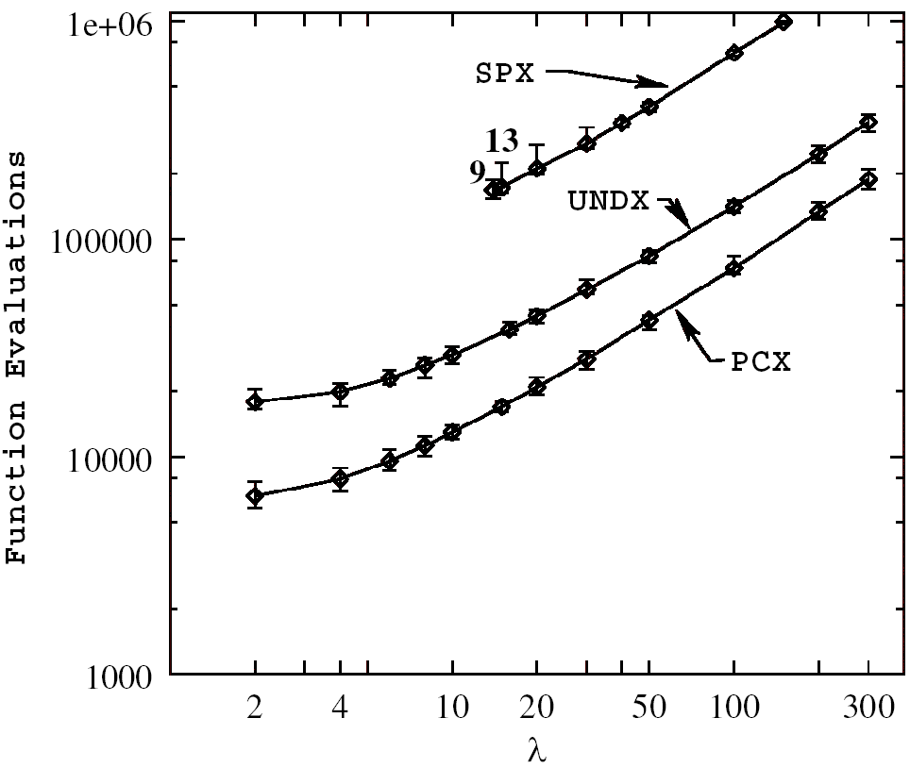
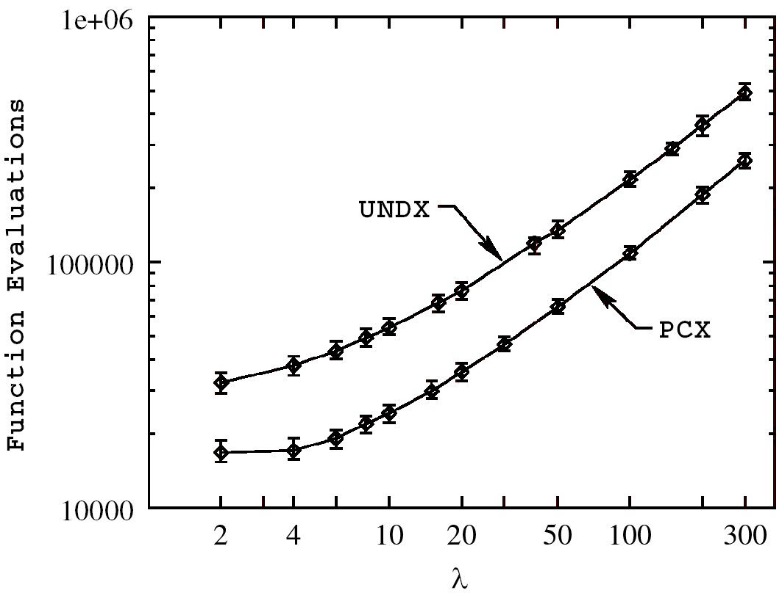
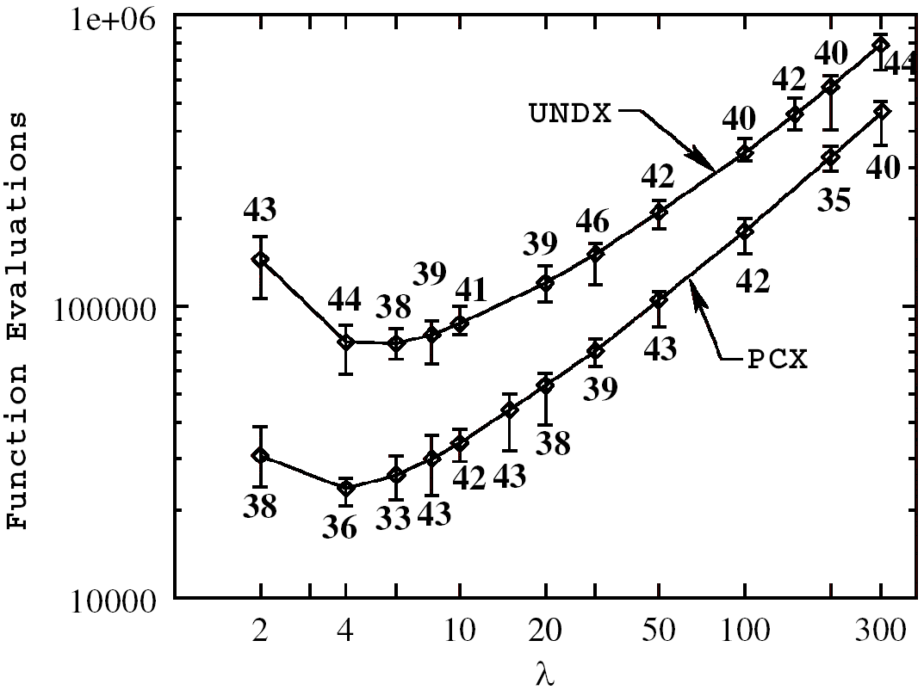
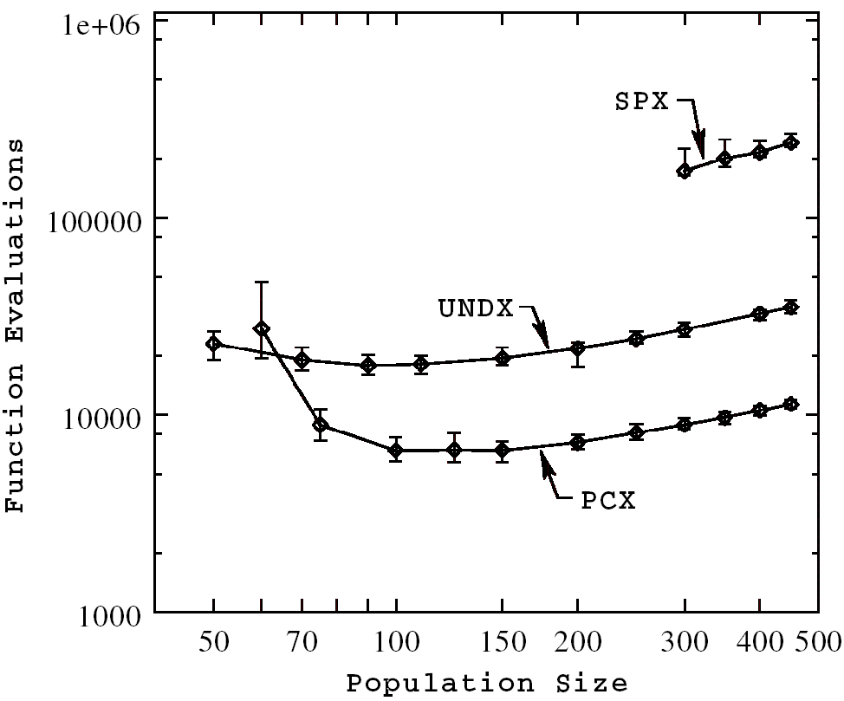
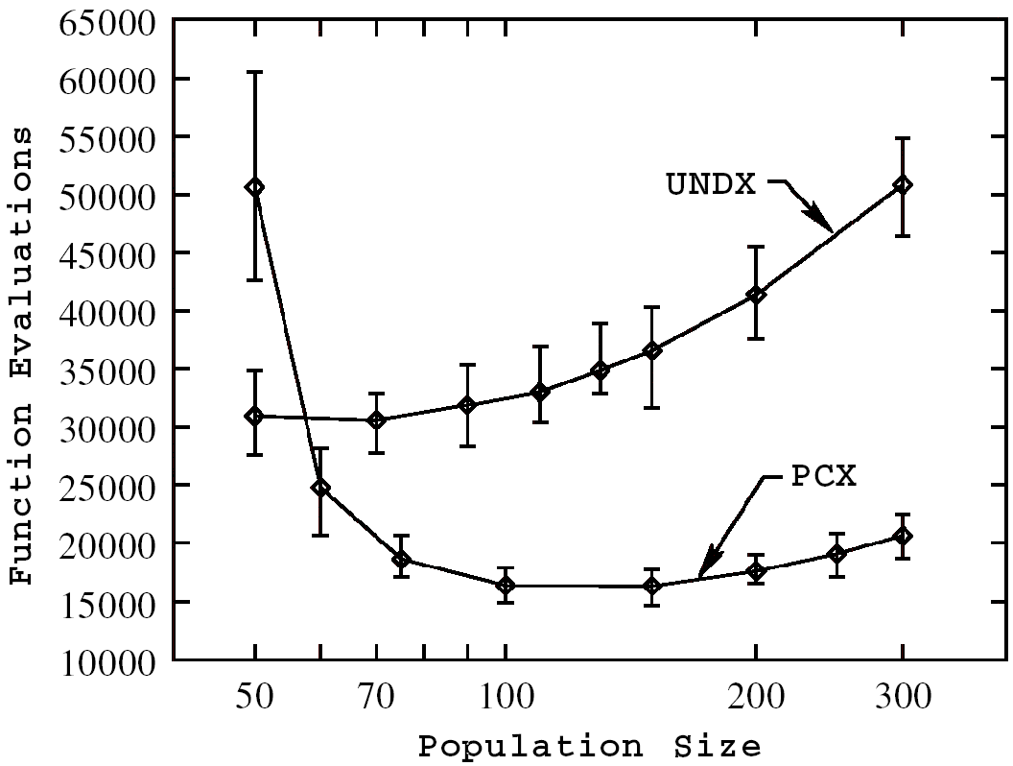
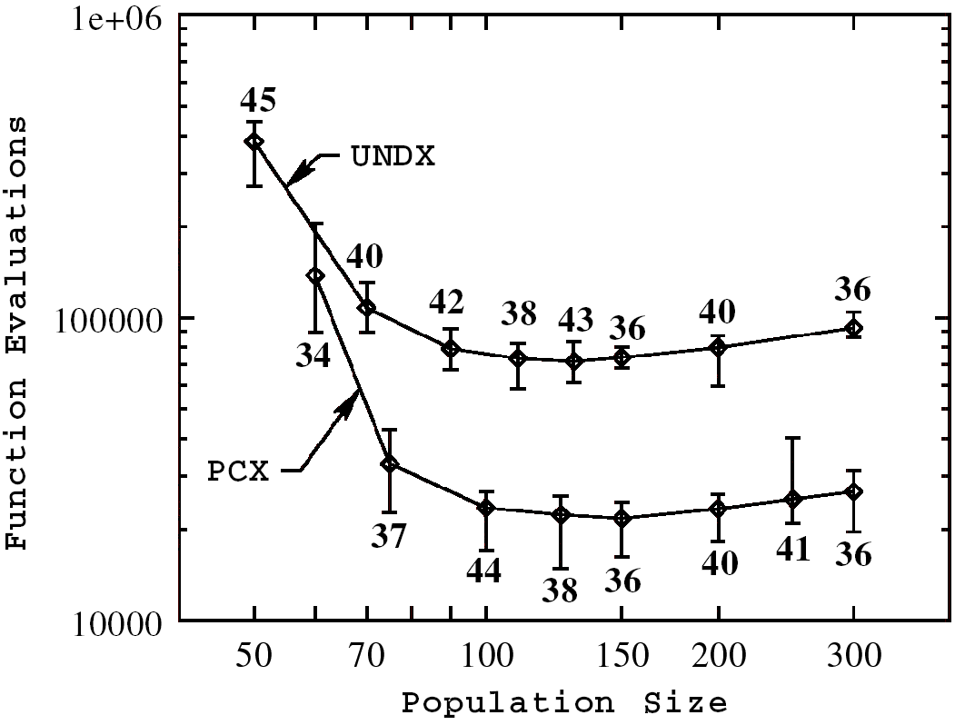
Experiments (2/9)
G3 Model - #evaluations to achieve the best fitness 10⁻²⁰
F_{elp}
F_{sch}
F_{ros}

Slide 13
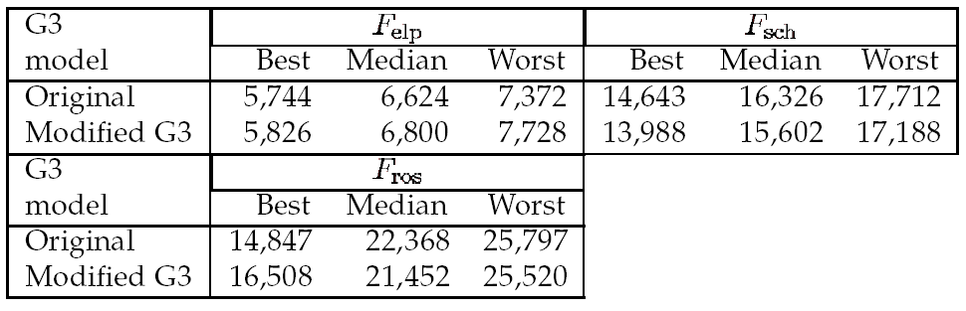
Experiments (3/9)
Modified G3 Model
  Instead of two parents, only one parent is chosen in Step 3 and updated in Step 4.
  We cannot conclude which of the two G3 models is better.

Slide 14
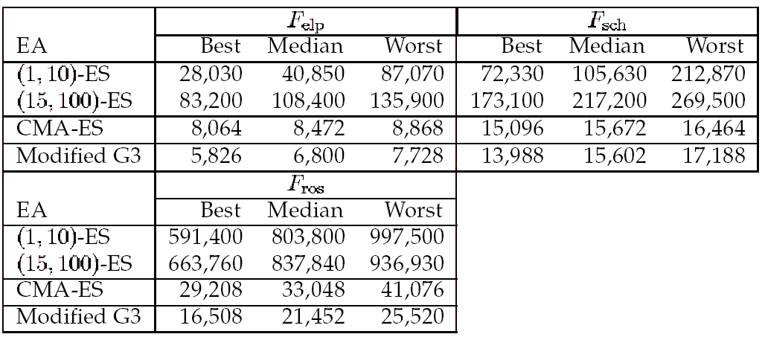
Experiments (4/9)
Self-Adaptive Evolution Strategies
  Covaraince Matrix Adaptation Evolution Strategy (CMA-ES)
    Collecting the information of previous mutations, the CMA-ES determines the new mutation distribution providing a larger probability for creating better solutions.

Slide 15
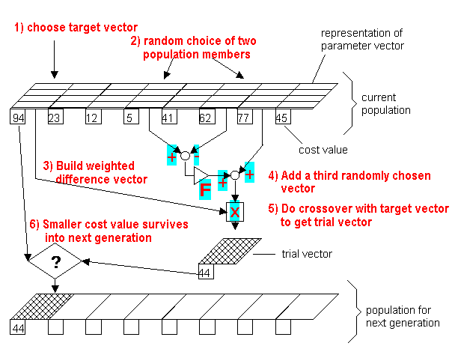
Experiments (5/9)
Differential Evolution

Slide 16
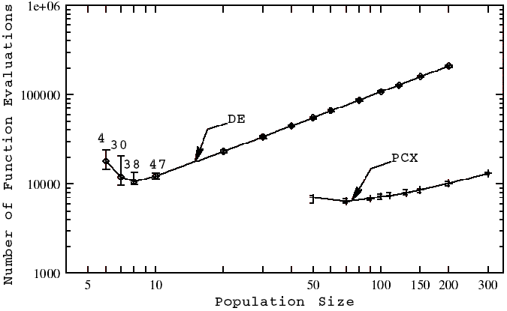
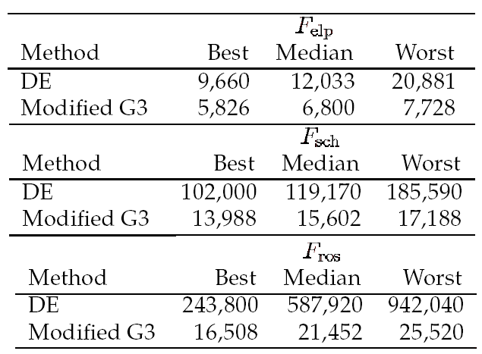
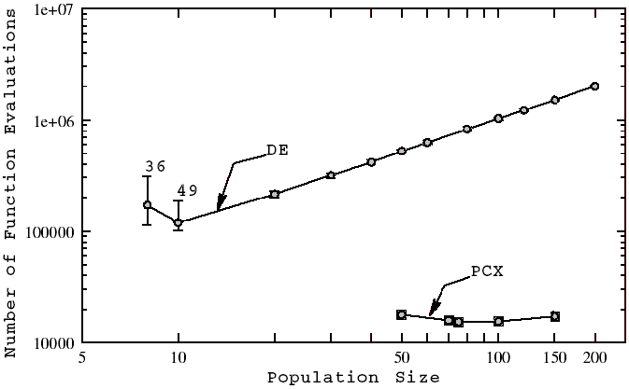
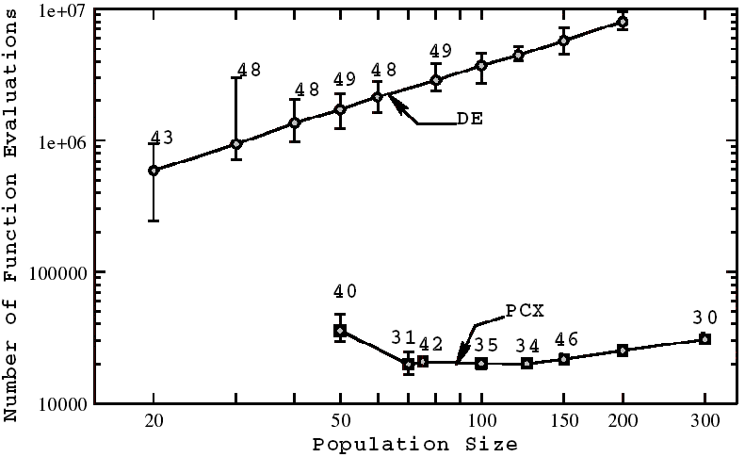
Experiments (6/9)
F_{elp}
F_{sch}
F_{ros}

Slide 17
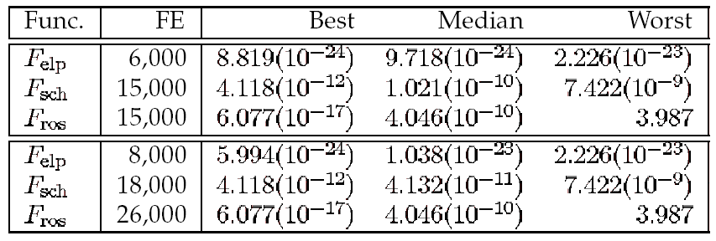
Experiments (7/9)
Quasi-Newton Method
  BFGS quasi-Newton method along with a mixed quadratic-cubic polynomial line search approach
    The best and worst function evaluations needed for the G3 model with the PCX operator to achieve an accuracy of 10⁻²⁰

Slide 18
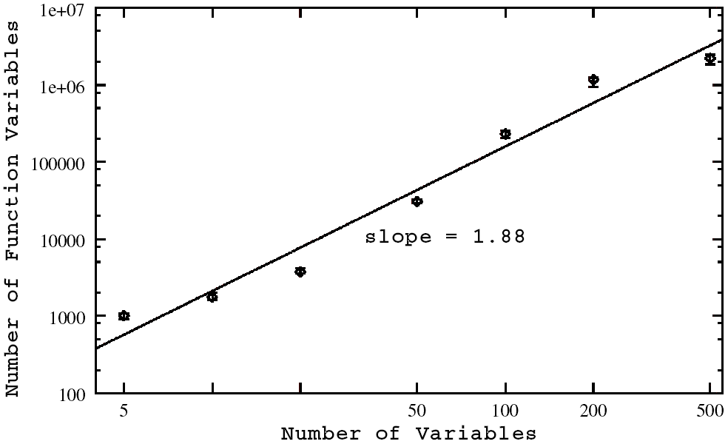
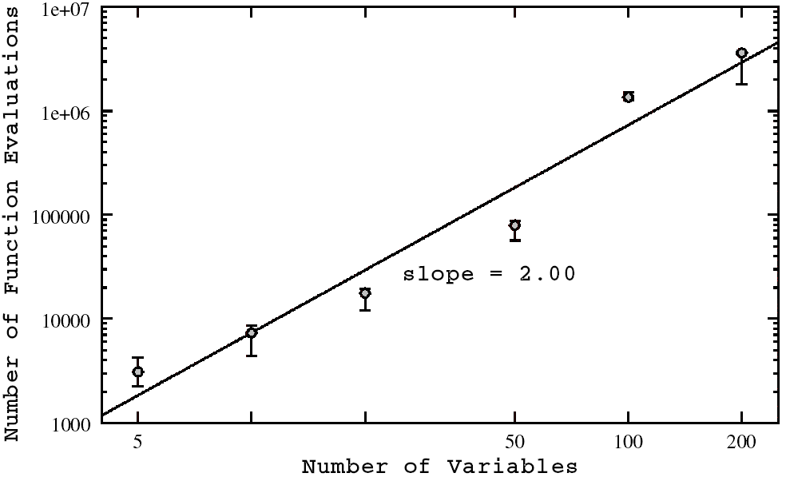
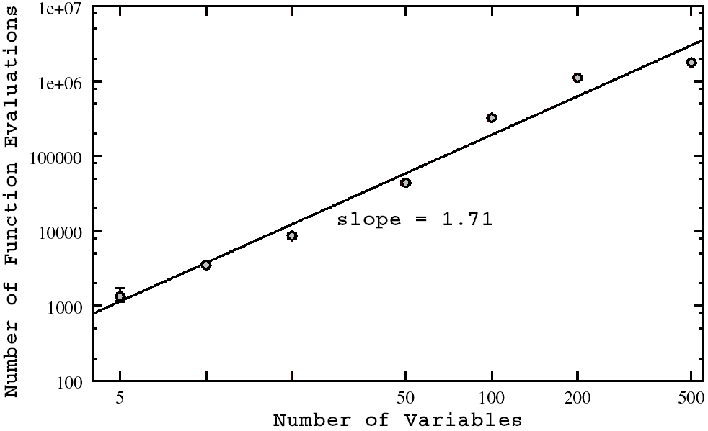
Experiments (8/9)
Scalability of the Proposed Approach
  Run 10 times from different initial populations
  Function evaluations needed to achieve 10⁻¹⁰
F_{elp}
F_{ros}
F_{sch}

Slide 19
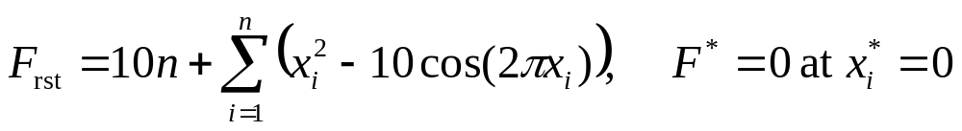
Experiments (9/9)
Rastrigin’s Function
    Multimodal problem
    x_{i} ∈[-10, -5]
  PCX: 15.936
  UNDX: 19.899

Slide 20
Review of Current Results with Respect to Past Studies
Skewed Initialization
  The knowledge of the exact optimum if usually not available in most real-world problems.
  An algorithm must overcome a number of local minima to reach the global basin.
  The performance of an EA on symmetric initialization ([-5.12, 5.12]) may not represent the EA’s true performance.
Scale-Up Study
  Required function evaluations are much larger than that needed by the G3 model with the PCX operator.

Slide 21
Conclusions
G3 Model with PCX Operator
  Performance
  Efficiency
  Scalability
  We recommend the use of proposed approach on more complex problems and on real-world optimization problems.

