Slide 1
Stochastic modeling of polymerase chain reaction and related biotechnologies
Fengzhu Sun
Bulletin of the International Statistical Institute, 53rd session proceedings, book 1: 393-396
Jang, Ha-Young

Slide 2
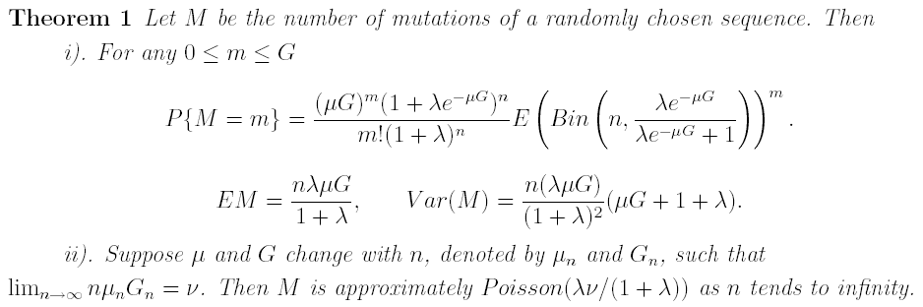
The Polymerase Chain Reaction

Slide 3


The Polymerase Chain Reaction
M₁, M₂, …, M_{s} is the number of mutations
H_{i,j} is the pairwise Hamming distance between sequence i and j

Slide 4
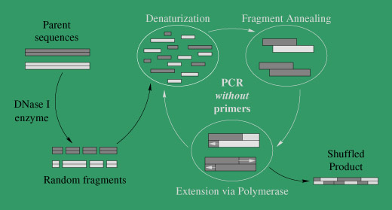
DNA shuffling

Slide 5
Model Development
100-150 full-length sequences
1,500-5,000 ssDNA molecules
Poisson fragmentation process
  Yield an exponential length distribution
Reassembly process
  ssDNA molecules randomly collide
  Decision is made whether the molecules will hybridize
  Hybridized molecules are extended with a fidelity and processivity

Slide 6
Model Development
Determine that collisions are not limiting over typical experimental time scales.
Calculate a Boltzmann weighted probability for each annealing event. (at least some minimum overlap – 7 base pairs)
Nearest-neighbor model
The fragment sequences are tracked throughout the process

Slide 7
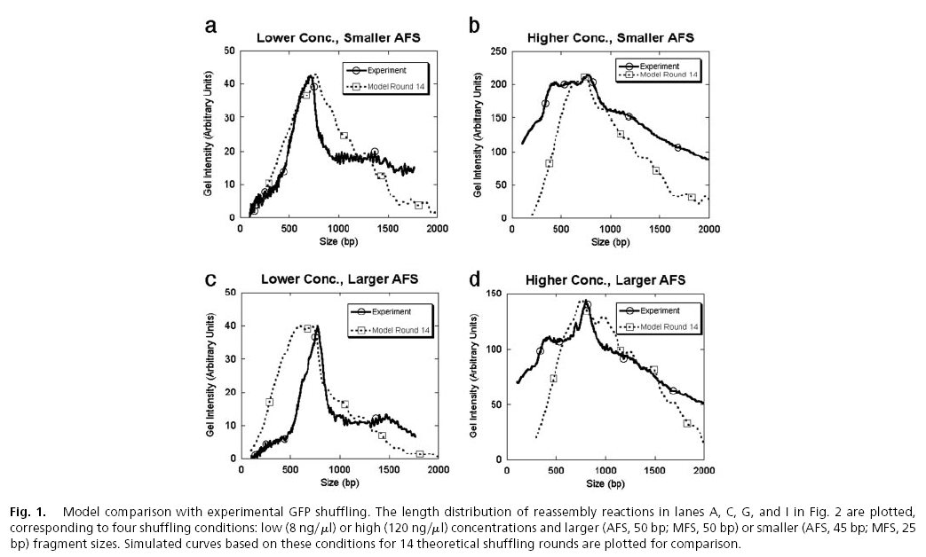
Model comparison with experimental GFP shuffling

Slide 8
Model Insights
The creation of “junk” sequences, or ones that do not resemble a full-length gene
A natural tradeoff between the percent of sequences containing a fully reassembled product and the frequency of crossovers in those sequences
The creation of multimetric reassembly peaks

Slide 9
Annealing thermodynamics
Two-state model of hybridization in which two ssDNA molecules transit directly between a single-stranded and double-stranded state.
Does not currently consider gapped annealing events.

Slide 10
Conclusion
Build theoretical models for in vitro evolution together with mutagenesis technique and to optimize experimental conditions.

