Slide 1
Hybridization Simulator Using Thermodynamic Data
Jang HaYoung
2003/07/03

Slide 2

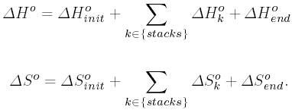
Nearest Neighbor Method
AGCTTAGGATGGCATGGAATCCGATGCATGGC
CGTACCTTAGGCT

Slide 3


Chain Reaction
Data Structure
  Bidirectional graph
  Maintain index between hybridized sequences
Parameters
  Concentration: salt, oligomer
  Population size
  Spatial infomation

Slide 4
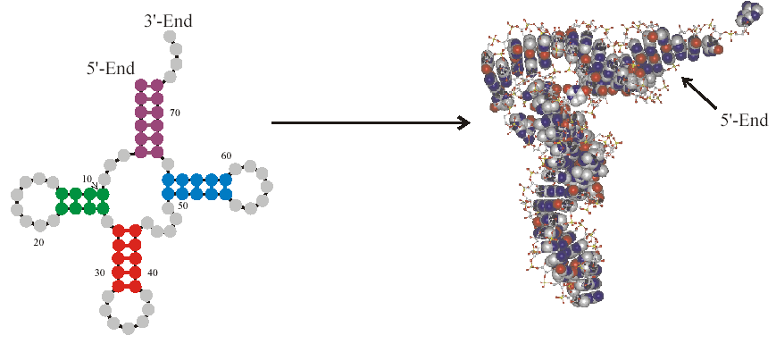
Data Structure

Slide 5
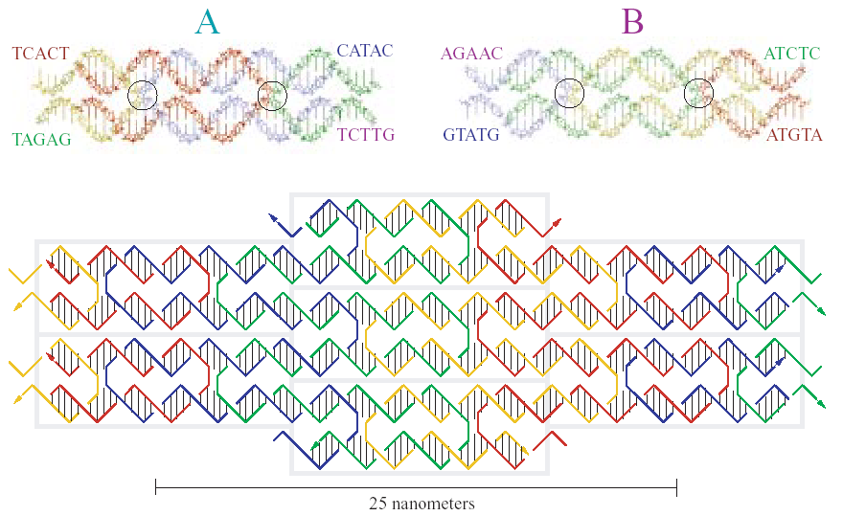
Data Structure

Slide 6
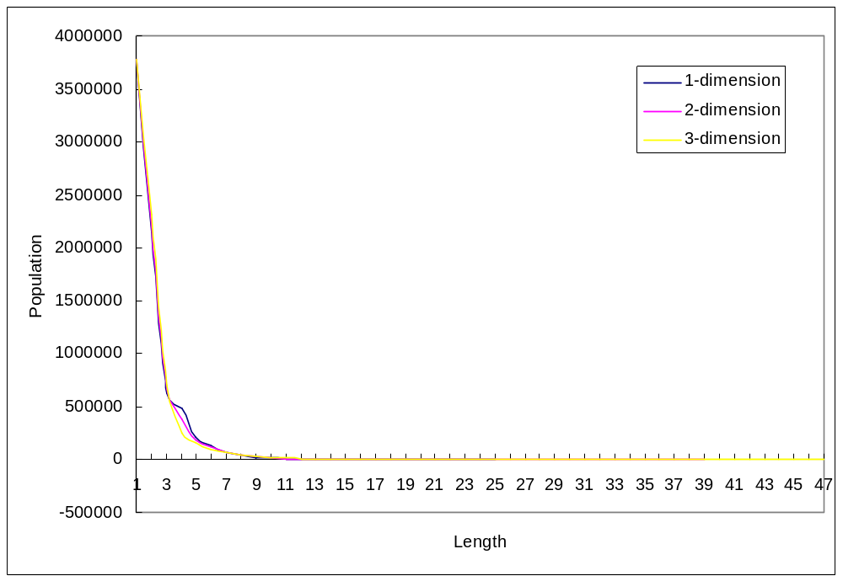
Parameters

Slide 7
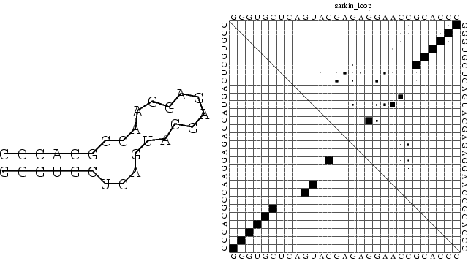
Vienna RNA Package

Slide 8
Vienna RNA Package
The minimum free energy algorithm
  yields a single optimal structure
Partition function algorithm
  calculates base pair probabilities in the thermodynamic ensemble
Suboptimal folding algorithm
  generates all suboptimal structures within a given energy range of the optimal energy
Inverse foldin

