Slide 1
Plan for NACST/Seq
Weekly Lab Seminar
2003. 4. 15
Lee, In-Hee

Slide 2
What NACST/Seq Can Do…
Produce a set of sequences
  With same length
  With same Tm, GC %
  With no hybridization to each other.
  Different from each other.
NACST/Seq Engine
  NSGA-II

Slide 3

Measure for Comparison
First front of run i: f_{i}
Front of unified result: F
Front Ratio
  Ratio of elements which belongs to the unified front
  The larger is the better
Distribution for 2 objectives
  Standard deviation of distances between nearest two solutions.
  The smaller is the better

Slide 4
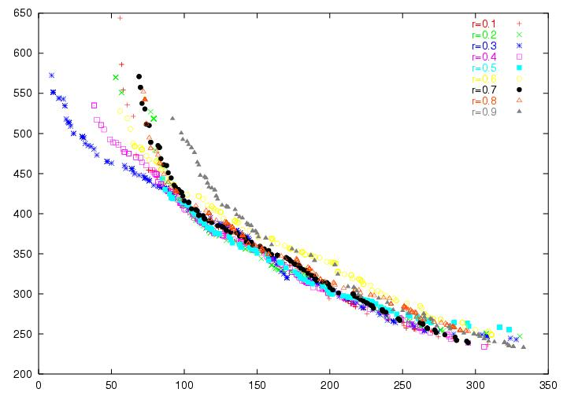
Tuning Parameters – reduction rate r

Slide 5
With small r
  Pressure towards first front is high.
With controlled elitism
  More extreme trade-off solution could be obtained.
R | Front Ratio (%) | Distribution (std.)
0.1 | 24.359 | 9.2002
0.2 | 28.736 | 6.5723
0.3 | 39.423 | 3.7129
0.4 | 18.584 | 2.9656
0.5 | 11.842 | 3.3106
0.6 | 0 | 3.6303
0.7 | 2.1053 | 3.9232
0.8 | 0 | 4.3784
0.9 | 1.4493 | 3.9363

Slide 6
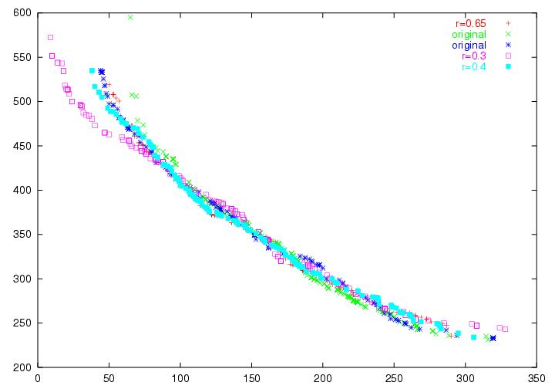
Main Engine: with or without controlled elitism
 | Front Ratio (%) | Distribution (std.)
Original (G) | 36.275 | 9.369
Original (B) | 22.892 | 3.8331
R=0.3 | 33.654 | 3.7129
R=0.4 | 15.044 | 2.9656
R=0.65 | 32.53 | 2.959

Slide 7
Future Work
Design of branch
  In current design, we consider shifted hybridization & similarity.
  Concatenation of sequences may interact to each other little…
    I hope…

Slide 8
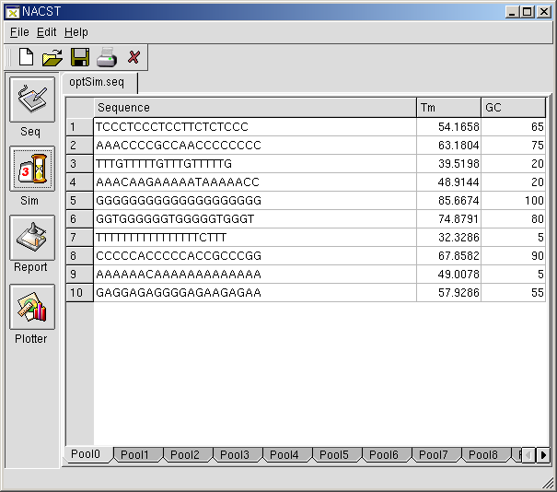
Future Work
Refinements for fitness measure
  H-Measure & Similarity
    Sum of pair
    Minimizing sum of pair
    -> give up minimizing one pair
  How about sum of square?
  Or split into two measure
    Avg. and Std.
Minimizing Similarity

Slide 9
Future Work
Insertion of enzyme site
  Necessity is at hand - designing sequences for GA
  Finding Repeats with Fixed Gap, R. Kolpakov, G. Kucherov, 2000.
Primer 1
CCAGCNNNNNNNNGTCTCC
GGTCGNNNNNNNNCAGAGGGGTC
NNNNNNNNNNNNNNC
NNNNNNNNNNNNNNGGGTC
0
Primer 2
CCAGCGGATGNNNNNNNNC
GGTCGCCTACNNNNNNNNGGGTC
CCAGCNNNNNNNNNNNNNN
GGTCGNNNNNNNNNNNNNN
1

