Slide 1
GenePath: a system for automated construction of genetic networks from mutant data
Journal of Bioinformatics 2003 vol.19: pp. 383-389
Blaz Zupan, Janez Demsar, Ivan Bratko, Peter Juvan, John A. Halter, Adam Kuspa, and Gad Shaulsky
2003-02-19
Weekly LAB Seminar
Summarized by Eom Jae-Hong

Slide 2
Abstracts
Genetic networks
  Often used in the analysis of biological phenomena.
  In Classical genetics - manually constructed.
  Large amounts data make the process too complicated.
Develop GenePath
  An intelligent assistant – automates the analysis of genetic data.
  Employ expert-defined patterns to uncover the relation from the data (use the relation as constraints in the search).
http://genepath.org.

Slide 3
Introduction
Geneticists use mutation
  For investigating biological phenomena.
  Mutations alter the behavior (phenotype) of the system.
  & Reveal possible components of the biological process.
Genetic network
  Outline the details of a biological mechanism are constructed by integrating the relationship between pair of genes.
GenePath
  Automate the consideration of all the data in a consistent manner.
  Allows geneticist to examine the possible consequences of planned mutations.
  Process experimental data & prior knowledge ➔ construct genetic network ➔ present it as a graph.

Slide 4
Introduction
Graph in GenePath
  Non-terminal nodes: genes.
  Terminal nodes: biological processes.
  Arcs: labeled either ‘inhibits’ or ‘excites’.
Use identical genetic logic of regulatory networks
  By [Avery and Wasserman, 1992].
  Signals are integrated through a cascade of gene products.
    Until they exerts and effect on the biological process.
The use of GenePath – demonstration
  On a process that regulates the transition from growth to development in the social amoeba Dictyostelium.
  Reconstruct a networks from exper. data and prior knowledge.
Notes:
http://bric.postech.ac.kr/webzine/content/review/plantbio/2001/Apr/soo04.html
토양 미생물인 Dictyostelium은 주위에 영양원이 있을 때는 단세포로서 이분 법으로 세포분열을 계속하게 되나 영양원의 고갈 또는 인위적으로 제거할 때 세포증식을 멈추고 세포들의 집합에 의한 다세포 체를 형성하여 발생 분화기에 들어가게 된다. Dictyostelium은 비교적 짧은 생활사를 가지고 있어서 발생분화를 시작한 뒤 약 24시간 후 stalk과 포자들을 둘러싸고 있는 포자낭군으로 이루어진 최종 표현형을 형성하게 된다.

Slide 5
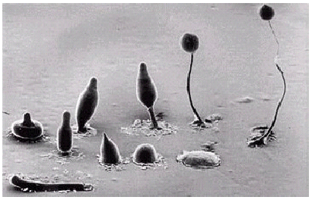
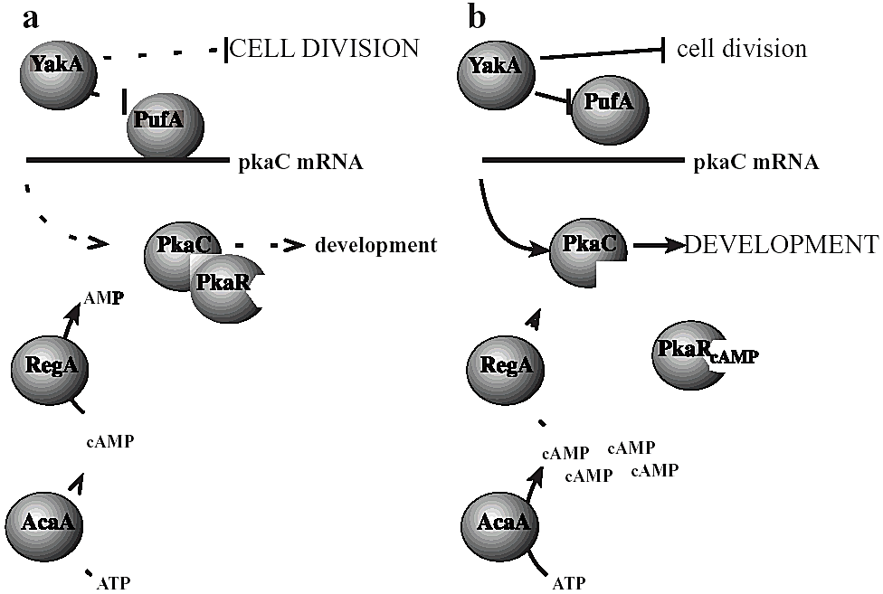
Introduction

Slide 6
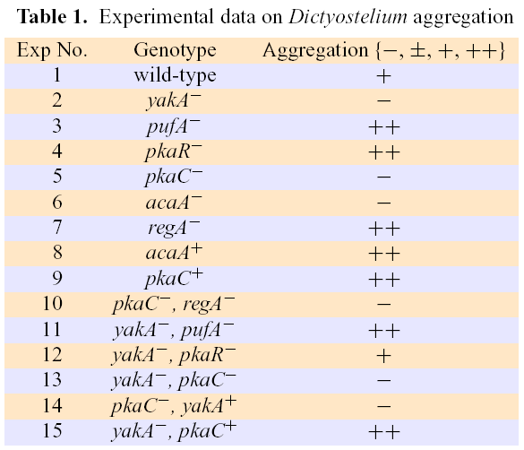
System and Methods – Genetic data
GenePath
  Receive data in the form of phenotype of single or double mutants.
  Possible degree of
  aggregation: 4
  Consider
    Qualitative phenotypes
    Numerical values
      Ascending order

Slide 7
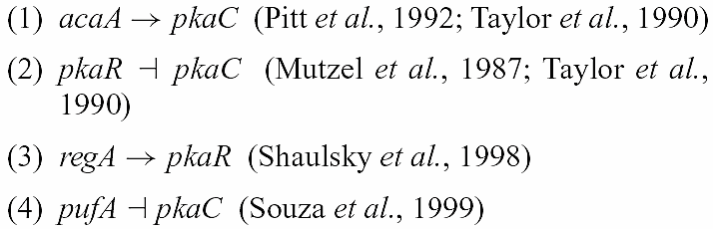


System and Methods – Prior Knowledge
Include following prior knowledge
  denotes inhibition.
  denotes excitation.

Slide 8
System and Methods
– Inference patterns –
The genetic logic
  Defined through a set of inference patterns such as
    “IF a certain combination of data exist, THEN a certain relationship between a gene and a biological process is hypothesized.”
The patterns
  Influence: does a gene influence the biological process?
    inf , infTC
  Parallelism: do two genes act in parallel paths of a genetic network?
    parDiff
  Epistasis: does one gene act after another in the gene network?
    epMut

Slide 9

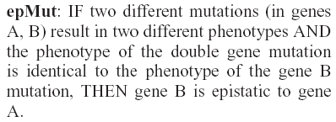


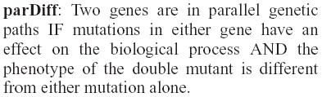
System and Methods
– Inference patterns –
The patterns
Influence
Epistasis
Parallelism

Slide 10
System and Methods
– Construction of genetic networks –
Genetic networks: node + edge
  Node: gene or biological process.
  Edge: excitatory (→) or inhibitory relations.
  Consider all the relations as constraints over the possible networks
  Attempt to find a network that satisfies the constraints.
  Check for conflicts between the constraints.
    A pair of genes that show both epistatic and parallel relations.
    A gene influences the biological process with + and - influences.
  Conflicts reported to the user.
  Consider the epistatic relation and examines adjacency.

Slide 11
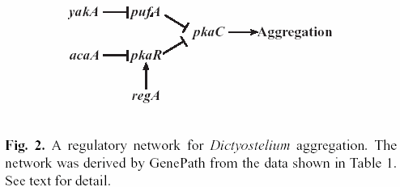



System and Methods
– Construction of genetic networks –
Example
  Is acaA adjacent to pkaC?
    From data:
    acaA→pkaC support this possibility.
    But, pkaR is epistatic to acaA. ( )
    And inhibits pkaC. ( )

Slide 12
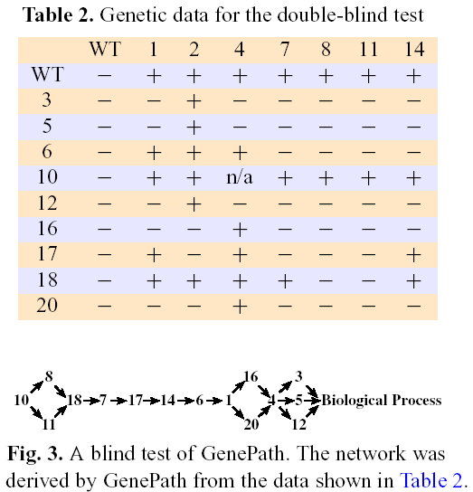
System and Methods
– a blind test –
Dauer larva formation in C. elegans.
  Excluding gene number 2
    daf-2.
  All result was correct.

Slide 13
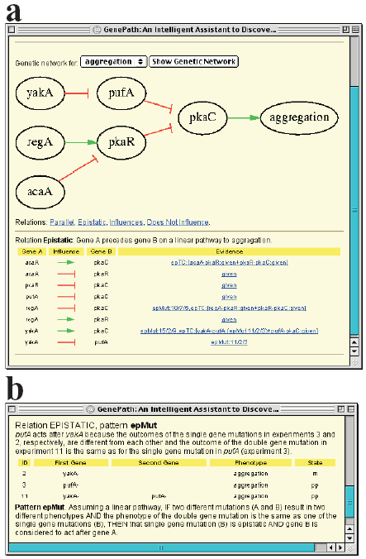
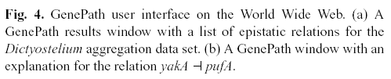
System & Results
Formalism
Limitation
  Plausible network
  Network ranking
  Sufficient rule
  Non-redundant rule
  Loops for feedback mechanisms

