Slide 1
Stochastic model for DNA denature
Joon Shik Kim

Slide 2
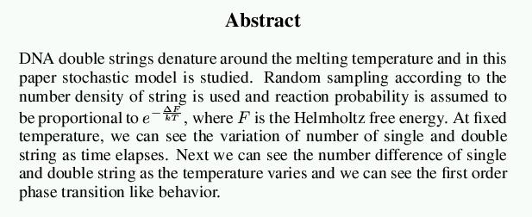
0. Abstract.

Slide 3
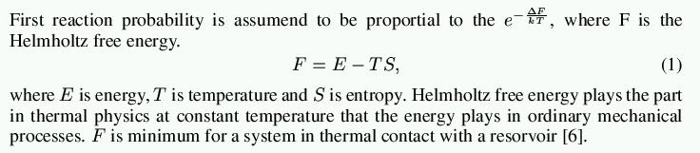
1. Theory (1/3).

Slide 4
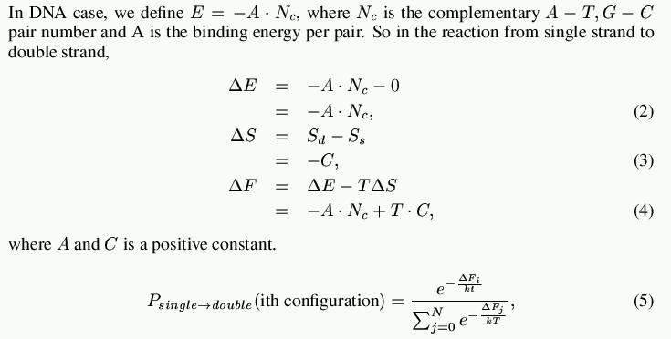
1. Theory (2/3).

Slide 5
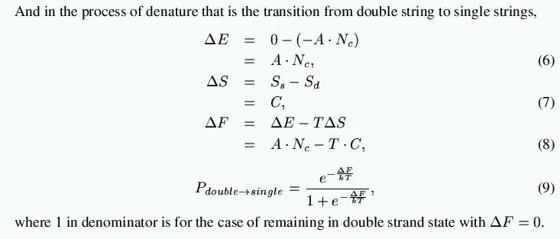
1. Theory (3/3).

Slide 6
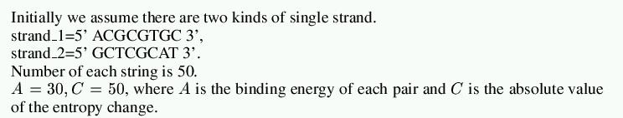
2. Simulation.

Slide 7
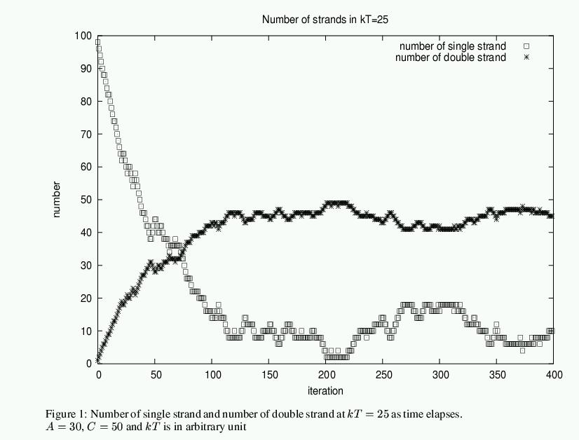
3. Simulation result (1/3).

Slide 8
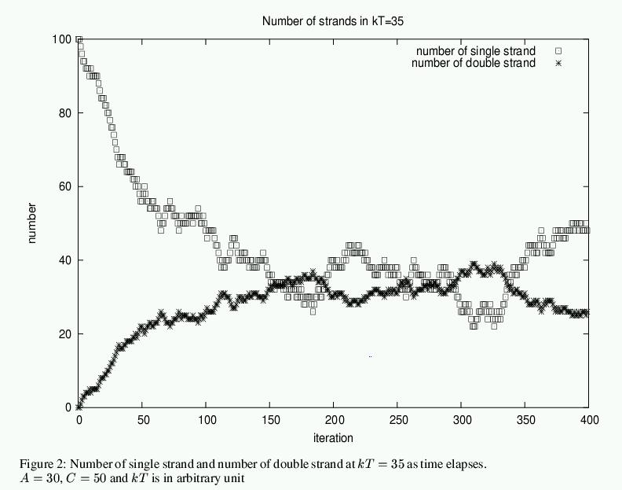
3. Simulation result (2/3).

Slide 9
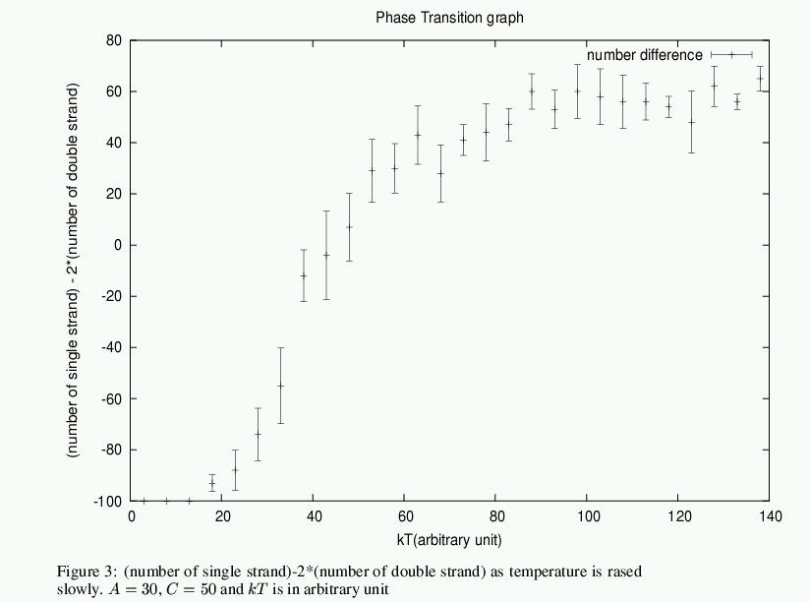
3. Simulation result (3/3).

Slide 10

4. Conclusion.

Slide 11
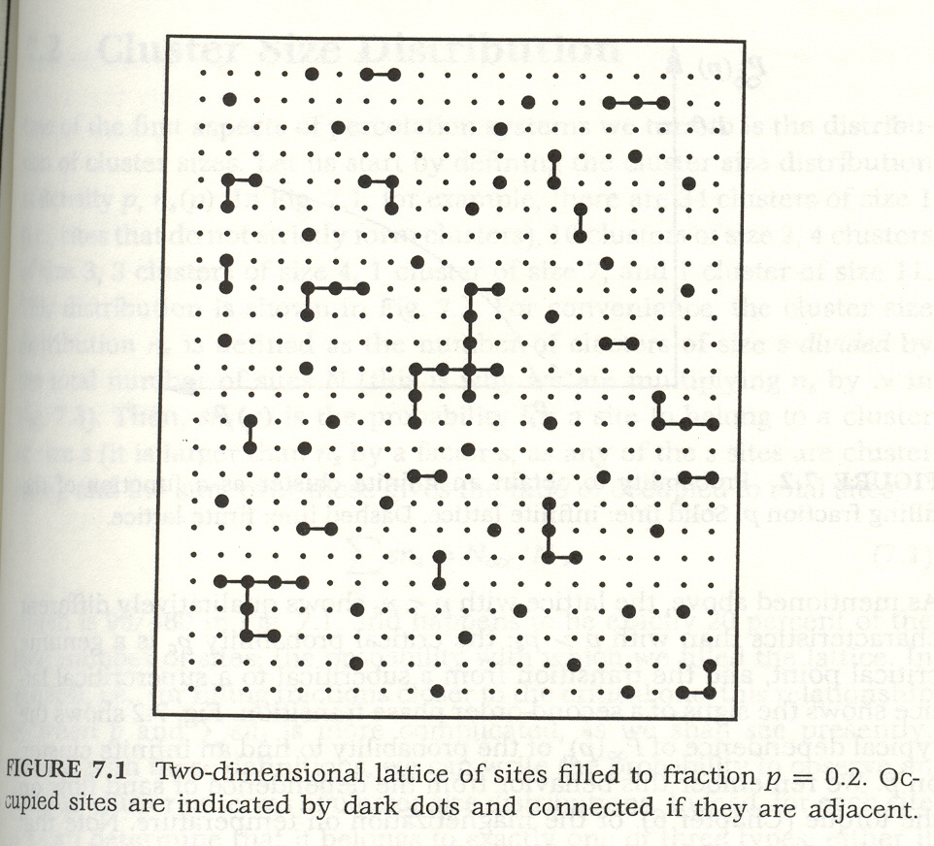
5. Further study.

