Slide 1
Survey of Kernel Methods
by
Jinsan Yang

Slide 2
Introduction
Support Vector Machines
  Formulation of SVM
  Optimization Theorem
  Dual Formulation of SVM
Reproducing Kernel Hilbert Space
Kernel Machines

Slide 3


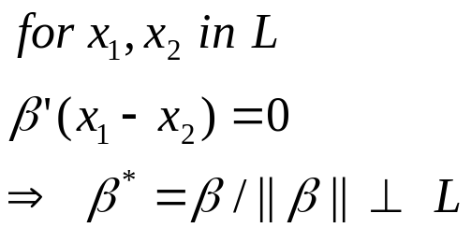
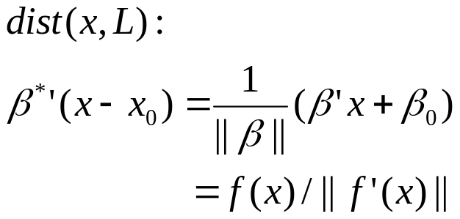



SVM Formulation
  Support vector classifiers:

Slide 4



SVM Formulation

Slide 5
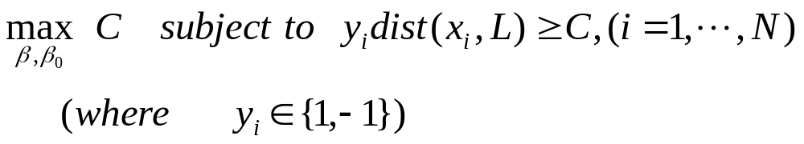

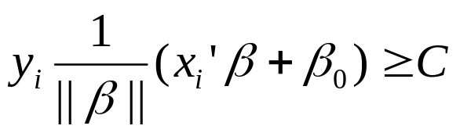

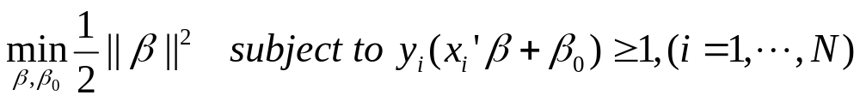
Optimal separating hyperplane
  Optimize:
  Note: Any positively scaled (multiple of a vector) satisfies
  Set by

Slide 6
Optimization Theorem
  Because of the many constraints, the optimization of SVM is still too complicate to solve
  →Change this to the corresponding dual formulation
  Need to use some theorems about duality:
    Kuhn Tucker Theorem
    Kuhn Tucker Saddle Point Condition (saddle point theorem)
    Wolfe (existence of dual solution)

Slide 7
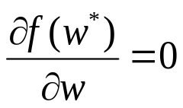
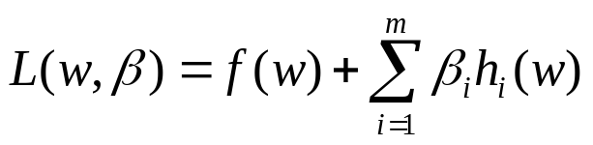
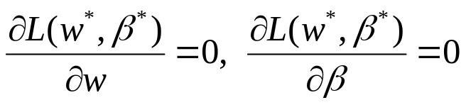
Optimization Theorem
  Generalization of the following optimization problem
  Theorem (Fermat,1629):
  For a convex f , w* is a minimum of f(w) iff
  Theorem (Lagrange,1797):
  For a convex Lagrangian ,
  w* is a minimum of f(w) subject to
  h_{i}(w) = 0, i=1, 2, .. , m iff

Slide 8

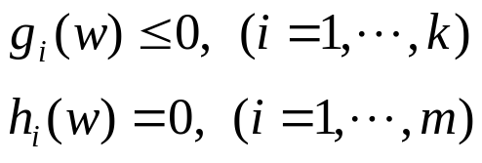
Optimization Theorem
  Kuhn and Tucker suggested a solution to the so called convex optimization problem, where one minimizes a certain type of (convex) objective function under certain (convex) constraints of inequality type.
  Problem: minimize
  subject to :
  Generalized Lagrangian function:

Slide 9


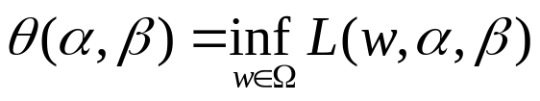



Optimization Theorem
  Lagrangian dual problem:
  maximize
  subject to (where )
  Theorem (weak duality theorem): for solutions between primal and dual problems,
  Corollary:
  Corollary: If , then
  Duality Gap: the difference between the primal and dual problems

Slide 10

Optimization Theorem
  Saddle point
  Theorem: is a saddle point of the Lagrangian function for the primal problem iff there is no duality gap
  for the optimal solutions
  Theorem (strong duality theorem, Wolfe): In the convex domain of primal problem and affine functions h and g, the duality gap is zero.

Slide 11


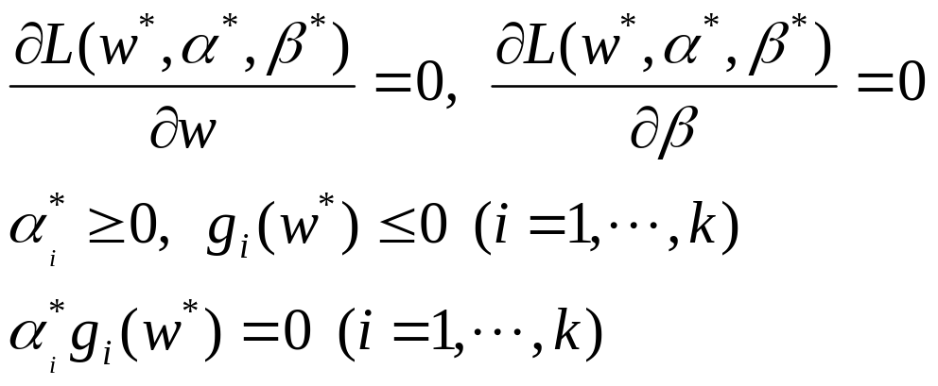
Optimization Theorem
  Theorem (Kuhn-Tucker, 1951) For a primal optimization problems with convex domain and affine g and h,
  is an optimal solution iff there are such that
(The Kuhn-Tucker conditions)

Slide 12




Optimization Theorem
  In the Kuhn-Tucker conditions, if
  and in that case, the corresponding constraint becomes
  inactive (since ) in the primal optimization problem.
  The constraint can be active ( or ) when
  .

Slide 13
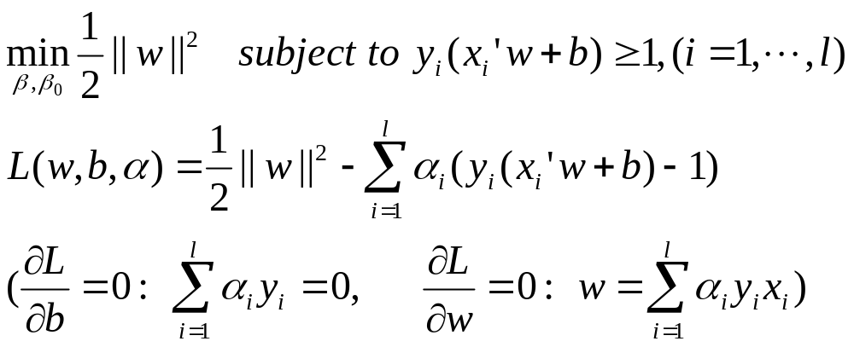
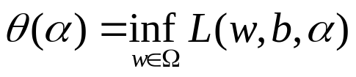
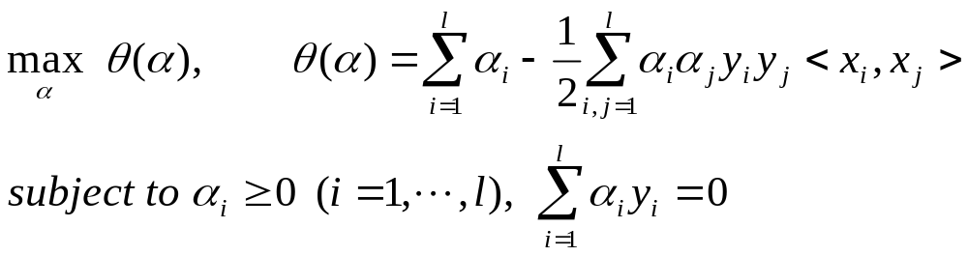
Dual form of SVM
  Primal problem:
  Dual problem:

Slide 14
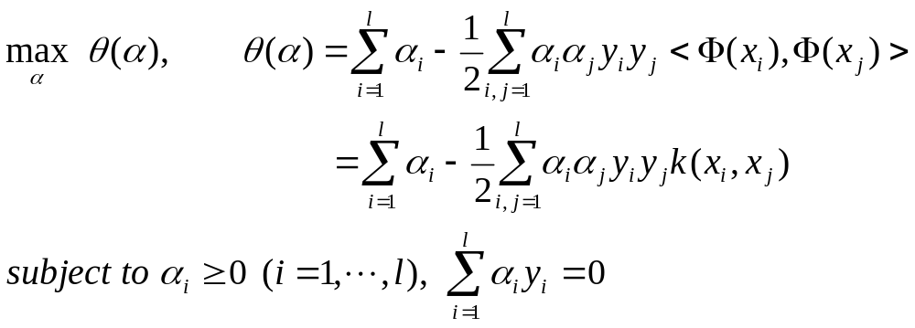
Nonlinear SVM
  Dual problem:

Slide 15
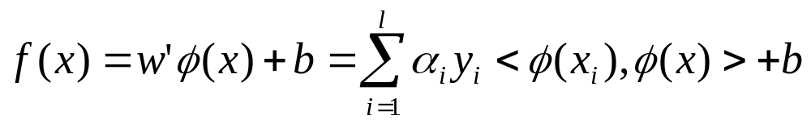

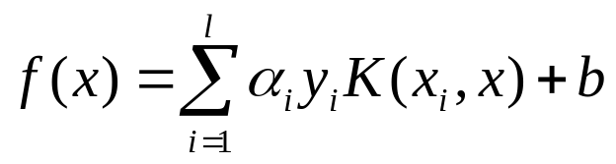

Reproducing Kernel Hilbert Space
  Dual representation of the hypothesis
  Kernel : a function K such that for all x, z ∈ X
  Using Kernel, we can compute the inner product
  in the feature space directly as a function of the original input space,

Slide 16
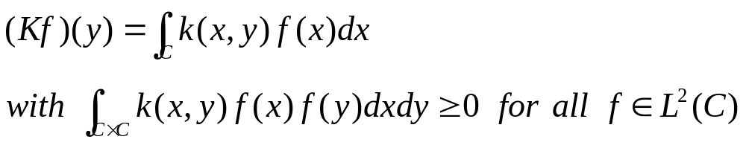


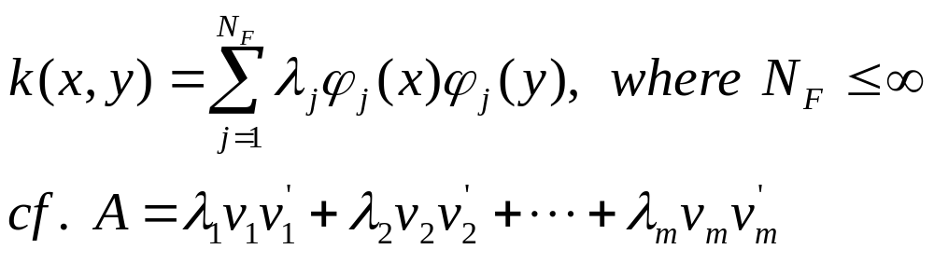
Reproducing Kernel Hilbert Space
  For a given Kernel, what is the corresponding feature mapping? (Ans: Mercer’s theorem)
  Theorem (Mercer): If k is a continuous symmetric kernel of a positive integral operator K, that is:
  ,it can be expanded in a uniformly convergent series in terms of Eigenfunctions and positive Eigenvalues

Slide 17
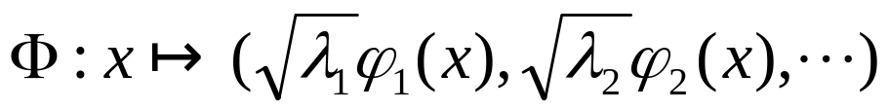

Reproducing Kernel Hilbert Space
  Note: construction of a feature map corresponding to a kernel K
  Proposition: If k is a continuous kernel of a positive
  integral operator (positive semi-definite in discrete case),
  one can construct a mapping Φ into a space where k acts as a dot product,
  k in mercer’s theorem is called mercer kernel.

Slide 18
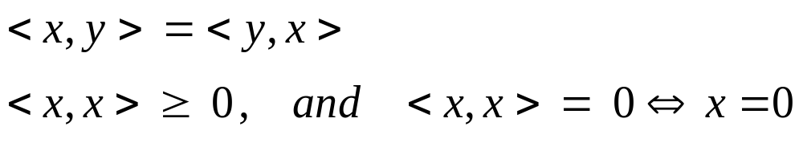

Reproducing Kernel Hilbert Space
  A vector space X is called inner product space if there is a real bilinear map <•, •> satisfying:
  Hilbert space: a complete separable inner product space
  (A space H is separable if there exists a countable subset D such that every element of H is the limit of a sequence of elements of D.)
  RKHS: RKHS is a Hilbert space of functions f on some set C such that all evaluation functionals
  are continuous. (Wahba)

Slide 19




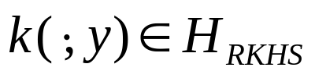

Reproducing Kernel Hilbert Space
  Riesz representation theorem: Let H be a Hilbert space and let be given. Then there is a unique
  such that
  Recall: If H_{rkhs} is a RKHS, then for each y in C, T_{y} (defined as ) is continuous.
  By the Riesz representation theorem, for each
  there exist a unique function of x, say,
  such that

Slide 20



Reproducing Kernel Hilbert Space
  spans the whole RKHS
  : By (*), implies f = 0.
  By (*),
  :The inner product on the RKHS space corresponds to a value of the reproducing kernel k
  Cf. is the completion of the continuous functions wrt. the L2-norm.

Slide 21
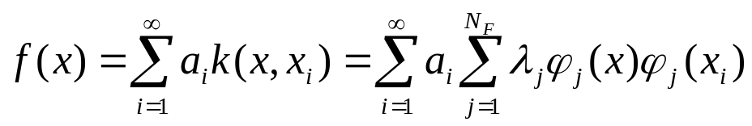

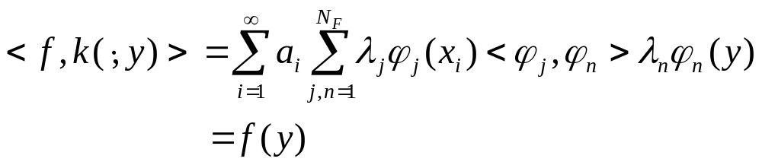
Reproducing Kernel Hilbert Space
  For a Mercer kernel k, it is possible to construct a dot product such that k becomes a reproducing kernel for a Hilbert space of functions of the form
  (check) Since k is symmetric, choose ϕ_{i} orthogonal as,

Slide 22
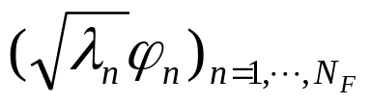
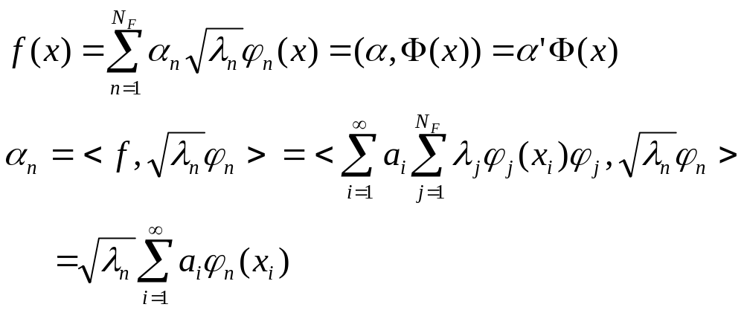
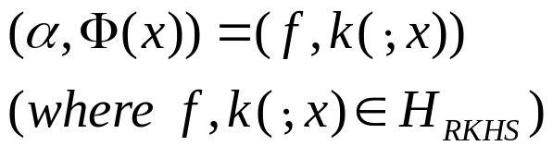
Reproducing Kernel Hilbert Space
  Feature space vs RKHS: feature space is a RKHS.
    Rewriting the functions of RKHS wrt. the orthonomal basis of Mercer’s theorem :
    Φ (x) is nothing but the coordinate representation of the kernel as a function of one argument.

Slide 23

Reproducing Kernel Hilbert Space
  The representation ability of a kernel k and l data points:
    The corresponding feature space H is spanned by
    The feature mapping is wrt. the corresponding Mercer’s
    eigenfunctions and an objective function f(t) may be
    expressed as a linear combination of these eigenfunctions.
    Since H is a RKHS, any such nonlinear function f(t) can be approximated with these kernels

Slide 24

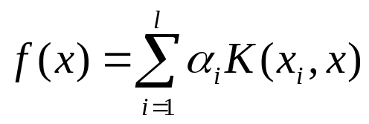
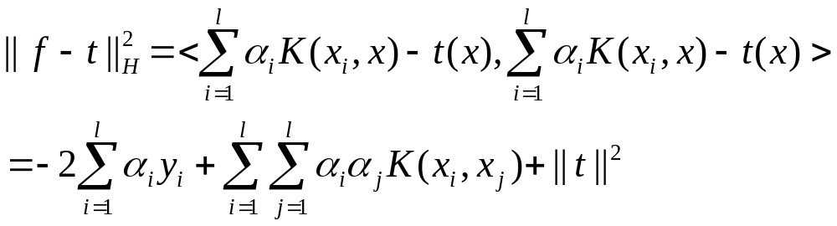
Example
  Nonlinear Regression for a training set
  generated from a target function t(x) :
  Assume a dual representation
  Minimize the norm

