Slide 1
Bioinformatic Quest for the Holy Grail: UG gene
Su Dong Kim
Biointelligence Lab.
Interdisciplinary Program in Cognitive Science,
Seoul National University
2003. 2. 19.

Slide 2
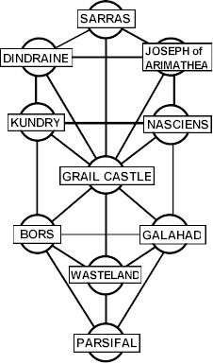

Bioinformatic Quest for the Holy Grail: UG gene
Logical necessity of UG
Evolution of UG
Brain structure and Language Disorders
Language Disorders & UG
SLI & WS
FOXP2, language gene
Cognitive Genetics
Bioinformatic Quest

Slide 3
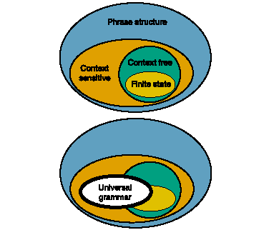
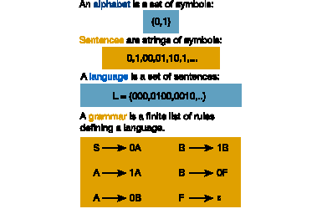
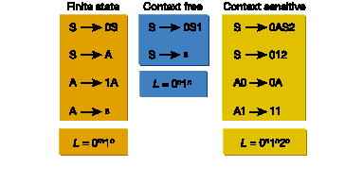
Logical necessity of UG

Slide 4
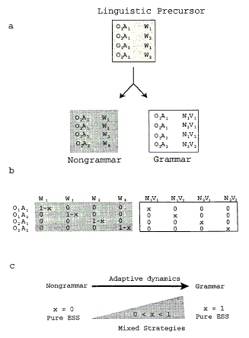
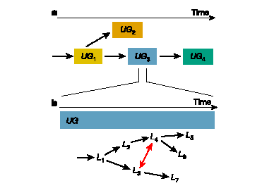
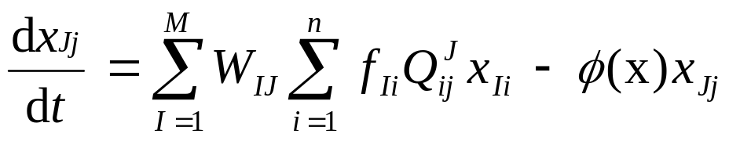


Evolution of UG

Slide 5
Why Study Language Disorders?
To locate language in the brain
To reveal workings of the grammar

Slide 6
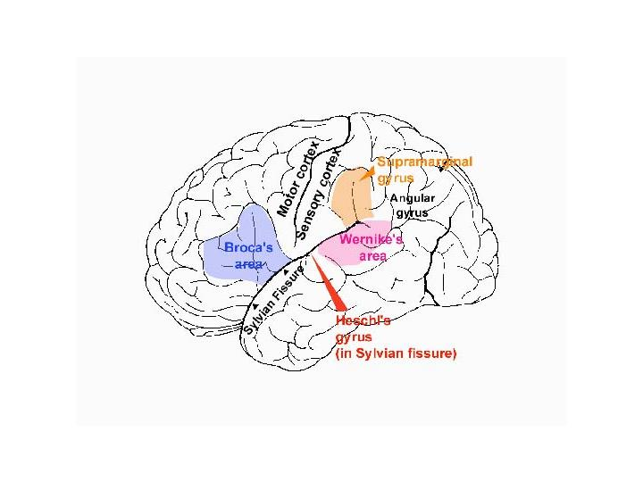
Brain Structure and Aphasia

Slide 7
Language Disorders & UG
Having language localized in a specific area of the brain predicts the following:
– impaired linguistic ability with regular intelligence
– impaired general intelligence with regular linguistic ability
Specific Language Impairment (SLI)
Williams’ Syndrome (WS)

Slide 8
Specific Language Impairment
Has a specific genetic profile
Slow rate of speech
Stopped to correct themselves
5X more than normal
OK with saying if words are English or not: Problems with inflection (tense, number)

Slide 9
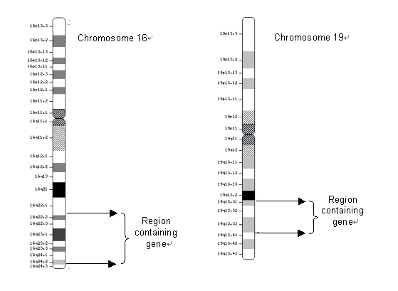
Genetic Study Results of SLI

Slide 10
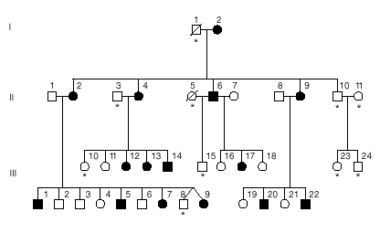
Pedigree of the KE family

Slide 11
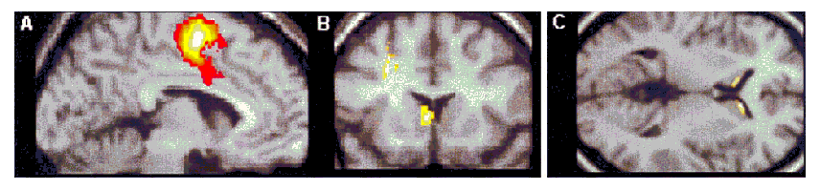
PET & MRI Study of the KE family
(A) Parasaggital section (PET)
(B) Coronal section (PET)
(C) Transverse section (MRI)

Slide 12
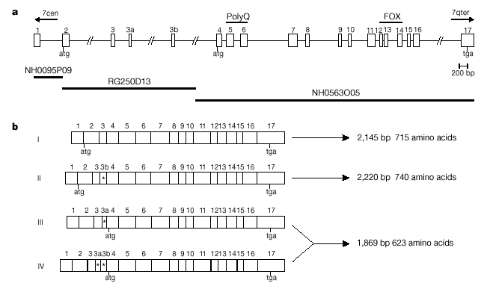
Identification of FOXP2 gene

Slide 13
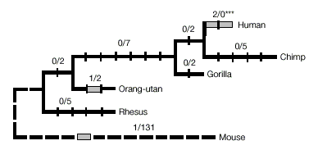
Phylogenetic Map of FOXP2

Slide 14
Williams’ Syndrome (WS)
Genetic hallmark;
– deletion on chromosome band 7q11.23.
Physical characteristics:
– elfin appearance
– particular heart defects
Cognitive problems:
– only rudimentary skills in reading, writing, math
– problems with spatial understanding
Normal to superior linguistic abilities;
– very expressive and fluent

Slide 15
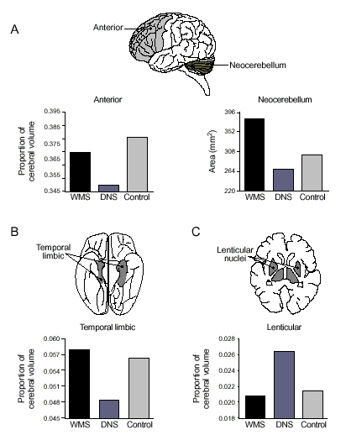
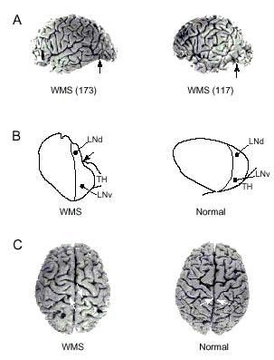
Brain Cytoarchitectonic in WS

Slide 16
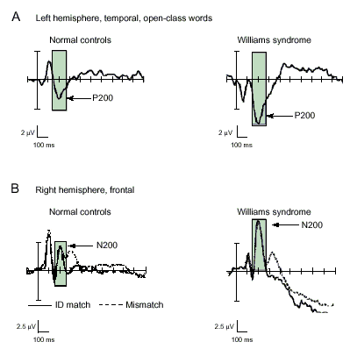
Neurophysiological Profile of WS

Slide 17
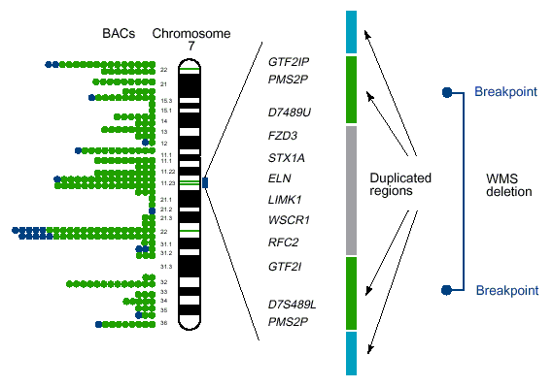
Molecular Genetic Profile for WS

Slide 18
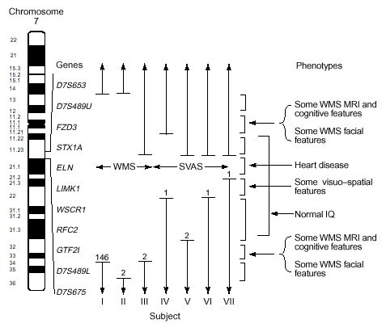
Genetics and Cognitive Ability

Slide 19
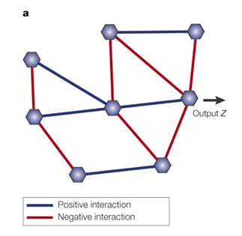
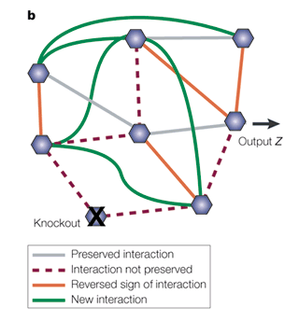
Bioinformatic Quest for the Holy Grail: UG gene

