Slide 1
Learning Semantic Similarity
Jaz Kandola, John Shawe-Taylor and Nello Cristianini
Univ. of London and UC Berkeley
NIPS 2002
Summarized by Sahng-Joon Auh

Slide 2
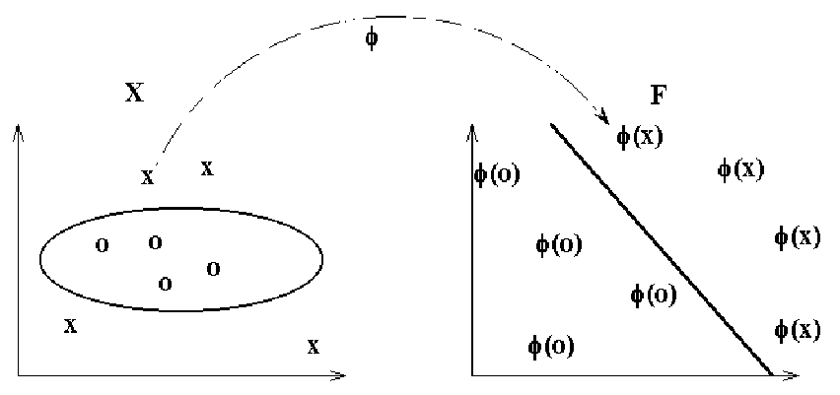
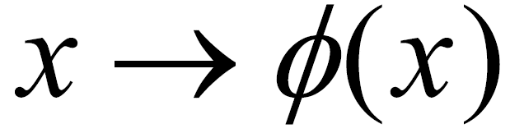

Kernel Methods for Pattern Analysis
Work by embedding data into a vector space
Need to know the inner product between the images of the data items (the kernel)
Defining a suitable kernel means finding a good representation
In our case: semantically similar documents should be mapped to nearby positions in feature space

Slide 3
Kernel Methods
Problem
  How to find a semantically meaningful kernel?
  We can:
    Define it, construct it, or learn it from data…
  Successive embeddings, each closer to the semantics, are possible

Slide 4
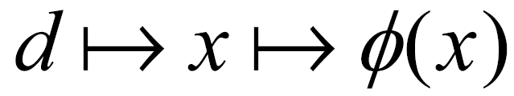
Vector Space Representations of Text Documents
x is a vector having one entry for each word in the lexicon (set of all possible words, dictionary)
The entry x_{i} is the number of occurrences of word i in the document d
We call this vector a bag of words (BOW)
Here ∅(x) is the image of x in a feature space (eg after normalizing, scaling or other operations, to be discussed later)

Slide 5
Problems with BOW
Although BOW works well, many well known problems:
  It only compares documents using the terms they have in common.
  How to deal with semantically related terms?
Ideally, two documents could be similar even with no terms in common…

Slide 6
More Linear Mappings
Problem: standard bag-of-words fails to capture semantic relations between words (and hence to recognize similarity between documents that contain synonyms)
One solution: design a map R that encodes such relation, l.e. if z and x share no terms, but some of them are synonymous, K(x,z) > 0
Try to achieve Rz ≈ Rx, if x and z are semantically similar
We call P(=R′R) a semantic proximity matrix

Slide 7
Vector Space Representations
General form:
K(d₁,d₂)=d₁′ Pd₂=d₁′ R′Rd₂=<Rd₁,Rd₂>
Different P will give different methods
Vector d: one entry for each possible term, weighted according to its importance
Standard in I.R., they can all be used to build kernels (and hence for categorization, and other tasks)

Slide 8
Semantic Mapping
Problem:
  How to design (or learn) a matrix P that contains meaningful terms-similarity
How to use it efficiently
Notice: using P is like ‘expanding’ the two documents, augmenting them with synonyms of their terms, increasing chances of a match

Slide 9
Inserting Semantic Knowledge
One would like to ‘expand’ the representation of a document to include all synonyms of terms in the document
The term by document matrix would be much less sparse

Slide 10
Latent Semantic Indexing
Compare two documents in a semantic space
Capture semantic correlations by detecting co-occurrences
Assumption: two documents are semantically related if they co-occur frequently in same documents
Used in Retrieval, better performance than VS, introduced by Deerwester et al.

Slide 11
Another Interpretation
Building semantic networks
Consider the graph having one node per term, connection between nodes given by co-occurrence in same document of corpus (simple semantic network)
The spectrum of a graph: eigenvectors of higher order used for graph partitioning
Latent semantic kernels(LSK) finds regions of the semantic network

Slide 12
Two Directions to Explore…
The GVSM:
  Just a first approximation of term similarity
  How can we extent it to longer range correlations?
The terms-graph idea: can we push it further?

Slide 13
Semantics from Equilibrium Conditions
Two documents are similar if they contain similar terms
Two terms are similar if they appear in similar documents

Slide 14
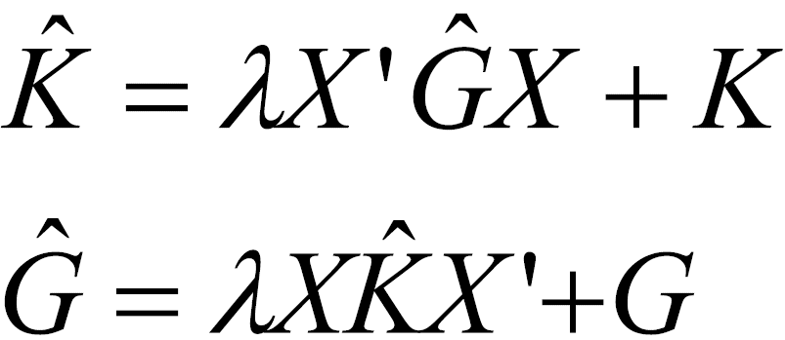
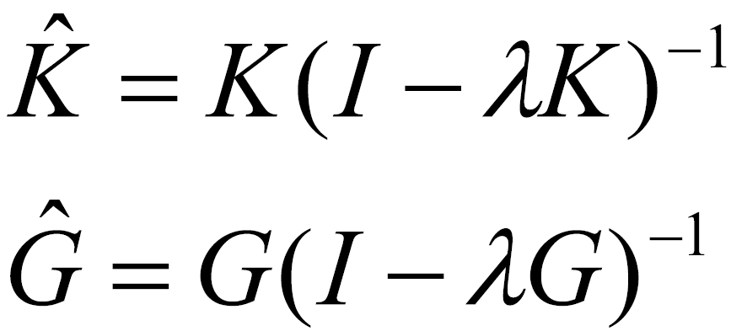
Semantics from Equilibrium Conditions
We can write the resulting system as follows:
K is doc/doc matrix (analogous to kernel matrix): level of similarity between documents
G is term/term matrix: level of similarity between terms
Its solution yields:

Slide 15

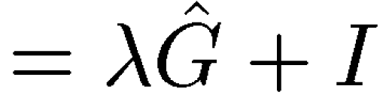

Semantic Proximity
And we can regard the new kernel matrix as defined by a semantic proximity matrix as follows:
Parameter controls decay rate of influence between correlated documents…

Slide 16
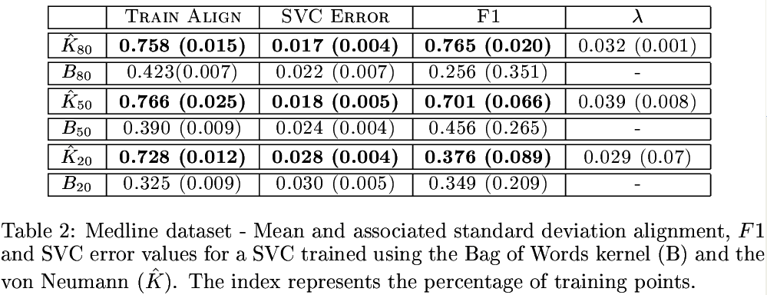
Some experiments…
Parameter tuned automatically using only training set information

Slide 17
Semantic Diffusion Kernels
Consider the graph whose nodes are terms, and edges exist between terms that co-occur in the corpus
We can consider the diffusion process from one node to the other, in order to refine the similarity notion given by co-occurrence analysis

Slide 18
The idea…
spacecraft
solar system
rocket
MOON
astronaut
earth

Slide 19
The idea
Similarity between two nodes determined by all possible paths connecting them (weighted to reduce long range effects)
From a local measure (co-occurrence) to a global measure (hopefully closer to semantic similarity)
Trying to capture the idea that the meaning depends on the way a word is used, and hence on global usage patterns…

Slide 20
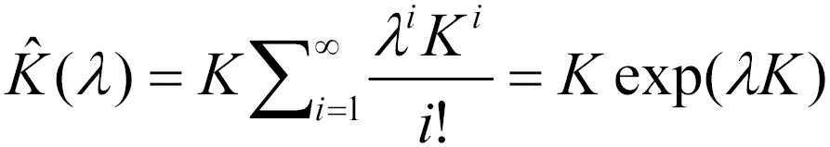
The Kernel
Somewhat similar to case before, but if we add a much faster decay rate, we obtain…(an extreme version of the generalized vector space model)

Slide 21
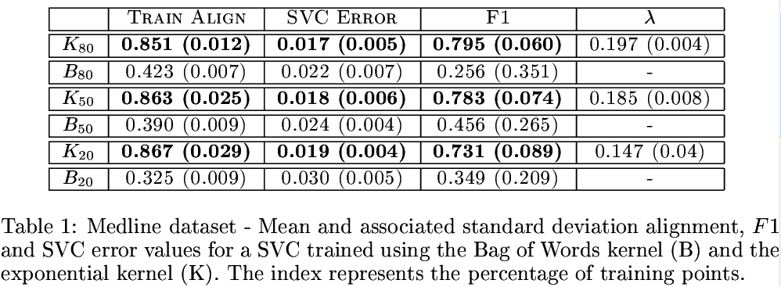
Some results…

Slide 22
Spectral Methods
Semisupervised learning: given a partially labeled set, complete the labeling (TRANSDUCTION)
Many possibilities: use the labels to learn a kernel, then use the kernel to label the data

Slide 23
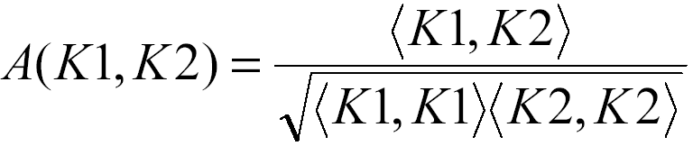
Kernel Alignment
Notion of similarity between kernels: Alignment ( = similarity between Gram matrices)

Slide 24
Kernel Alignment Properties
Ranges between –1 and 1, [0,1] for positive definite matrices
Sharply concentrated around expected value E[A], (expectation is wrt random choice of sample), can reliably estimate it from one sample

Slide 25
Many interpretations
As measure of clustering in data
As correlation coefficient between ‘oracles’
Basic idea: the ‘ultimate’ kernel should be YY’, that is should be given by the labels vector (after all: target is the only relevant feature!)

Slide 26
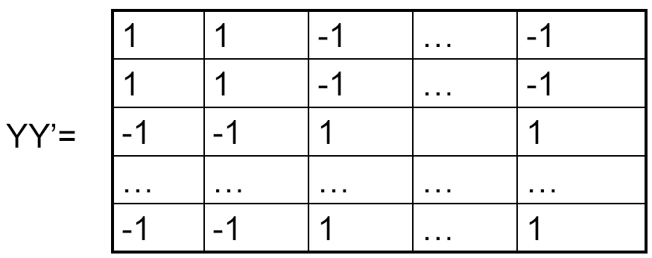
The ideal kernel

Slide 27
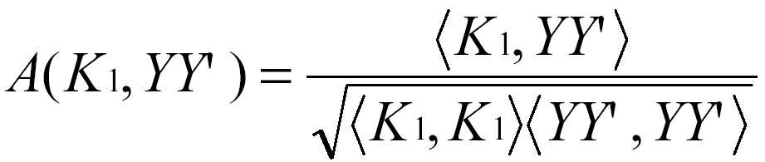
Combining Kernels
Alignment is increased by combining kernels that are aligned to the target and not aligned to each other
Choose K₁ from a set so to optimize:

Slide 28
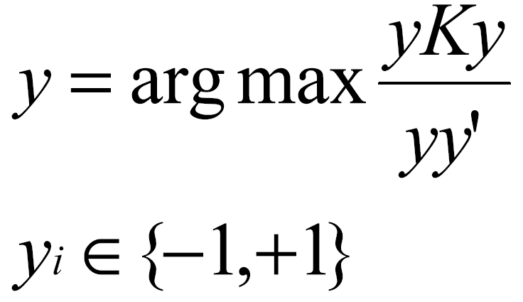
Spectral Machines
Can (approximately) maximize the alignment of a set of labels to a given kernel
By solving this problem:
Approximated by principal eigenvector (thresholded) (by courant-hilbert theorem)

Slide 29
Thanks !

