Slide 1
3. Linear Methods for Regression

Slide 2
Contents
Least Squares Regression
QR decomposition for Multiple Regression
Subset Selection
Coefficient Shrinkage

Slide 3
1. Introduction
Outline
  The simple linear regression model
  Multiple linear regression
  Model selection and shrinkage—the state of the art

Slide 4
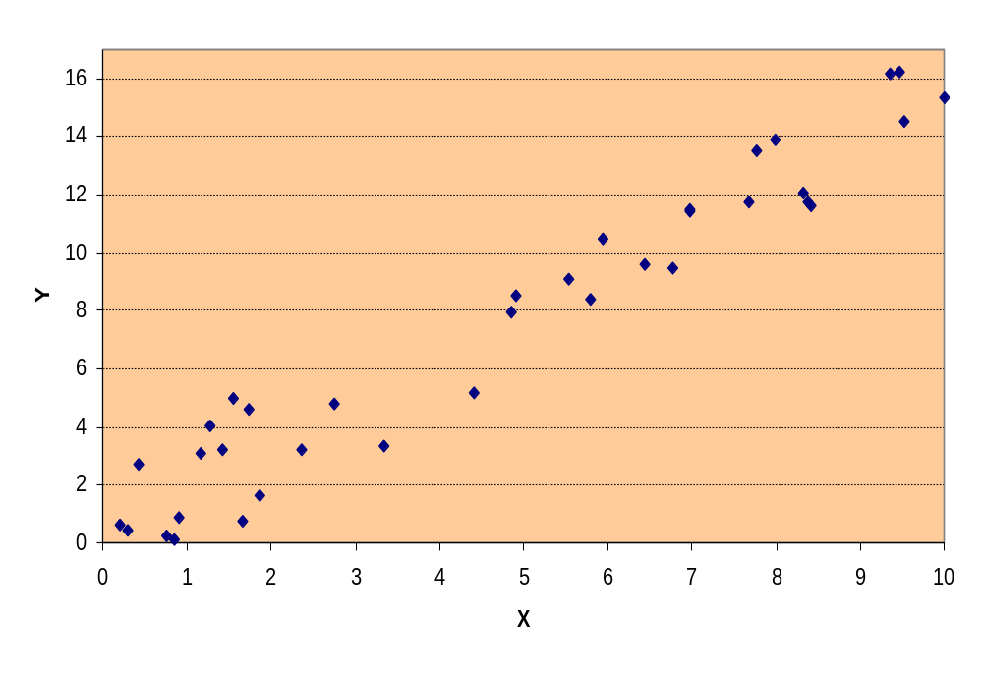
Regression
How can we model the generative process for this data?

Slide 5
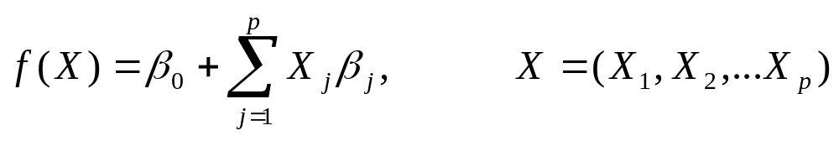
Linear Assumption
A linear model assumes the regression function E(Y | X) is reasonably approximated as linear
i.e.
  The regression function f(x) = E(Y | X=x) was the result of minimizing squared expected prediction error
  Making the above assumption has high bias, but low variance

Slide 6
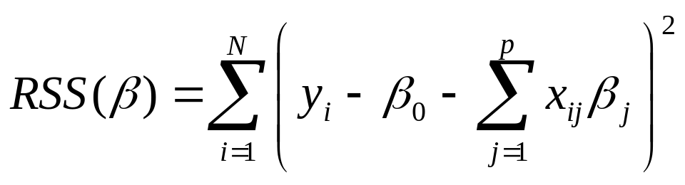
Least Squares Regression
Estimate the parameters β based on a set of training data: (x₁, y₁)…(x_{N}, y_{N})
Minimize residual sum of squares
  Training samples are random, independent draws
  OR, y_{i}’s are conditionally independent given x_{i}
Reasonable criterion when…

Slide 7
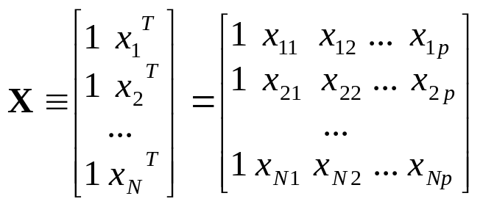
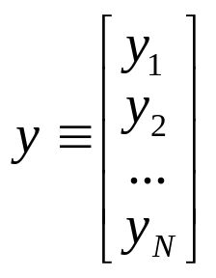
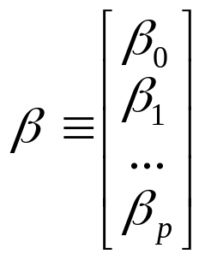
Matrix Notation
X is N × (p+1) of input vectors
y is the N-vector of outputs (labels)
β is the (p+1)-vector of parameters

Slide 8
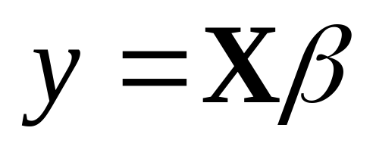
Perfectly Linear Data
When the data is exactly linear, there exists β s.t.
(linear regression model in matrix form)
Usually the data is not an exact fit, so…

Slide 9
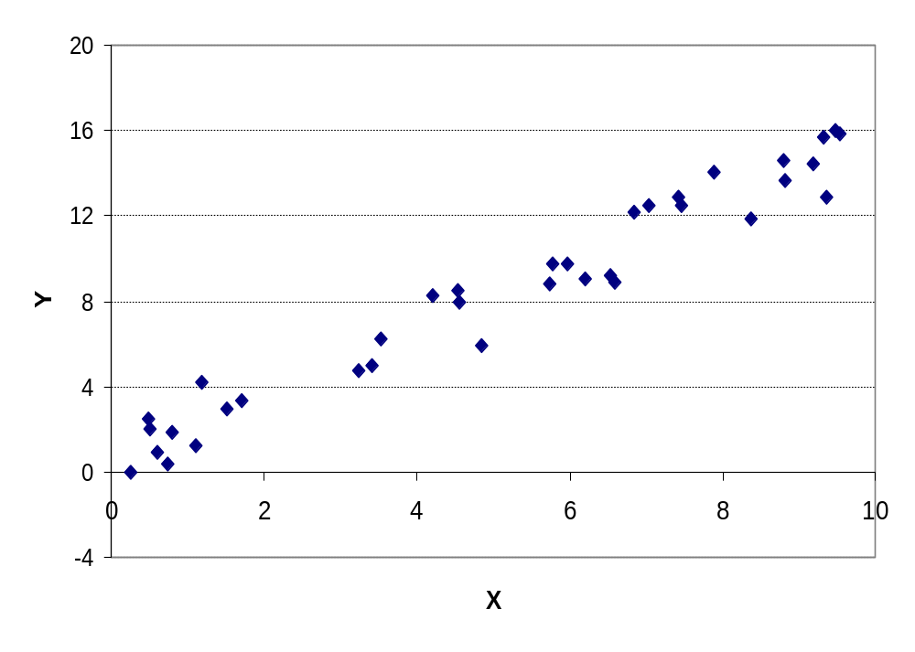
Finding the Best Fit?
Fitting Data from Y=1.5X+.35+N(0,1.2)

Slide 10
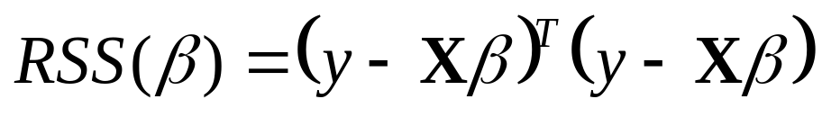
Minimize the RSS
We can rewrite the RSS in Matrix form
Getting a least squares fit involves minimizing the RSS
Solve for the parameters for which the first derivative of the RSS is zero

Slide 11
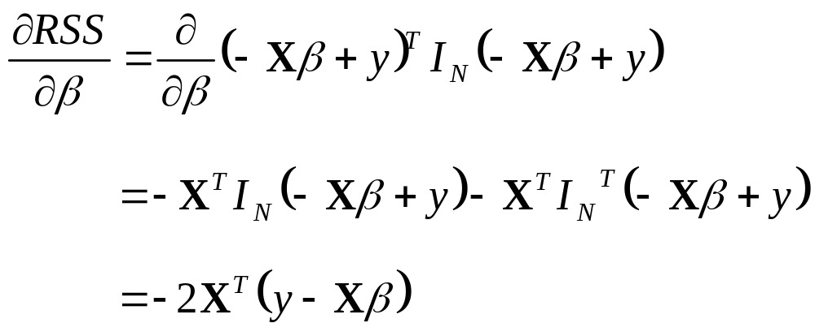
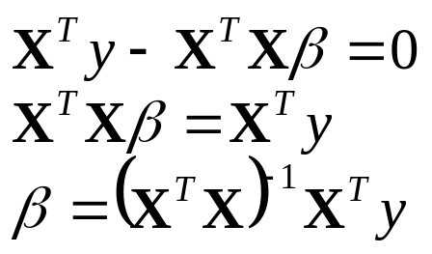
Solving Least Squares
Derivative of a Quadratic Product
Then,
Setting the First Derivative to Zero:

Slide 12
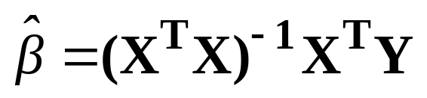
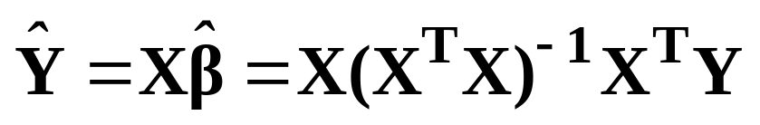
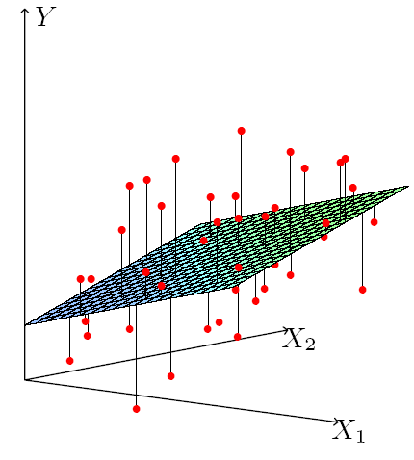
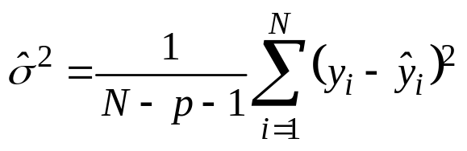
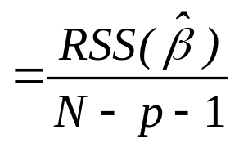
Least Squares Solution
Least Squares Coefficients
Least Squares Predictions
Estimated Variance

Slide 13
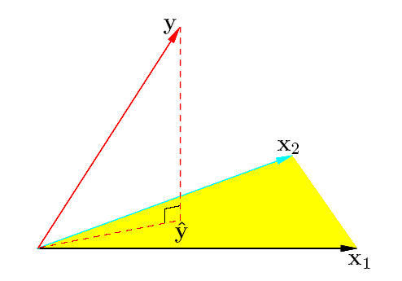
The N-dimensional Geometry of Least Squares Regression

Slide 14
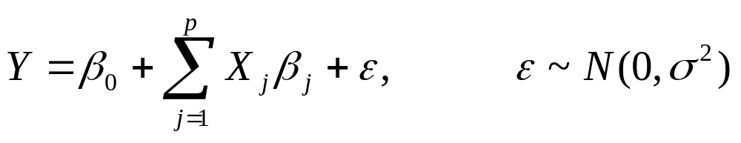
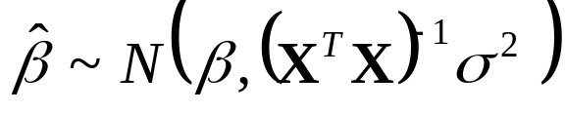
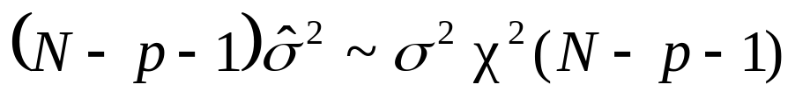
Statistics of Least Squares
We can draw inferences about the parameters, β, by assuming the true model is linear with noise, i.e.
Then,

Slide 15
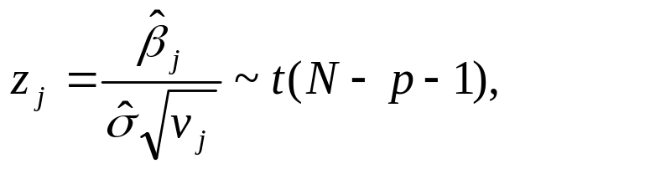
Significance of One Parameter
Can we eliminate one parameter, X_{j} (β_{j}=0)?
Look at the standardized coefficient
v_{j} is the j^{th} diagonal element of (X^{T}X)⁻¹

Slide 16
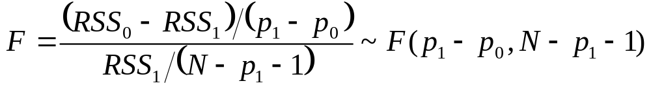
Significance of Many Parameters
We may want to test many features at once
  Comparing model M₁ with p₁+1 parameters to model M₀ with p₀+1 parameters from M₁ (p₀<p₁)
Use the F statistic:

Slide 17
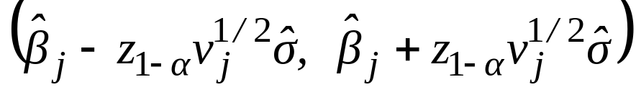
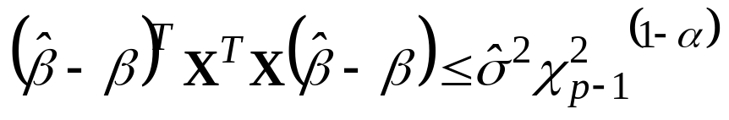
Confidence Interval for Beta
We can find a confidence interval for β_{j}
Confidence Interval for single parameter (1-2α confidence interval for β_{j} )
Confidence Interval for entire parameter (Bounds on β)

Slide 18
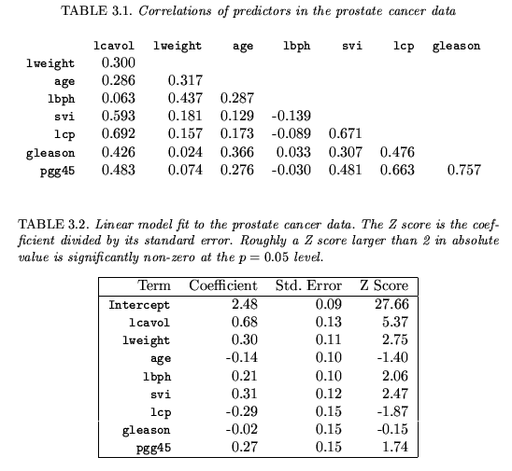
2.1 : Prostate cancer < Example>
Data
  lcavol: log cancer volume
  lweight: log prostate weight
  age: age
  lbph: log of benign prostatic
  hyperplasia amount
  svi: seminal vesicle invasion
  lcp: log of capsular penetration
  Gleason: gleason scores
  Pgg45: percent Gleason scores 4 or 5

Slide 19
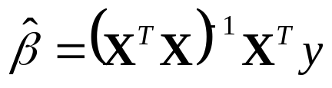




Technique for Multiple Regression
Computing directly has poor numeric properties
QR Decomposition of X
  Decompose X = QR where
    Q is N × (p+1) orthogonal vector (Q^{T}Q = I_{(p+1)})
    R is an (p+1) × (p+1) upper triangular matrix
  Then
…

Slide 20
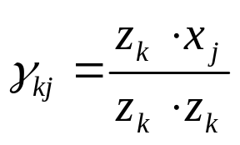
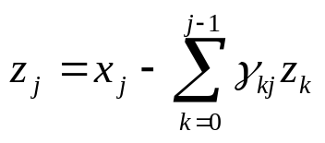
Gram-Schmidt Procedure
Initialize z₀ = x₀ = 1
For j = 1 to p
  For k = 0 to j-1, regress x_{j} on the z_{k}’s so that
  Then compute the next residual
Let Z = [z₀ z₁ … z_{p}] and Γ be upper triangular with entries γ_{kj}
  X = Z Γ = ZD⁻¹D Γ = QR
  where D is diagonal with D_{jj} = || z_{j} ||
(univariate least squares estimates)

Slide 21
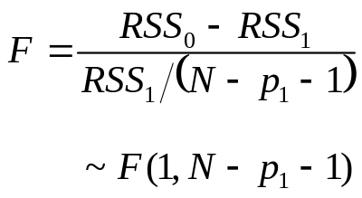
Subset Selection
We want to eliminate unnecessary features
Best subset regression
  Choose the subset of size k with lowest RSS
  Leaps and Bounds procedure works with p up to 40
Forward Stepwise Selection
  Continually add features to β with the largest F-ratio
Backward Stepwise Selection
  Remove features from β with small F-ratio
Greedy techniques – not guaranteed to find the best model

Slide 22
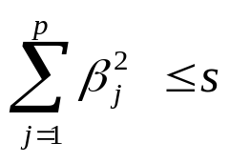
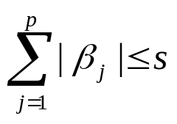
Coefficient Shrinkage
Use additional penalties to reduce coefficients
Ridge Regression
  Minimize least squares s.t.
The Lasso
  Minimize least squares s.t.
Principal Components Regression
  Regress on M < p principal components of X
Partial Least Squares
  Regress on M < p directions of X weighted by y

Slide 23
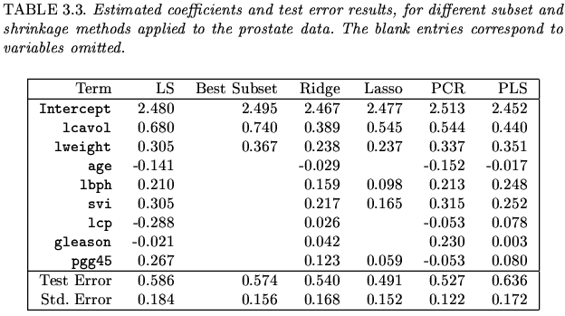
4.2 Prostate Cancer Data Example-Continued

Slide 24
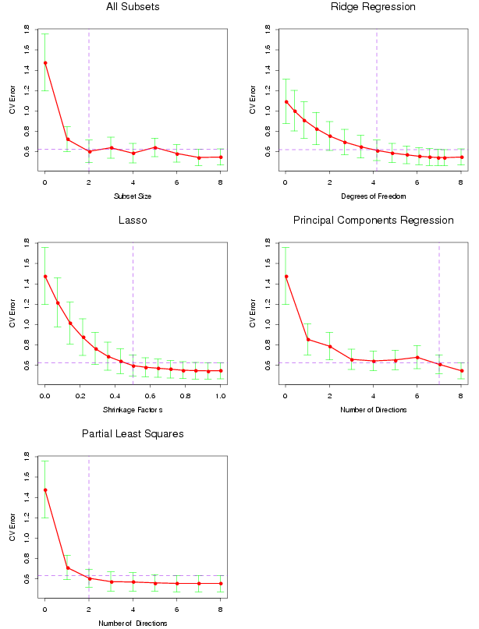
Error Comparison

Slide 25
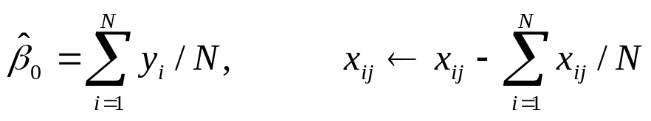
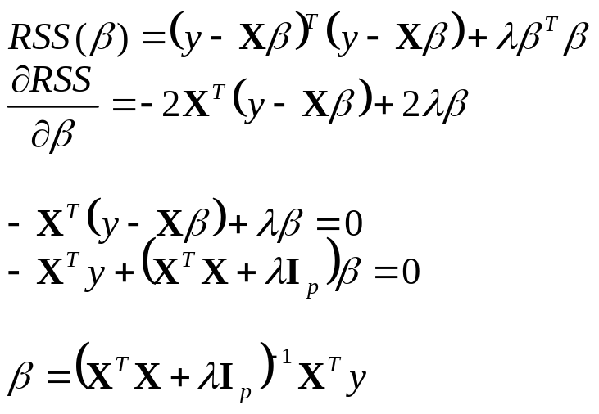
Shrinkage Methods (Ridge Regression)
Minimize RSS(β) + λβ^{T}β
  Use centered data, so β₀ is not penalized
  x_{j} are of length p, no longer including the initial 1
The Ridge estimates are:

Slide 26
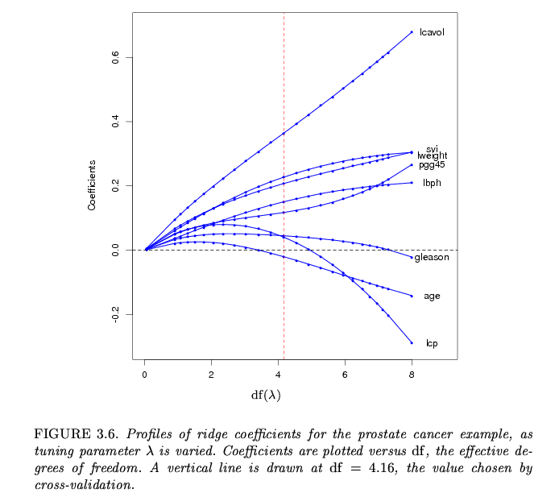
Shrinkage Methods (Ridge Regression)

Slide 27
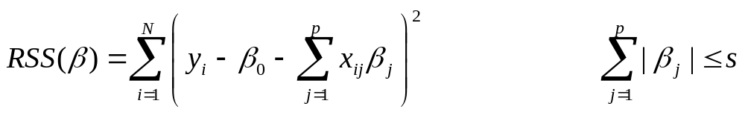
The Lasso
Use centered data, as before
The L₁ penalty makes solutions nonlinear in y_{i}
  Quadratic programming are used to compute them
subject to

Slide 28
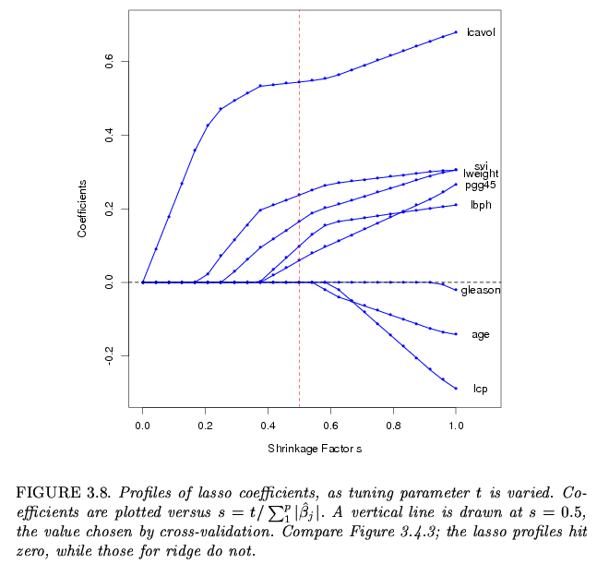
Shrinkage Methods (Lasso Regression)

Slide 29

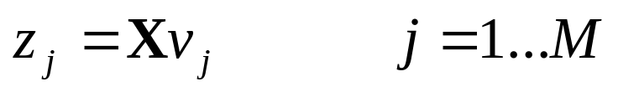
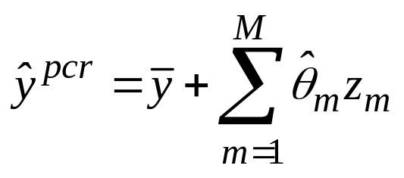
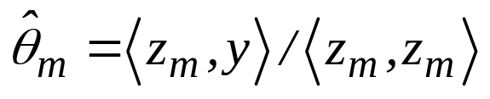
Principal Components Regression
Singular Value Decomposition (SVD) of X
  U is N × p, V is p × p; both are orthogonal
  D is a p × p diagonal matrix
Use linear combinations (v) of X as new features
  v_{j} is the principal component (column of V) corresponding to the j^{th} largest element of D
  v_{j} are the directions of maximal sample variance
  use only M < p features, [z₁…z_{M}] replaces X

Slide 30
Partial Least Squares
Construct linear combinations of inputs incorporating y
Finds directions with maximum variance and correlation with the output
The variance aspect seems to dominate and partial least squares operates like principal component regression

Slide 31
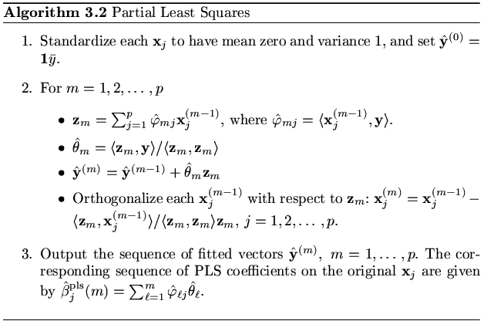
4.4 Methods Using Derived Input Directions (PLS)
Partial Least Squares

Slide 32
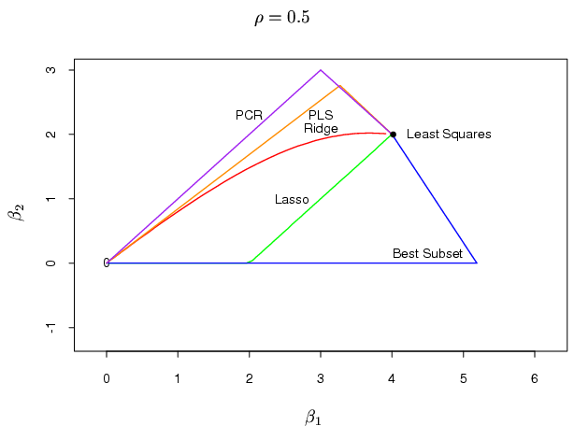
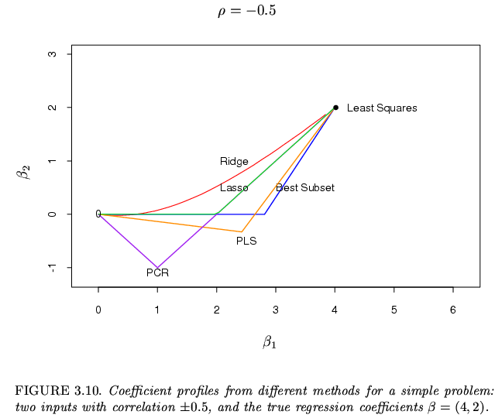
Discussion : a comparison of the selection and shrinkage methods

Slide 33
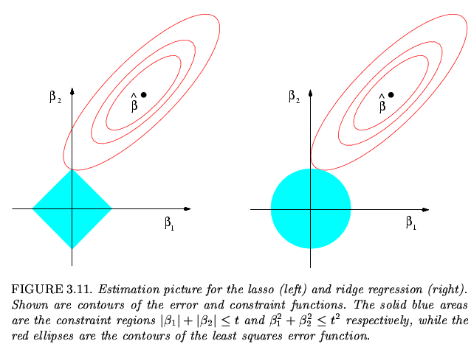
4.5 Discussion : a comparison of the selection and shrinkage methods

Slide 34
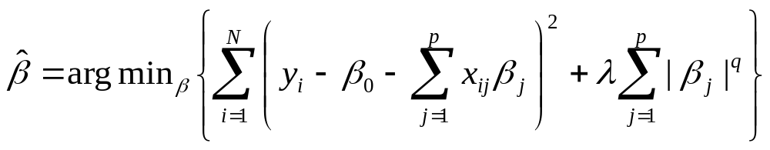
A Unifying View
We can view all the linear regression techniques under a common framework
λ includes bias, q indicates a prior distribution on β
  λ=0: least squares
  λ>0, q=0: subset selection (counts number of nonzero parameters)
  λ>0, q=1: the lasso
  λ>0, q=2: ridge regression

Slide 35

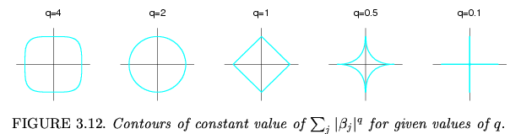
Discussion : a comparison of the selection and shrinkage methods
Family of Shrinkage Regression

