Slide 1
Gaussian Process Networks
Nir Friedman and Iftach Nachman
UAI-2K

Slide 2

Abstract
Learning structures of Bayesian networks
  Evaluating the marginal likelihood of the data given a candidate structure.
For continuous networks
  Gaussians, Gaussian mixtures were used as priors for parameters.
In this paper, a new prior Gaussian Process is presented.

Slide 3
Introduction
Bayesian networks are particularly effective in domains where the interactions between variables are fairly local.
Motivation - Molecluar Biology problems
  To understand transcription of genes.
  Continuous variable are necessary.
Gaussian Process prior
  A Bayesian method.
  Semi-parametric nature allows to learn the complicated functional relationships between variables.

Slide 4

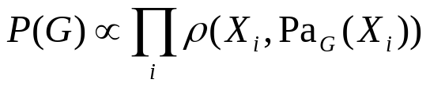
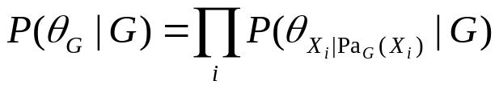
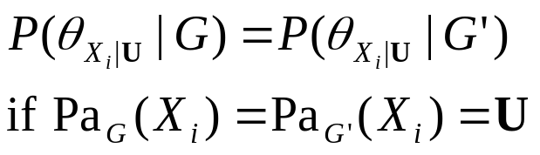
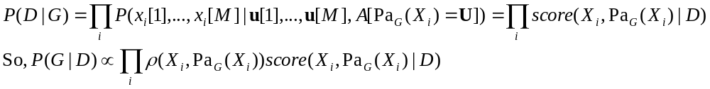
Learning Continuous Networks
The posterior probability
Three assumptions
  Structure modularity
  Parameter independence
  Parameter modularity
The posterior probability is now can be represented as follows.

Slide 5
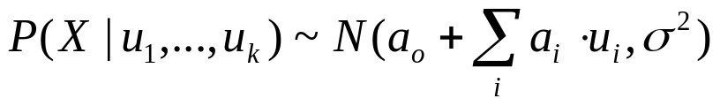
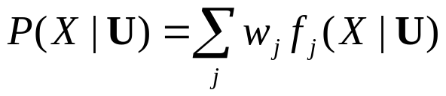
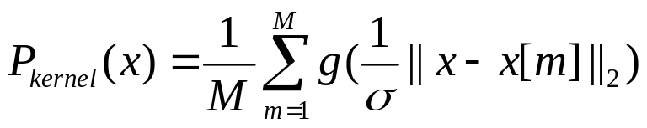
Priors for Continuous Variables
Linear Gaussian
  So simple…
Gaussian mixtures
  Approximations are required to learn.
Kernel method
  Smoothness parameter

Slide 6
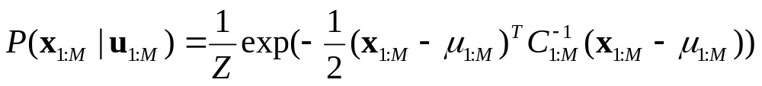
Gaussian Process(1/2)
Basic of Gaussian Process
  A prior over a variable X is a function of U.
  The stochastic process over U is said to be Gaussian Process if for each finite set of values, u_{1:M} = {u[1], …, u[M]}, the distribution over the corresponding random variables x_{1:M} = {X[1], …, X[M]} is a multivariate normal distribution.
The joint distribution of x_{1:M} is

Slide 7
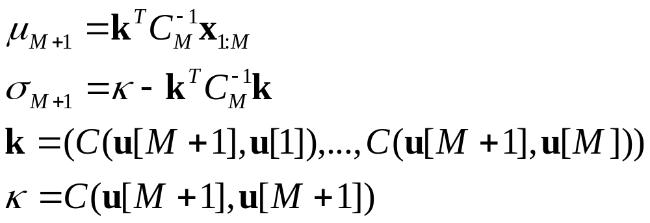
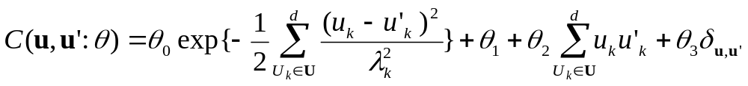
Gaussian Process(2/2)
Prediction
  P(X_{M+1}|X_{1:M}, U_{1:M}, U_{M+1}) is a univariate Gaussian distribution.
Covariance functions
  Williams and Rasmussen suggest the following function.

Slide 8
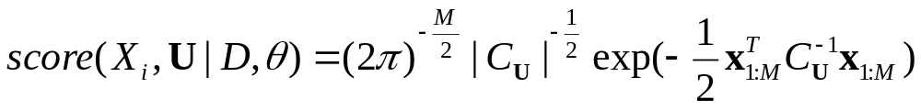

Learning Networks with Gaussian Process Priors
score is defined as follows.
With this Gaussian process prior, the computation of marginal probability can be done in closed form.
Parameters for covariance matrix
  MAP approximation
  Laplace approximation

Slide 9
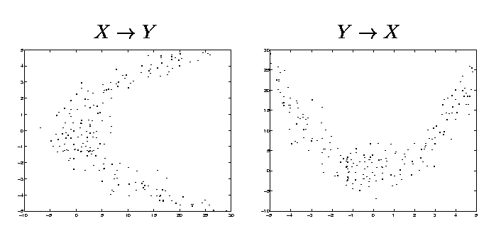
Artificial Experimentation(1/3)
For two variables X, Y
  Non-invertible relationship

Slide 10
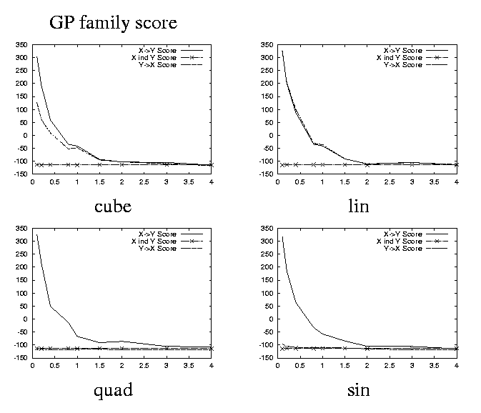
Artificial Experimentation(2/3)
The results for non-invertible dependencies learning

Slide 11
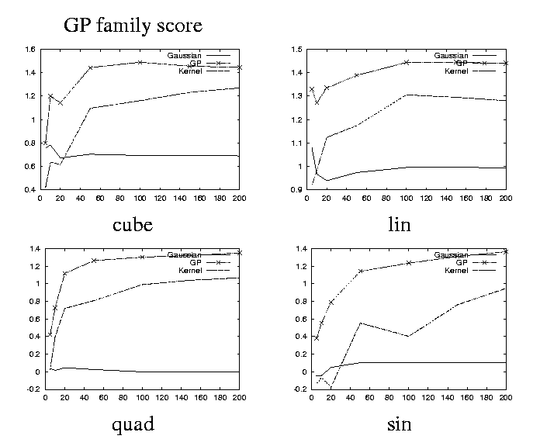
Artificial Experimentation(3/3)
Comparison for Gaussian, Gaussian Process, Kernel methods

Slide 12
Discussion
Reproducing Kernel Hilbert Space(RKHS) and Gaussian Process
Currently this method is applied to analyze biological data.

