Slide 1

Query Expansion in Information Retrieval using a Bayesian Network-Based Thesaurus
Luis M. de Campus, Juan M. Fernandez, Juan F. Huete

Slide 2

Introduction
Methods for query expansion based on Bayesian networks
  preprocessing: Smart [25]
  learning: constructing a Bayesian network(thesaurus for a given collection) that represents some of the relationships among the terms appearing in a given document collection
  query expansion: given a particular query, we instantiate the terms that compose it and propagate this information through the network by selecting the new terms whose posterior probability is high and adding them to the original query.

Slide 3
IRS
indexing
inverted file
query, indexing
c.f. four classic retrieval models: Boolean, vector space, cluster, probabilistic models [21, 25]
BNs to IR: Croft and Turtle’s document and query networks[7, 28], Ghazfan et al. [13], Fung et al. [10], [2, 9, 18, 24]
Building Thesaurus: Schutze and Pederson [26].

Slide 4
Thesaurus Construction Algo.
Thesaurus (based on a Bayesian network, dag, polytree(singly connected graph)) from a inverted file.→ go to next page
nodes: a term in the form of a binary variable, α = {α₀, α₁}
Learning: PA algo, RP algo.
Propagation: MWST: Kruskal and Prim’s algorithm

Slide 5

Why Polytree instead of a more general BNs?
big number of terms
learning phase → [3, 20]
propagation phase →[19]

Slide 6
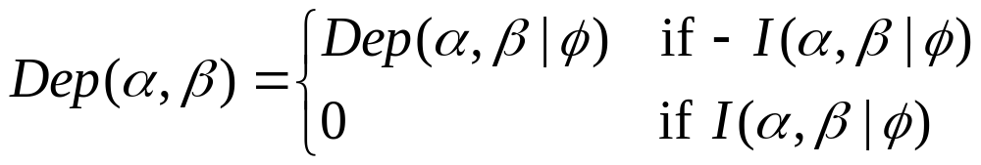
Algorithm for Learning a Polytree
1. For every pair of nodes α,β∈U, being U the set of nodes, do
1.1. Compute Dep(α,β|φ).
2. Build a maximum weight spanning tree G, where the weight of each edge α-β is
3. For every triplet of nodes α,β,γ∈U such that α-γ, γ- β∈G do
3.1. If Dep(α,β|φ)< Dep(α,β|γ) and –I (α,β| γ) then direct the subgraph α- γ - β as α→γ←β.
4. Direct the remaining edges without introducing new head to head connections.
5. Return G.
cal. Dep. degree.
skeleton construction
performing orientation

Slide 7
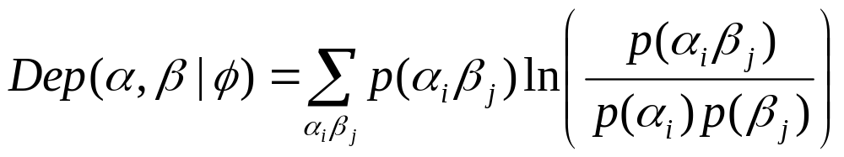
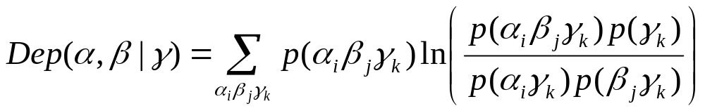
Dependency
Marginal dependency (Kullback-Leibler cross entropy, Mutual information measure)
Conditional dependency degrees (conditional mutual information measure)

Slide 8

Experimentation
three standard test collections
  Adi, Cranfield and Medlars
  ftp.cs.cornell.edu (with smart)
Collection | Adi | Cranfield | Medlars
Subjects | Inform.Sci. | Aeronautics | Medicine
Documents | 82 | 1398 | 1033
Terms | 828 | 3852 | 7170
Queries | 35 | 225 | 30

Slide 9
Query Expansion Process
Given that all the terms in the query (e.g. α) are relevant, get the probability(posterior probability: p(β₁ |α₁)) that a term(β) is relevant from the learnt polytree (threshold).
Add the term of which the posterior probability is larger than pre-determined threshold.

Slide 10
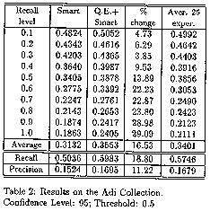

Slide 11
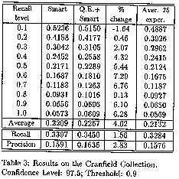

Slide 12
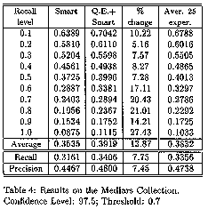

Slide 13
Concluding Remarks
Contributions
  propose a new approach of learning thesaurus using BNs
  Combine RP and PA algo. in learning polytree(dependency graph).
Further improvement
  more accuracy in thesaurus learning algo.
  incorporating documents into our models
  improving performance of the propagation process

