Slide 1
Artificial Intelligence
Chapter 3
Neural Networks

Slide 2
Outline
3.1 Introduction
3.2 Training Single TLUs
  Gradient Descent
  Widrow-Hoff Rule
  Generalized Delta Procedure
3.3 Neural Networks
  The Backpropagation Method
  Derivation of the Backpropagation Learning Rule
3.4 Generalization, Accuracy, and Overfitting
3.5 Discussion

Slide 3
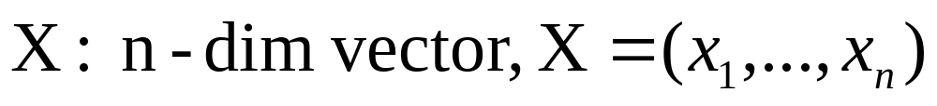
3.1 Introduction
TLU (threshold logic unit): Basic units for neural networks
  Based on some properties of biological neurons
Training set
  Input: real value, boolean value, …
  Output:
    d_{i}: associated actions (Label, Class …)
Target of training
  Finding f(X) corresponds “acceptably” to the members of the training set.
  Supervised learning: Labels are given along with the input vectors.

Slide 4
3.2 Training Single TLUs
3.2.1 TLU Geometry
Training TLU: Adjusting variable weights
A single TLU: Perceptron, Adaline (adaptive linear element) [Rosenblatt 1962, Widrow 1962]
Elements of TLU
  Weight: W =(w₁, …, w_{n})
  Threshold: θ
Output of TLU: Using weighted sum s = W⋅X
  1 if s − θ > 0
  0 if s − θ < 0
Hyperplane
  W⋅X − θ = 0

Slide 5
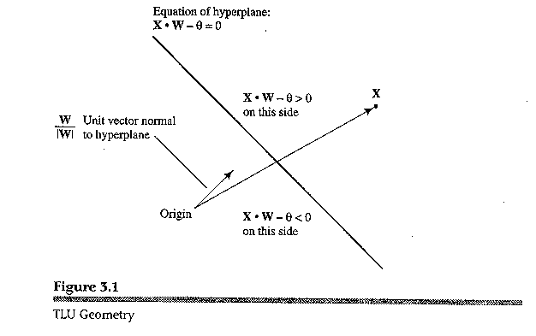

Slide 6
3.2.2 Augmented Vectors
Adopting the convention that threshold is fixed to 0.
Arbitrary thresholds: (n + 1)-dimensional vector
W = (w₁, …, w_{n}, 1)
Output of TLU
  1 if W⋅X ≥ 0
  0 if W⋅X < 0

Slide 7

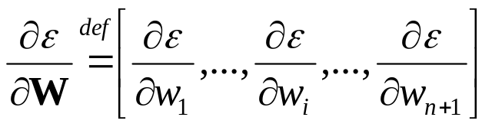
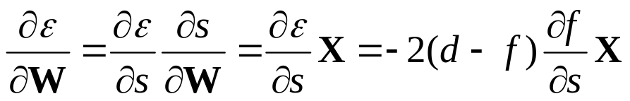
3.2.3 Gradient Decent Methods
Training TLU: minimizing the error function by adjusting weight values.
Batch learning v.s. incremental learning
Commonly used error function: squared error
  Gradient :
  Chain rule:
Solution of nonlinearity of ∂f / ∂s :
  Ignoring threshod function: f = s
  Replacing threshold function with differentiable nonlinear function

Slide 8
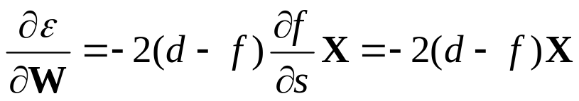
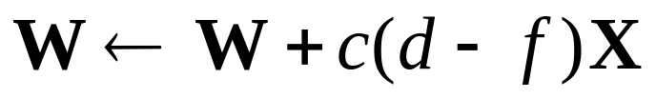
3.2.4 The Widrow-Hoff Procedure: First Solution
Weight update procedure:
  Using f = s = W⋅X
  Data labeled 1 → 1, Data labeled 0 → −1
Gradient:
New weight vector
Widrow-Hoff (delta) rule
  (d − f) > 0 → increasing s → decreasing (d − f)
  (d − f) < 0 → decreasing s → increasing (d − f)

Slide 9
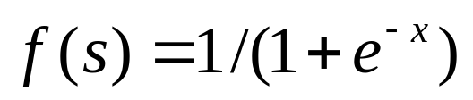
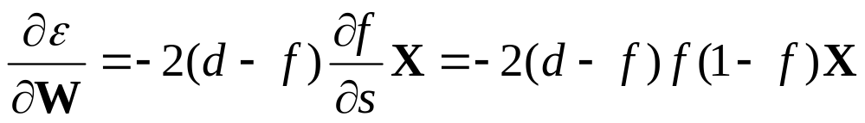

3.2.5 The Generalized Delta Procedure: Second Solution
Sigmoid function (differentiable): [Rumelhart, et al. 1986]
Gradient:
Generalized delta procedure:
  Target output: 1, 0
  Output f = output of sigmoid function
  f(1– f) = 0, where f = 0 or 1
  Weight change can occur only within ‘fuzzy’ region surrounding the hyperplane (near the point f(s) = ½).

Slide 10
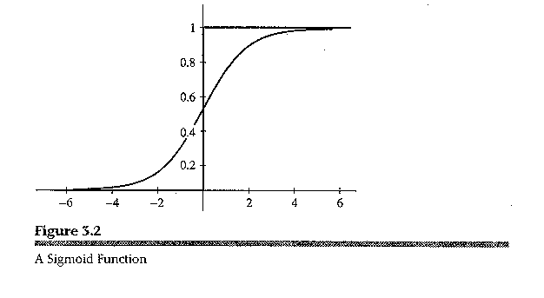

Slide 11
3.2.6 The Error-Correction Procedure
Using threshold unit: (d – f) can be either 1 or –1.
In the linearly separable case, after finite iteration, W will be converged to the solution.
In the nonlinearly separable case, W will never be converged.
The Widrow-Hoff and generalized delta procedures will find minimum squared error solutions even when the minimum error is not zero.

Slide 12

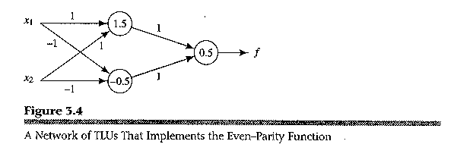
3.3 Neural Networks
3.3.1 Motivation
Need for use of multiple TLUs
  Feedforward network: no cycle
  Recurrent network: cycle (treated in a later chapter)
  Layered feedforward network
    j_{th} layer can receive input only from j – 1_{th} layer.
Example :
    그림 3.4

Slide 13
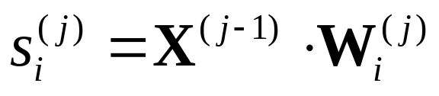
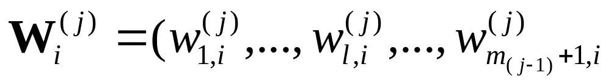
3.3.2 Notation
Hidden unit: neurons in all but the last layer
Output of j-th layer: X^{(j)} → input of (j+1)-th layer
Input vector: X⁽⁰⁾
Final output: f
The weight of i-th sigmoid unit in the j-th layer: W_{i}^{(j)}
Weighted sum of i-th sigmoid unit in the j-th layer: s_{i}^{(j)}
Number of sigmoid units in j-th layer: m_{j}

Slide 14
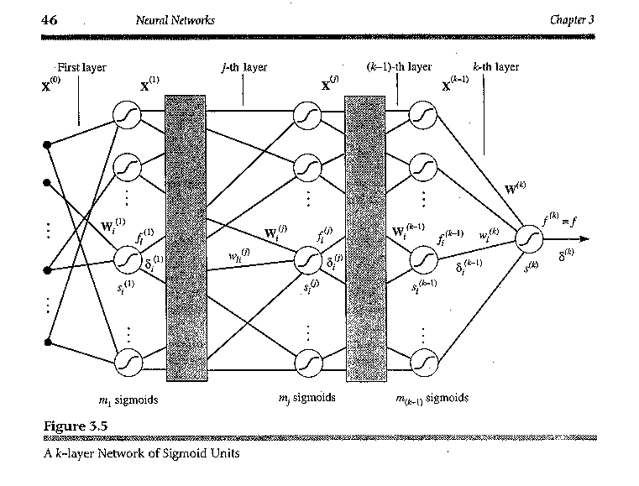
그림 3.5

Slide 15
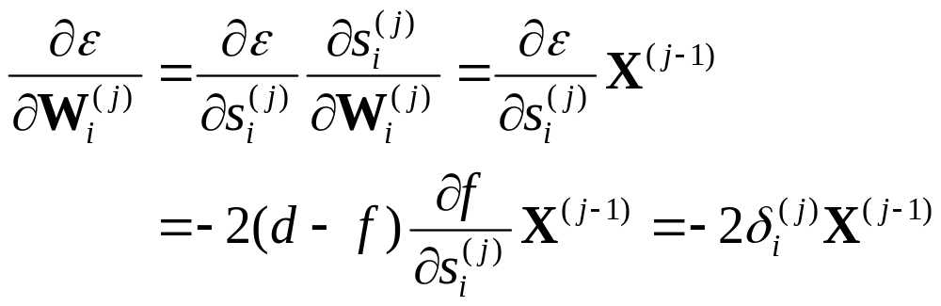
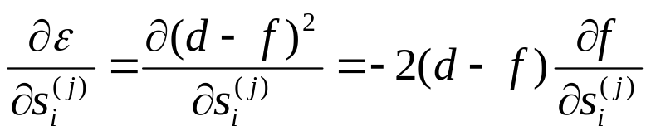
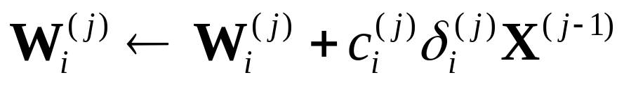
3.3.3 The Backpropagation Method
Gradient of W_{i}^{(j)} :
Weight update:
Local gradient

Slide 16
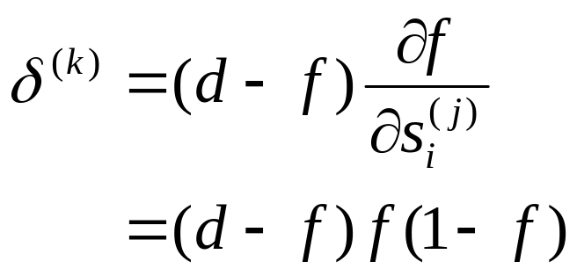
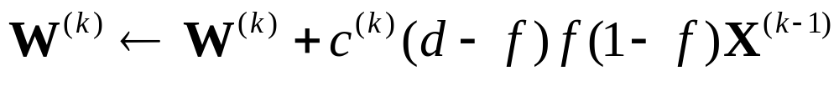
3.3.4 Computing Weight Changes in the Final Layer
Local gradient:
Weight update:

Slide 17
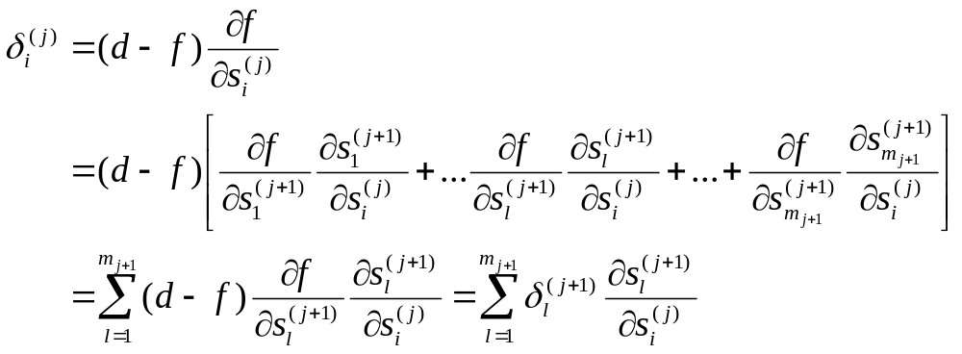
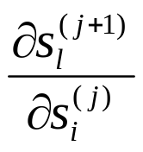
3.3.5 Computing Changes to the Weights in Intermediate Layers
Local gradient:
  The final ouput f, depends on s_{i}^{(j)} through of the summed inputs to the sigmoids in the (j+1)-th layer.
Need for computation of

Slide 18
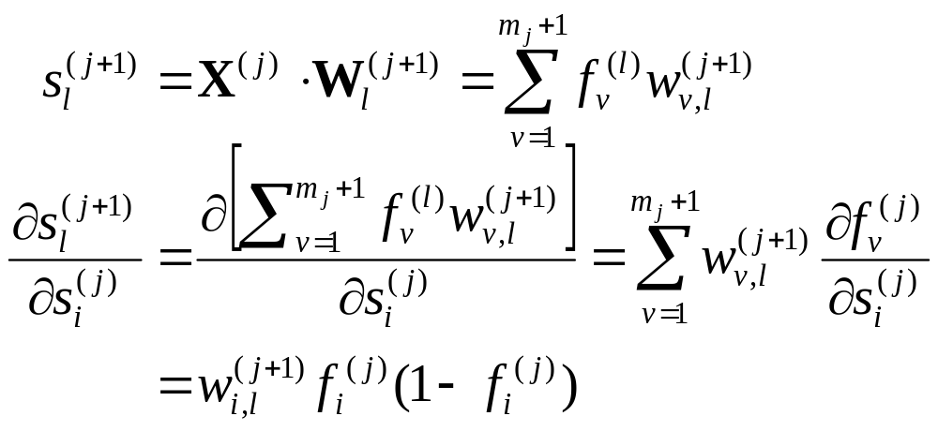
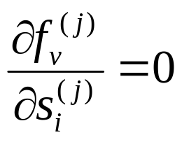
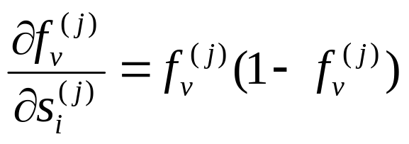
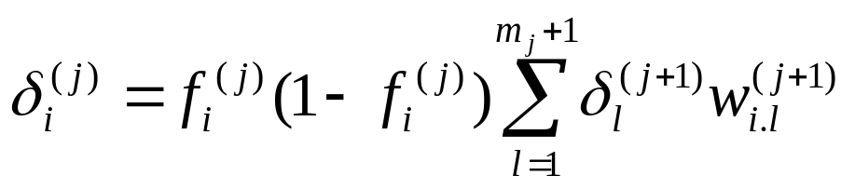
Weight Update in Hidden Layers (cont.)
  v ≠ i : v = i :
  Conseqeuntly,

Slide 19
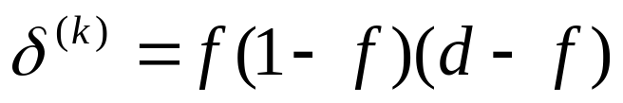

Weight Update in Hidden Layers (cont.)
Attention to recursive equation of local gradient!
Backpropagation:
  Error is back-propagated from the output layer to the input layer
  Local gradient of the latter layer is used in calculating local gradient of the former layer.

Slide 20
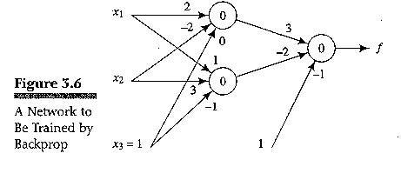
3.3.5 (con’t)
Example (even parity function)
  Learning rate: 1.0
input |  |  | target
1 | 0 | 1 | 0
0 | 0 | 1 | 1
0 | 1 | 1 | 0
1 | 1 | 1 | 1

Slide 21
3.4 Generalization, Accuracy, and Overfitting
Generalization ability:
  NN appropriately classifies vectors not in the training set.
  Measurement = accuracy
Curve fitting
  Number of training input vectors ≥ number of degrees of freedom of the network.
  In the case of m data points, is (m-1)-degree polynomial best model? No, it can not capture any special information.
Overfitting
  Extra degrees of freedom are essentially just fitting the noise.
  Given sufficient data, the Occam’s Razor principle dictates to choose the lowest-degree polynomial that adequately fits the data.

Slide 22
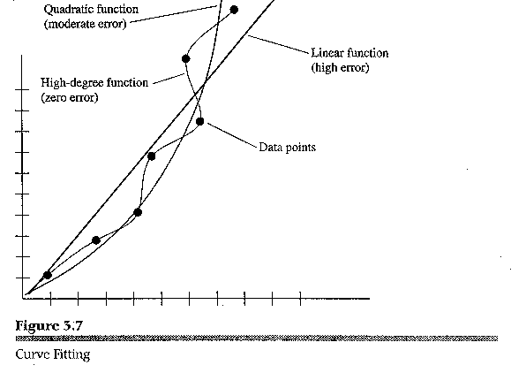
그림 3.7

Slide 23
3.4 (cont’d)
Out-of-sample-set error rate
  Error rate on data drawn from the same underlying distribution of training set.
Dividing available data into a training set and a validation set
  Usually use 2/3 for training and 1/3 for validation
k-fold cross validation
  k disjoint subsets (called folds).
  Repeat training k times with the configuration: one validation set, k-1 (combined) training sets.
  Take average of the error rate of each validation as the out-of-sample error.
  Empirically 10-fold is preferred.

Slide 24
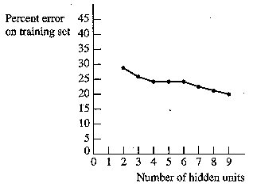
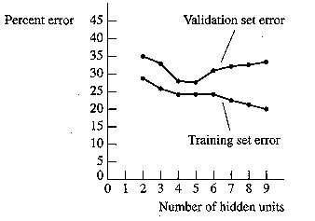
Fig 3.8 Error Versus Number of Hidden Units
Fig 9. Estimate of Generalization Error Versus Number of Hidden Units

Slide 25
3.5 Additional Readings and Discussion
Applications
  Pattern recognition, automatic control, brain-function modeling
  Designing and training neural networks still need experience and experiments.
Major annual conferences
  Neural Information Processing Systems (NIPS)
  International Conference on Machine Learning (ICML)
  Computational Learning Theory (COLT)
Major journals
  Neural Computation
  IEEE Transactions on Neural Networks
  Machine Learning

