Slide 1
Artificial Intelligence
Chapter 8
Uninformed Search

Slide 2
Outline
Search Space Graphs
Depth-First Search
Breadth-First Search
Iterative Deepening

Slide 3
1. Formulating the State Space
For huge search space we need,
  Careful formulation
  Implicit representation of large search graphs
  Efficient search method

Slide 4
e.g.) 8-puzzle problem
  state description
    3-by-3 array: each cell contains one of 1-8 or blank symbol
  two state transition descriptions
    8×4 moves: one of 1-8 numbers moves up, down, right, or left
    4 moves: one black symbol moves up, down, right, or left
2
8
3
1
2
3
1
6
4
8
4
7
5
7
6
5

Slide 5
  The number of nodes in the state-space graph:
    9! ( = 362,880 )
  State space for 8-puzzle is
    Divided into two separate graphs : not reachable from each other

Slide 6
2. Components of Implicit State-Space Graphs
3 basic components to an implicit representation of a state-space graph
  1. Description of start node
  2. Actions: Functions of state transformation
  3. Goal condition: true-false valued function
2 classes of search process
  Uninformed search: no problem specific information
  Heuristic search: existence of problem-specific information

Slide 7
3. Breadth-First Search
Procedure
  1. Apply all possible operators (successor function) to the start node.
  2. Apply all possible operators to all the direct successors of the start node.
  3. Apply all possible operators to their successors till goad node found.
  ♠ Expanding : applying successor function to a node

Slide 8
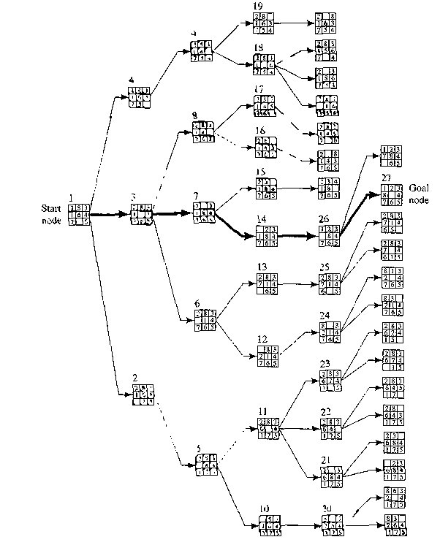

Slide 9
Advantage
  Finds the path of minimal length to the goal.
Disadvantage
  Requires the generation and storage of a tree whose size is exponential the the depth of the shallowest goal node
Uniform-cost search [Dijkstra 1959]
  Expansion by equal cost rather than equal depth

Slide 10
4. Depth-First or Backtracking Search
Procedure
  Generates the successor of a node just one at a time.
  Trace is left at each node to indicate that additional operators can be applied there if needed.
  At each node a decision must be made about which operator to apply first, which next, and so on.
  Repeats this process until the depth bound.
  chronological Backtrack when search depth is depth bound.

Slide 11
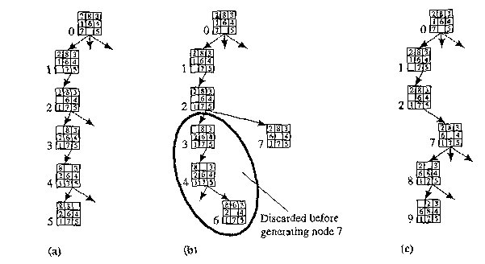
8-puzzle example
  depth bound: 5
  operator order: left → up → right → down

Slide 12
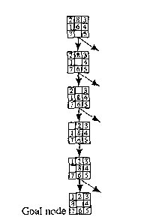
  goal reached

Slide 13
Advantage
  Low memory size: linear in the depth bound
    saves only that part of the search tree consisting of the path currently being explored plus traces
Disadvantage
  No guarantee for the minimal state length to goal state
  The possibility of having to explore a large part of the search space

Slide 14
5. Iterative Deepening
Advantage
  Linear memory requirements of depth-first search
  Guarantee for goal node of minimal depth
Procedure
  Successive depth-first searches are conducted – each with depth bounds increasing by 1

Slide 15
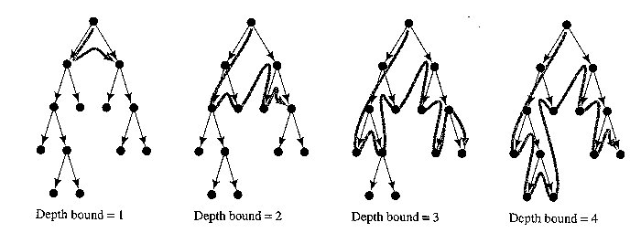

Slide 16
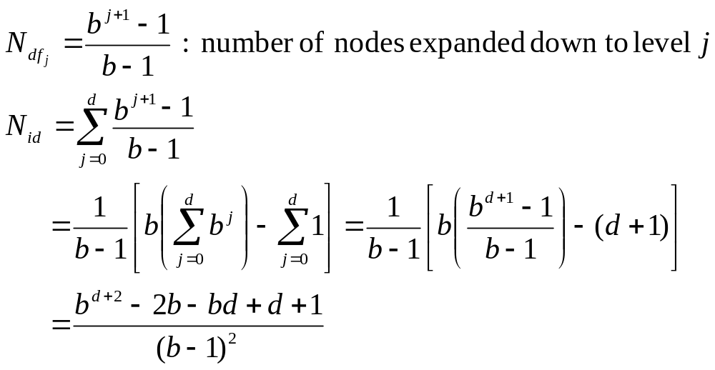
The number of nodes
  In case of breadth-first search
  In case of iterative deepening search

Slide 17
  For large d the ratio N_{id}/N_{df} is b/(b-1)
  For a branching factor of 10 and deep goals, 11% more nodes expansion in iterative-deepening search than breadth-first search
  Related technique iterative broadening is useful when there are many goal nodes

Slide 18
6. Additional Readings and Discussion
Various improvements in chronological backtracking
  Dependency-directed backtracking [Stallman & Sussman 1977]
  Backjumping [Gaschnig 1979]
  Dynamic backtracking [Ginsberg 1993]

