Slide 1
Artificial Intelligence
Project 2
Genetic Algorithms
Biointelligence Lab
School of Computer Sci. & Eng.
Seoul National University

Slide 2
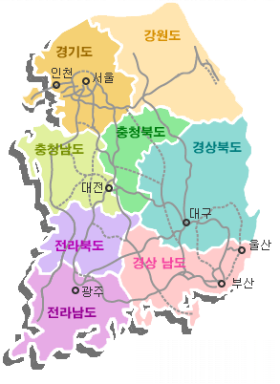
Traveling Salesman Problem (TSP)
What is TSP?
  One of the most widely studied combinatorial optimization problems
    Given a finite number of cities along with the cost of travel between each pair of them, find the cheapest way of visiting all the cities and returning to your starting point.
  TSP exhibits all aspects of combinatorial optimization and has served, and continues to serve, as the benchmark problem for new algorithmic ideas.

Slide 3
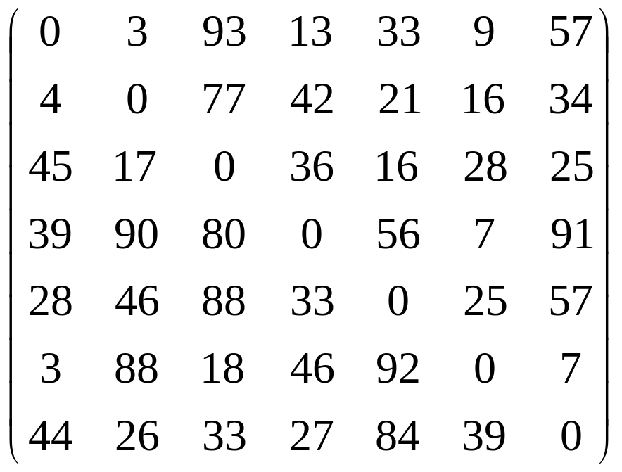
Cost Matrix
Cost from node i to node j

Slide 4
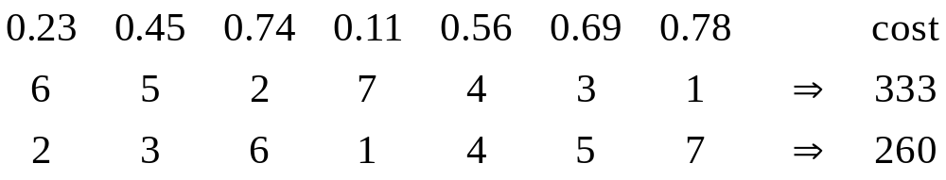
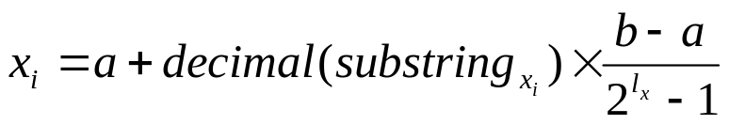
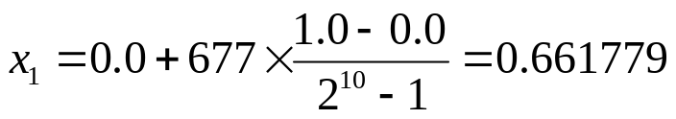
Representation
Random Keys Representation
  Random numbers from [a, b]
    Ex) a=0.0, b=1.0
  Mapping from a binary string to real number
    Ex) l_{x} = 10, a=0.0, b=1.0
B | 1010100101
D | 677

Slide 5
Framework of Simple GA
Generate Initial Population
Fitness Function
Evaluate Fitness
Termination Condition?
Yes
Best Individual
No
Select Parents
Crossover, Mutation
Generate New Offspring

Slide 6
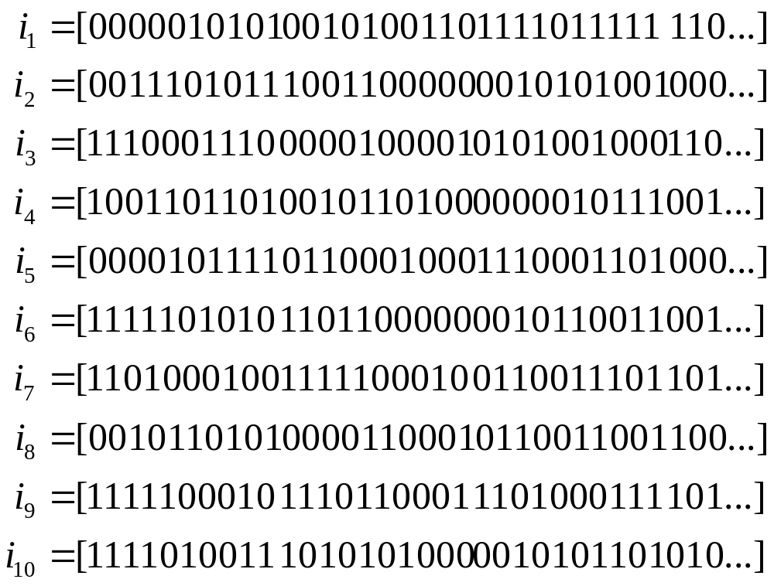
Initial Population
Initial population is randomly generated.

Slide 7
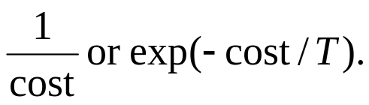
Fitness Evaluation
Procedure: Evaluation
  Convert the chromosome’s genotype to its phenotype.
    This means converting binary string into relative real values, and then sorting in ascending or descending order to get the tour.
  Calculate the traveling cost.
  Convert the cost into fitness for fitness proportional (roulette wheel) selection.
    For the minimization problem, the fitness is

Slide 8
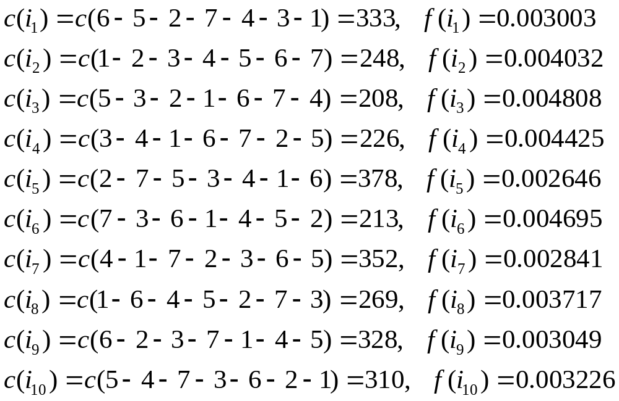

Slide 9
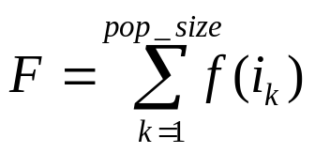
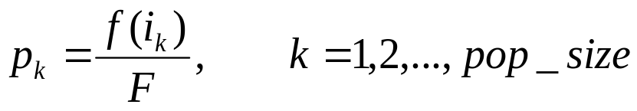
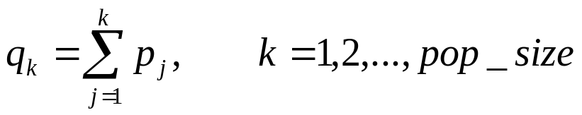
Selection
Fitness proportional (roulette wheel) selection
  The roulette wheel can be constructed as follows.
    Calculate the total fitness for the population.
    Calculate selection probability p_{k} for each chromosome v_{k}.
    Calculate cumulative probability q_{k} for each chromosome v_{k}.

Slide 10
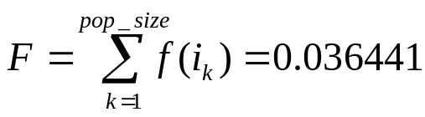
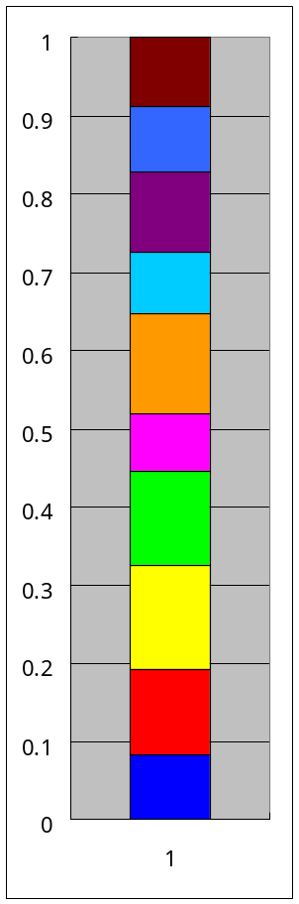
Procedure: Proportional_Selection
  Generate a random number r from the range [0,1].
  If r ≤ q₁, then select the first chromosome v₁; else, select the kth chromosome v_{k} (2≤ k ≤ pop_size) such that q_{k-1} < r ≤ q_{k}.
 | p_{k} | q_{k}
1 | 0.082407 | 0.082407
2 | 0.110652 | 0.193059
3 | 0.131931 | 0.324989
4 | 0.121423 | 0.446412
5 | 0.072597 | 0.519009
6 | 0.128834 | 0.647843
7 | 0.077959 | 0.725802
8 | 0.102013 | 0.827802
9 | 0.083663 | 0.911479
10 | 0.088521 | 1.000000

Slide 11
Tournament Selection
  Repeat below procedure two times
    Randomly draw a tournament of size t from the population with replacement.
    Choose fittest program to be parent.

Slide 12
Genetic Operations
Crossover
  One point crossover
  Crossover rate p_{c}
Procedure: Crossover
  Select two parents.
  Generate a random number r_{c} from the range [0,1].
  If r_{c} < p_{c} then perform undergo crossover.
Mutation
  Mutation alters one or more genes with a probability equal to the mutation rate p_{m}.

Slide 13
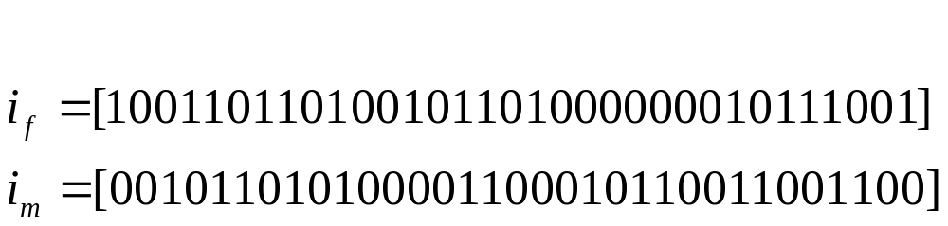
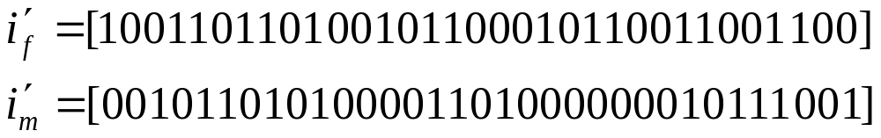
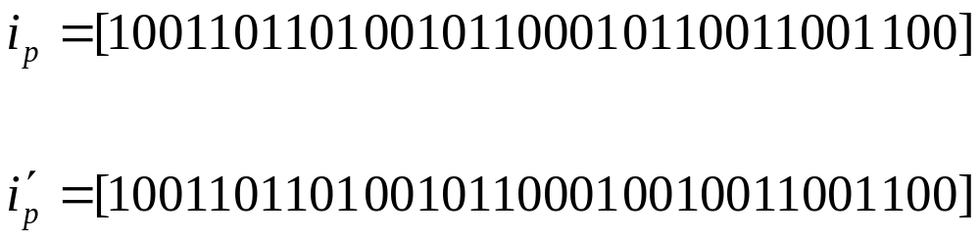

Slide 14
Experiments (Minimum Requirements)
At least three problems
Various experimental setup
  Termination condition: maximum_generation
  2 Selection methods × 3 settings × 10 runs
    Proportional: fitness function and T
    Tournament: tournament size t,
    Crossover p_{c} and mutation p_{m}
  Elitism
    The best chromosome of the previous population is just copied.

Slide 15
Results
For each problem
  Result table and your analysis
  Present the optimal tour and its cost.
    Both genotype and phenotype (real value and order)
  Draw a learning curve for the run where the best solution was found.
 | Proportional |  |  | Tournament
 | Average ± SD | Best | Worst | Average ± SD | Best | Worst
Setting 1
Setting 2
Setting 3

Slide 16
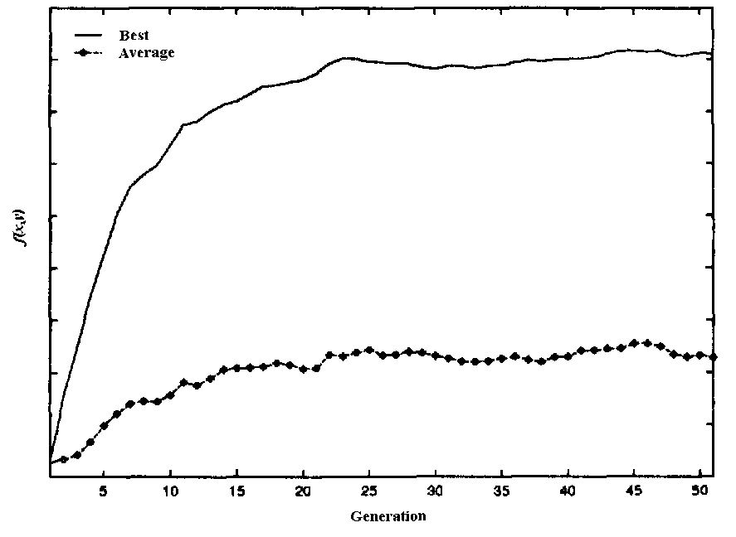

Slide 17
References
Source Codes
  Simple GA coding
  GA libraries (C, C++, JAVA, …)
  MATLAB Tool box
Web sites
Books
  Genetic Algorithms and Engineering Design, Mitsuo Gen and Runwei Cheng, John Wiley & Sons, 1997.
  Genetic algorithms in search, optimization, and machine learning, David E. Goldberg, Addison-Wesley, 1989.

Slide 18
Pay Attention!
Due (October 28, 2001): By the begin of class
Submission
  Source code and executable file(s)
    Proper comments in the source code
    Via e-mail
  Report: Hardcopy!!
    Running environments
    Results for many experiments with various parameter settings
    Analysis and explanation about the results in your own way

