Slide 1
Artificial Intelligence
Chapter 7
Agents That Plan
Biointelligence Lab
School of Computer Sci. & Eng.
Seoul National University

Slide 2
7.1 Memory Versus Computation
Memory-based implementation
  The action is selected by designer.
  Agent would require large amounts of memory.
  Designer would require foresight in anticipating appropriate reactions for all possible situations.
Computation-based implementation
  It will reduce the agent’s memory requirements and the burden on the designer.
  The designer specifies the computation instead of all possible situations.
  These computations will take time

Slide 3
7.1 Memory Versus Computation (Cont’d)
Computations
  Predict the consequences of the actions possible in any given situation.
  If these consequence-predicting computations could be automatically learned or evolved, the agent would be able to select appropriate actions even in those environments that a designer might not have been able to foresee.
  An agent must have a model of the world it inhabits and models of the effects of its actions on its model of the world.

Slide 4
7.2 State-Space Graphs
An example
  Grid-space world containing 3 toy blocks (A, B, C).
  All initially are on the floor.
  The task is to stack blocks so that A is on top of B and B is on top of C and C is on the floor.
  Instances of a schema
    move(x, y) – x can be A, B, C and y can be A, B, C and floor.
  Operators
    move(A, C) , move(A, B) …

Slide 5
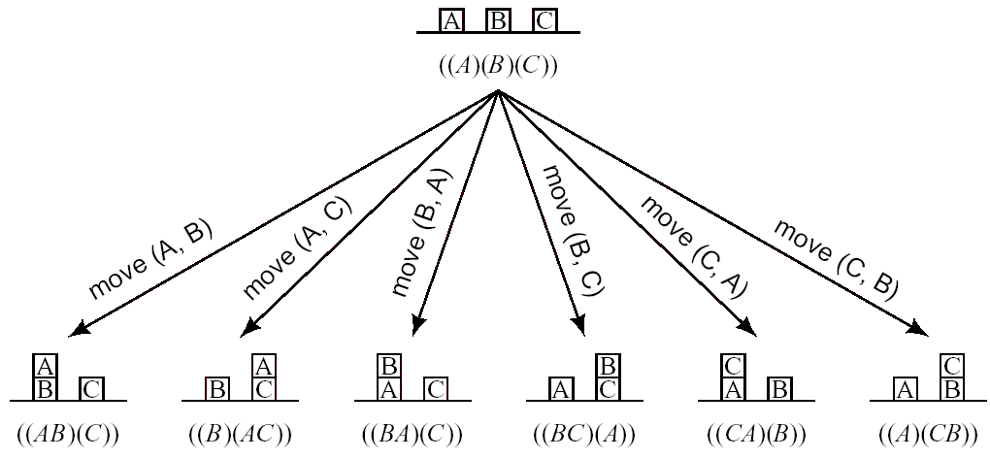
7.2 State-Space Graphs (Cont’d)
Figure 7.1 Effects of Moving a Block

Slide 6
7.2 State-Space Graphs (Cont’d)
Directed graph
  A most useful structure for keeping track of the effects of several alternative sequences of actions.
  Node
    Representations of the individual worlds
    Iconic or feature
  Arc
    Operators

Slide 7
7.2 State-Space Graphs (Cont’d)
State-space graph
  A graph representing all of the possible actions and situations
  Any of the nodes in the graph can be taken to represent a goal situations.

Slide 8
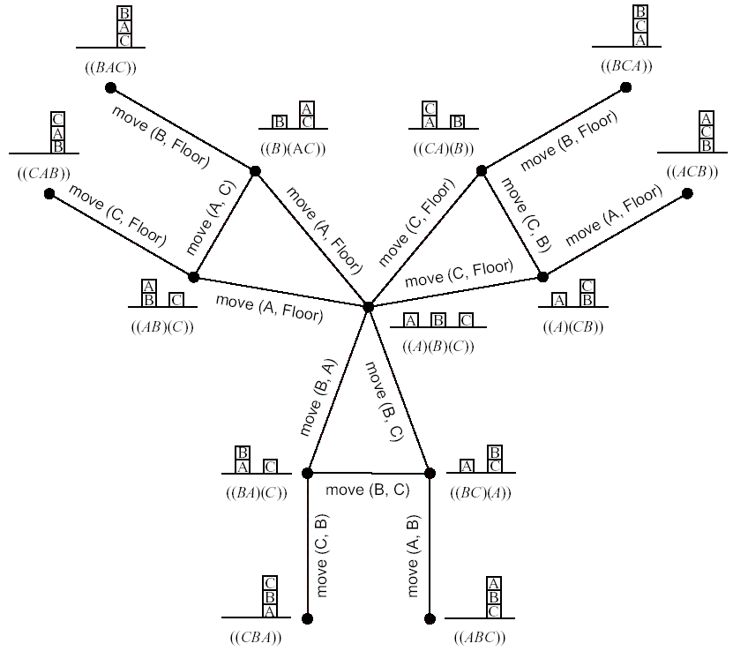

Slide 9
7.2 State-Space Graphs (Cont’d)
Plan
  A sequence of the operators labeling the arcs along a path to a goal.
  Planning is searching for such a sequence.
Projecting
  The process of predicting a sequence of world states resulting from a sequence of actions.

Slide 10
7.3 Searching Explicit State Spaces
Search methods for explicit graphs involve propagating markers over the nodes of the graph.
  Label the start node with a 0.
  Propagate successively larger integers out in waves along the arcs until an integer hits the goal.
  Trace a path back from the goal to the start along a decreasing sequence of numbers.
Expansion
  Puts marks on all of the marked node’s unmarked neighbors.

Slide 11
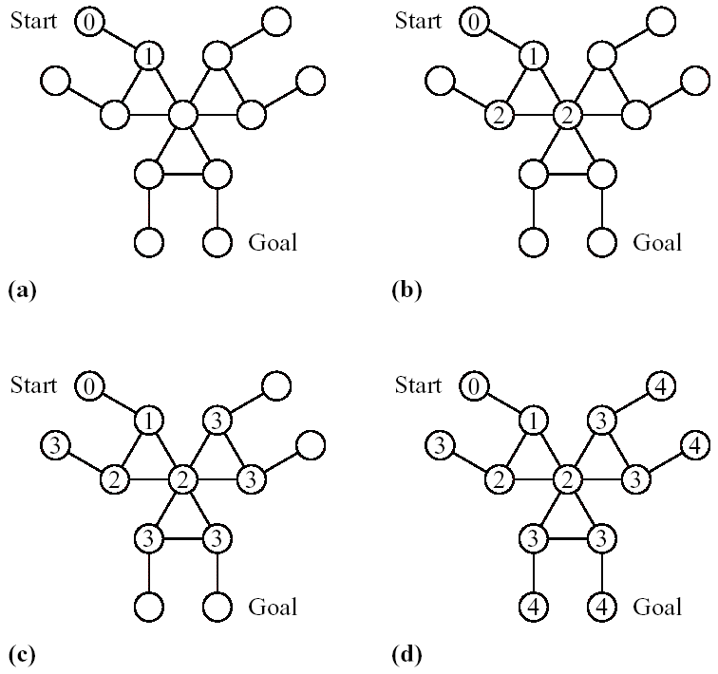
Figure 7.3 Stages of Search

Slide 12
7.4 Feature-Based State Spaces
Feature-Based graphs need a way to describe how an action affects features.
  STRIPS [Fikes & Nilsson, 1971]
    Define an operator by 3 lists
    Precondition list specifies those features that must have value 1 and 0 in order that the action can be applied.
    Delete list specifies those features that will have their values changed from 1 to 0.
    Add list specifies those features that will have their values changed from 0 to 1.

Slide 13
7.4 Feature-Based State Spaces (Cont’d)
Neural Networks
  Train a neural network to learn to predict the value of a feature vector at time t from its value at time t-1 and the action taken at time t-1. [Jordan & Rumelhart 1992]
  After training, the prediction network can be used to compute the feature vectors that would result from various actions.
  Computed features in turn could be used as new inputs to the network to predict the feature vector two steps ahead, and so on.

Slide 14
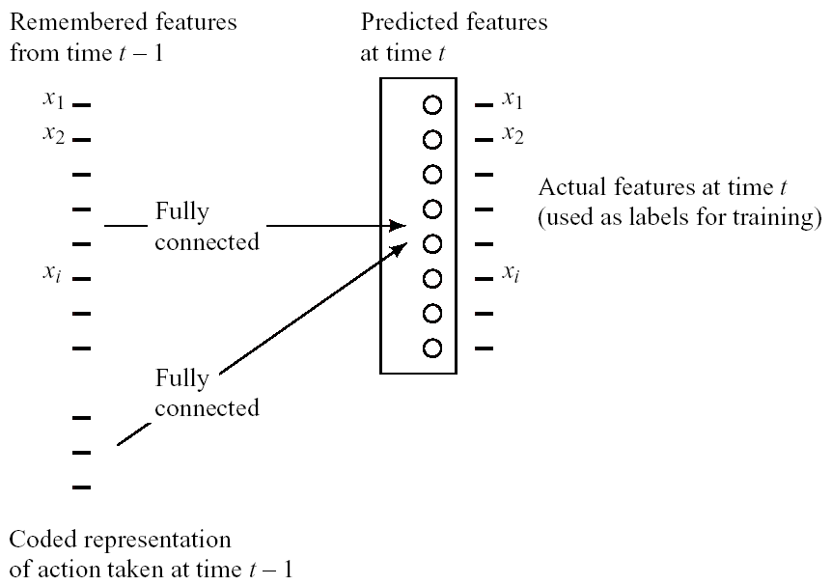
Figure 7.4 Predicting a Feature Vector with a Neural Network

Slide 15
7.5 Graph Notation
A graph consists of a set of nodes.
  Arcs connect certain pairs of nodes.
  A directed graph
    Arcs are directed from one member of the pair to the other.
    Successor (child)
    Parent
  An undirected graph
    Edges are undirected arcs.
    Contain only edges.

Slide 16
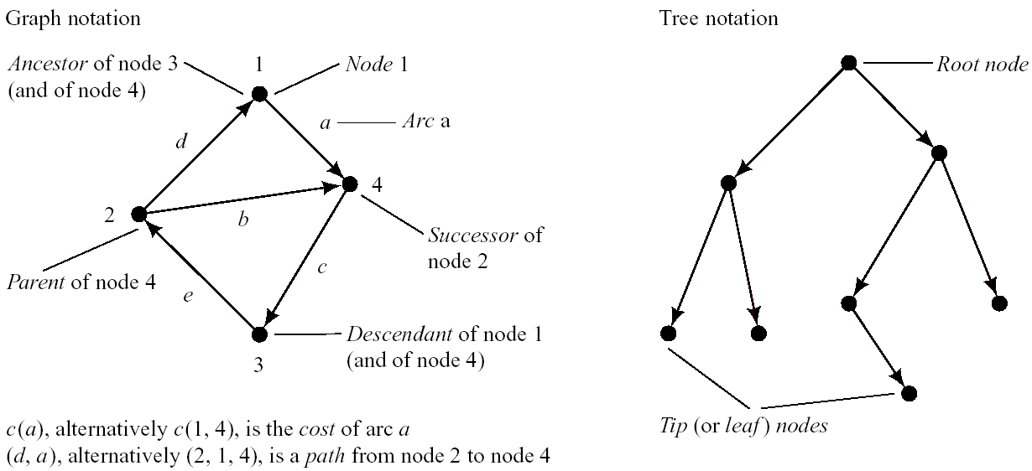
Figure 7.5 Graph and Tree Notation

Slide 17
7.5 Graph Notation (Cont’d)
Tree is a special case of a graph.
  A directed tree
    A root node has no parent.
    Each has exactly one parent except root.
    A leaf node has no successors.
    Depth of any node is defined to be the depth of its parent plus 1. ( The root node is of depth zero.)
  An undirected tree
    There is only one path along edges between any pair of nodes.

Slide 18
7.5 Graph Notation (Cont’d)
A path of length k from node n₁ to node n_{k}.
  A sequence of nodes with each n_{i+1} a successor of n_{i} for i=1,…,k-1
Accessible
  Exist a path from one node to other node.
Descent, Ancestor
Optimal path
  Path having minimal cost between two nodes.
A spanning tree
  A tree including all nodes in a graph

