Slide 1
4. Associators and Synaptic Plasticity
Fundamentals of Computational Neuroscience, T. P. Trappenberg, 2010.
Lecture Notes on Brain and Computation
Byoung-Tak Zhang
Biointelligence Laboratory
School of Computer Science and Engineering
Graduate Programs in Cognitive Science, Brain Science and Bioinformatics
Brain-Mind-Behavior Concentration Program
Seoul National University
E-mail: btzhang@bi.snu.ac.kr
This material is available online at http://bi.snu.ac.kr/

Slide 2
Outline
4.1 4.2 4.3 4.4 | Associative memory and Hebbian learning The physiology and biophysics of synaptic plasticity Mathematical formulation of Hebbian plasticity Synaptic scaling and weight distributions

Slide 3
4.1 Associative memory and Hebbian learning
To find the general principles of brain development is one of the major scientific quests in neuroscience
Not all characteristics of the brain can be specified by a genetic code
  The number of genes would certainly be too small to specify all the detail of the brain networks
  Advantageous that not all the brain functions are specified genetically
    To adapt to particular circumstances in the environment
An important adaptation mechanism that is thought to form the basis of building associations
Adapting synaptic efficiencies (learning algorithm)

Slide 4
4.1.1 Hebbian learning
Donald O. Hebb, The Organization of Behavior
“When an axon of a cell A is near enough to excite cell B or repeatedly or persistently takes part in firing it, some growth or metabolic change takes place in both cells such that A’s efficiency, as one of the cells firing B, is increased.”
Brain mechanisms and how they can be related to behavior
Cell assemblies
The details of synaptic plasticity
Experimental result and evidence
Hebbian learning

Slide 5
4.1.2 Associations (1)
Computer memory
  Information is stored in magnetic or other physical form
  Using memory address for recalling
  Natural systems cannot work with such demanding precision
The human memory
  Recall vivid memories of events from small details
  Learn associations
    Trigger memories based on related information
  Only partial information can be sufficient to recall memories
  Association memory
    The basis for many cognitive functions

Slide 6

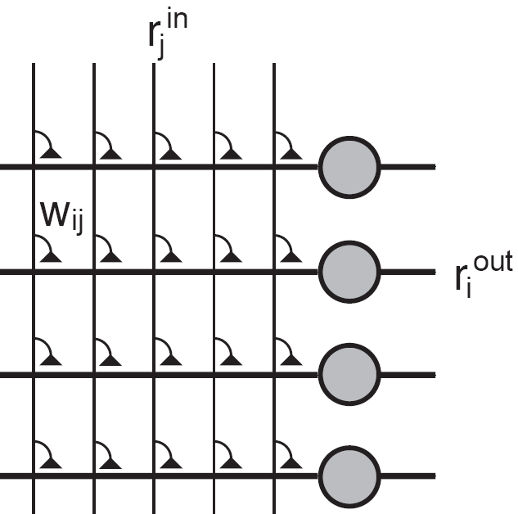
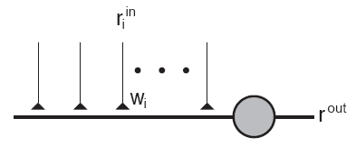
4.1.2 Associations (2)
Fig. 4.1 A simplified neuron that receives a large number of inputs r_{i}^{in}.
Fig. 4.2 A network of associative nodes

Slide 7
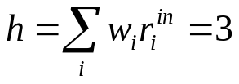
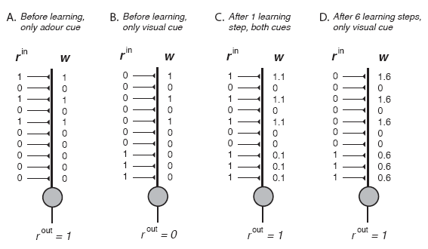
4.1.2 Associations (3)
(A) , threshold = 1.5
(4.1)
Fig. 4.3 Examples of an associative node that is trained on two feature vectors with a Hebbian-type learning algorithm that increases the synaptic strength by δw = 0.1 each time a presynaptic spike occurs in the same temporal window as a postsynaptic spike

Slide 8
4.1.3 Hebbian learning in the conditioning framework (1)
The mechanisms of an associator
  The first stimulus, the odour of the hamburger, was already effective in eliciting a response of neuron before learning
    Unconditioned stimulus (USC)
    Based on the random initial weight distribution
  For the second input, the visual image of the hamburger, the response of the neuron changes during learning
    Conditioned stimulus (CS)
The input vector to the assciator is a mixture of UCS and CS as illustrated in Fig. 4.4A

Slide 9
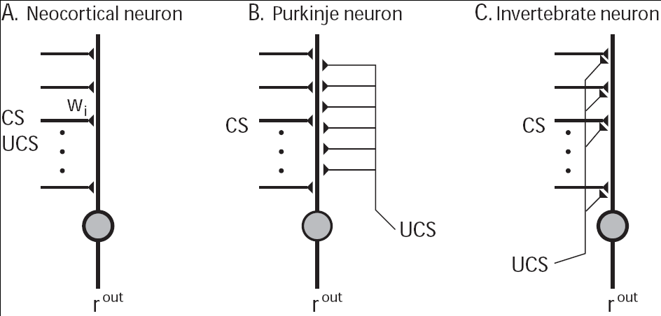
4.1.3 Hebbian learning in the conditioning framework (2)
Fig. 4.4 Different models of associative nodes resembling the principal architecture found in biological nervous systems

Slide 10
4.1.4 Features of associators and Hebbian learning
Pattern completion and generalization
  Recall from partial input
  The output node responds to all patterns with a certain similarity to the trained pattern
Prototypes and extraction of central tendencies
  The ability to extract central tendencies
  Noise reduction
Graceful degradation
  The loss of some components of system should not make the system fail completely.
  Fault tolerance

Slide 11
4.2 The physiology and biophysics of synaptic plasticity
Synaptic machinery can change
  The number of release sites
  The possibility of neurotransmitter release
  The number of transmitter receptors
  The conductance and kinetics of ion channels

Slide 12
4.2.1 Typical plasticity experiments (1)
The experiment by Bliss and Lomo (1973) in hippocampus cultures
  LTP
    High-frequency stimulus applied
    Increased amplitude of EFP (Fig. 4.5A)
  LTD
    Low-frequency stimulus applied
    Decreased ampliduce of EFP (Fig. 4.5B)
The experiment by Fine and Enoki in hippocampal slices of rats
    High-frequency stimulus applied
    Increased amplitude of EPSP (Fig. 4.6A)

Slide 13
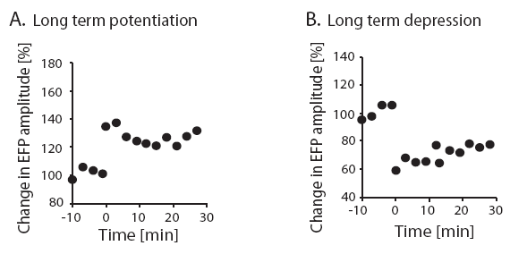
4.2.1 Typical plasticity experiments (2)
Fig. 4.5

Slide 14
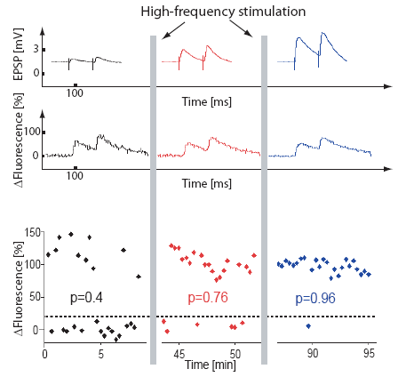
4.2.1 Short-term plasticity
Fig. 4.6

Slide 15
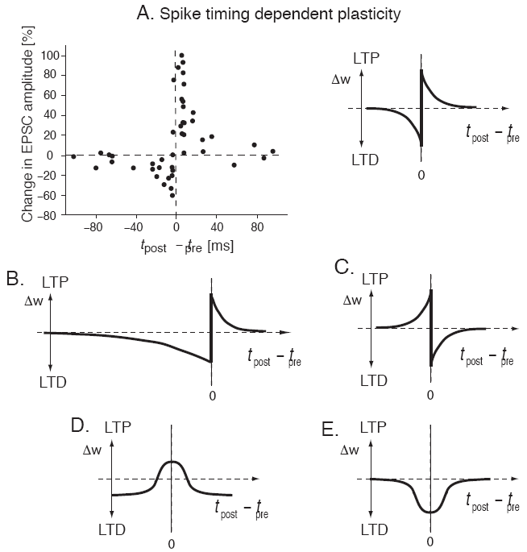
4.2.2 Spike timing dependent plasticity
Relative changes of EPSC amplitudes (and therefore weights) for different values of the time differences between pre- and postsynaptic spikes.
  Assymetrical Hebbian plasticity (Fig. 4.7B-C)
  Symmetrical Hebbian plasticity (Fig. 4.7D-E)
Fig. 4.7 Several examples of the schematic dependence of synaptic efficiencies on the temporal relations between pre- and postsynaptic spikes

Slide 16
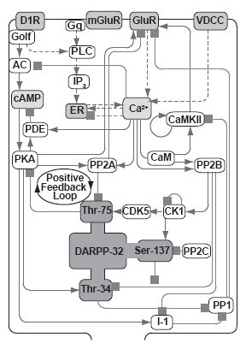
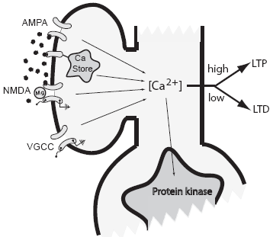
4.2.3 The calcium hypothesis and modeling chemical pathways
Fig. 4.8
Fig. 4.8

Slide 17
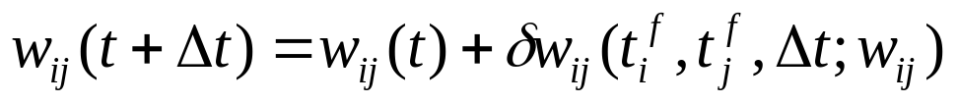
4.3 Mathematical formulation of Hebbian plasticity
Synaptic plasticity by a change of weight values
The weight values are not static but can change over time
The variation of weight values after time steps Δt in a discrete fashion as
The dependence of the weight changes on various factors
  Activity-dependent synaptic plasticity
    Depend on the firing times of the pre- and postsynaptic neuron
  The strength of synapse can vary within some interval
(4.2)

Slide 18
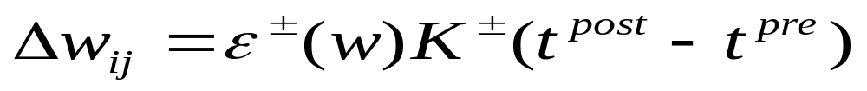
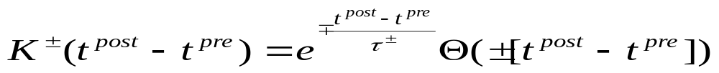
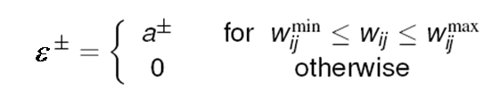

4.3.1 Spike timing dependent plasticity rules
General form
  Kernel function
  Additive rule
  Multiplicative rule

Slide 19
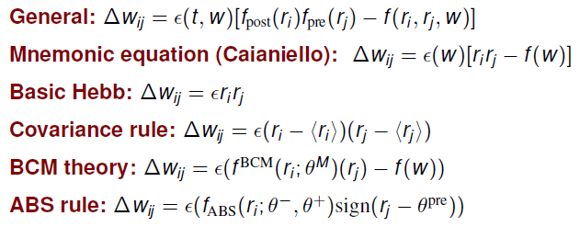
4.3.2 Hebbian learning in population rate models (1)
The average behavior of neurons or cell assemblies

Slide 20
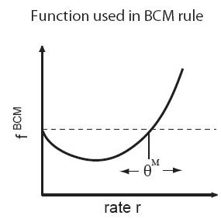
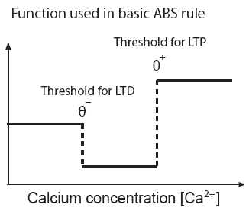
4.3.2 Hebbian learning in population rate models (2)
Fig. 4.10
Fig. 4.11

Slide 21
4.3.3 Negative weights and crossing synapses
In single neurons
  Synaptic learning rules should not change the sign of weight values.
In population nodes
  Domain crossing of weight values is allowed.

Slide 22
4.4 Synaptic scaling and weight distribution
Repeated application of additive association rules results in runway (unstable) synaptic values.
Real neural systems need some balance and competition between synapses to allow stable learning.

Slide 23
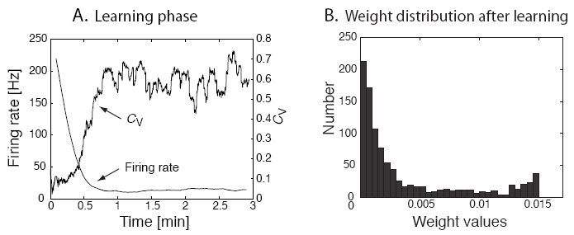
4.4.1 Examples of STDP with spiking neurons (1)
Asymmetric Hebbian rules for spiking neurons
Fig. 4.12 (A) Firing rate (decreasing curve) and C_{v}, the coefficient of variation (increasing and fluctuating curve), of an IF-neuron that is driven by 1000 excitatory Poisson spike trains while the synaptic efficiencies are changed according to an additive Hebbian rule with asymmetric Gaussian plasticity windows. (B) Distribution of weight values after 5 minutes of simulated training time (which is similar to the distribution after 3 minutes). The weights were limited to be in the range of 0-0.015. The distribution has two maxima, one at each boundary of the allowed interval.

Slide 24
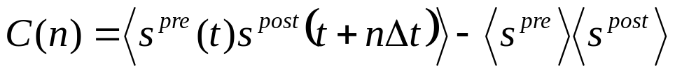
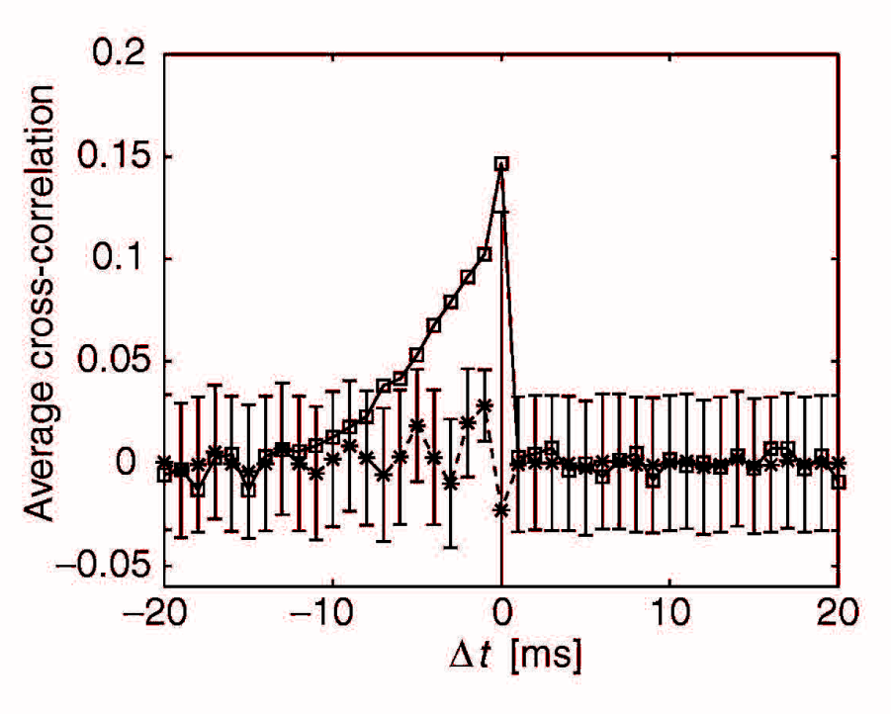
4.4.1 Examples of STDP with spiking neurons (2)
The firing time of the IF-neuron is mainly determined by the average firing input current
Measure this statement using cross-correlation function
Fig. 4.13 Average cross-correlation function between pre-synaptic Poisson spike trains and the postsynaptic spike train (averaged over all presynaptic spike trains) in simulation of an IF-neuron with 1000 input channels. The spike trains that lead to the results shown by stars were generated with each weight value fixed to value 0.015. The cross-correlations are consistent with zero when considered within the variance indicated by the error bars. The squares represent the simulation results from simulations of the IF-neuron driven by the same presynaptic spike trains as before, but with the weight matrix after Hebbian learning shown in Fig. 7.9. Some presynaptic spike trains caused postsynaptic spiking with a positive peak in the average cross-correlation functions when the presynaptic spikes precede the postsynaptic spike. No error bars are shown for this curve for clarity.

Slide 25

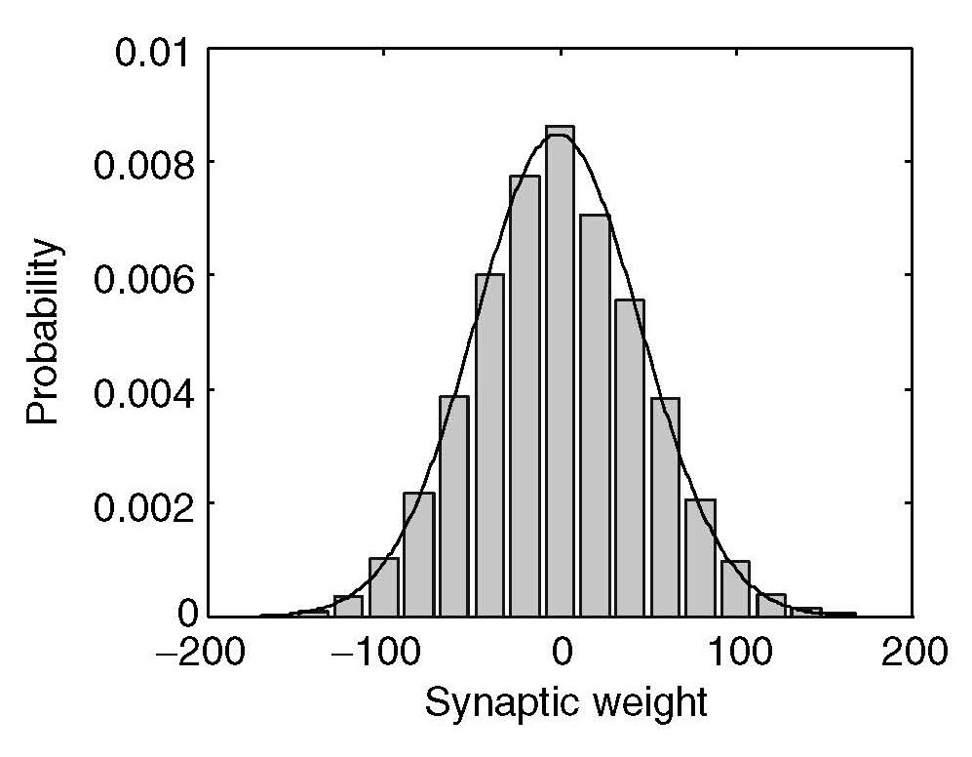
4.4.2 Weight distributions in rate models
After learning Np with Hebbian covariance rule (eq. 4.11), w_{ij}⁰ =0
Rate models of recurrent networks trained with the Hebbian training rule on random patterns have Gaussian distribution weight component
Fig. 4.14 Normalized histograms of weight values from simulations of a simplified neuron (sigma node) simulating average firing rates after training with the basic Hebbian learning rules 4.11 on exponentially distributed random patterns. A fit of a Gaussian distribution to the data is shown as a solid line.

Slide 26
4.4.3 Competitive synaptic scaling and weight decay (1)
The dependence of overall synaptic efficiencies on the average postsynaptic firing rate
  Crucial to keep the neurons in the regime of high variability
    Keep neurons sensitive for information processing in the nervous systems
Many experiments have demonstrated
  Synaptic efficiencies are scaled by the average postsynaptic activity
The threshold where LTP is induced can depend on the time-averaged recent activity of the neuron
Weight normalization
Weight decay

Slide 27
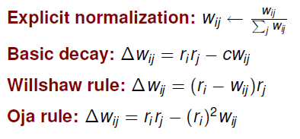
4.4.3 Competitive synaptic scaling and weight decay (2)

Slide 28
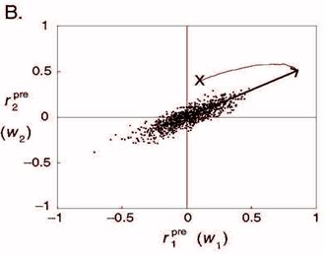
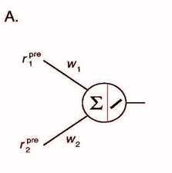
4.4.4 Oja’s rule and principal component analysis (PCA)
Oja’s rule (in the previous section) also implements efficiently an algorithm called PCA
PCA is to reduce the dimension of high-dimensional data.
Fig. 4.15
Fig. 4.16

