Slide 1
Programmable and Autonomous Computing Machine Made of Biomolecules
Y. Benenson, T.Paz-Elizur, E. Keinan, Z. Livneh and E. Shapiro
Nature, v.414, 22 Nov. 2000, pp.430-434
Summarized by Lee, In-hee

Slide 2
Introduction
Constructed finite automaton
Hardware
  Class IIS restriction nuclease FokI
  T4 DNA ligase
  ATP
Software
  Eight ds DNA molecules (transition molecules)
  ds DNA encoding initial state and input
  Two output detection molecules

Slide 3
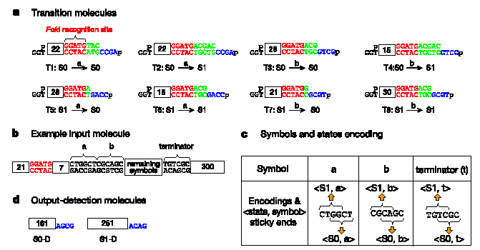
Operation

Slide 4
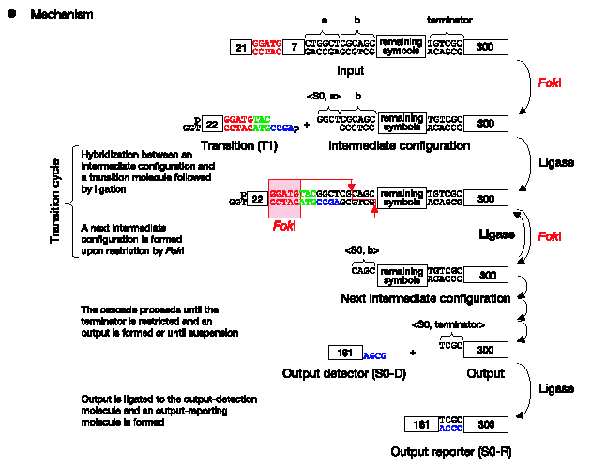
Operation

Slide 5
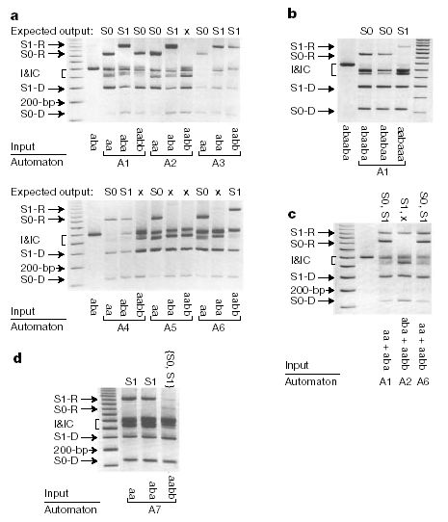
Experiment

Slide 6
Summary
10⁹ transitions per second
Energy consumption rate 10⁻¹⁰ W
Complexity is bounded by number of non-palindromic sticky ends

