Slide 1
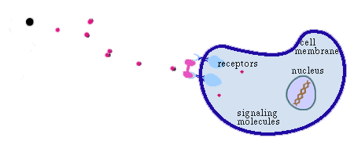
Basic Scheme of Biological Phenomena
Signals

Slide 2
Proteome 분석기술의 필요성
생체 내 기능은 단백질이 한다 (약 30,000종류).
단백질 발현 정도는 mRNA양과 다르다.
단백질은 다양한 modification이 많다.
이를 분석할 수 있는 high throughput proteome 분석 기술이 필요하다.

Slide 3
Application of Proteome Analysis
Basic life science
Growth,
proliferation,
aging, death
Diseases
암, 면역/뇌/심혈관
질환등
Adaptation to
environment
Protein modification
Differential protein
expression
Protein-protein
interaction
Discovery of target proteins
Development of drug marker
Screening of chemical library
Proteome analysis
Development of therapeutic
and diagnostic drugs

Slide 4
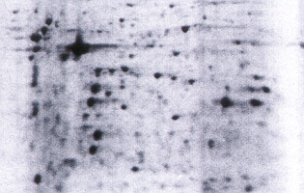
Differentially Expressed proteins
Changes in protein-protein interaction
Protein modification
Sample preparation
Prefractionation
2D - PAGE
IEF
SDS
Proteome separation
MALDI-TOF-MS
Spot excision
in gel digestion
Spot analysis
peptide fingerprinting
peptide sequencing
Database
10000
Counts
8000
6000
4000
2000
0
1000
1500
2000
2500
3000
Mass (m/z)
Identification of proteins
Comparison with Genebank
(Bioinformatics)
Functional studies
of identified proteins
Protein Overexpression, Cell line,
mutant construction, antibody production
Development of new drug target

Slide 5
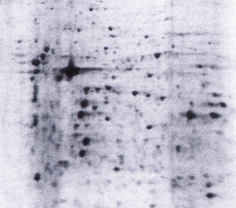
Proteome Separation : 2-D PAGE
(2-Dimensional polyacrylamide gel electrophoresis)
Organ, Tissue, Cells
Sample Preparation
2-D gel Electrophoresis
  IEF & Mol. wt
Stain and/or Blot
Image Analysis
IEF
SDS-PAGE

Slide 6

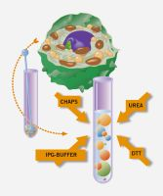

2D gel electrophoresis
2. Apply rehydration solution
1. Samples prep – denatured and solubilized using urea, a non-ionic detergent, IPG Buffer, and a reducing agent
3. Lay IPG strip
from www.apbiotech.com

Slide 7


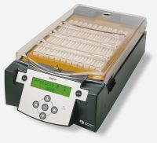

4. Apply protein sample
6. Place cover
7. Place assembled strip holder on IPGphor platform and run
5. Apply oil
from www.apbiotech.com

Slide 8

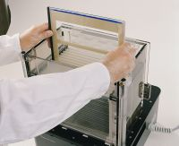
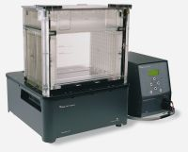
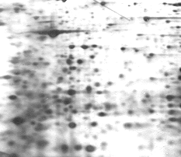
8. After a precast gel is loaded, the IPG strip is added, sealed into position, and the cassette is placed into the Ettan DALT II Separation Unit
9. Spot detection & analysis
IEF
SDS-PAGE
Ettan DALT II System
from www.apbiotech.com

Slide 9
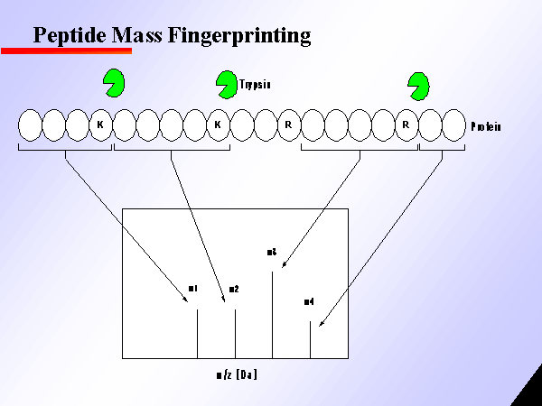

Slide 10
Peptides from Proteins
intact protein
peptide fragments
enzyme
MEMEKEFEQIDKSGSWAAIYQDIRHEASDFPCRVAKLPKNKNRNRYRDVS
PFDHSRIKLHQEDNDYINASLIKMEEAQRSYILTQGPLPNTCGHFWEMVW
EQKSRGVVMLNRVMEKGSLKCAQYWPQKEEKEMIFEDTNLKLTLISEDIK
SYYTVRQLELENLTTQETREILHFHYTTWPDFGVPESPASFLNFLFKVRE
SGSLSPEHGPVVVHCSAGIGRSGTFCLADTCLLLMDKRKDPSSVDIKKVL
LEMRKFRMGLIQTADQLRFSYLAVIEGAKFIMGDSSVQDQWKELSHEDLE
PPPEHIPPPPRPPKRILEPHNGKCREFFPNHQWVKEETQEDKDCPIKEEK
GSPLNAAPYGIESMSQDTEVRSRVVGGSLRGAQAASPAKGEPSLPEKDED
HALSYWKPFLVNMCVATVLTAGAYLCYRFLFNSNT

Slide 11
MALDI-TOF MS
Matrix-Assisted Laser Desorption/Ionization Time Of Flight MS
Sample
plate
Extraction
grids
Reflector
detector
Reflector
Laser
Timed ion
selector
Linear
detector
Camera
Pumping
Pumping
UV laser
337 nm
Disorbed
ions
Matrix
Sample

Slide 12
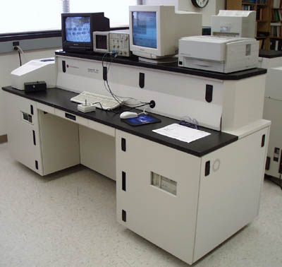
MALDI-TOF MS
STR (PerSepive)
MALDI TOF MS
delayed extraction
Reflector
High current detector STR (PerSepive)

Slide 13
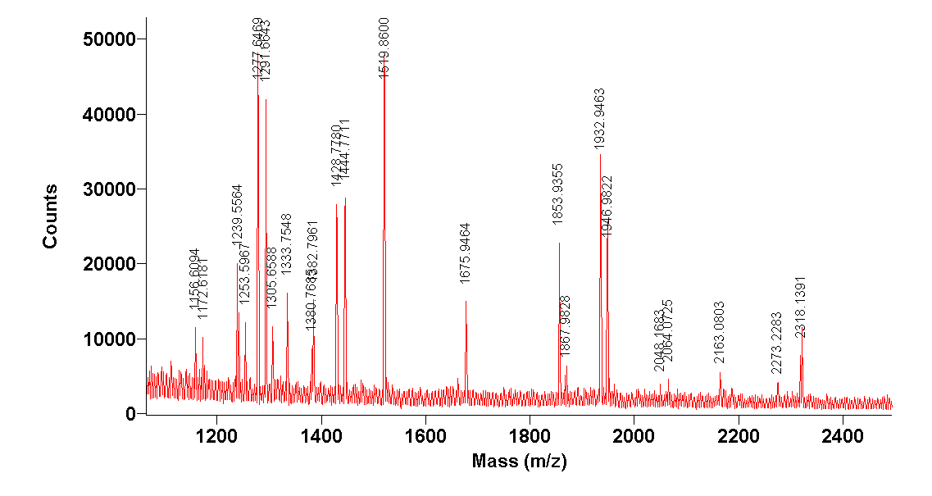
Automatic Data Acquisition of Gel Spot

Slide 14
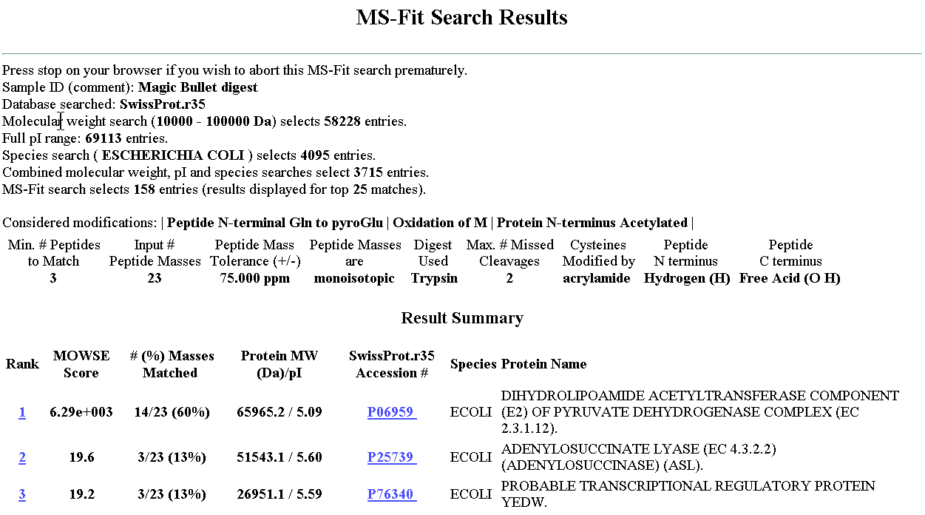
Database Search Results

Slide 15
Conclusions
Proteomics using 2-D gel electrophoresis and MALDI-TOF MS are valuable analytical tool for identification of
Differentially expressed proteins
Protein modifications
Protein-protein interaction
Peptide sequencing

