Slide 1
Artificial Chemistries – A Review
Peter Dittrich, Jens Ziegler, and Wolfgang Banzhaf
Artificial Life 7:225-275, 2001
Summarized by In-Hee Lee

Slide 2
Contents
Artificial life and artificial chemistry
Basic concepts
Approaches
Applications
Common phenomena
Discussion and outlook

Slide 3
1. Artificial Life and Artificial Chemistry
Artificial Life
  Abstracts from specific examples of real living processes and tries to integrate different approaches into one interdisplinary attempt to extract the first principles of life.
Artificial Chemistry
  By abstracting from natural molecular processes, tries to investigate the dynamics of these complex systems.

Slide 4
2. Basic Concepts
Artificial Chemistry
  Man-made system that is similar to a real chemical system.
  Defined by a triple (S, R, A).
    Set of molecules S
    Set of rules R
    Reactor algorithm A – dynamics
  S: all valid molecules that may appear in an AC.
  R: interactions between molecules in S.
  A: determines how R is applied to a collection of molecules.

Slide 5

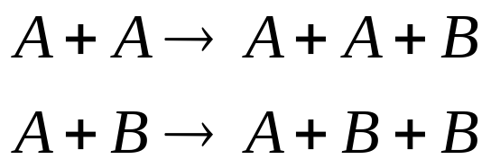
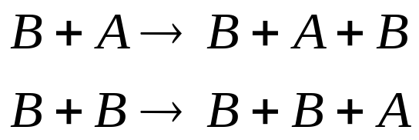
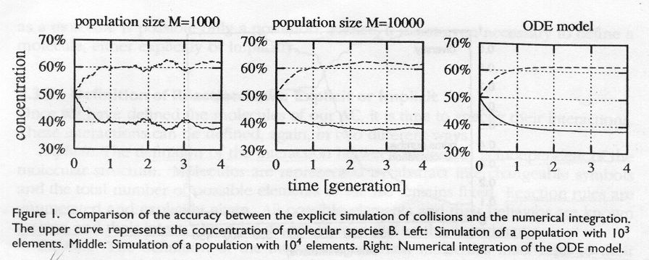
2.1 Two Examples (1/2)
Non-constructive explicit chemistry
  Molecules:
  Reactions:

Slide 6

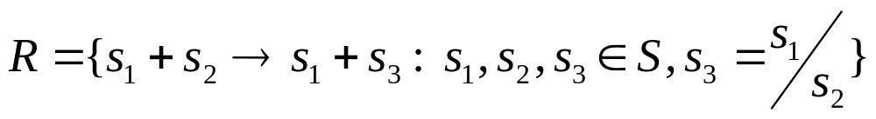
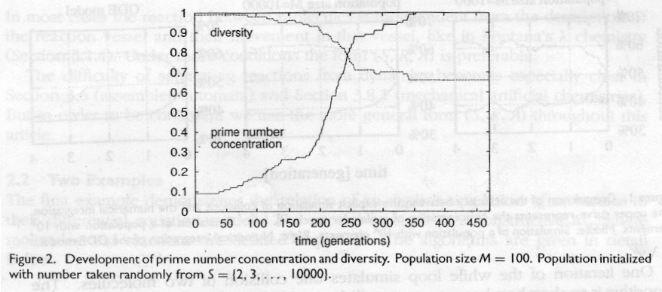
2.1 Two Examples (2/2)
Constructive implicit chemistry
  Molecules:
  Reactions:

Slide 7
2.2 Characteristics and Methods (1/2)
Definition of molecules
  Explicit: enumeration of symbols.
  Implicit: description of how to construct a molecule.
Definition of reaction laws
  Explicit: interaction between molecules is independent of the molecule structure.
  Implicit: interaction must refer to their structures.
Definition of dynamics
  Explicit: series of formally defined interactions
  Implicit: dynamics is caused by the synchronous or asynchronous update of interactions

Slide 8
2.2 Characteristics and Methods (2/2)
Levels of abstraction
  Analogous: an isomorphism between a molecule or action in AC to a molecule or action in chemistry exists
  Abstract: such isomorphism doesn’t exist.
Constructive dynamical systems
  New components can appear.
Random chemistries
Measuring time
Pattern matching
Spatial topology

Slide 9
3. Approaches (1/6)
Rewriting or production systems
  Consists of certain entities or symbols and a set of rules for performing replacements.
  Rule defines whether a pattern of symbols can be replaced by other pattern.
  Examples
    The chemical abstract machine (CHAM)
    The chemical rewriting system on multisets (ARMS)
    The chemical casting model (CCM)
    Lambda-calculus (AlChemy)

Slide 10
3. Approaches (2/6)
Arithmetic operations
  Representations and operators can be borrowed from mathematics to construct AC.
  Examples
    Simple arithmetic operations
    Matrix-multiplication chemistry
Autocatalytic polymer chemistries
  Molecules: character sequences
  Reactions: concatenation and cleavage.

Slide 11
3. Approaches (3/6)
Abstract automata
  Represent molecules as collections of bits organized as binary strings
  Molecules appear in two forms: passive data (binary string), active machine.
Artificial molecular machines
  Molecules: strings of symbols (data or machine)
  Reactions: two molecules binds at a site and executes instructions at the site.
  Examples
    Polymers as Turing machines
    Machine-tape interaction
    Automata reaction

Slide 12
3. Approaches (4/6)
Assembler automata
  Parallel computation machine that consists of a core memory and parallel processing units.
  Programs struggle for computer resources and may fight each other.
  Examples
    Coreworld
    Tierra
    Avida

Slide 13
3. Approaches (5/6)
Lattice molecular systems
  Consists of a regular lattice.
  Each lattice can hold a part of a molecule.
  Bonds can be formed between parts.
  Examples
    Autopoietic system
    Lattice polymers
    Lattice molecular automaton
    Self-replicating cell

Slide 14
3. Approaches (6/6)
Other approaches
  Mechanical artificial chemistry
    Basic units are regular triangular units, which may form bonds by magnets.
  The chemical metaphor in cellular automata (CA)
    Self-replicating loops
    Embedded particles in CA as molecules
  Typogenetics

Slide 15
4. Applications (1/2)
Modeling, information processing, and optimization.
Modeling
  Biochemical systems are mainly modeled.
  Population dynamics, ecological systems, social systems, or economic markets.
Information processing
  Data can be seen as molecules carrying ‘meaning’.
  Processing of data can be regarded as molecule interactions.
  Real or artificial chemical computing

Slide 16
4. Applications (2/2)
Optimization
  Use the ability of AC to create evolutionary behavior (or self-evolution)
  Use AC for evolutionary optimization.

Slide 17
5. Common Phenomena (1/3)
Reduction of diversity
  Single self-replicating molecule dominates.
  Inert population in which no reaction takes place.
  Simple network of a few interacting molecules.

Slide 18
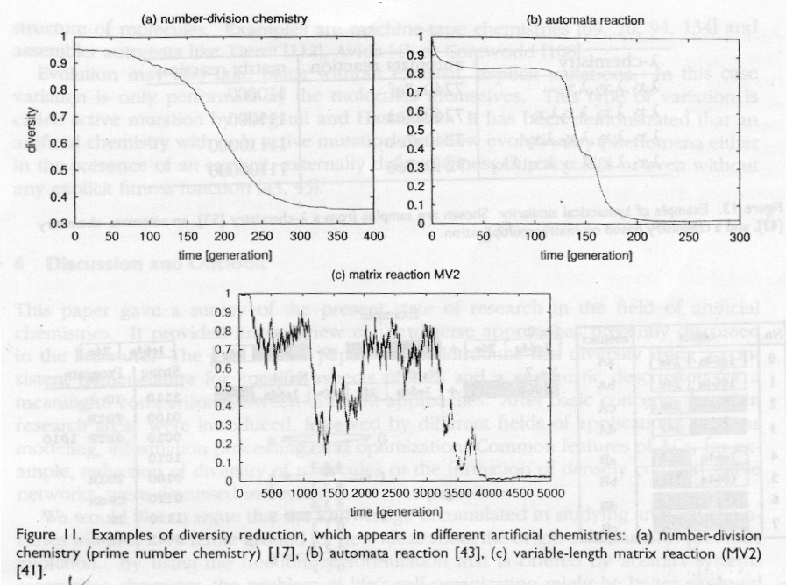
5. Common Phenomena (2/3)

Slide 19
5. Common Phenomena (3/3)
Formation of densely coupled stable networks
Syntactic and semantic closure
  Molecules in stable networks show similarities in structure and function.
Evolution and punctuated equilibrium

Slide 20
6. Discussion and Outlook
The knowledge accumulated in studying AC will provide a fertile ground for new ideas about the origin of life.
Important questions
  What level of abstraction for an AC is appropriate?
  Which key ingredients are missing in current AC?
  Do we have to incorporate detailed physical / chemical knowledge?
  Is an AC able to create information?

