Slide 1
A Surface-Based DNA Algorithm for the Expansion of Symbolic Determinants
Z. Frank Qiu and Mi Lu
Third Workshop on Bio-Inspired Solutions to Parallel Processing Problems,
May 2000
Cho, Dong-Yeon

Slide 2
Surface-Based Operations
Abstract Model
  Reset (S): initialization, generating all the strands
  Mark (C, S): all strand in set S satisfying the constraint C are identified as marked.
  Unmark() : unmark all the marked strands.
  Append (C, X): a word X represented by a strand segment is appended to all strands satisfying constraint C.
  Readout (C, S): selecting an element in S following criteria C

Slide 3
Biological Implementation
  Reset (S): all the strands generated are attached to a surface instead of floating in the solution.
  Mark (C, S): strands are marked simply by making them double-strands.
  Unmark(): raising the temperature and washing the surface
  Delete (C): by picking different enzymes, marked (double) or unmarked (single) strands can be destroyed selectively.
  Append (C, X): ligation for marked strands or simple hybridization of a splint oligonucleotide followed by ligation for unmarked ones
  Readout (C, S): there are many existing methods developed for solution based DNA computing readout.

Slide 4
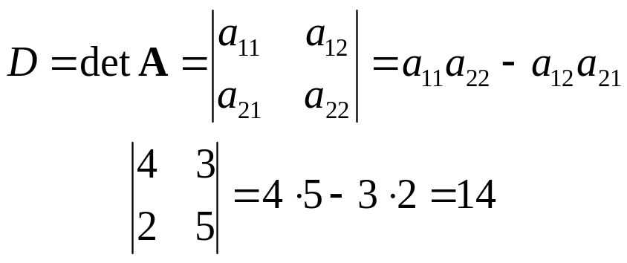
Hard Computation Problem
Expansion of Symbolic Determinants Problem
  A determinant of second order

Slide 5
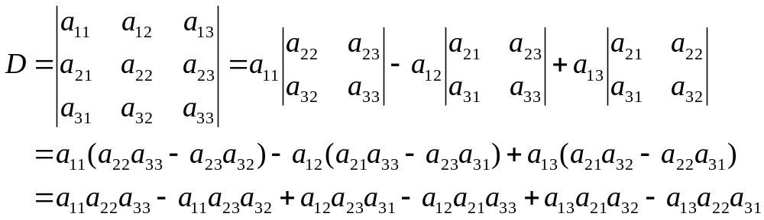
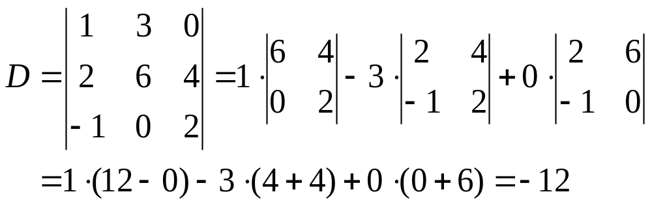
  A determinant of third order

Slide 6
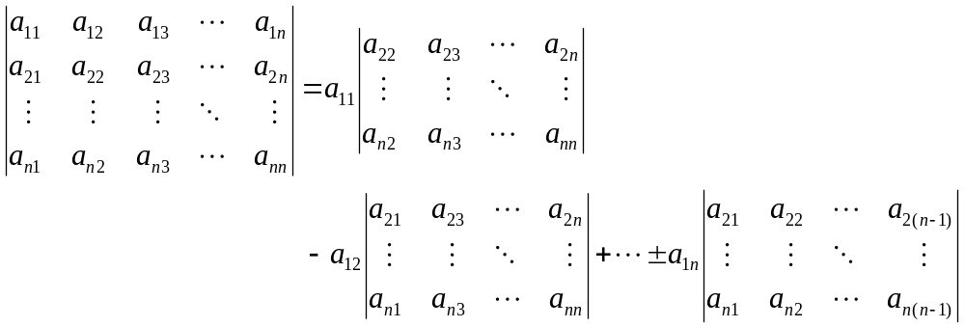
  A n×n determinant
  A complete matrix expansion has n! items.

Slide 7
Surface-Based Algorithm: O(n)
Reset (S): initially empty (the basic header)
Append (X, S): X is a_{ij}≠0 while i is set as one and j ∈ [1 : n].
Repeat the step 2 with i incremented by one until i reaches n.
Mark (X, S): we mark all strands containing X and X is initially set as a_{i} (i = 1).
Delete (UM): eliminating unmarked strains which contain less than n rows.
Repeat the steps 4 and 5 n-1 times with different i, i ∈ [2 : n]
Repeat the steps 4, 5, and 6 with different a_{j}, j ∈ [1 : n]
Readout (S): readout all the remaining strands on the surface.

