Slide 1
Gene Expression Profile Diagnosis through DNA Molecular Computation
Allen P. Millis, Jr.
Trends in Biotechnology
Vol. 20, no. 4, 2002
Summarized by In-Hee Lee

Slide 2
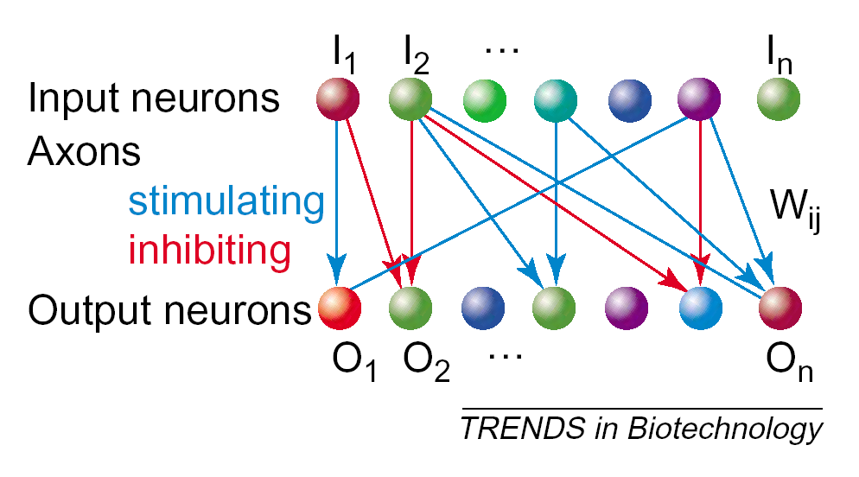
DNA Neural Networks

Slide 3
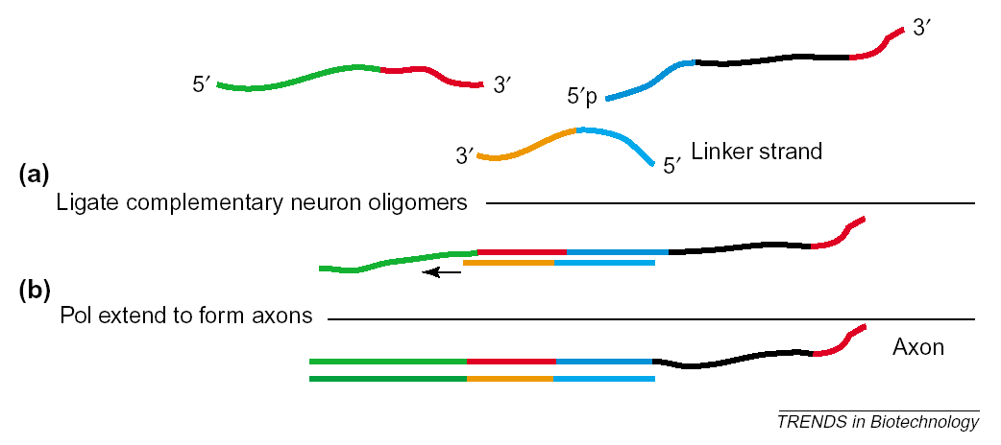
Formation of Axon

Slide 4
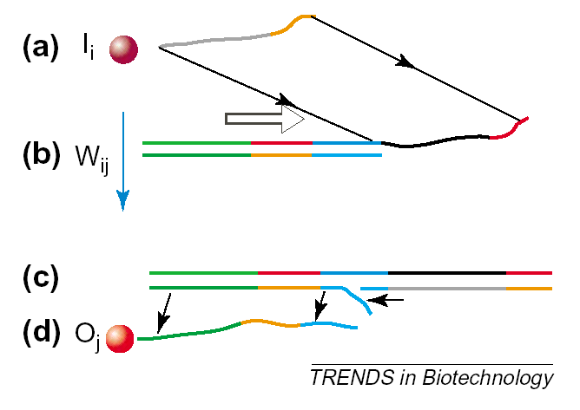
Single Layer DNA Neural Network

Slide 5
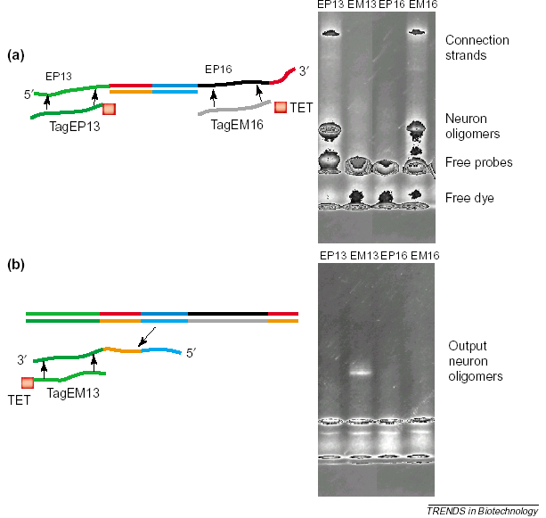
Experiment

