Slide 1
The Biophysics of DNA Hybridization with Immobilized Oligonucleotide Probes
V. Chan, D. J. Graves, and S. E. McKenzie
Biophysical Journal, V. 69, Dec 1995,
pp. 2243-2255

Slide 2
Abstract
Reaction-diffusion model limited irreversible model
Two different mechanism
  Direct hybridization from the solution (3D)
  Hybridization by molecules that adsorb nonspecifically and then surface diffuse to the probe (2D)

Slide 3
Basic model
Based on the Brownian nature of a ligand’s motion and the nonspecific adsorption/desorption of ligands on the cell surfaces.
Based on the literature of receptor-ligand interactions
Extend the Axelrod and Wang model
  Reduction of dimensionality kinetics at reaction limited cell surface receptors, Biophys. J. 66:588-600, 1994

Slide 4
Physical model of heterogeneous DNA hybridization on a surface
그림 1

Slide 5
Assumption
The surface is covalently linked to a fixed number of probe that are equally spaced and exposed to the same chemical environment
Each of probes reacts irreversibly with only one complementary DNA target from free solution
The number of available probes is constant throughout the hybridization and is independent of the reaction rate

Slide 6
Assumption
The surface is an infinite flat plate
The lateral interactions between the adsorbed molecules can be neglected

Slide 7
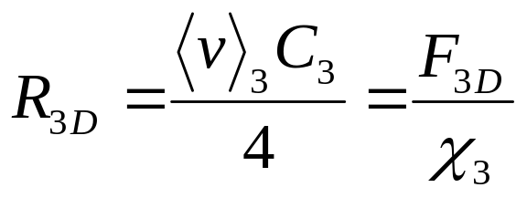
The reaction-limited model of heterogenous hybridization
Direct probe-target collision + nonspecific adsorption followed by surface diffusion
Collision rate of a Brownian solute in free solution with a surface having unit area

Slide 8
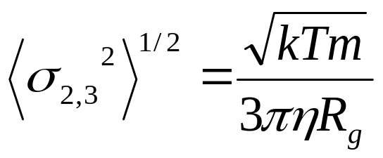
Principal values for DNA-DNA hybridization
The Brownian mean square displacement
  The value for the Brownian persistence distance of a spherical particle, σ
Boltzmann constant
Absolute temperature
Molecular weight
Viscosity of water
The radius of gyration of DNA

Slide 9
Brownian motion
Brownian motion can be applied to small particles ranging from 1 nm to 10 μm.
  Usual DNA molecules.
It is well known that DNA molecules behaves as Brownian particles in solution.
Simple collision mechanism between the two complementary molecules.

