Slide 1
Scale-up of Theorem Proving
MEC Meeting
Hanyang University
Proteome Research Lab
2002. 11. 29
Park, Ji-Yoon

Slide 2
Contents
Primer Design
  Thermodynamics
New Amplification and Detection
  Loop-mediated Isothermal Amplification(LAMP)
  Ramplification Amplification Method(RAM)
  Rolling Circle Amplification(RCA)
  Structure Specific Enzyme Cleavage

Slide 3
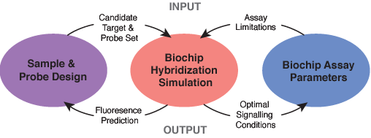
The Primer Design

Slide 4
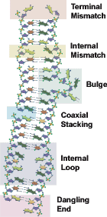
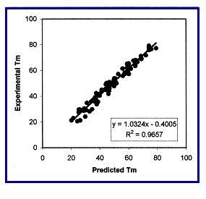
Nucleic Acid Thermodynamic Parameters and Structural Motifs

Slide 5
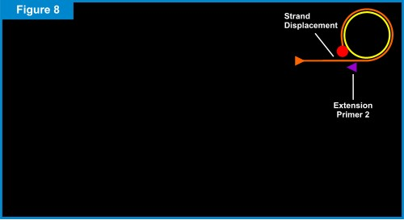
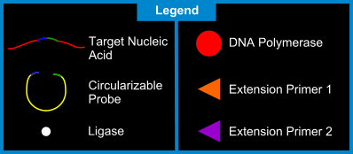
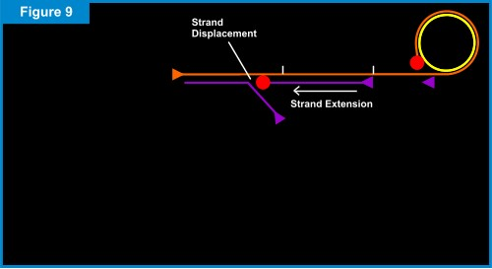
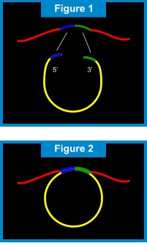
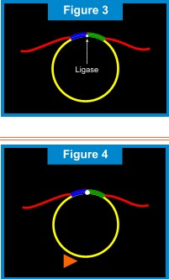
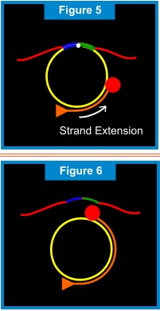

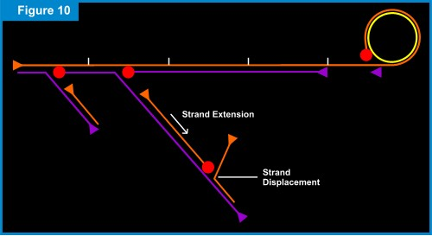
Ramplification Amplification Methods

Slide 6
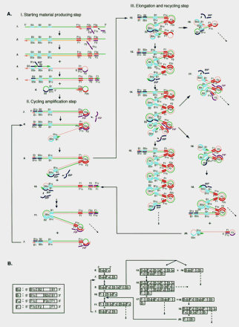
Loop-Mediated Isothermal Amplification
Nucleic Acids Res. 28, e63(2000)
13

Slide 7
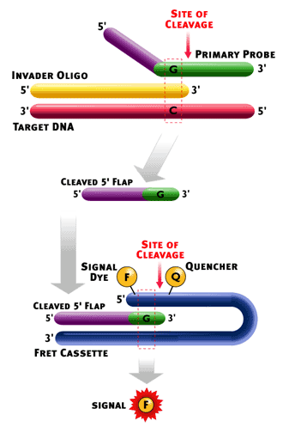
Invasive Cleavage Reaction
Nat. Biotechnol. 19, 1053-1059(2001)
Directly detect genomic DNA
No target amplification required
Sensitive & Accurate
Easy to integrate into the routine laboratory

Slide 8
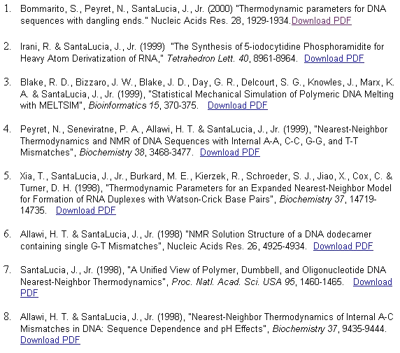

Slide 9
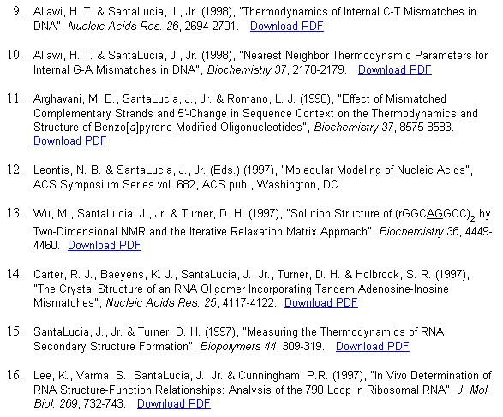

Slide 10
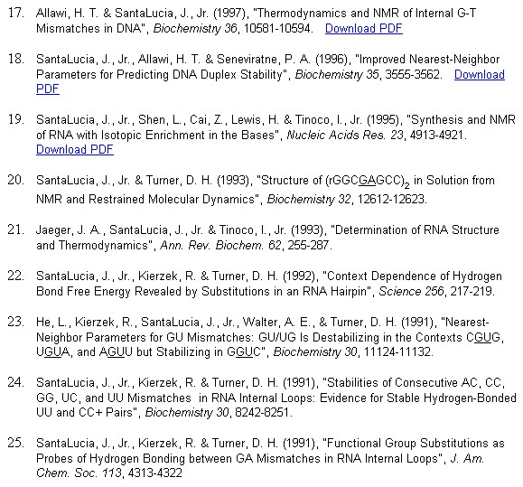

Slide 11
In Theorem Proving…
Non-PCR Amplification
Effective Detection
Consideration of several parameter

