Slide 1
u TAS
(micro total analysis system)
2002
Sixth international Conference on Minaturized Chemical and Biochemical
Analysis System
November 3-7 m,2002
Nara New Public Hall ,Nara,Japan

Slide 2
Contents
Microfluidics
Fluid Dispensing
Fluid Mechanics and Modeling Tools
World-to-chip Interfacing
Others
MEMS Technology
Micromachining Methods
Plastic Machining
Micropumps and Valves
Microfluidic Components
Others

Slide 3
Nanotechnology
Nanofluidics Components
Nanoengineered Material
Others
Materials
Surface Modification
Chemical and Biochemical Arrays
Interfacial Characterization
Others

Slide 4

Detection Technologies
Micro-Optical Systems
Electrochemical Detection
Mass Spectrometry
Novel Quantification Strategies
Others
Application
Clinical Diagnostics
Genomics and Proteomics
Environmental Assays
Separation Science
Cellular Analysis
Drug Discovery
Others

Slide 5
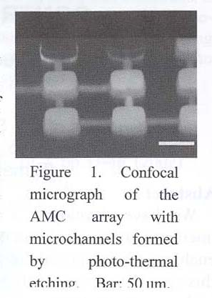
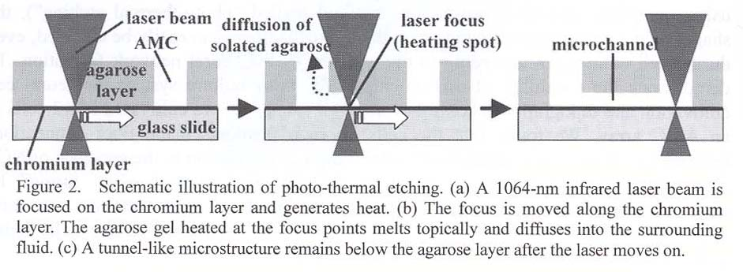
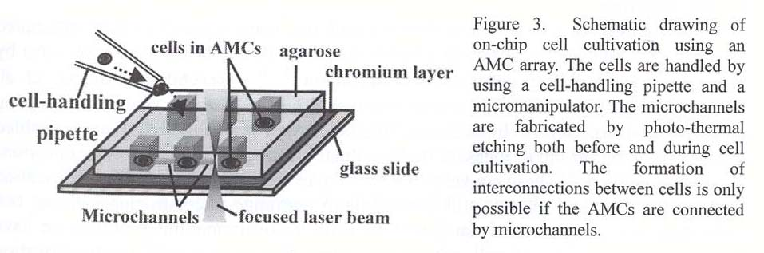
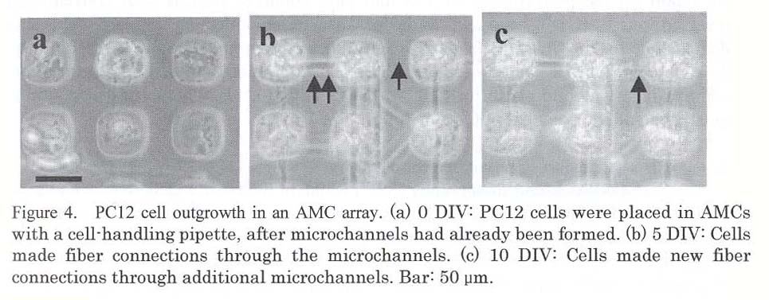
ON-CHIP AGAROSE MICROCHAMBER (AMC) ARRAY CELL-CULTIVATION SYSTEM FOR TOPOGRAPHICAL CONTROL OF NEURAL NETWORK
Hiroyuki Moriguchi, Kazunori Takahashi, Tomoyuki Kaneko and Kenji Yasuda

Slide 6
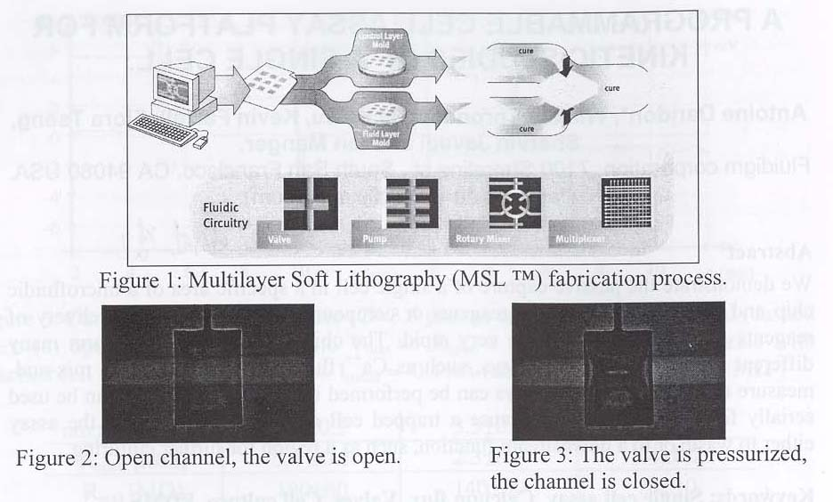
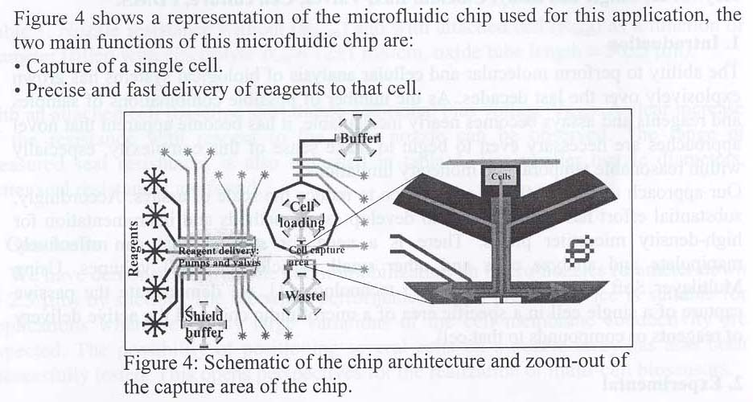
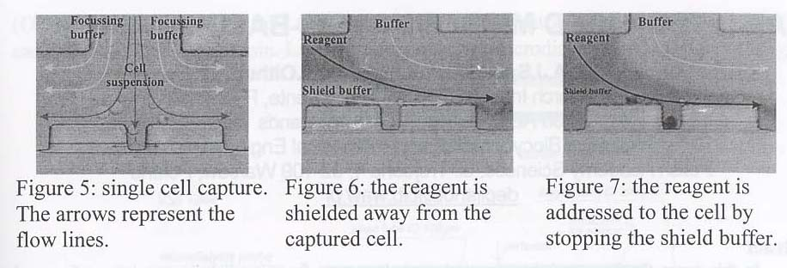
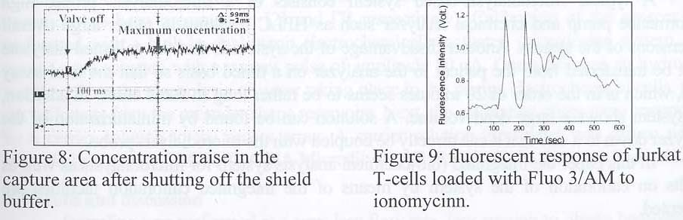
A PROGRAMMABLE CELL ASSAY PLATFORM FOR KINETIC STUDIES OF A SINGLE CELL
Antoine Daridon, William Throndset, Ian Liau, Kevin Farrell, Flora Tseng, Shervin Javadi and Ian Manger

Slide 7
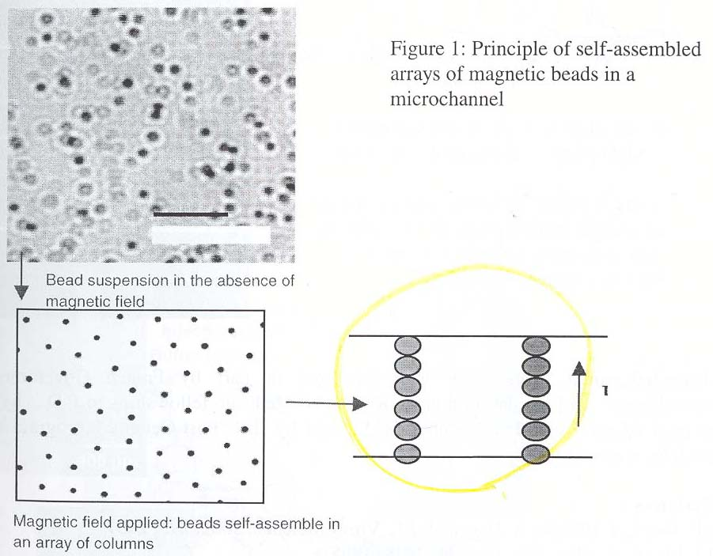
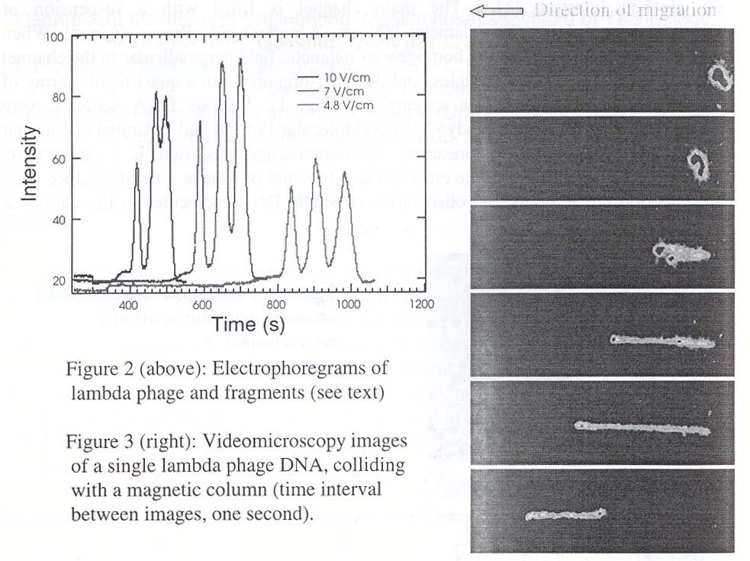
SELF-ASSEMBLED MAGNETIC COLLOIDS FOR DNA SEPARATIONS IN MICROFLUIDIC DEVICES
Patrick S. Doyle, Claus F_tterer, Nicolas Minc, C_cile Goubault, J_r_me Bibette and Jean-Louis Viovy

Slide 8
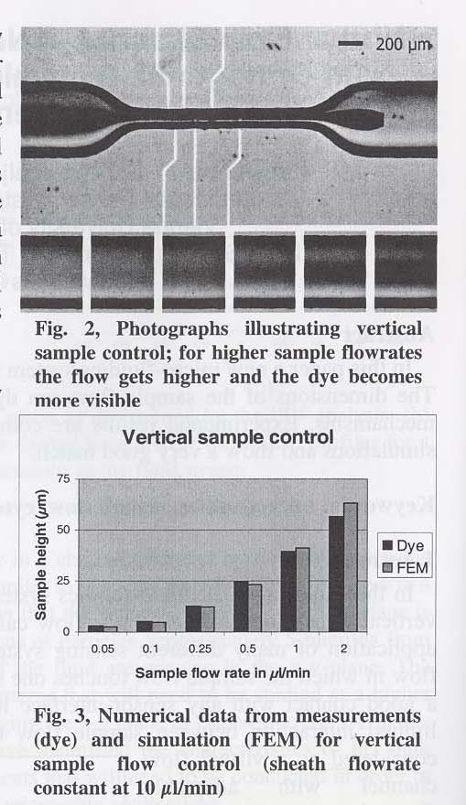
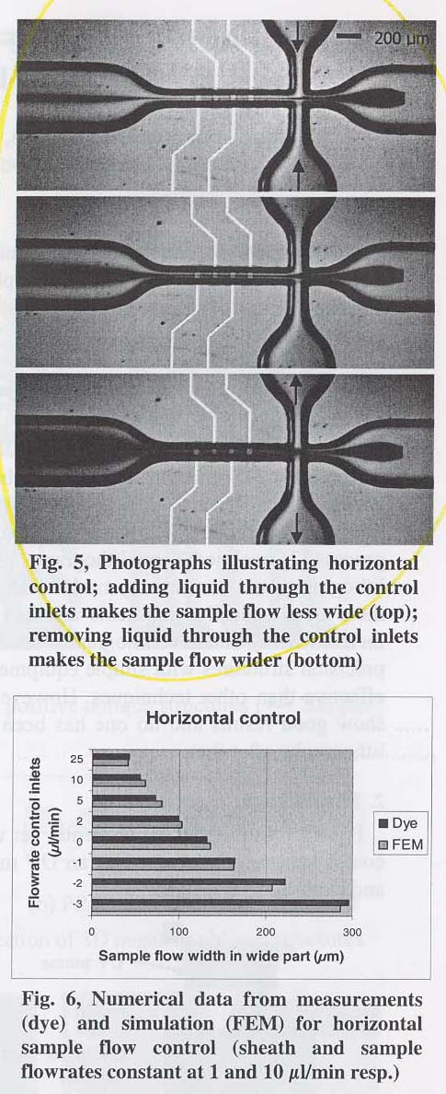
VIRTUAL FLOW CHANNEL: A NOVEL MICRO-FLUIDICS SYSTEM WITH ORTHOGONAL, DYNAMIC CONTROL OF SAMPLE FLOW DIMENSIONS J. H.
Nieuwenhuis, J. Bastermeijer, P. M. Sarro and M. J. Vellekoop

Slide 9
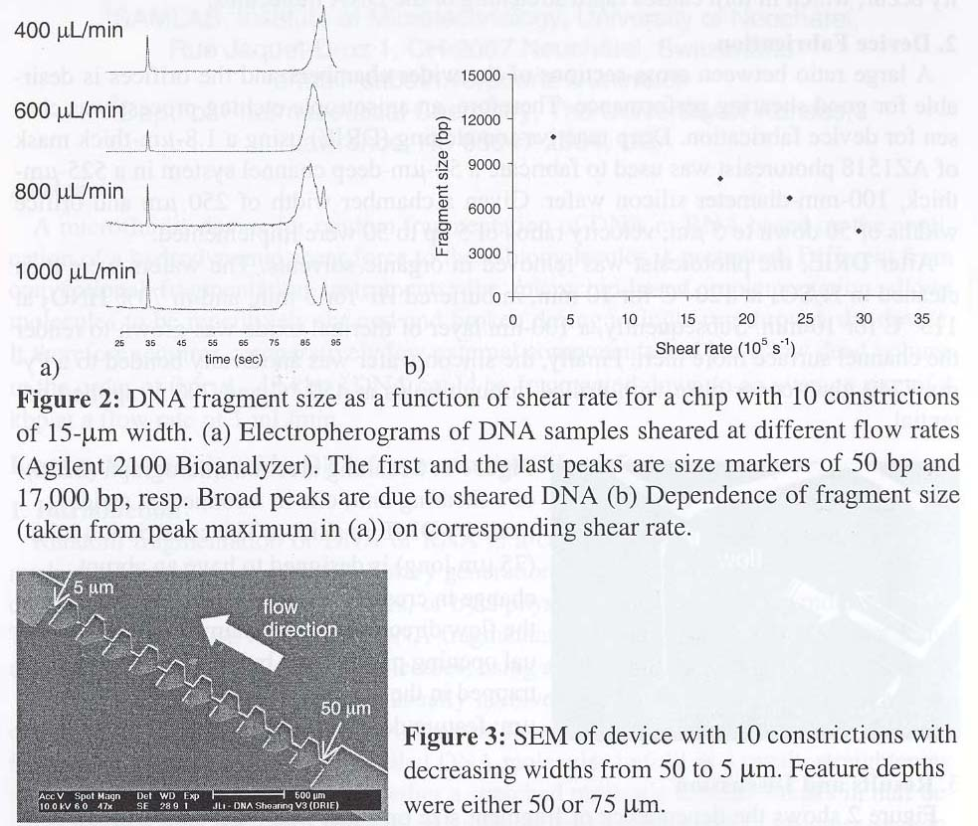
MICROFLUIDIC DEVICE FOR NUCLEIC ACID FRAGMENTATION BY SHEAR FORCE Jan Lichtenberg, Laura Ceriotti, Nathan A. Lacher, Susan M. Lunte, Nico F. de Rooij and Elisabeth Verpoorte

Slide 10
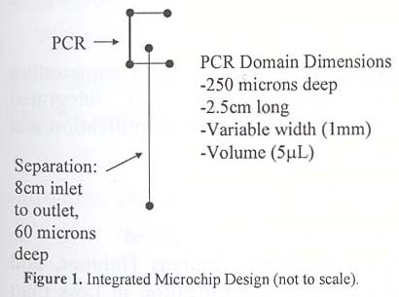
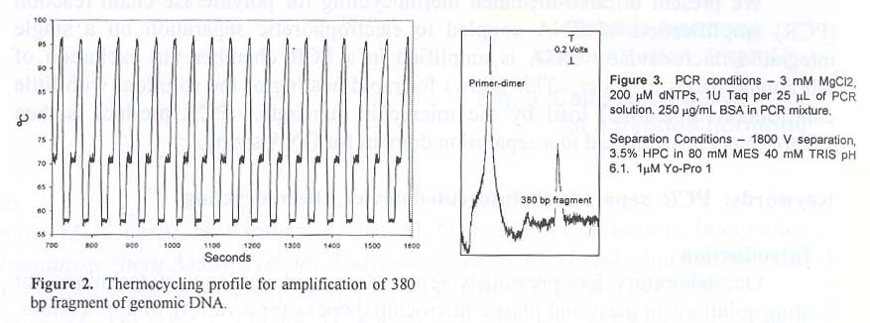
INFRARED-MEDIATED THERMOCYCLING FOR DNA AMPLIFICATION AND ELECTROPHORETIC SEPARATION ON AN INTEGRATED MICROCHIP DEVICE
Yien C. Kwok, Braden C. Giordano, Jerome P. Ferrance and James P. Landers

Slide 11
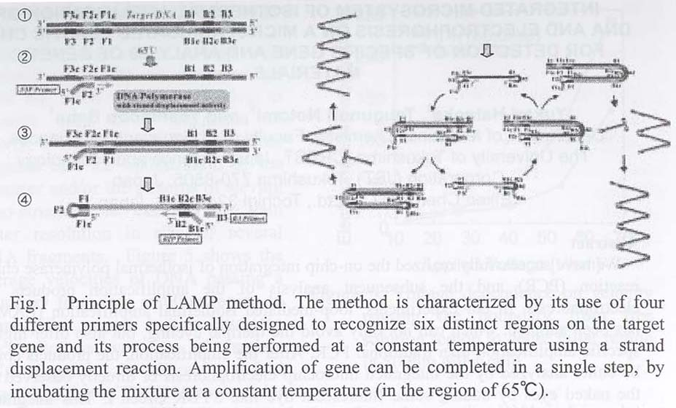
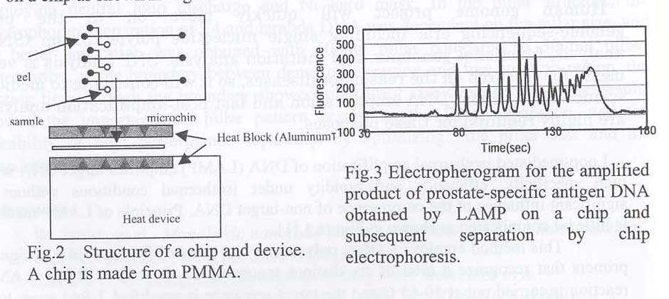
INTEGRATED MICROSYSTEM OF ISOTHERMAL AMPLIFICATION OF DNA AND ELECTROPHORESIS ON A MICROFABRICATED PLASTIC CHIP FOR DETECTION OF SPECIFIC GENE AND ANALYSIS OF GENETIC MATERIALS
Yukari Hataoka, Tsugunori Notomi and Yoshinobu Baba

Slide 12
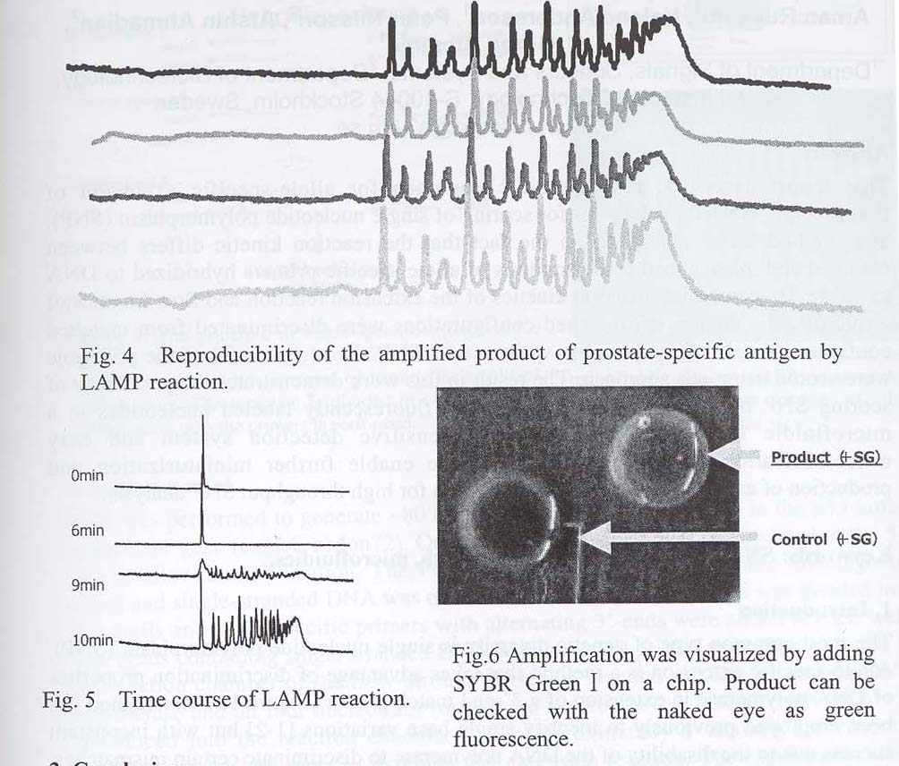

Slide 13
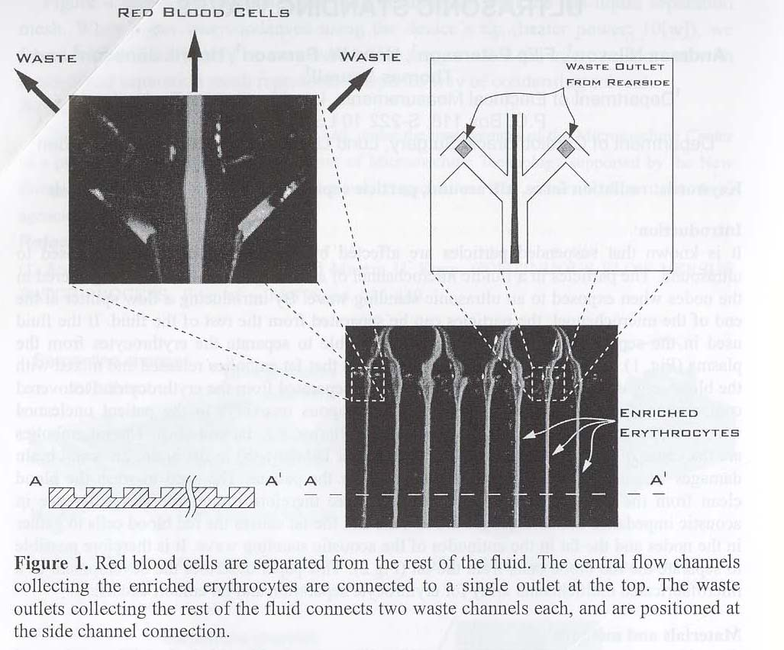
AUTOLOGOUS BLOOD RECOVERY AND WASH IN MICROFLUIDIC CHANNEL ARRAYS UTILIZING ULTRASONIC STANDING WAVES Andreas Nilsson,
Filip Petersson, Hans W. Persson, Henrik J_nsson and Thomas Laurell

Slide 14
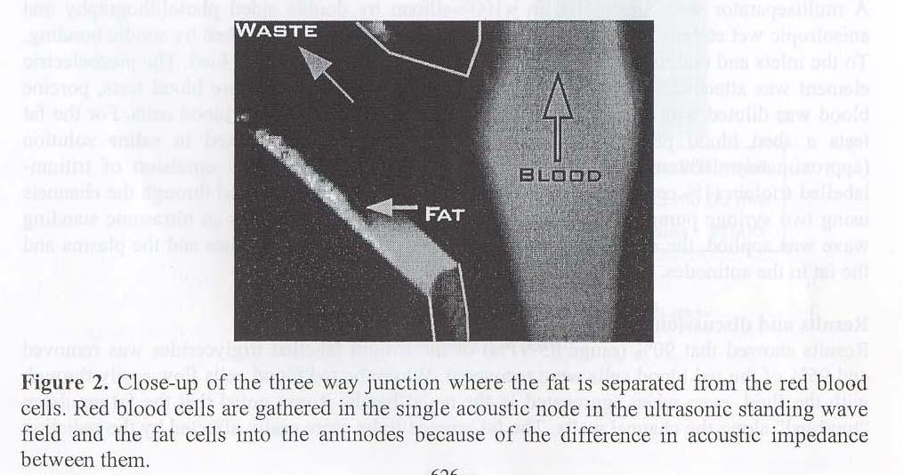

Slide 15
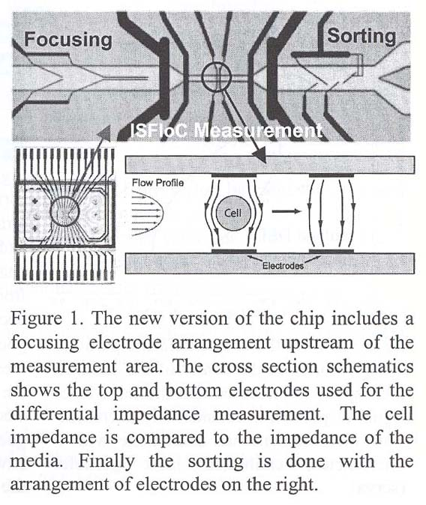
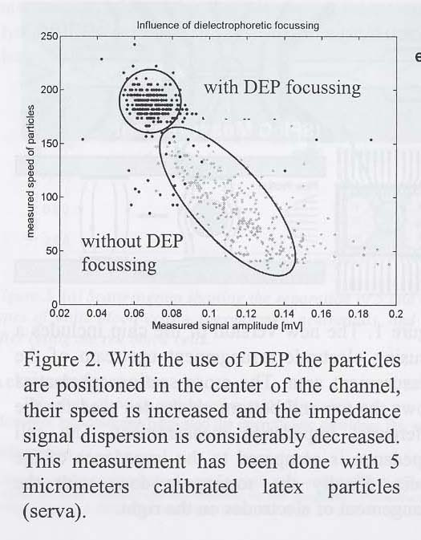
LEUKOCYTES DISCRIMINATION BY IMPEDANCE SPECTROSCOPY FLOW CYTOMETRY
Shady Gawad, Pascal Batard, Urban Seger, Stefan Metz and Philippe Renaud

Slide 16
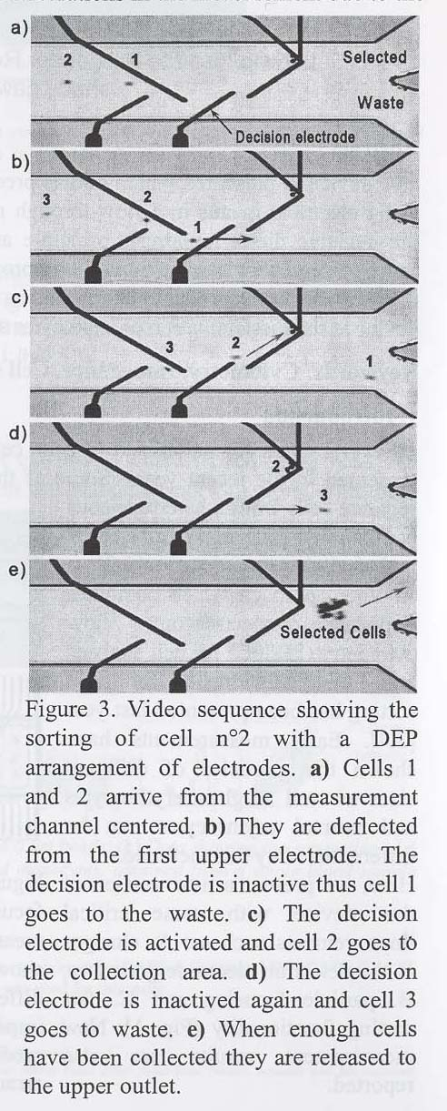
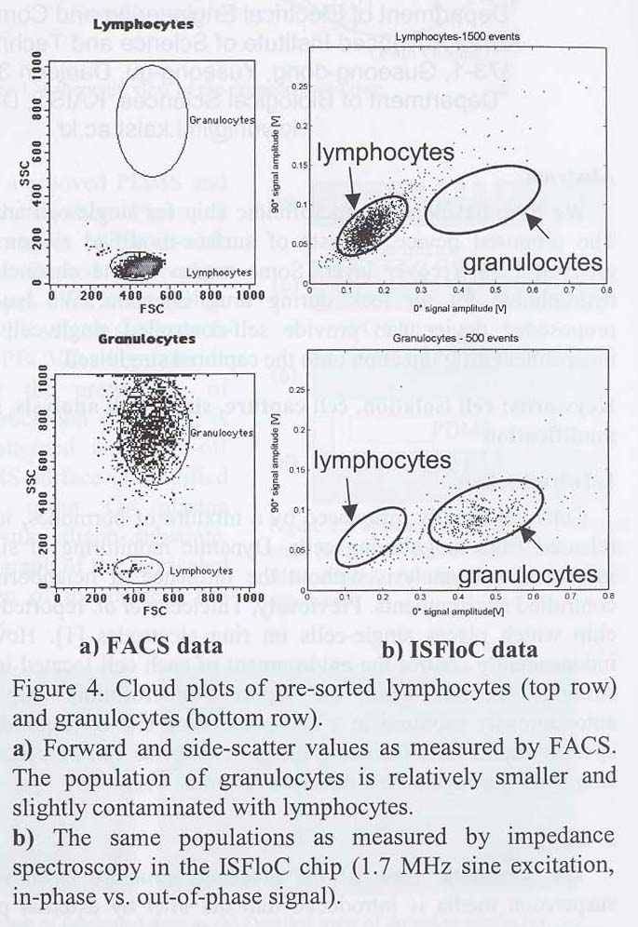

Slide 17
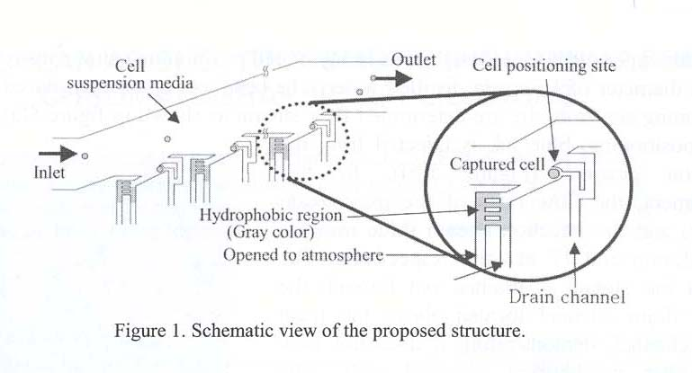
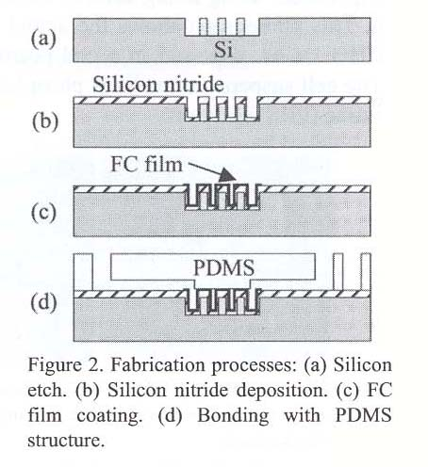
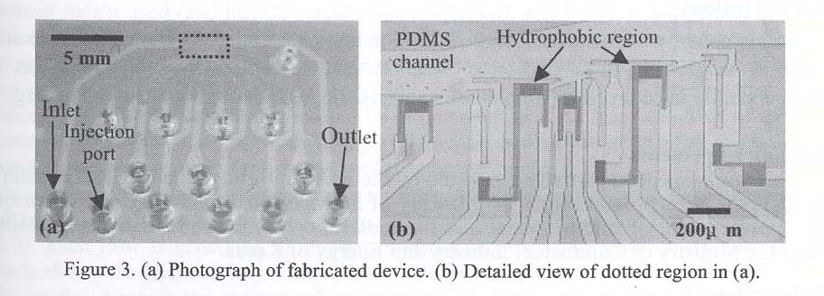
DESIGN AND FABRICATION OF MICRO/NANO-FLUIDIC CHIP PERFORMING SINGLE-CELL POSITIONING AND NANOLITER DRUG INJECTION FOR SINGLE-CELL ANALYSIS
Kwang-Seok Yun, Sang-Il Lee, Gyun Min Lee and Euisik Yoon

Slide 18
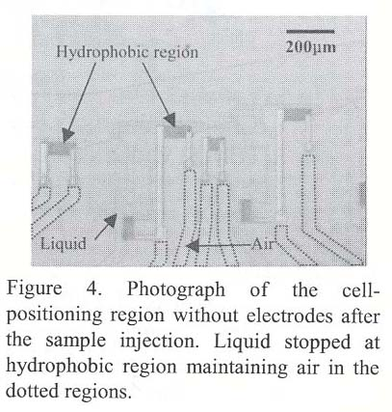
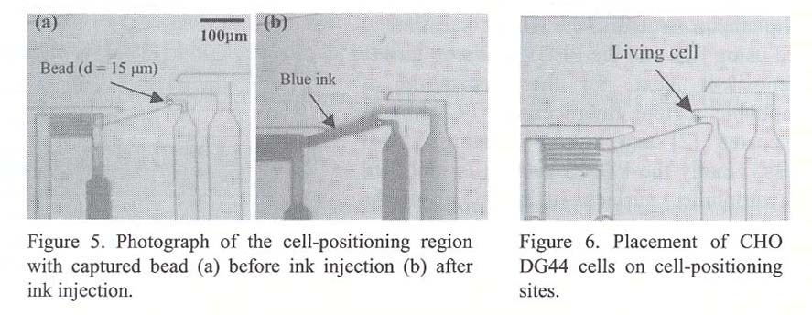

Slide 19
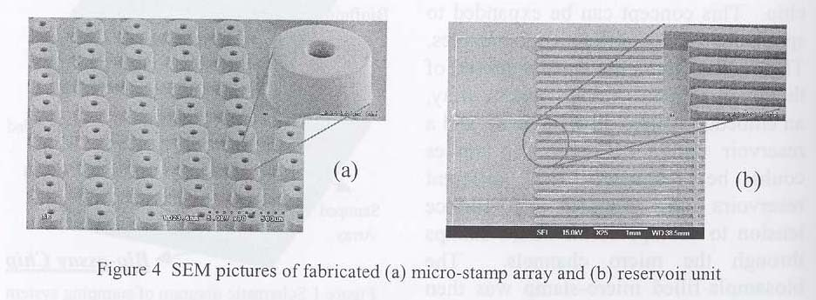
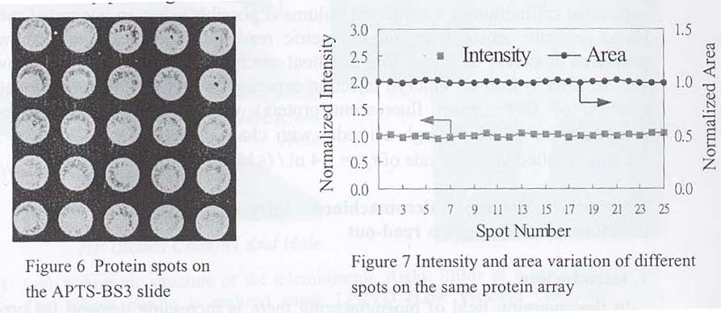
PROTEIN MICROARRAY PATTERNED BY A SURFACE-TENSION-DRIVEN STAMPING SYSTEM WITH DISCRETE DISPENSING CHANNELS
Shih-Chang Lin, Yi-Chin. Tsai, Fan-Gang Tseng, Haimei Huang and Ching-Chang Chieng

Slide 20
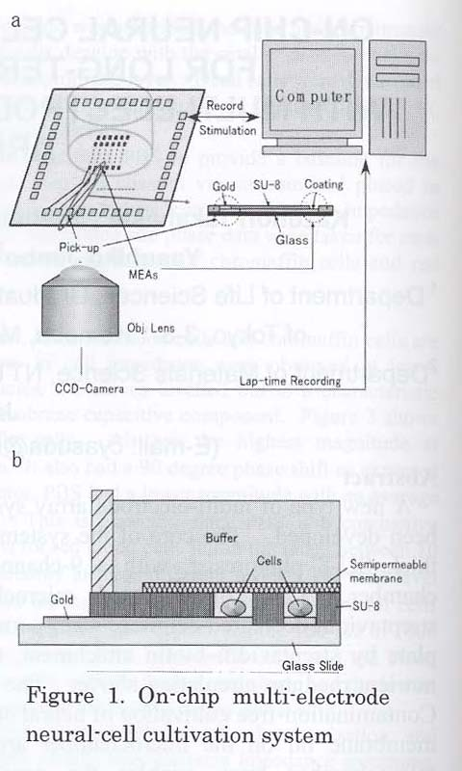
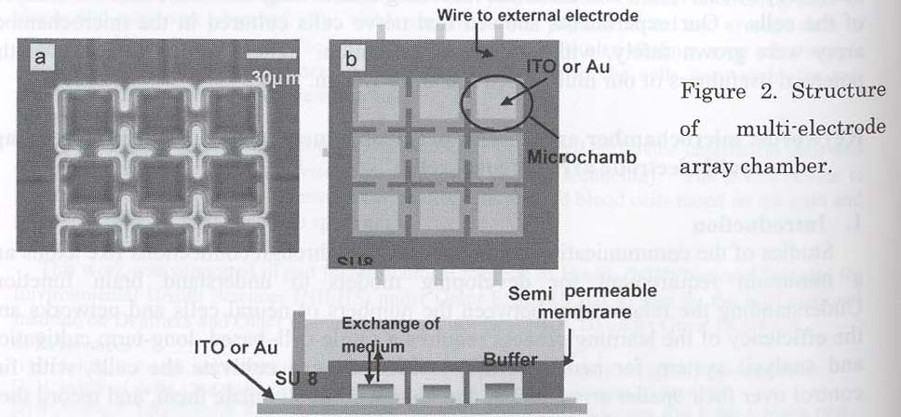
ON-CHIP NEURAL CELL CULTIVATION SYSTEM FOR
LONG-TERM OBSERVATION WITH MULTI ELECTRODE AND
MICRO-CHAMBER ARRAYS
Kazunori Takahashi, Yoshihiro Sugio, Hiroyuki Moriguchi, Yasuhiko Jimbo and Kenji Yasuda

Slide 21
