Slide 1
Locked Nucleic Acid
- Novel DNA Anolog
MEC Meeting
Hanyang University
Proteome Research Lab
2002. 12. 13
Park, Ji-Yoon

Slide 2
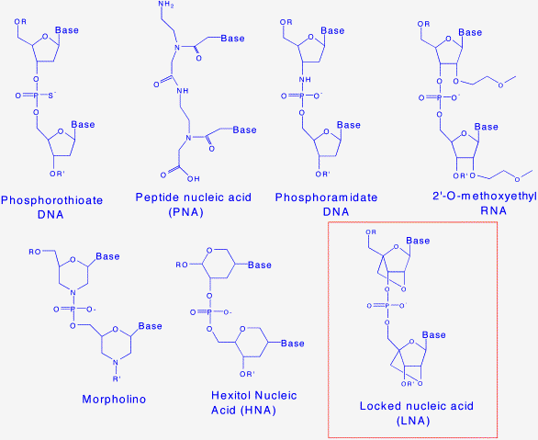
Nucleic Acid Analogs

Slide 3
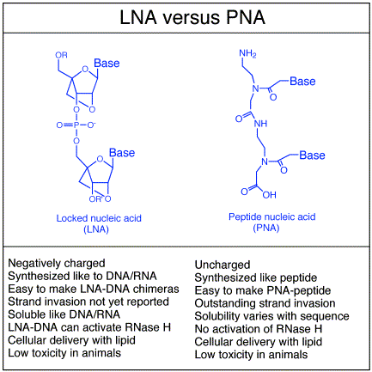
Comparison of LNA and PNA

Slide 4
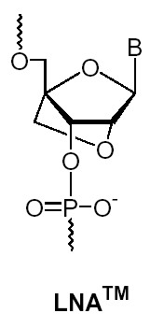
Locked DNA Analog(LNA)
Novel chemical DNA Anolog
Bicyclic nucleic acid
A ribonucleoside is linked between the 2’ oxygen and the 4’ carbon atoms with a methylene unit

Slide 5

General Properties
Base pairs with DNA and RNA
Obey standard WC base pairing rule
Exceptionally high thermal stability
Improved discrimination
Compatible with most enzymes
Predictable melting behaviour
Synthesis by standard phosphoramidite chemistry using DNA-synthesizers
mixed with DNA, RNA and other nucleic acid analogs
synthesized with e.g. aminolinkers, biotin, Cy dyes etc
water soluble(gel electrophoresis, ethanol precipitation)

Slide 6
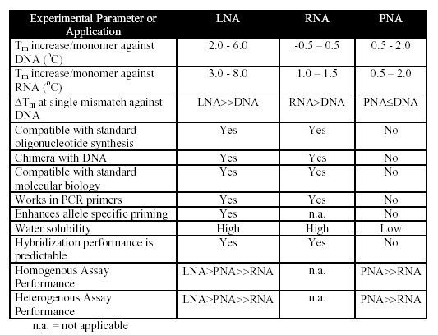
Experimental Parameters or Application

Slide 7
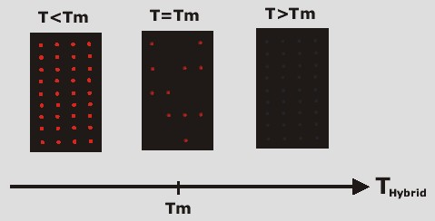
Melting Temperature( Tm )

Slide 8
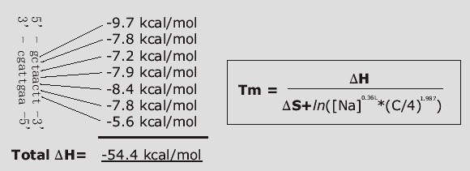
Nearest Neighbor Thermodynamics

Slide 9
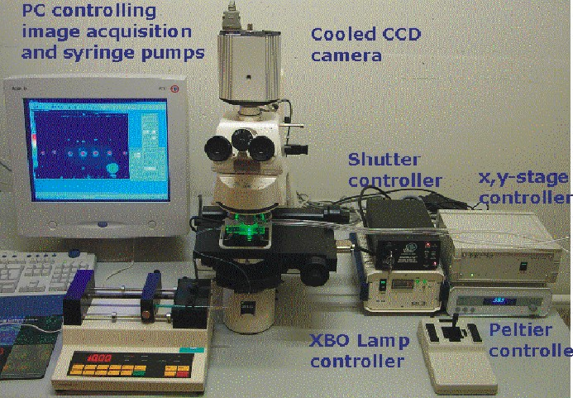
Fluorescence Microscope for generating Melting Curve
Fluorescence measurement in real-time PCR instrument
Decrease in fluorescence intensity from specific binding to ds DNA

Slide 10
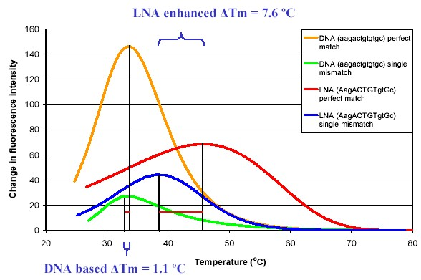
How LNA Substitution Increase ∆Tm

Slide 11
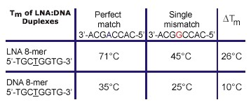
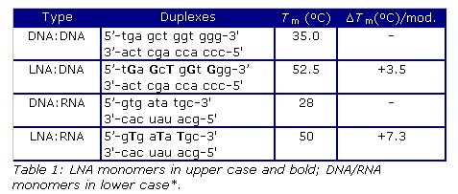
Comparison of LNA and DNA Stability

Slide 12
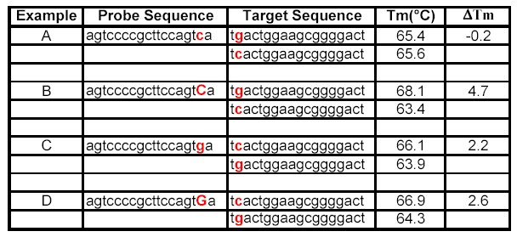
Effect of Single LNA Substitution

Slide 13
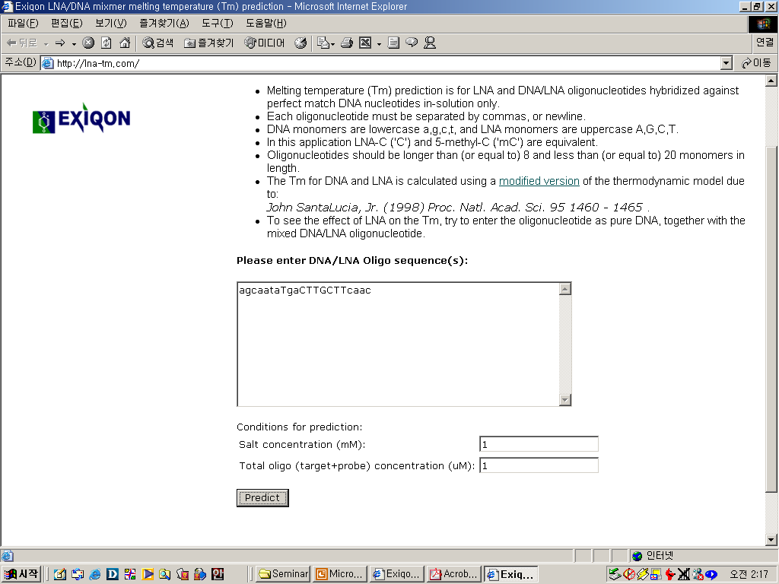
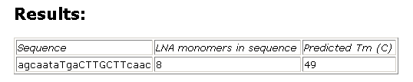
www.LNA-Tm.com

Slide 14
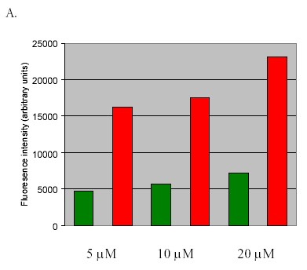
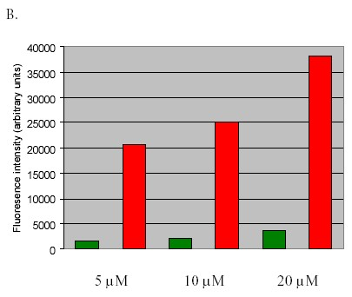
Sensitivity Test
LNA Capture Probes(50mer) vs DNA Capture Probe(50mer)
< Hybridization condition>
A) 65°C, in 3x SSC
B) Hybridization: 70°C, in 3x SSC

Slide 15
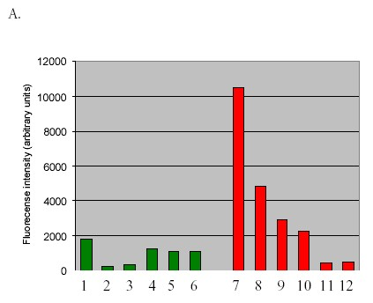
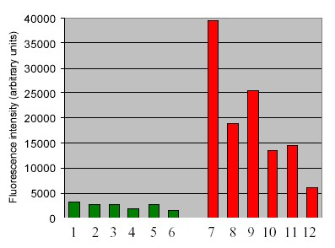
Specificity Test
LNA Capture Probes(40mer) vs DNA Capture Probe(40mer)
Hybridization condition: 65°C, in 3x SSC
- Perfect match: 1-7
- Mismatch: 2-8, 3-9, 4-10, 5-11, 6-12

Slide 16
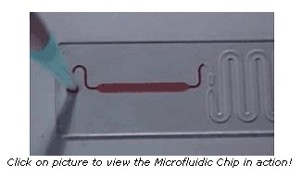
Microfluidic Chip in Action

