Slide 1
Lab-on-a-Chip
Seoul National University
Cell & Microbial Engineering Lab.
Jung Ah Kim

Slide 2
What is a Lab-On-a-Chip(LOC)?
미세 가공 및 조립기술을 이용하여 칩 위에 화학적 실험실구성
시료의 전처리과정, 화학적 분리 및 분석
  LOC의 구성요소
    미세유동(microfluidics)
    시료처리시스템
    분석및검출개요
    신호처리
    Control software
    화학센서

Slide 3
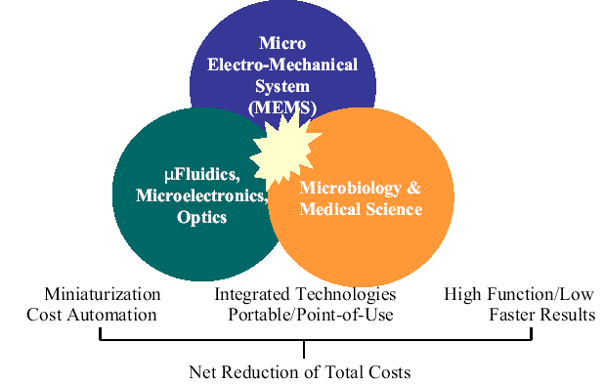
Technologies comprising LOCs

Slide 4
Advantages of LOCs
Ability to run multiple operation in parallel or in nonlaboratory setting
Exploitation of microfabrication and miniaturization technologies
Potential for integration of mechanics, electronics, and optics
Lower manufacturing costs for portable instruments
Conservation of reagents
Lower operating and maintenance costs
Lower power consumption for instrumentation
Ability to integrate several analytical system into very small areas

Slide 5
The Challenge of LOCs
Microfluidics : active pumping for sophisticated LOCs
Microseparations : samples such as blood and urine absolutely require some type of separation
Optoelectronics and integrated optics : fast, versatile optical sensing
Plastic micromachining
Packaging : combination of mechanical, optical, and electronical LOCs require advanced packaging strategies, formats, and materials
Biocompatability
Control and communication : for repeatability, synchronization between reagent mixing, separations, and analysis
Integration: putting all the above components for compact, reliable, and self-sustaining

Slide 6
Disadvantage Of LOCs And Barriers To Commercialization
전기적 연결은 package의 크기를 증가시킨다.
미세 유동에서 유체의 특성은 유동방식을 제한한다.
매체가 액체로 제한된다.
기존의 기구보다 유연성이 떨어진다.
Difficult to problem-shoot erroneous results
  시료의전처리
  미세조립
  결과검출
  미세유동

Slide 7
Mechanical And Process Issues For LOCs
Sample-tacking : get a very small homogeneous sample into a very small instrument
Adding of mixing reagents : multiple chambers on the structure containing reagents for separation or detection
Incubation :a cavity that remains undisturbed during analysis, chemical association, or synthesis
Fluid dynamics and bubbles : in micro scale fluid handling bubble and surface tension are very important
Separation steps : chromatography and electrophoresis are the principle analytical tools of biochemists and chemists
Detection : magnetics, electrochemistry, electrical, and optical detection method

Slide 8
Performance Requirements
LOC은 분석 한계면에서 기존의 기구보다 월등해야 한다.
시약과 분석물 보관 및 반응이 일어날 공간필요
분석 시간의 측면에서 기존의 기구보다 빨라야 한다
사용자가 최대한 진행과정을 볼 수 있어야 한다
시료로 부터 필요한 정보를 얻기 위해서 여러 기능을가지고 있어야 한다.

Slide 9
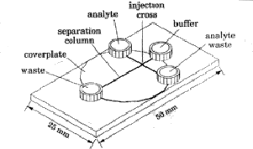
Electrophoresis LOCs –Biochemical Analysis
Capillary Channels, reactors, flasks 등을 식각한 유리판이용
전기장을 이용하여 유체의 흐름 유도(electroosmosis)
Capillaries를 지나는 물질은 형광물질을 통해 관측
채널은 표준 사진공정과 습식 식각 방식을 이용
Electroosmosis를 이용하여 pump, valve, and nozzle 없이 유동제어–전위차를 이용하여 유동제어

Slide 10
Polymerase Chain Reaction on a Silicon Microstructure
Polymerase chain reaction(PCR)
    Identify genes by amplifying portions of genetic material
    Analyze using standard electrophoresis
    용도: forensic medicine, medical diagnostics, genetic screening, and biomedical research
    Elaborate temperature-cycling regime필요
    개선방향: packaging, sample preparation, and sample transfer

Slide 11
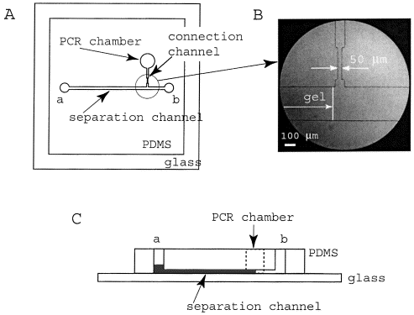
Design of the PDMS-glass hybrid microchip for PCR and CGE
( J.W.Hong et al, Electroporesis, 22,328-333 (2001))

Slide 12
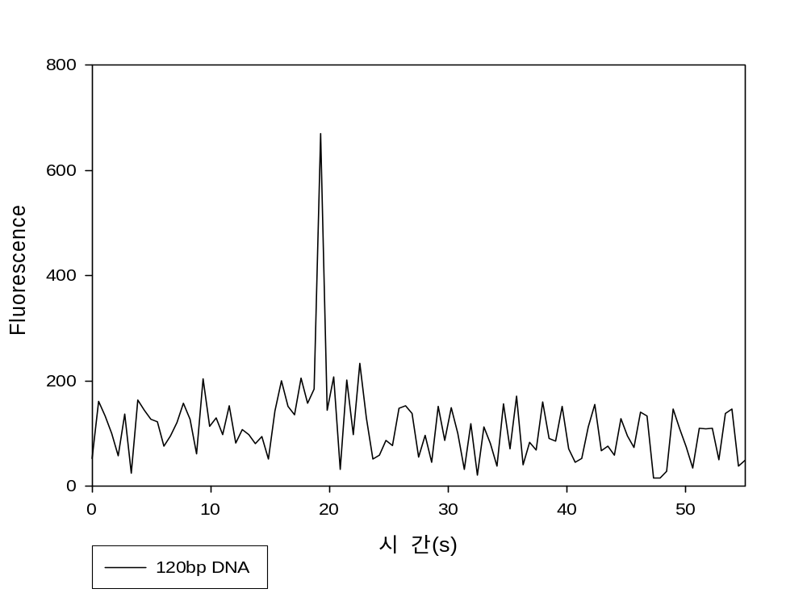
Agarose Gel electrophoresis on Chip

Slide 13
Layout of the PDMS chip for CGE
8.5mmm,
9mm
4mm,
25mm
Detection
point
3.5mm
5mm
45°

Slide 14
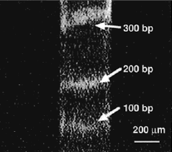
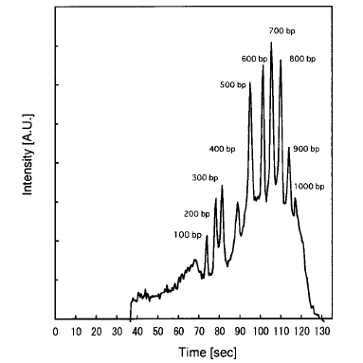
CCD Images & Electropherogram of the 100bp DNA ladder

Slide 15
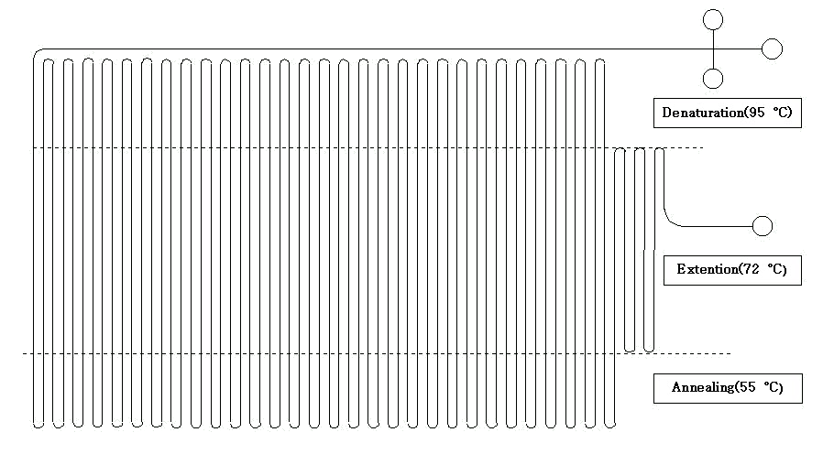
Continuous Flow PCR

