Slide 1
A DNA-based in vitro Genetic Program
J.A. Rose, M. Hagiya, R.J. Deaton, A. Suyama
Journal of Biological Physics, 2002

Slide 2
Introduction
PWPCR
  PNA-mediated Whiplash PCR
  Autonomous, parallel execution of a set of finite state machines
Generate and Search Strategy
  Limited by the exponential size of the solution space
→Combination with Evolutionary Strategy
→Evolutionary PWPCR (EWPCR) to evolve approximate solutions to HPP

Slide 3
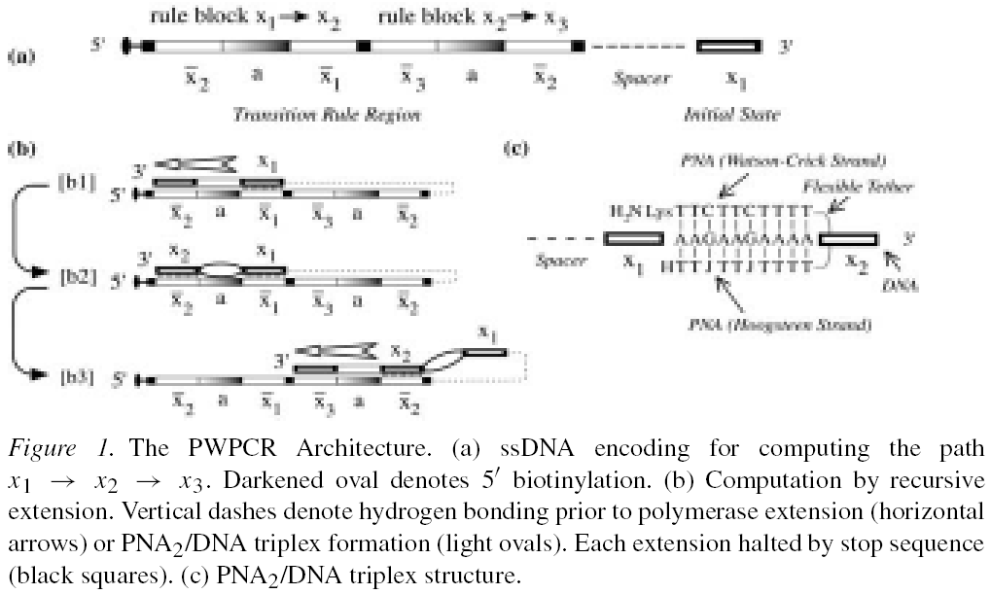
PNA-Mediated Whiplash PCR
Reduce Back-Hybridization!

Slide 4
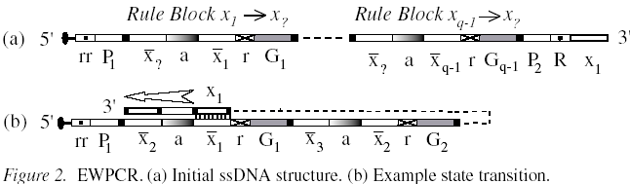
A PWPCR-based in vitro Genetic Program for HPP
Vertex→state, Edge→state transition
r: restriction site BseDI(C↓CTTGG)
G_{i}: block’s initial state and relative order from the 5’ end
P₁, P₂: primer for PCR
rr: restriction site SnaBI(T↓ACGTA) for 5’ de-biotinylation
R: restriction site EcoRV(GAT↓ATC) for 3’ tail detachment

Slide 5
EWPCR
Initialization
Fitness Evaluation
Selection
Recombination
Re-Initialization

Slide 6
Initialization
Combinatorial incomplete mixture of rule blocks.

Slide 7
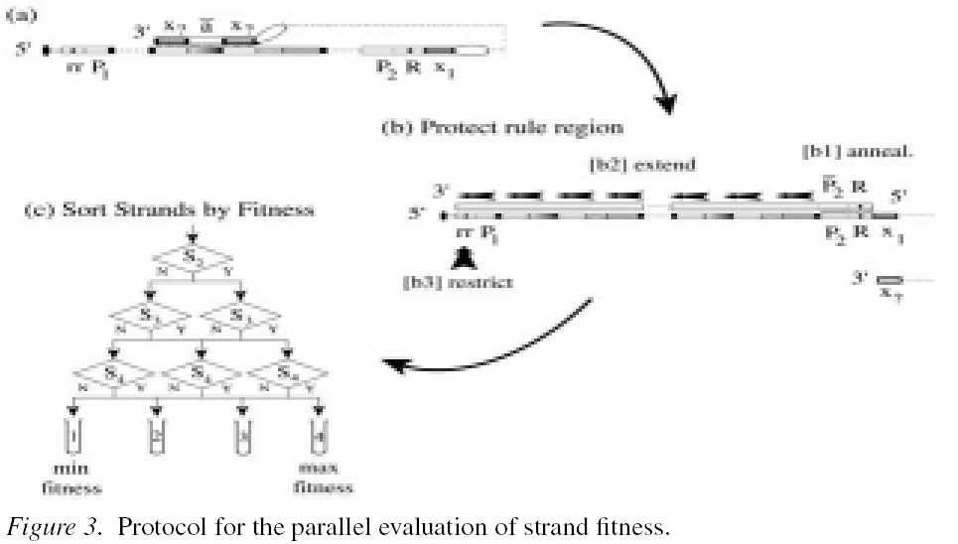
Fitness Evaluation
Eleminate haripin structure
Prevent unexpected annealing
Genereate a restriction site at rr
T₁
T_{q}
q-1 affinity separation
If T_{q} is nonempty or if T_{q} is empty and g_{max} then terminate and assign yes/no

Slide 8
Selection
Fitness-squared-proportional selection
  Restriction of all strands at R
    Remove 3’ tail
  For each tube T_{f}
    PCR amplified
      •-rrP_{1,} and RP’₂ (•- : biotinylation)
    V_{f} = n₀f²/C_{f}b is merged to form new tube T_{s}
      b = sum of all f²
      C_{f} = concentration of tube T_{f}
  Reanchored, denatured and washed

Slide 9
Recombination
T_{s} is divided into T_{c} and T_{c’}
  With volume V_{c} = p_{c}V_{s} and V_{c’} = V_{s}-V_{c’}
  P_{c} → crossover probability
  T_{c} → recombination
  T_{c’} bypass recombination
T_{c} is divided into q-1 tubes of equal volume
  T_{j}: j = 1~q-1
  Uniform-length, single point, two-parent crossover at rule block i=j
  Primer extension by primer G_{j’}
  Restriction and Recombination

Slide 10
