Slide 1
H-Measure & Similarity
2003. 4. 3
Weekly MEC Seminar
In-Hee Lee

Slide 2

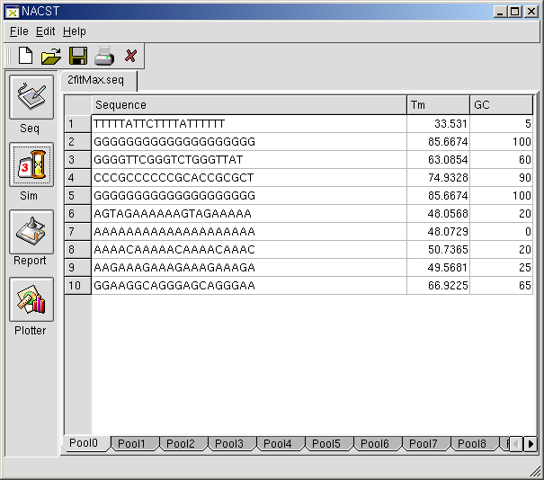
Motivation
Optimizing only 2 objectives
  To compare with EDA
  Odd sequences were generated.

Slide 3
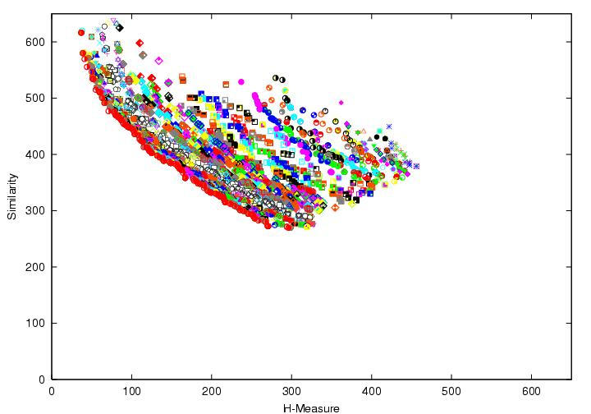
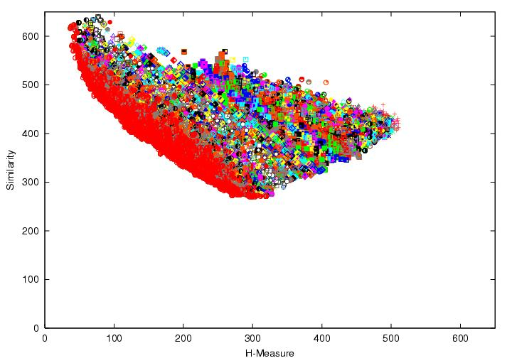
Several experiments: optimizing both objectives
With controlled elitism
1st fronts
 | A | B | C | D
Front Ratio (%) | 27.103 | 2.381 | 0 | 80.723
Distribution (std.) | 3.3996 | 2.968 | 5.1364 | 2.959
Whole populations

Slide 4
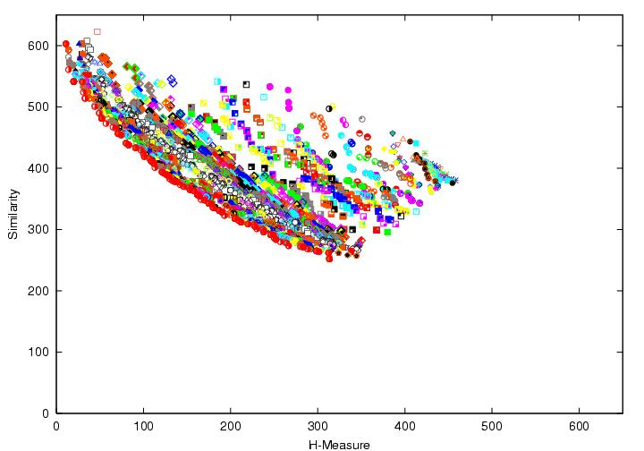
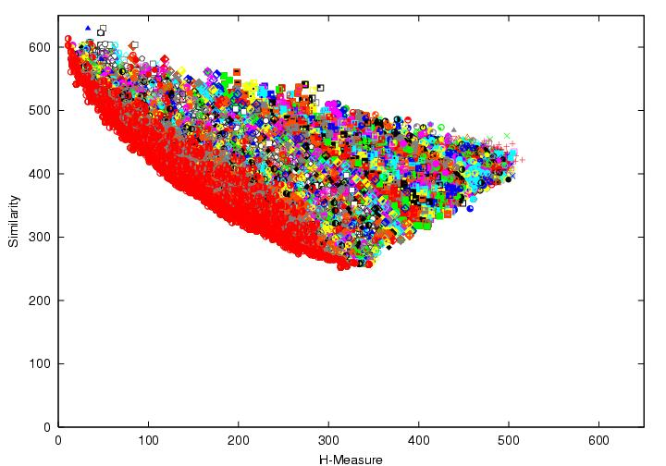
Several experiments: optimizing both objectives
Using original NSGA-II
1st fronts
 | A | B | C | D | E
Front Ratio (%) | 34.831 | 0 | 49.02 | 34.94 | 8.3333
Distribution (std.) | 4.4656 | 4.6171 | 9.369 | 3.8331 | 5.7049
Whole populations

Slide 5
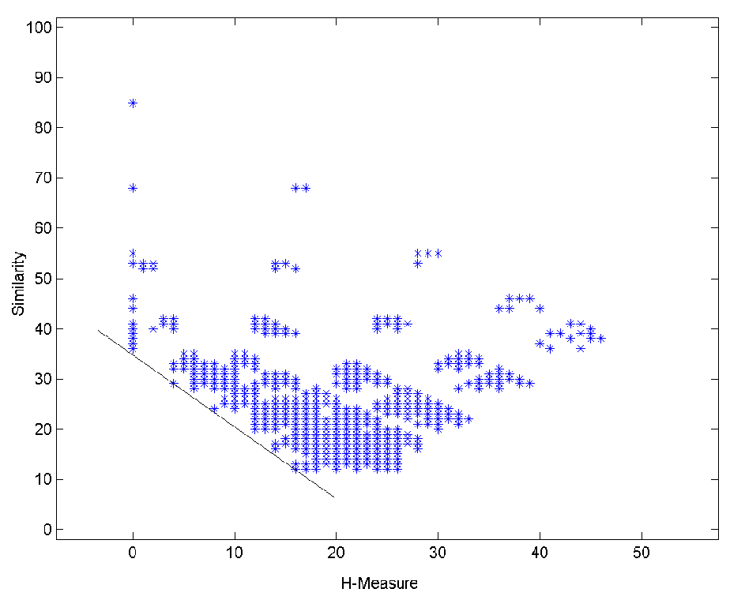
Adjusting Reduction Rate (r)
So far, we set it as 0.65
  As suggested in the original paper.
  Should be reduced
    Discreteness of
    fitness space
5 experiments
  r=0.1 to 0.5

Slide 6
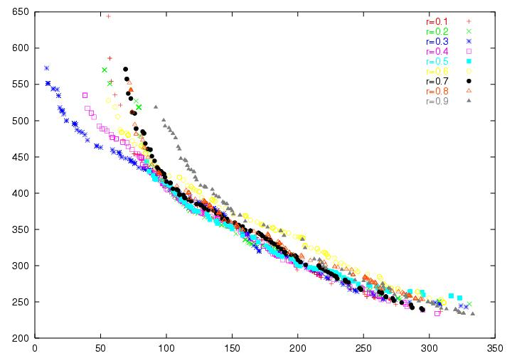
Adjusting Reduction Rate (r)

Slide 7
Adjusting Reduction Rate (r)
R | Front Ratio (%) | Distribution (std.)
0.1 | 24.359 | 9.2002
0.2 | 28.736 | 6.5723
0.3 | 39.423 | 3.7129
0.4 | 18.584 | 2.9656
0.5 | 11.842 | 3.3106
0.6 | 0 | 3.6303
0.7 | 2.1053 | 3.9232
0.8 | 0 | 4.3784
0.9 | 1.4493 | 3.9363

Slide 8
Adjusting Reduction Rate (r)
Almost similar results
When r=0.3 & 0.4, showed best spread and coverage.
  Convergence was similar for all settings.
  Minor difference was shown at the extreme trade-off solutions.

Slide 9
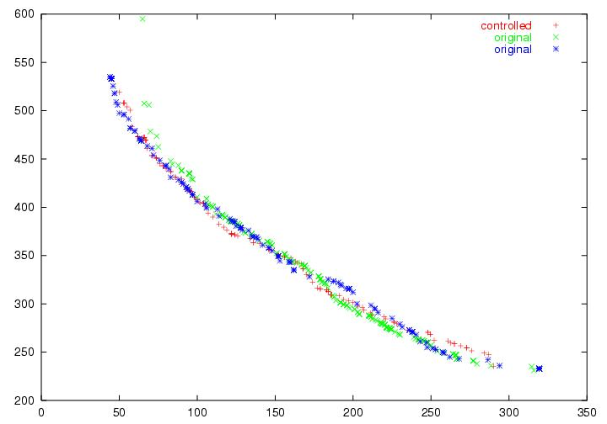
Original NSGA-II vs. Controlled Elitism
r=0.65
 | Front Ratio (%) | Distribution (std.)
Controlled | 42.196 | 2.959
Original (G) | 40.196 | 9.369
Original (B) | 44.578 | 3.8331

Slide 10
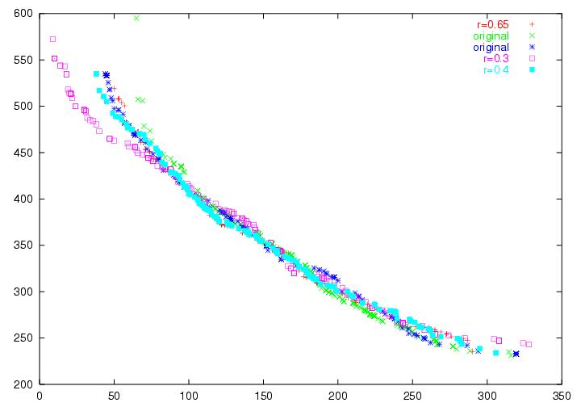
Original NSGA-II vs. Controlled Elitism
 | Front Ratio (%) | Distribution (std.)
Original (G) | 36.275 | 9.369
Original (B) | 22.892 | 3.8331
R=0.3 | 33.654 | 3.7129
R=0.4 | 15.044 | 2.9656
R=0.65 | 32.53 | 2.959

Slide 11
Original NSGA-II vs. Controlled Elitism
Overall convergence is similar in most cases.
  Especially, when r=0.3.
Do we really need controlled elitism?
  Needs more experiments.

Slide 12
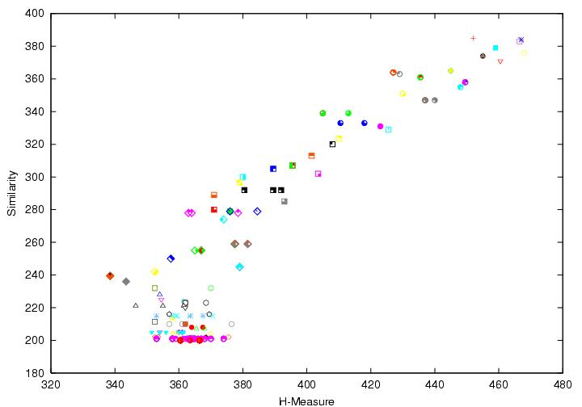
Similarity Bound
In most cases, we could not make similarity lower than 200.

Slide 13
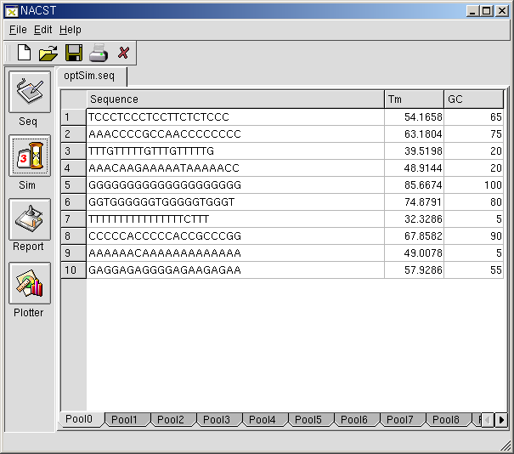
Similarity Bound
Similarity is defined as sum of pairs.
  Similarity value of each pair was 30~40.
  Only two sequence is very similar to each other.

