Slide 1
A proposal of DNA computing on beads and its application to
SAT problems
Takenaka Yoichi and Hashimoto Akihiro
September 7, 2001
Park, Ji-Yoon

Slide 2
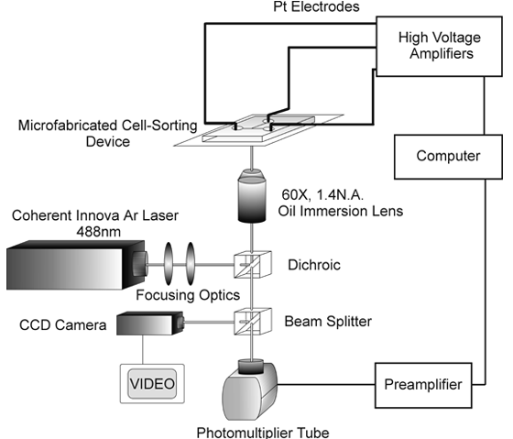
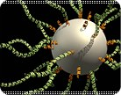
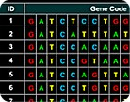
Abstract
A new approach to the DNA computing with using tiny beads
Each bead represents one of the candidate solutions
Use competitive hybridization for the calculation
Extract the solution by FACS

Slide 3
DNA Computing on Beads
Create beads so that they consist the whole problem space
Make all the co-candidates that are labeled with a fluorophore. * candidate; DNA strands that encode candidate solutions * co-candidate; complementary strands of candidates
For each constraint of the problem, make co-candidates that don’t satisfy the constraint and label them with an other fluorophore
Hybridize competitively the co-candidates to the beads
Extract beads by FACS(fluorescence-activated cell sorter)
Read out the strands

Slide 4
For SAT instance
(w∨ x ∨ y ∨z) ∧ (¬ w ∨ ¬ y ∨z) ∧ (¬ x ∨ y) ∧ (¬ w ∨z)
1. Create 2⁴ kinds of beads.
2. Make the complementary strands of the entire candidate, amplify them by PCR, label them with Cy5
3. Make the complementary strands of candidates that don’t satisfy the clause, label them with R110
4. Hybridize competitively the strands made in 2nd and 3rd steps to the strands on the beads (True: only Cy5)
5. Extract the beads labeled only with Cy5 by FACS
6. Read out the solution

Slide 5
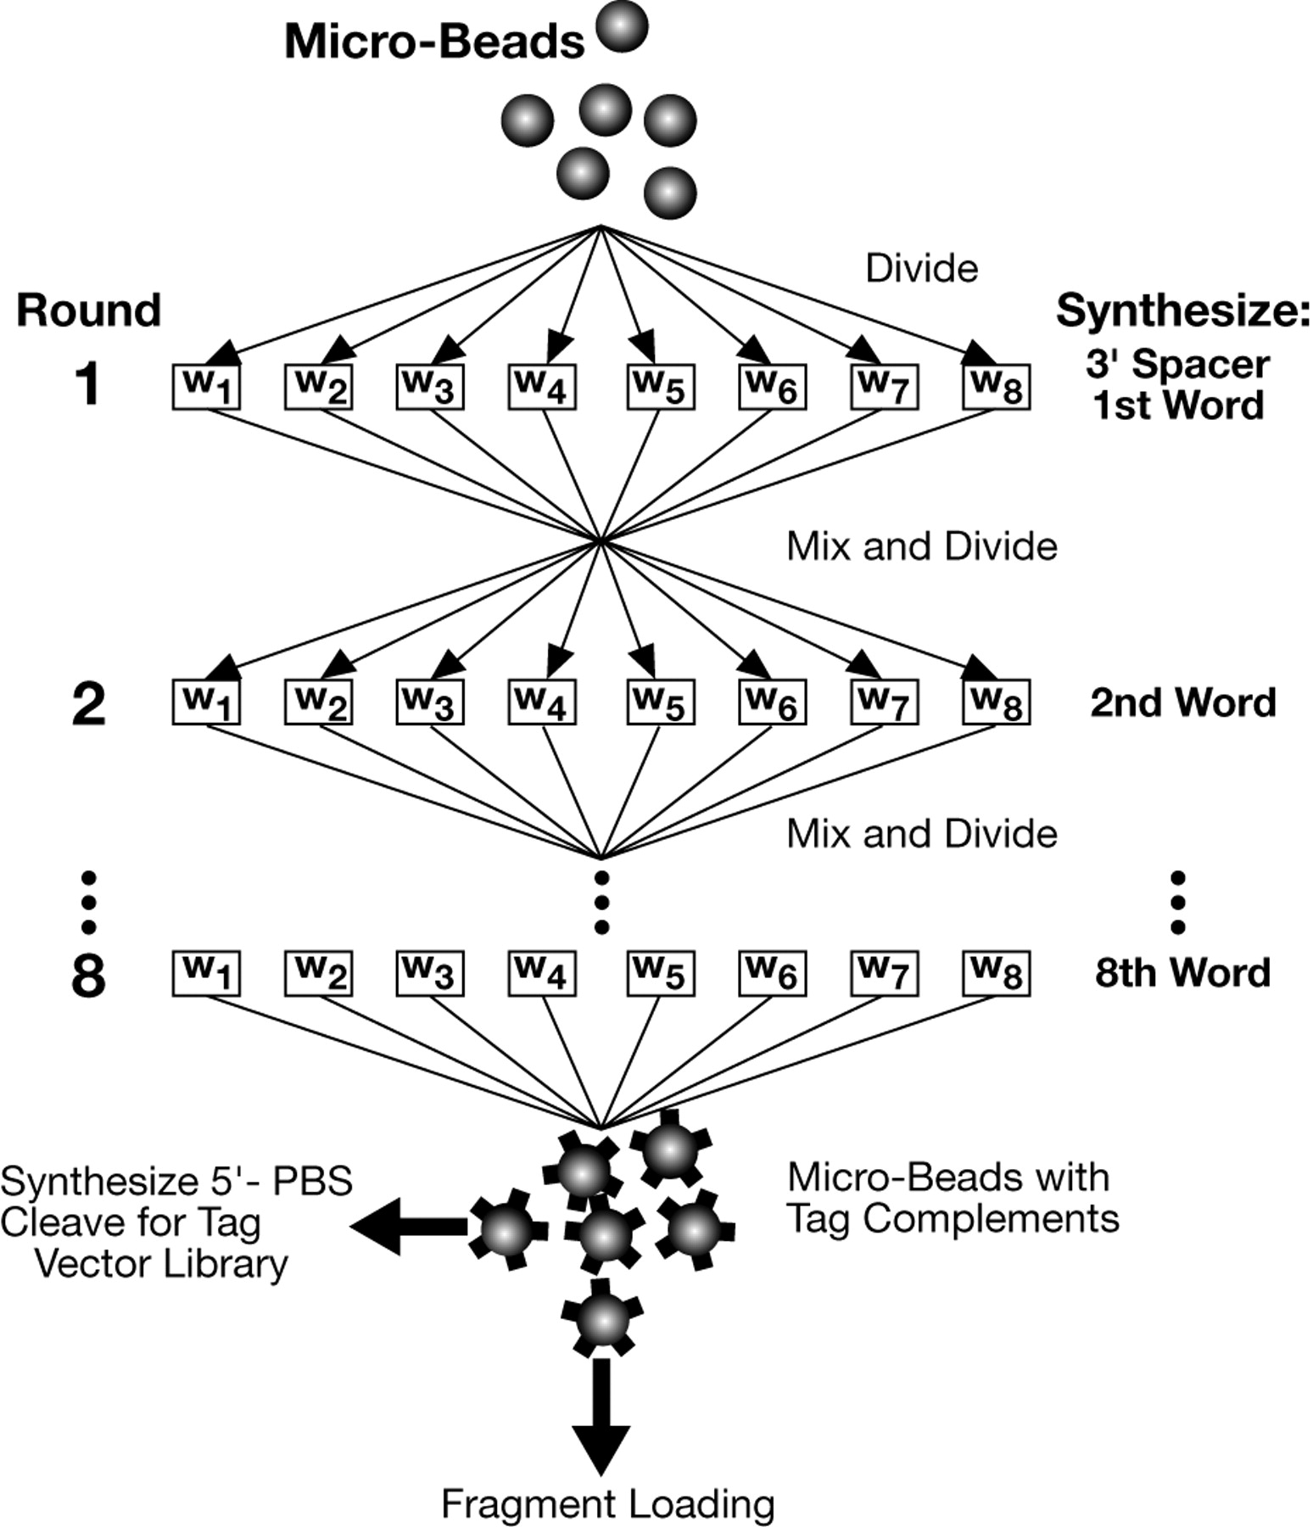
Fig 2. Tags were synthesized by eight rounds of combinatorial synthesis

Slide 6
Principle of the Method
Each nucleic acid molecule in a complex mixture first is labeled with an oligonucleotide tag, after which a simple of the resulting library of tag–molecule conjugates is amplified.
After amplification, a sample of n molecules will yield a library containing n families of clones, each identified by a unique tag.
Nucleic acid seqs used as tags and anti-tags maximize the efficiency and discrimination of hybridization of a given clone to a given microbead

Slide 7
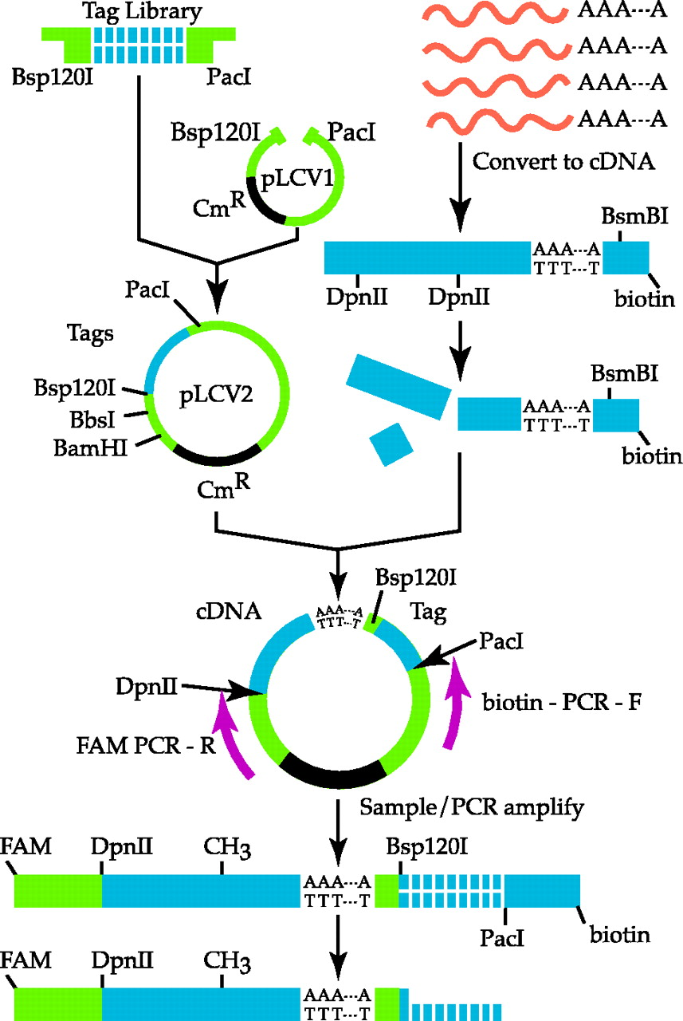

Slide 8
Design the repertoire of Tags
i) repertoire must be diverse enough to enable the unique tagging of all the molecules in large libraries
ii) tags must remain physically attached to the tagged molecules after operations such as cleavage by restriction enzymes
iii) the Tm of all tag/anti-tag duplexes must be isothermal
iv) the difference in Tm between any perfectly matched tag/anti-tag duplex and any duplex with a single mismatch must be both the same for all seq and large enough to discriminate strongly in favor of the perfect matchy
v) a practical and effective manner must exist to enable construction
vi) there must be a simple way of applying the method

Slide 9
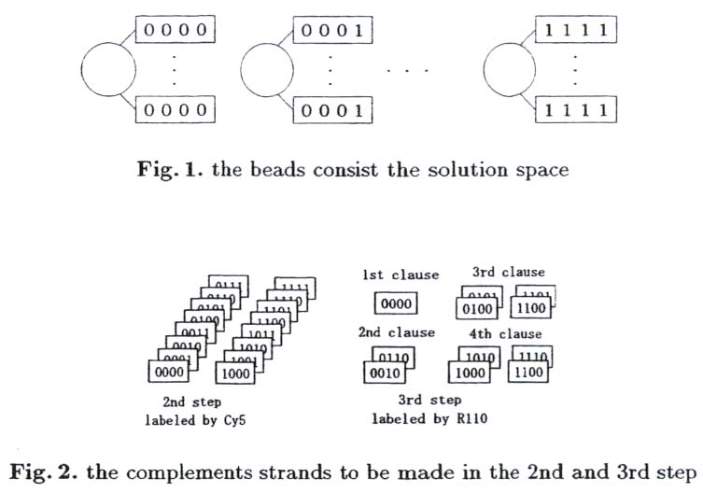

Slide 10
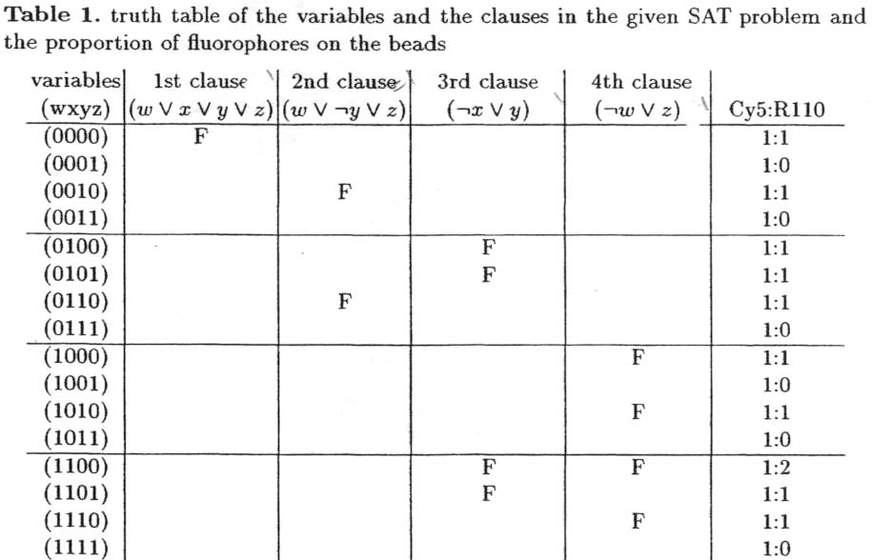

Slide 11
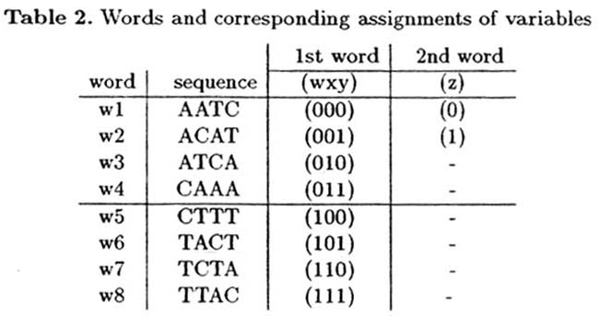

Slide 12
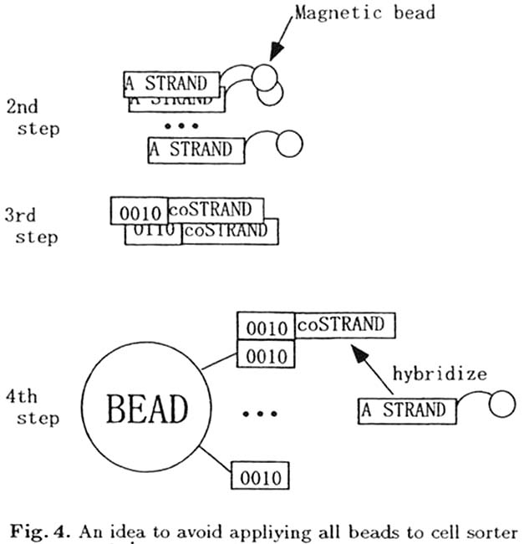

Slide 13
Benefit of Megaclone™
Substantially all the different DNA molecules present in a sample are represented in the final micro-bead collection
These million or more DNA molecules can be analyzed simultaneously in various applications
The need for storing and handling millions of individual DNA clones is eliminated

Slide 14
Advantages of MPSS™
Sequences DNA molecules on as many as one million or more Megaclone beads simultaneously
Eliminate the need for individual sequencing reactions and gels
Identify each of the DNA molecules by a unique 16-20 base signature sequence
Produces a comprehensive quantitative profile of gene expression in cells or tissues of interest
Identify even the rarest expressed genes

Slide 15
Discussion & Conclusions
Advantages
1. Solve MAX-SAT problems which belongs APX-complete
- distingush “no solution” , or no assignment to satisfy all the clauses
2. Easy to extract the solution and to read out the DNA seq by FACS and MPSS
Disadvantages
1. Needs larger volume than other DNA computing
more sensitive to the physically limitation of the volume
the loss in parallelism
2. Cell sorter selects the beads sequentially, not in parallel.
Approach to DNA computing on beads through SAT
Solve up to 24 variables with Megaclone and MPSS

