Slide 1
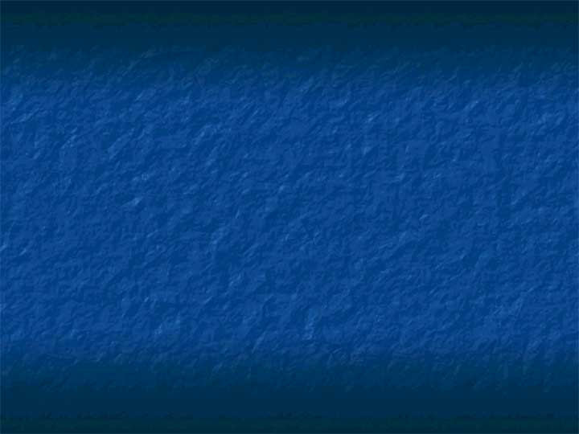
Self-Assembling DNA Graphs
2002. 7. 5
Summarized by Park, Ji - Yoon

Slide 2
Introduction
A variety of computational models
  Based on DNA properties & WC complementarity
  The inherent three dimensional structure of DNA & self-assembly
    DNA tiles(double & triple cross-over molecules)
    Branched junction, graph-like DNA structure
      - Splicing of tree like structure(junction & graph-like DNA)
    - these model are yet to be confirmed experimentally
In this paper…
  The experimental design & construction of a non-regular graph by vertics and edges
  A graph(5 vertices, 8 edges) for self-assembly
  Vertex-edge specific sticky ends & WC complementarity

Slide 3
The 5 vertices
  3-armed junction for v1, v3, v4, v5
  4-armed junction for v2
  The sticky ends were designed ….
  - hybridize & ligate to form the graph structure
6 DNA strands
  in construction of each edge connects two vertices
  The distances between the vertices
  * e1= {v1,v2}; e2={v2,v3}; e5={v3,v4}; e8={v5,v1} » 4 helical turns(42 bp)
  To attain desired flexibility the other distance were longer
  * edges e3= {v2,v5}; e4={v2,v4}; e7={v3,v5} » 6 helical turns (63 bp)
  * e6= {v1,v4} » 8 helical turns(84 bp)
  e3, e4, e6, e7(long edge molecules)
    An additional hairpin of one & a half helical turn in the middle of the molecule
    The 3-junction of the hairpins; bulges of T’s at each turn(Fig.4, Fig 5)
    Shorter edges - Sticky ends: 6 base
    Longer edges – 8 base
  More detail analysis; a unique restriction site into the sequence of each edge
  Long edge/ restriction site incluede in the sequence of the hairpin
The sequence for each of the strands » SEQUIN
The sticky ends design by DNASequenceGenerator

Slide 4
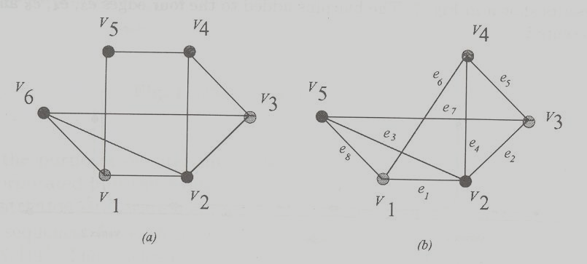
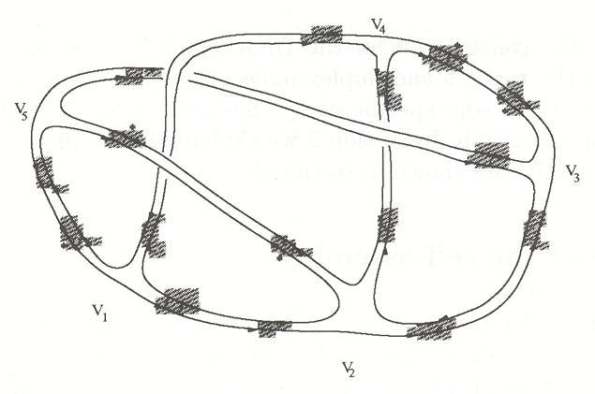
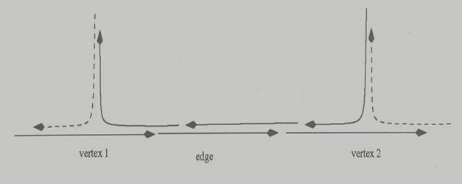
Design of the self-assembly
Fig 1. The graph to be DNA self-assembled
Fig 2. The final DNA structure representing
the graph in Fig 1(b)
Fig 3. Six DNA strands involved in assembling
an edge connection

Slide 5
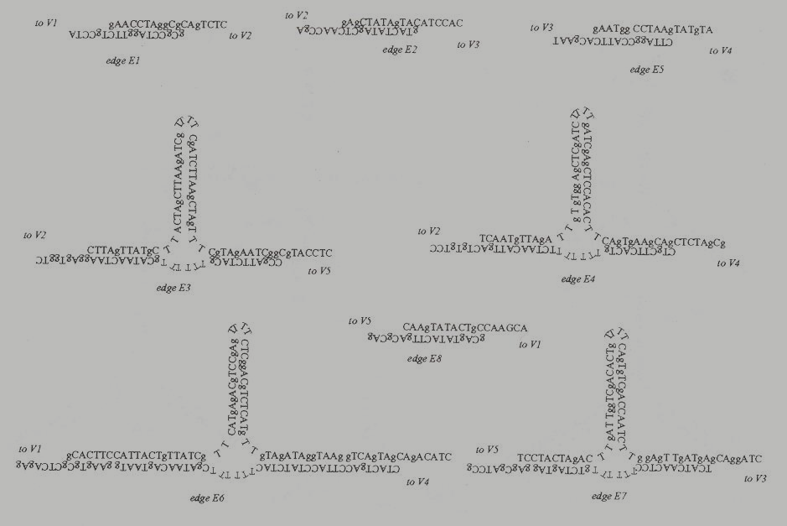
Fig 4. DNA sequences for the edges

Slide 6
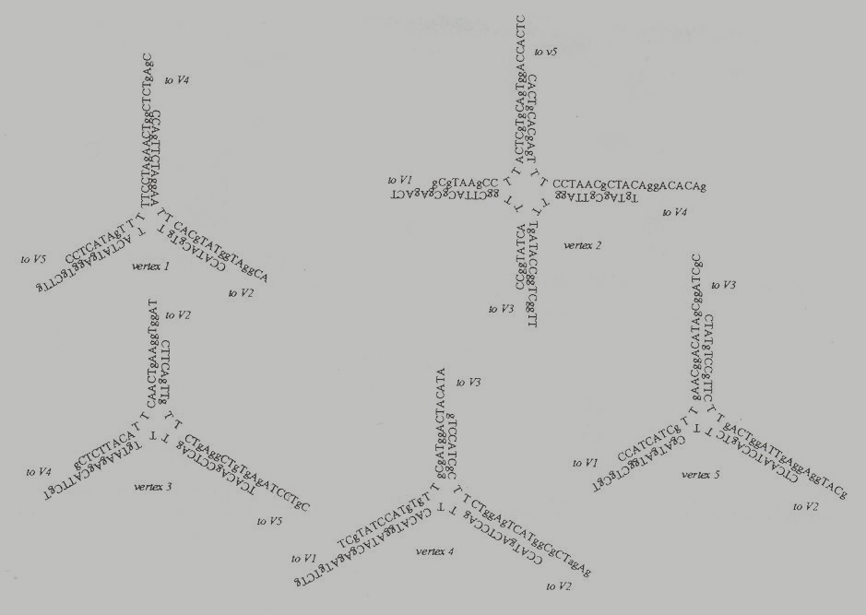
Fig 5. DNA sequences for the vertices

Slide 7
Experimental Methods
DNA oligonucleotide synthesis; 5 vertices & 4 edges
Junction & edge were annealed by heating 90℃ for 2min,slowly cooled to RT
  - 12% Polyacrylamide gel electrophoresis v2 & v5 (Fig. 7)
Expected final product labeled with r-³²P-ATP
  - V1, v3, v4, v5 all labeling for 1 hr (Fig. 2)
  - The ligation of the whole graph
  1) by annealing all junction & edges separately
  2) All complexes were mixing together & T4 DNA ligase at RT overnight
  3) The final single cyclic DNA: 1084 bases
  - Efficiency
Two-dimensional gel electrophoresis(Fig. 8)
  3.5% denaturing gel » 5% denaturing gel
  The final cyclic product; complex secondary structure( topoisomerase )
  Circled cyclic band(A-H) extraction, elution & linearization(95℃ for 20min)
  B, E: A unique clear band of the expected size 1100 bases

Slide 8
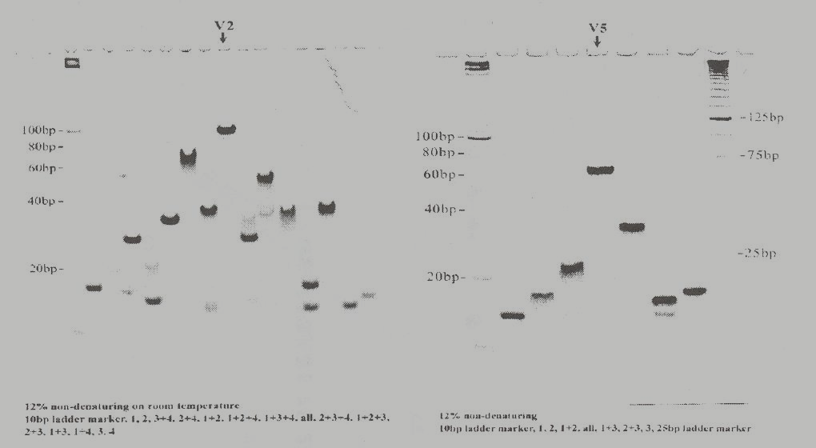
Experimental Results
Fig 6. Non-denaturing gels for the junction molecules representing
vertices v2 and v5

Slide 9
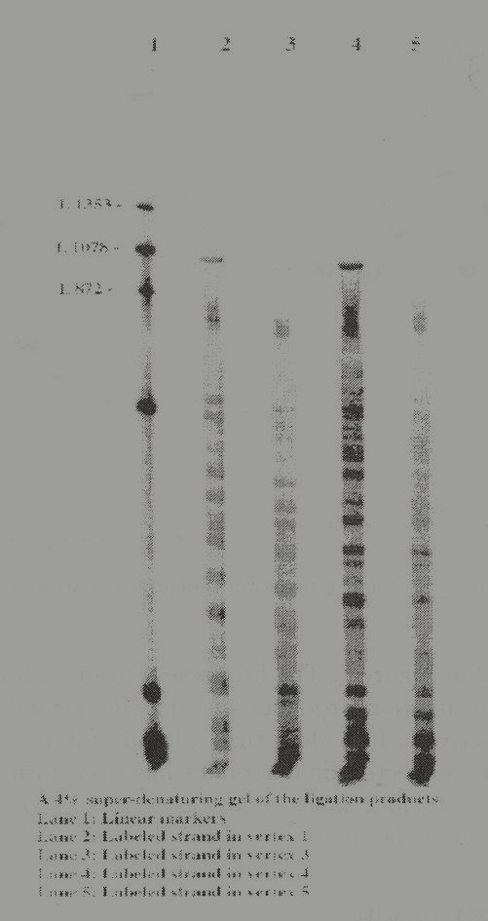
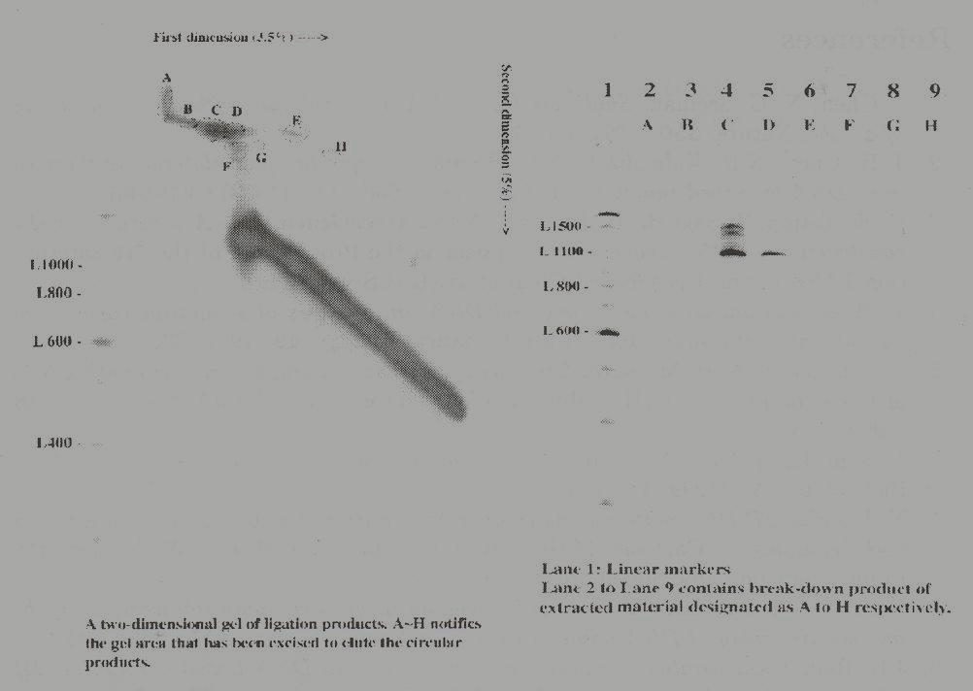
Fig 8. Left: 2D denaturing gel of the ligation
product
Right: denaturing gel of the linearization of
the bands extract from the 2D-gel
Fig 7. Ligation product of self-assembly

Slide 10
Concluding Remarks
Not confirm with the desired cyclic molecule
  By sequencing the final product & confirming with the sequence of the oligonucleotides
  The yield of the resulting molecules is very low,
  the extracted product will need to be amplified by PCR

