Slide 1
Binary Arithmetic for DNA Computers
R. Barua and J. Misra
Preliminary Proceedings of the Eighth International Meeting on DNA Based Computers, pp. 202-210, June 2002
Cho, Dong-Yeon

Slide 2
Abstract
A Recursive DNA Algorithm
  Adding two binary numbers
  O(log₂n) bio-steps
  O(n) different type of DNA strands
Salient Feature
  The input strands and the output strands have exactly the same structure

Slide 3
Introduction (1/2)
Previous Attempts
  [Guarneiri et al., 1996]
    Non-procedural since the output strands are vastly different in structure from the input strands
  [Gupta et al., 1997]
    It requires that all the possible intermediate results be coded manually one by one during processing.
  [Qiu and Lu, 1998]
    Possible number of encoding of different intermediate results seems to be exponential.
    The cleansing operation is not an error resistant operation.

Slide 4
Introduction (2/2)
Salient Features
  Fully procedural
    The structure of the output strands is exactly similar to that of the input strands.
  The number of different DNA strands required is at most of the order of size of the binary number.
  The number of bio-steps required for addition is, on average, O(log₂n).
  All logical operations on binary numbers can be performed very easily.

Slide 5
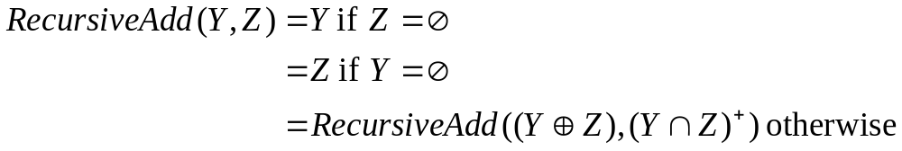

Recursive DNA Arithmetic (1/7)
Underlying Mathematical Model
  X[α]={i: α_{i} = 1} and X[β]={j: β_{j} = 1}
    X[101] = {3, 1} and X[011] = {2, 1}
  Z + i = {z+i: z∈Z} and Z⁺ = Z + 1
    Z = X[011], then Z⁺ = {3, 2}
  X₁ ⊕ X₂ = {x: x ∈ X₁ ∪ X₂ but x ∉ X₁ ∩ X₂}
    X[101] ⊕ X[011] = {3, 2}
  Add(α, β) = Val(RecursiveAdd(X[α], X[β]))

Slide 6
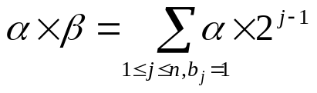
Recursive DNA Arithmetic (2/7)
  Multiplication
    X[α×2^{j-1}] = X[α] + j-1
  Subtraction
    2’s complement addition
  Division
    Once we can perform addition and subtraction then mapping of division in terms of these can be done using any of the standard digital arithmetic techniques.

Slide 7

Recursive DNA Arithmetic (3/7)
DNA Algorithm
  DNA encoding of binary numbers
    Each binary number is represented by a set of integers which are positions where bits set to 1.
    T[α] = {ds_{i}: i ∈ X[α]}
  Addition
    Step 0: Check whether T[α] or T[β] is empty.
    Step 1: Make T[α]⊕T[β] and T[α]∩T[β].
    Step 2: Increment by one.
    Step 3: Go back to step 0.

Slide 8
Recursive DNA Arithmetic (4/7)
  Multiplication
    Step 1: For each j ∈ X[β], construct test-tube T_{j}[α]
    Step 2: Perform addition concurrently with successive pairs of tubes.
  Subtraction
    Step 0: By GE, determine whether α ≥ β or β ≥ α. Assume α ≥ β.
    Step 1: Construct T[α], T[β] and T that consists of ds_{i} for all i.
    Step 2: Obtain T₁ = T - T[β].
    Step 3: Perform addition with T[α] and T₁.
    Step 4: Perform addition with T₁ and T[1].
    Step 5: Extract the DNA strands encoding n+1. The residual test tube gives the desired result.

Slide 9
Recursive DNA Arithmetic (5/7)
  Logical operation
    OR: Mix the test tubes T[α] and T[β].
    XOR: T[α]⊕T[β]
    AND: T[α]∩T[β]
    NAND: {1,…,n} – (T[α]∩T[β])
Use in Cryptography
  Implement the Vernam one-time-pad
    Encryption: T = T[α]⊕T[κ]
    Decryption: T[α] = T⊕T[κ]

Slide 10
Recursive DNA Arithmetic (6/7)
Complexity Analysis
  Time complexity
    Addition: O(log₂n)
    Multiplication: O((log₂n)²)
    Subtraction: O(log₂n)
    Logical Operations: O(1)
  Volume complexity
    At no stage do we require some strand to be destroyed or filtered out.
    So the total number of strands remains more or less constant.

Slide 11

Recursive DNA Arithmetic (7/7)
Errors
  The first source of error is the extract operation.
  More serious source of error
    Sliding or partial annealing which could take place because of periodic nature of our coding
  New coding

Slide 12
Conclusion
Methods for carrying out arithmetic and logical operations
  It can be easily implemented in the DNA computing paradigm
  Reducing errors
  Cryptographic implementation
The potential use for DNA computers depends one the efficiency of the bio-steps involved.

