Slide 1
Engineering Signal Processing in Cells:
Towards Molecular Concentration Band Detection
Subhayu Basu et al. , DNA8, (2002) 80-89
MEC Seminar
Su Dong Kim
2002. 7. 12.

Slide 2
Outline
Introduction
Background
Design of a Chemical Concentration Band Detection Circuit
Forward Engineering of Band Characteristics
Preliminary Experimental Results
Conclusions

Slide 3
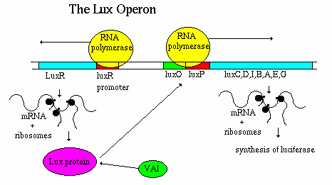
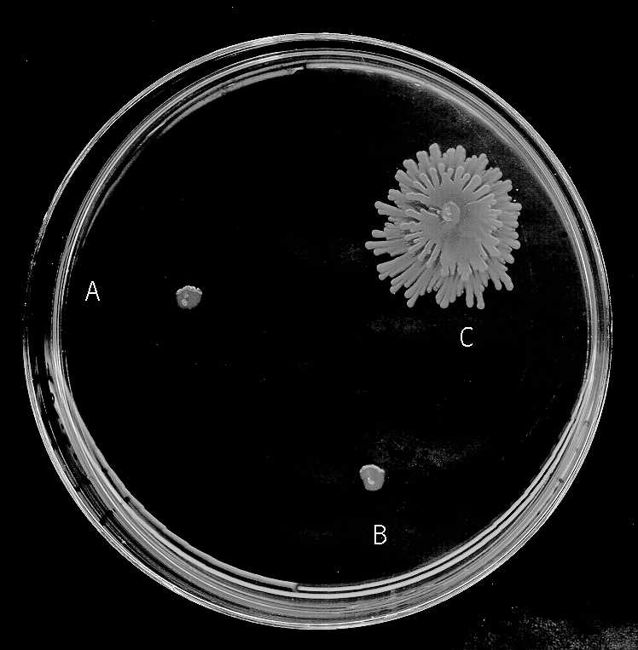
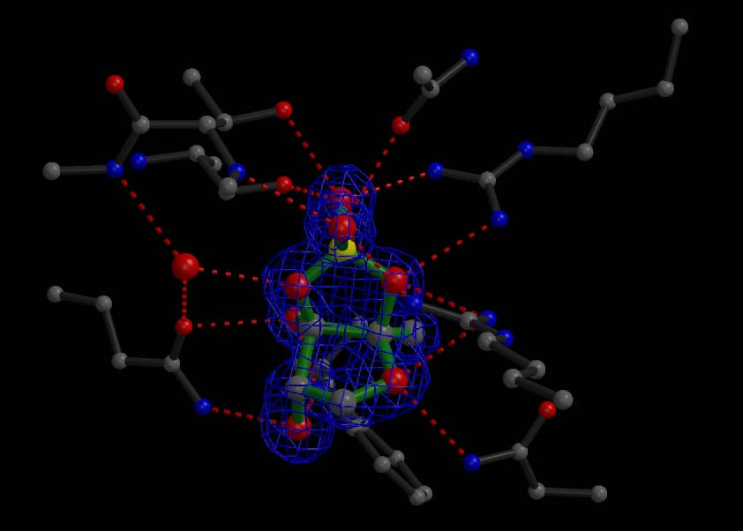
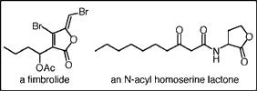
Introduction

Slide 4
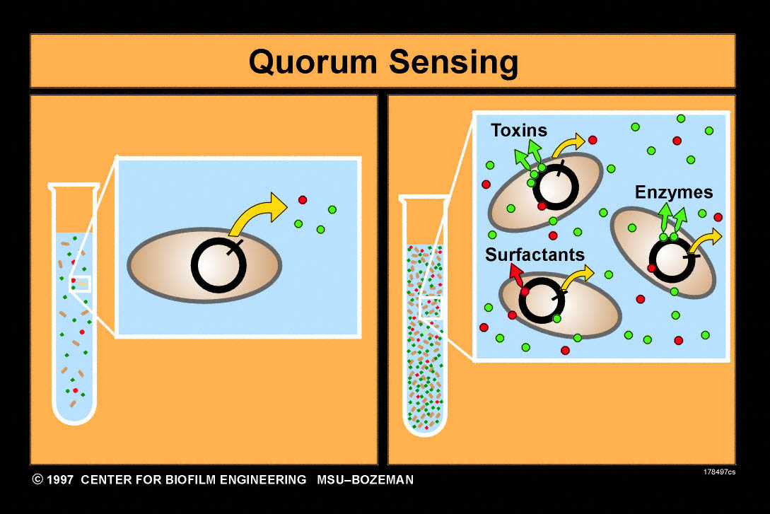
Background

Slide 5
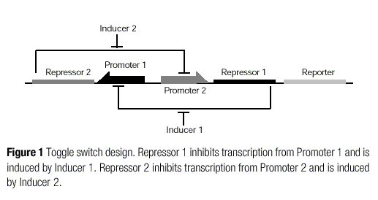
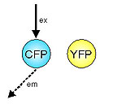
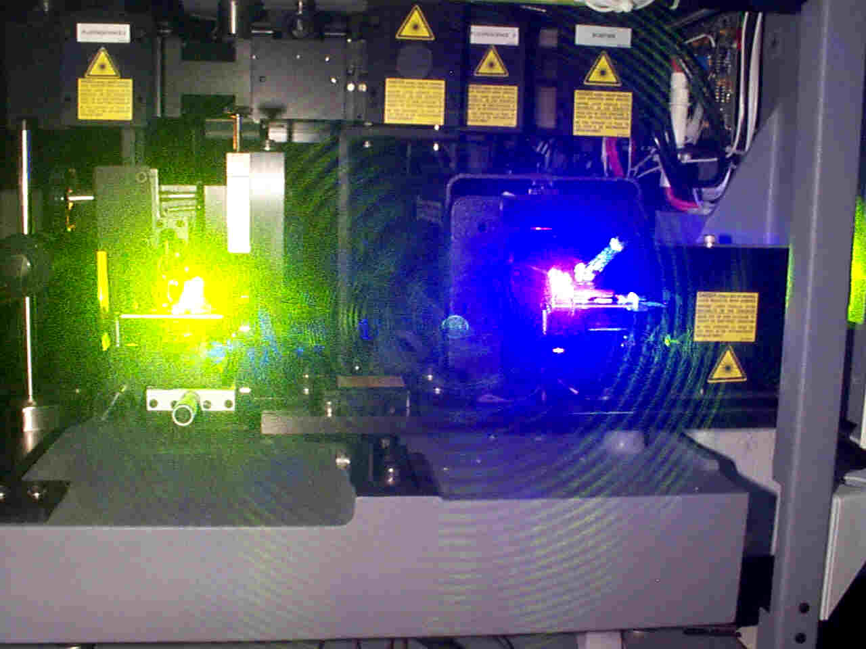
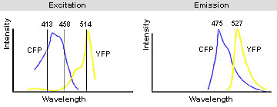
Synthetic gene network

Slide 6
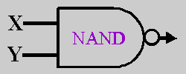
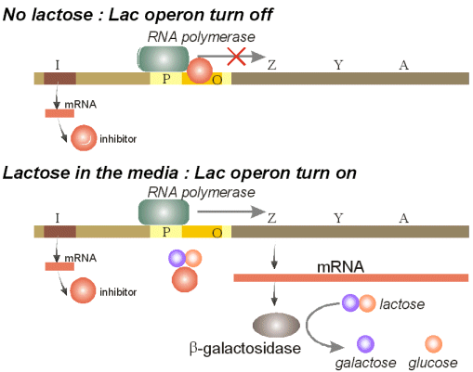
Design of a
Chemical Concentration Band Detection Circuit

Slide 7
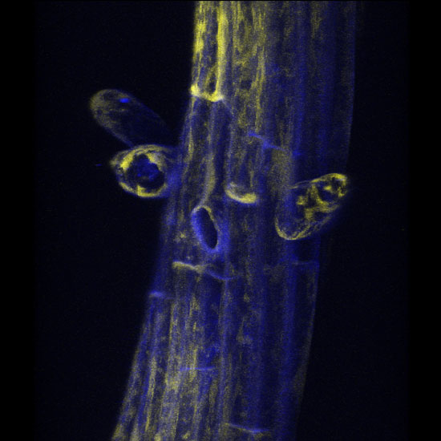
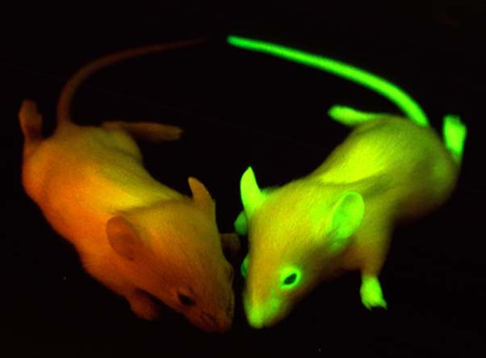
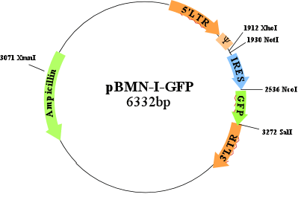
Forward Engineering of
Band Characteristics

Slide 8
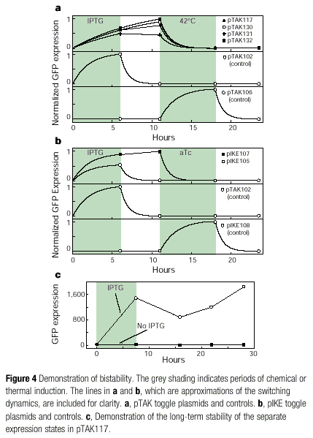
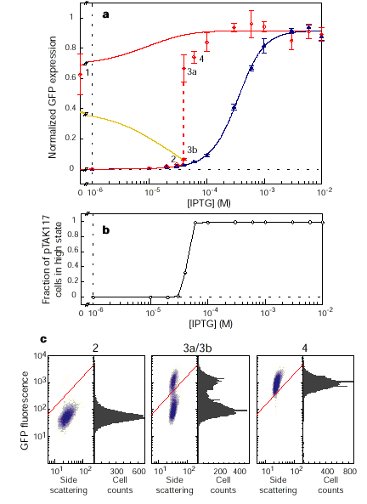
Preliminary Experimental Results

Slide 9
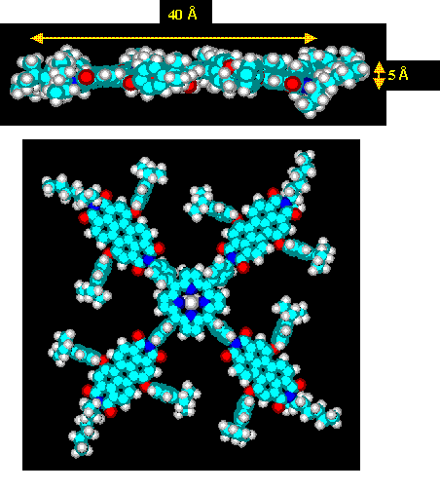
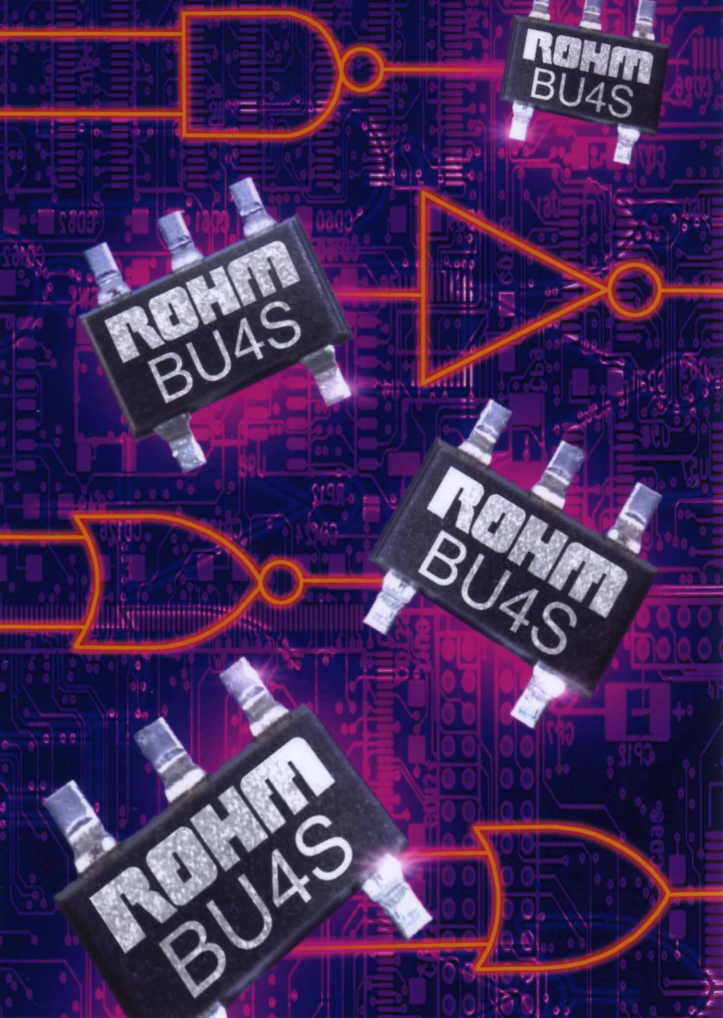
Conclusions

