Slide 1
A PCR-based Protocol for In Vitro Selection of Non-Crosshybridizing Oligonucleotides
R. Deaton, J. Chen, H. Bi, M. Garzon,
H. Rubin and D. H. Wood

Slide 2
Introduction
Evolution
In vitro evolution
Non-crosshybridizing olgonucleotides
Fitness function: implemented in an experimental protocol (Modified version of PCR)
Maximal amplification of mismatched oligonucleotides → Select maximally mismatched oligonucleotides

Slide 3
Protocol
Look Fig. 1. PCR with adjustable mutation and selection
Random region
PCR is done at a low temperature
→ Selectively amplifies oligonucleotides that are present in mismatched duplex configurations, and thus, have a lower thermal stability
Rapid quenching step (during annealing: heating and rapid cooling) that freezes pairs sequences attached at each end (Duplex configurations with a range of mismatches)

Slide 4
Carefully designed primers
  Uniqueness
  Restriction site

Slide 5
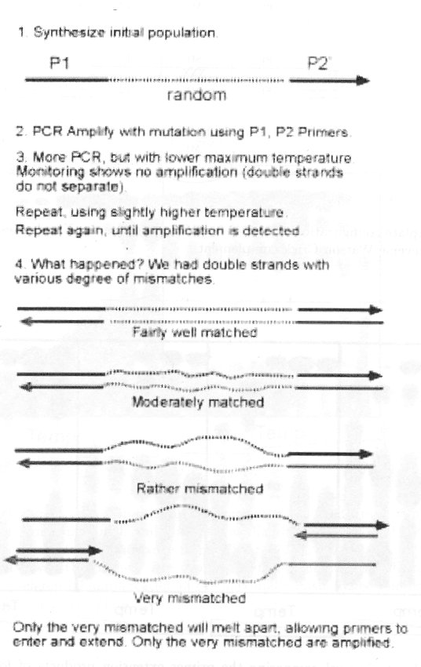
Fig. 1. PCR with adjustable mutation and selection

Slide 6
Experimental Design
Selection properties of PCR protocol
  The ability of the protocol to preferentially amplify maximally mismatched oligonucleotides rather than oligonucleotides that are closer to being Watson-Crick complements must be confirmed
  Selection property of the protocol had to be confirmed over a range of temperatures, as well as the efficiency of the polymerase at lower temperatures

Slide 7
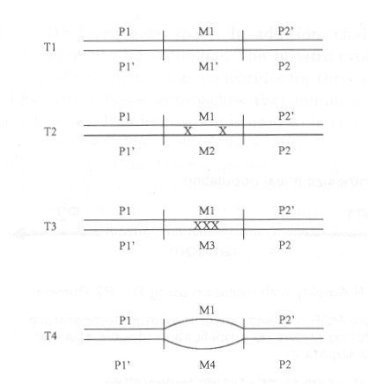
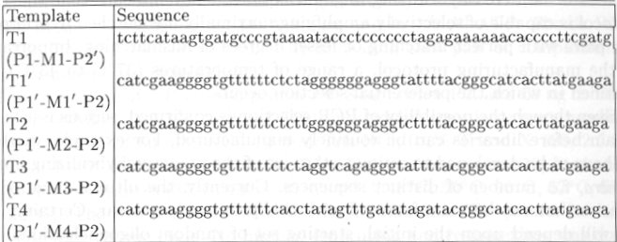
Four different degrees and type of mismatch
  T1: Watson-Crick complementary
  T2: two isolated mismatches
  T3: region of 3 contiguous mismatches
  T4: completely mismatched
  Sequence design: new software tool (211 page, NN model)

Slide 8
Materials and Methods
Oligonucleotides: purchased
Purification: denaturing polyacrylamide gel
Primer P1: ³²P-labeled
dsDNA: annealing each pair

Slide 9
PCR
  8ng ³²P-labeled primer P1, 8ng primer P2, 60ng dsDNA
  in a PCR buffer of 50mM KCl, 10mM Tris-HCl, 0.1% Triton X-100, 2.5mM MgCl2, 0.4mM 4dNTP
  3 U Taq DNA Polymerase in total 10 μl volume at designed temperatures
  The reaction was incubated for 60 minutes.
  The primer extension was done for just one cycle.
Electrophoresis
  12% denaturing polyacrylamide gel (8M Urea), run for 1 hour at 60℃, 400 V

Slide 10
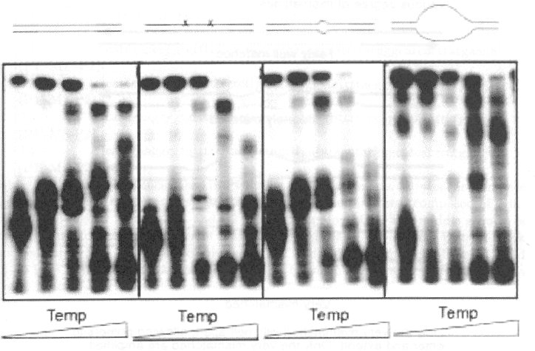
Fully extended 60 mer
Unsuccessfully extended
Primer (20 mer)
Fig. 3. A denaturing gel comparing the primer extension products of four different templates
  → Shows the ability of PCR to selectively amplify different degrees of matching

Slide 11
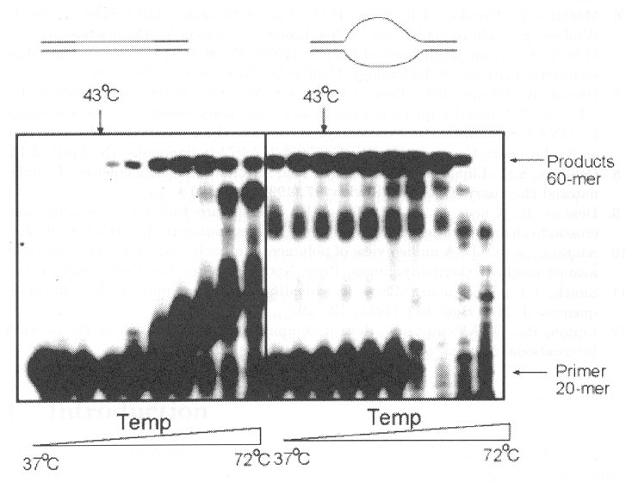
Fig. 4. A denaturing gel comparing the primer extension products of two templates
  Perfect matched vs maximally mismatched

Slide 12
Discussion
A first step in the in vitro manufacture of huge libraries of non-crosshybridizing oligonucleotides
PCR protocol is capable of selectively amplifying maximally mismatched hybrid paris over pairs with perfect matching or less degrees of mismatching
Serious issues still remain

