Slide 1
Algorithms for testing that DNA word designs avoid unwanted secondary structure
Mirela Andronescu, Danielle Dees, Laura Slaybaugh, Yinglei Zhao, Anne Condon, Barry Cohen, and Steven Skiena.
DNA8,
Summarized by Dongmin Kim, 2002. 7.

Slide 2

Introduction
Word sets are carefully designed behave well in the computation.
Structure freeness problem for combinatorial sets
  Pre-designed pairs of words
  Set S denoted by
  All of the 2^{t} strands in S are predicted to have no secondary structure.
Structure freeness problem for Kleene sets
  Are all words in S* structure free?

Slide 3
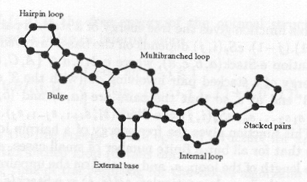
Secondary Structures

Slide 4
Free Energy
The free energy of a secondary structure measures the stability of a secondary structure.
The free energy of a folded RNA or DNA strand can be estimated as the sum of the free energies of its component loops.
The free energy of a loop depends on temperature.
  Assume that the temperature is fixed.

Slide 5
Standard Free Energy Model
eSs(i,j) : gives the free energy of a stacked pair that consists of i.j and (i+j).(j-1).
eHs(i,j) : gives the free energy of a hairpin loop closed by i.j.
eLs(i,j,i’,j’) : gives the free energy of an internal loop.
A strand s is structure free if its free energy is greater than 0.
The strand s has structure if the free energy is less than 0.

Slide 6
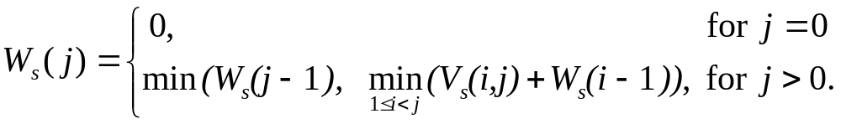
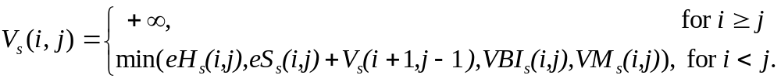
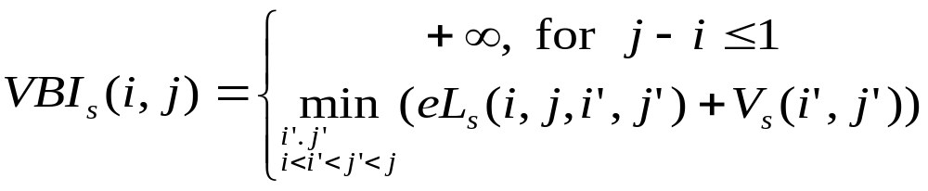
An Algorithm for Secondary Structure Prediction
Ws(j) is the minimum free energy taken over all structures of the strand s₁s₂…s_{j}.
Vs(i,j) is the free energy of the optimal structure, assuming i.j forms a base pair in that structure.
VBIs(i,j) is the free energy of the optimal structure, assuming i.j closes a bulge or internal loop.
VMs(i,j) is the free energy
of the optimal structure,
assuming i.j closes a multibranched loop.

Slide 7
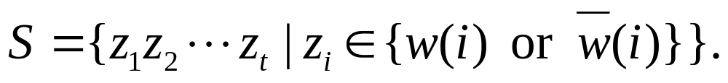
Structure Freeness for Combinatorial Sets
The input for the algorithm is a list of words.
Structure freeness for combinatorial sets
  Test that all strands in a combinatorial set S are structure free.

Slide 8
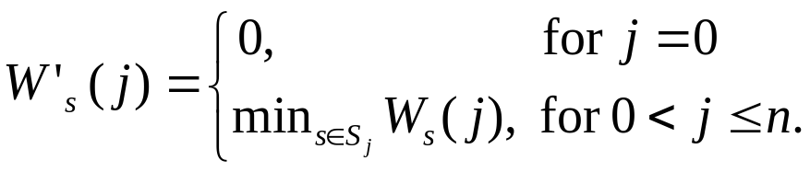
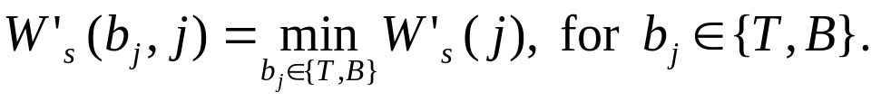
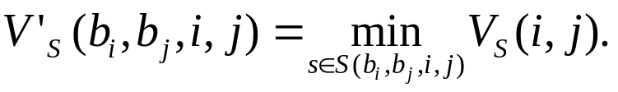
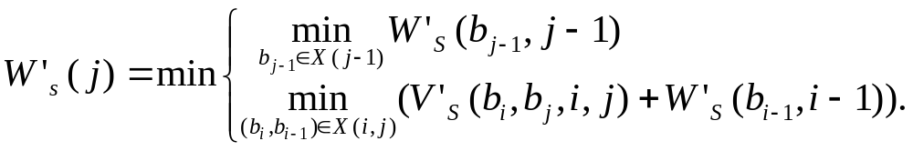
Algorithm for the Free Energy Model
W’s(j) is the minimum of Ws(j), taken over all s in S.

Slide 9
Structure Freeness for Kleene Sets
Definition
  Given a finite set S of equilength words, are all wrods in S* structure free?
Theorem 1.
  There is a constant m, which depends on S, such that if there is a word with structure in S*, then there is a word with structure in S^{m}. The constant m is bounded by exp(poly (|S|,l)), where l is the length of words in S.
Thus, we can apply the algorithm of the free energy model to this problem.

Slide 10
Conclusion
Present an efficient algorithm for determining structure freeness of combinatorial sets.
Future works
  Use partition functions to cover the range of alternative structures.
  Generalize to determine structure freeness of more general sets of strands.
    Ex) Adlemn’s Hamiltonian graph experiments.

