Slide 1


The Design of Autonomous DNA
Nanomechanical Devices:
Walking and Rolling
John H. Reif
Duke University

Slide 2
Prior Nanomechanical Devices built of DNA
Seeman
used rotational transitions of ds DNA conformations between the
B-form (right handed) to the Z-form (left-handed) controlled by ionic
effector molecules and
Yurke and Turberfield
used a fuel DNA strands acting as a hybridization catalyst to
generate a sequence of motions in another tweezers strand of DNA
extended this technique to be DNA sequence dependant
the two strands of DNA bind and unbind with the overhangs to
alternately open and shut the tweezers.
Other Related Work:
Shapiro’s recent autonomous 2 state DNA computing machine
uses DNA ligase and two restriction enzyme

Slide 3
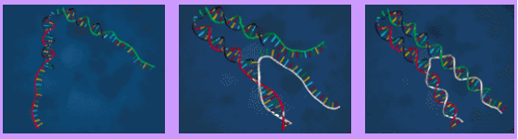
Bernard Yurke’s Molecular Tweezers (Bell Lab): Composed of DNA and powered by DNA hybridization.
Two ds DNA arms are connected by a ssDNA hinge
Two ssDNA “handles ” at the ends of the arms.
To close tweezers:
Add a special “fuel ” strand of ssDNA..
The “fuel ” strand attaches to the handles and draws the two strand
arms together .

Slide 4
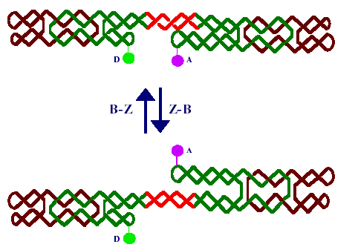
B-Z DNA Nanomechanical Device
[Seeman, 1999]

Slide 5
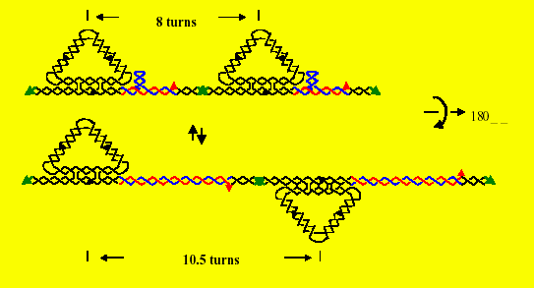
DNA Nanomechanical Device (Hao, Duke)
Walking Triangles:
By binding the short red strand (top figure) versus the long red
strand (bottom figure) the orientation of and distance between the triangular tiles is altered.
Applications:
Programmable state control for nanomechanical devices.

Slide 6
Key restrictions on the use of prior DNA nanomechanical devices:
Minor Restriction:
They can only execute one type of motion
(rotational or translational).
Major Restriction:
Prior DNA devices require environmental changes
such as temperature cycling or bead treatment of
biotin-streptavidin beads to make repeated motions.
Our Technical Challenge:
To make an autonomous DNA nanomechanical device
that executes cycles of motion
(either rotational or translational or both)
without external environmental changes.

Slide 7
Designs for the first autonomous DNA nanomechanical devices that execute cycles of motion without external environmental changes.
Walking DNA device
Uses ATP consumption by DNA ligase in conjunction
with restriction enzyme operations.
Rolling DNA device
Uses hybridization energy
Generate random bidirectional movements that acquire after n
steps an expected translational deviation of O(n1/2).

Slide 8
Energy sources that can fuel
DNA movements:
(i) ATP consumption by DNA ligase in
conjunction with restriction enzyme
operations
(ii) DNA hybridization energy in trapped states
(iii) kinetic (heat) energy

Slide 9
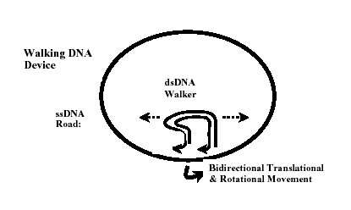
Walking DNA Autonomous Nanomechanical Device:
Energetic: Uses ATP consumption by DNA ligase in
conjunction with
restriction enzyme operations : Achieves random
bidirectional translational and rotational motion
around a circular ssDNA strand.

Slide 10

Walking DNA Device Construction
The Road
A circular repeating strand R of ssDNA written in 5’ to 3’ direction from left to right.
consists of an even number n of subsequences, which we call steppingstones, indexed from 0 to n-1 modulo n.
The i^{th} steppingstone consists of a length L
(where L is between 15 to 20 base pairs) sequence
A^{i} of ssDNA. the A^{i} repeat with a period of 2.

Slide 11
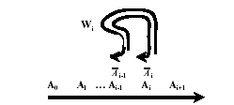
Walking DNA Device Construction
The i^{th} Walker
A unique a partial duplex DNA strand W_{i} with 3’ ends i₋₁ and i that are hybridized to consecutive i₋₁th and i^{th} steppingstones A_{i-1} and A_{i}

Slide 12
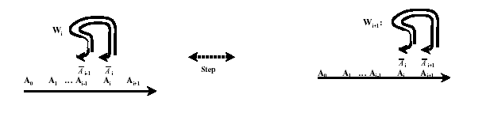
The Goal of the Device Construction
Bidirectional, translational movement
both in the 5’ to 3’ direction (from left to right) and vise versa
(in the 3’ to 5’ direction) on the road.
The i^{th} walker W_{i} will reform to another partial duplex DNA strand
called the _{i+1}th walker W_{i+1} which is shifted one unit over to the left
or the right.
Cycle back in 2 stages, so that W_{i+2} = W_{i} for each stage i.

Slide 13
Use 2 distinct types of restriction enzymes
Use DNA ligase
provides a source of energy (though ATP consumption) and
a high degree of irreversibility.
Simultaneous Translational and Rotational Movements
Secondary structure of B-form dsDNA Rotates 2∏ radians
every approx 10.5 bases
So in each step of translational movement, the walker rotates 1/10.5 around the axis of the road.

Slide 14
Sequence design
(i) use superscript R to denote the reverse of a sequence
(ii) use overbar to denote the complement of an ssDNA sequence.
To ensure there is no interaction between a walker
and more than one distinct road at a time:
- use a sufficiently low road concentration and solid support attachment
of the roads.
To ensure there is no interaction between a road and
more than one walker:
- we use a sufficiently low walker concentration.

Slide 15


Definition of the Walker W_{i}
walker W_{i} has:
the 3’ end _{i-1} hybridized to steppingstone A_{i-1} on the road.
the 3’ end i hybridized to steppingstone A_{i} on the road.
Definition of the Stepper S_{i}

Slide 16
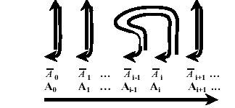


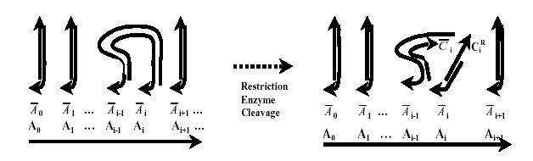
Hybridization of the Walker to steppingstones of the Road
Resulting Products of Cleavage
Restriction Enzyme Cleavage of the Walker

Slide 17


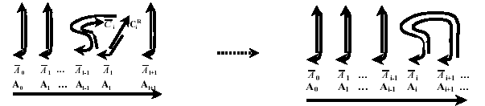
The Reformation of the Walker

Slide 18
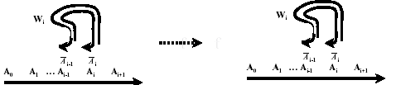
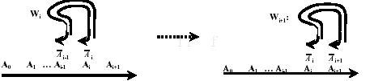
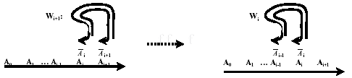
Possible Movements of the Walker
Forward:
Stall:
The cleavage operation can be reversed by re-hybridization
Reversal:
The walker has two possible (dual) restriction enzyme
recognition sites which can result in a reversal of movement

Slide 19
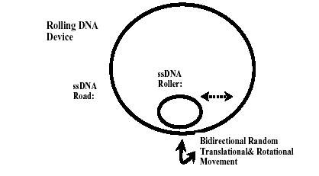
Rolling DNA Autonomous Nanomechanical Device
requires no temperature changes
makes no use of DNA ligase or any restriction enzyme
it uses instead the hybridization energy of DNA in trapped states

Slide 20
Oglionucleotides used in the Rolling DNA Construction
Let A0, A1, B0, B1 each be distinct oglionucleotides:
of low annealing cross-affinity,
consisting of L (L can be between 15 to 20) bases pairs.
Let a0, a1 be oglionucleotides
derived from A0, A1 by changing a small number of bases,
so their annealing affinity with 0^{R}, 1^{R} respectively is somewhat reduced,
but still moderately high.
Strong Hybridization:
Hybridization between A0 and reverse complementary sequence 0^{R}
(or between A1 and reverse complementary 1^{R})
Weak Hybridization:
Hybridization between a0 and 0R (or between a1 and 1^{R})
Key Idea:
A strong hybridization is able to displace a weak hybridization.

Slide 21

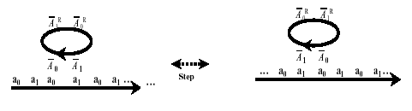
Rolling DNA Device
The Road: an ss DNA
with a0, a1, a0, a1, a0, a1, … in direction from 5’ to 3’,
consisting of a large number of repetitions of the sequences a0, a1.
The Wheel: a cyclic ss DNA
of base length 4L
with 0^{R}, 1^{R}, 0^{R}, 1^{R} in direction from 5’ to 3’
this corresponds to 1, 0, 1, 0 in direction from 3’ to 5’.

Slide 22
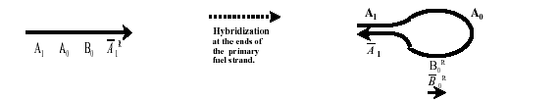
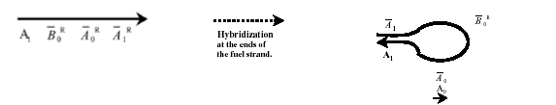
DNA Fuel Loop Strands
Loop Configuration
Primary Fuel Strand
Complementary Fuel Strand
Loop Configuration

Slide 23
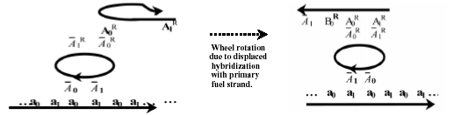
The Sequence of Events of a Feasible Movement of the Wheel
Hybridizations of a 0th primary fuel strand:
Initial Hybridization of the second segment A₀ of the 0th primary
fuel strand with the reverse complementary segment 0^{R} of the wheel.
Extension of that initial hybridization to a hybridization of two first
segments A₁, A₀ of the 0th primary fuel strand with the consecutive
reverse complementary segments 1^{R} 0^{R} of the wheel.

Slide 24
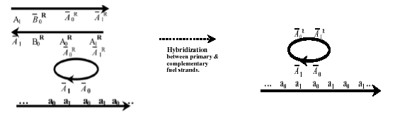
The Sequence of Events of a Feasible Movement of the Wheel
2) Hybridizations of a type 0 complementary fuel strand:
Hybridization with reverse complementary subsequences of the type 0
primary fuel strand,
first at that fuel strand’s newly exposed 3’ end segment A₁^{R}
then at B₀.
Formation of a type 0 fuel strand duplex removes the type 0 fuel
strands from the wheel, completing the step.

Slide 25
Potential Applications
Array Automata:
The state information could be stored at each site
of a regular DNA lattices, and additional mechanisms for finite state
transiting would provide for the capability of a cellular array
automata.
Nanofabrication:
These capabilities might be used to selectively
control nanofabrication stages. The size or shape of the lattice may
be programmed through the control of such sequence-dependent
devices and this might be used to execute a series of foldings

Slide 26
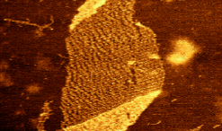

DNA Lattices
DNA tiles of size 14 x 7 nanometers
Composed of short DNA strands with Holliday
Key Application: Molecular robotic Components

Slide 27
