Slide 1
On Template Method for DNA Sequence Design
Satoshi Kobayashi, Tomohiro Kondo.
DNA8,
Summarized by Dongmin Kim, 2002. 8.

Slide 2
Introduction
The design of DNA sequences is an important problem.
  Not only in DNA computing but also in other biotechnologies such as the design of DNA chips.
The design of DNA sequence is dependent on the protocol of biological experiments.
Template method
  The position of [GC] and [AT] are fixed for all sequences.
  The position of [AG] and [CT] are determined for each sequence using the theory of error correcting code.

Slide 3
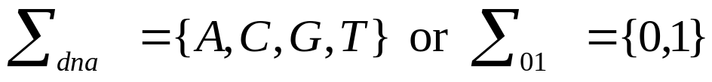

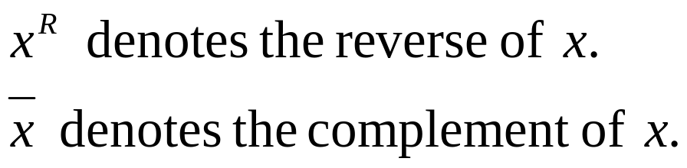
Template Method (1)
Alphabet
is a word on the alphabet.
lg(x) denotes the length n of x.
<x> denotes the proper subword of x of length n-2.
H(x,y) denotes the Hamming distance.
H(S) is the minimum Hamming distance among all pairs of distinct elements in S.

Slide 4
Template Method (2)
n<=m, H_{M}(x,y) = min{H(x,y’) | y’ is a subword of y of length n}.
Constraints
  Hamming distance – should be at least a given integer d.
  Hamming distance with reverse-complement.
  Hamming distance between concatenated words.
  GC content

Slide 5
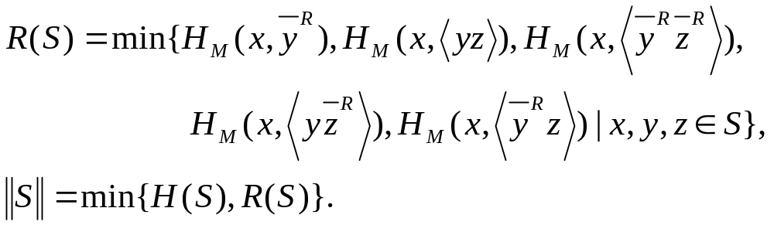


Template Method (3)
Problem 1 For a given positive integer d and n, design a set S of n words over such that and GC content of each word in S is the same to each other.

Slide 6
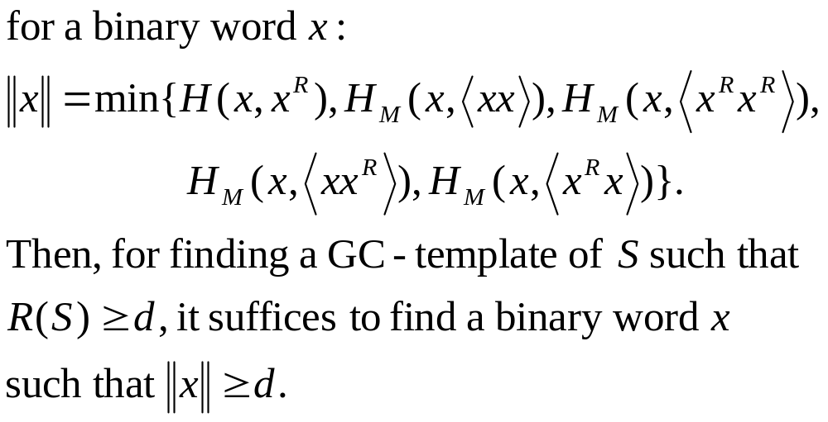
Template Method (4)

Slide 7
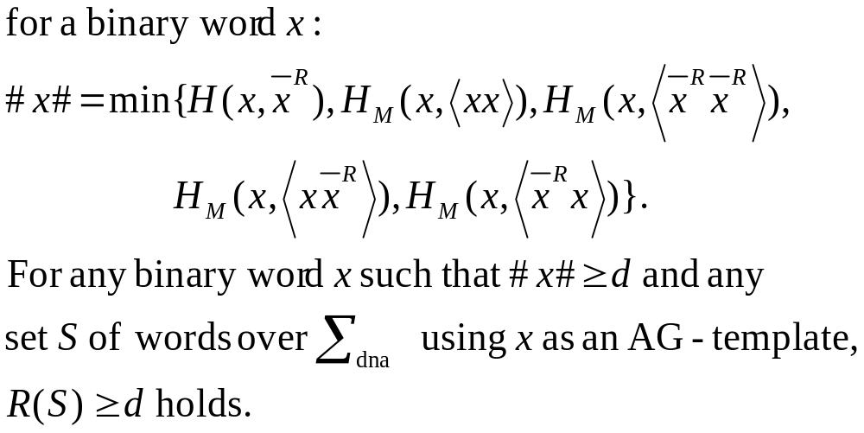
DNA Sequence Design Using AG-Templates (1)

Slide 8
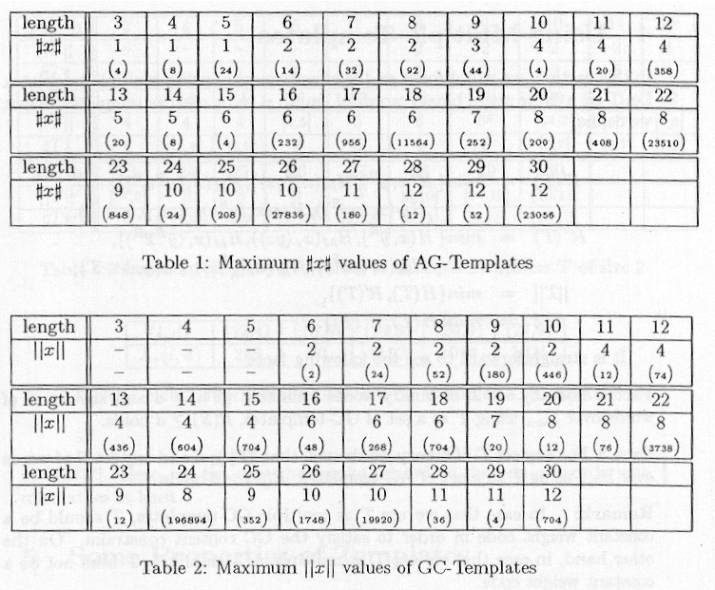
DNA Sequence Design Using AG-Templates (2)

Slide 9
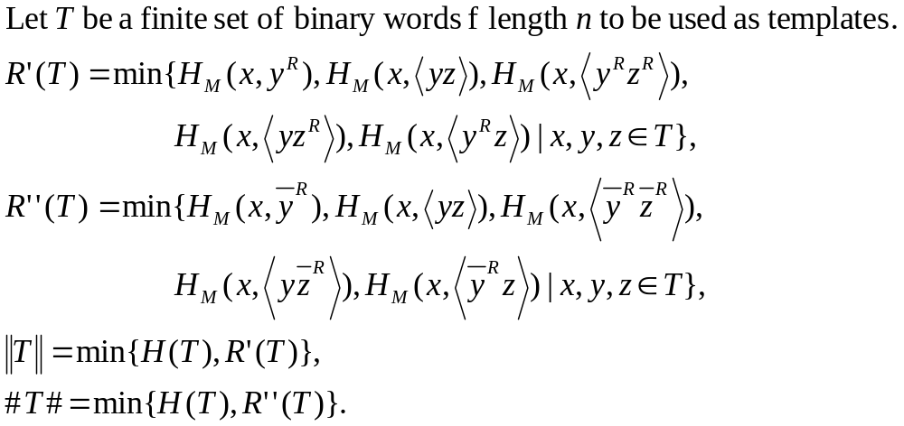
Using Multiple Templates (1)

Slide 10
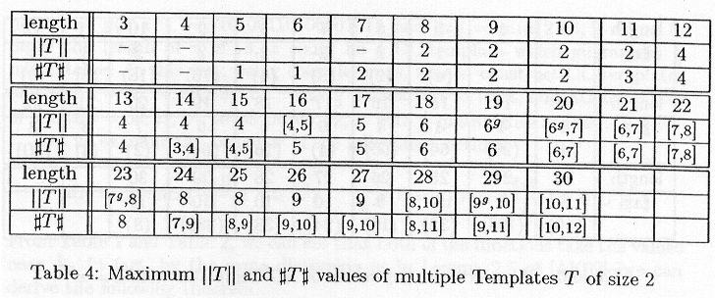
Using Multiple Templates (2)

Slide 11
Conclusions
Extend the template method.
AG-templates instead of GC-templates show a better performance at some lengths.
Propose to use multiple templates method.
Future works
  The stability of structures should be dealt with using energy based methods.
  The validity of template method should be checked by biological experiments.
  Further theoretical analysis should be done in a more general framework.

