Slide 1
Biomolecular Implementation of Computing Devices with Unbounded Memory
Matteo CAVALIERE, Nataša JONOSKA, Nadrian C. SEEMAN.
Department of Computer Science and Artificial Intelligence,
University of Sevilla,
Sevllia, Spain

Slide 2
Introduction
Implement automata with unbounded stack memory (PDA)
  Using circular DNA strands and the enzyme called PsrI that is able to cut a DNA strand in two places at the same time.
Implement push-down automata with two stacks (2PDA)
  Using 2 circular molecules glued with a DX molucule and a class IIs restriction enzyme.

Slide 3
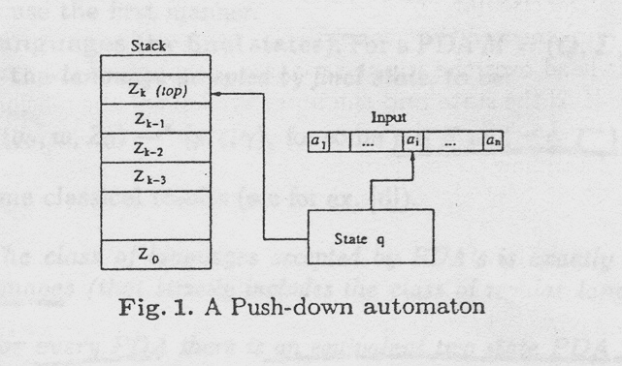
1. Push-down automata with one stack
A push-down automaton is a finite state machine with a stack memory. The class of languages accepted by PDA’s is the class of context-free language.

Slide 4
Push-down automata with one stack (contd.)
Definition 1. A push-down automaton M is a system (Q,Σ,Г,δ,q₀,Z₀,F) where:
  Q is a finite set of states;
  Σ is an input alphabet (it’s elements are called input-symbols);
  Г is a stack alphabet (it’s elements are called stack-symbols);
  q₀ in Q is the initial state;
  Z₀ in Г is a particular stack-symbol called the start symbol;
  F ⊆ Q and the set of final states;
  δ is the transition mapping from Q×(Σ ∪{ε})×Г to finite subsets of Q× Г *

Slide 5
Push-down automata with one stack (contd.)
Theorem 1. The class of languages accepted by PDA’s is exactly the class of context-free languages (that strictly includes the class of regular languages).
Theorem 2. for every PDA there is an equivalent two state PDA that accepts the same language.

Slide 6
Implementing PDA’s: An example
Without loss of generality, we suppose that every input word is inserted with a symbol indicating end of input denoted with τ.

Slide 7
Implementing PDA’s: An example (contd.)
A non regular language L₁ = {a^{n}b^{n} | n∈N},
a PDA accepting the language L1 is the following:
  M₁ = (Q,Σ,Г,δ,q₀,Z₀,F), with Q = {0, 1}, Σ = {a, b}, Г = {Z, #}, Z₀ = #, F = {1}.
  δ is, (i) δ(0, a, #) = (0, Z#)
  (ii) δ(0, a, Z) = (0, ZZ)
  (iii) δ(0, b, Z) = (1, ε)
  (iv) δ(1, b, Z) = (1, ε)
  (v) δ(0, τ, #) = (1, #)

Slide 8
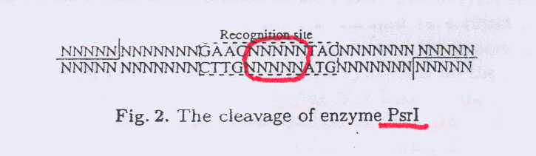
Restriction enzyme PsrI
Using the enzyme PsrI together with circular molecules containing the information for the stack and the tape, and linear DNA strands for the transitions.

Slide 9
Sequence design
Input symbols: a = TTC and b = AAC
Stack symbols: Z = TCCAG and # = CAAAC
Input symbols are separated with GC
end-of-input (τ ): CAGGC

Slide 10
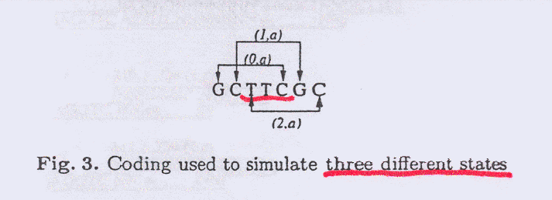
Sequence design (contd.)
Example: an input sequence “aabb” is,
GCTTCGCTTCGCAACGCAACGCCAGGC
The sequence GC allows “moving” between different states.

Slide 11
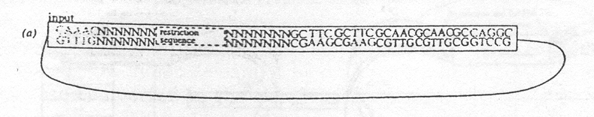
Circular DNA (init.)
Initial configuration
  The first part CAAAC represents the initial configuration of the stack.
  The middle portion GAACNNNNNNTAC is the restriction site for the enzyme PsrI.
  The final part is the input.

Slide 12
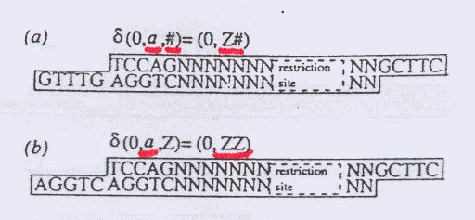
Transitions (a-b)
Five linear DNA strands that encode the transitions of the PDA are also needed.
(a) and (b) in Fig. 4 add a symbol Z on the stack, do not change the states. This is obtained by having NN between the restriction site and the sticky-end representing the input symbol to the right.

Slide 13
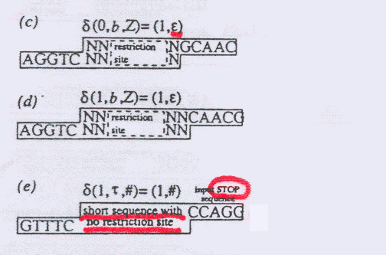
Transitions (c-e)
The transistions (c) and (d) are similar, except they are removing Z’s from the stack.
(e) is the transition 5 and stops in the final state.

Slide 14
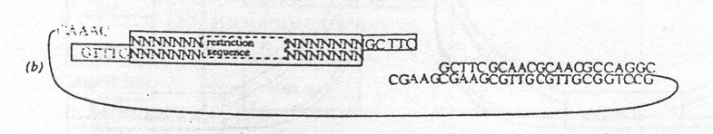
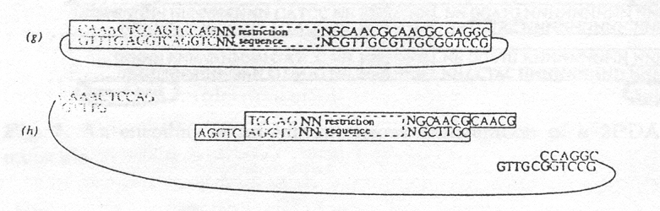
Circular DNA (some stages)

Slide 15
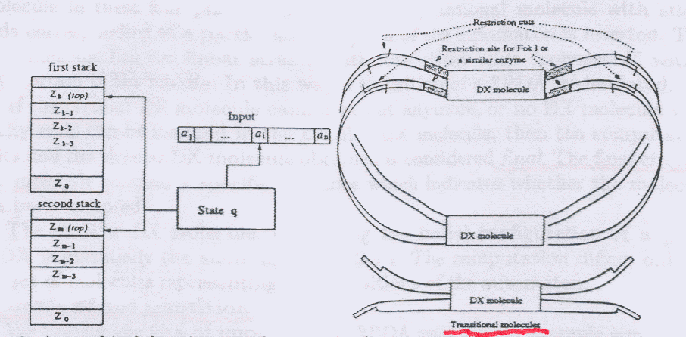
2. Implementing 2PDA’s using DX molecules
Two circular molecules are “connected” with two DX molecules (called here circular DX molecule) and a class IIs restriction enzyme FokI or a similar.

Slide 16
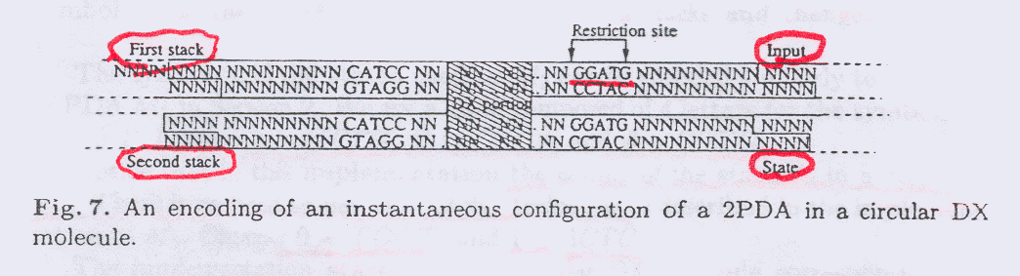
Implementing 2PDA’s using DX molecules (contd.)
The restriction site for FokI is placed in four places of the strands.

Slide 17
Implementing 2PDA’s using DX molecules (contd.)
2PDA
  M₂ = (Q,Σ,Г,δ,q₀,Z₀, Z₁,F), with Q = {0, 1},
Σ = {a}, Г = {Z, #}, Z₀ = Z₁ = #, F = {1}.
  δ(0, a, #, #) = (1, Z#, Z#)
Sequence design
  a = GTTG, Z = TCCA, # = GCTG
  The coding of the state is in a “direct” way. There is no need to use the “shift” technique.
  0 = TGGT, 1 = ACTC

Slide 18
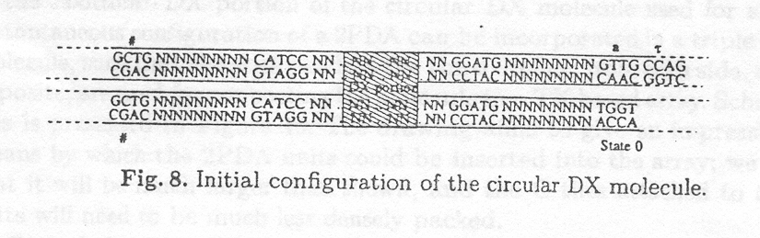
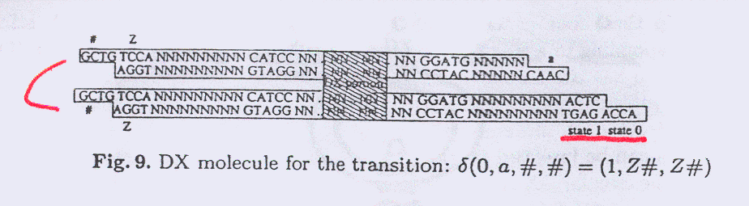
Circular DX molecules & Transitions

Slide 19
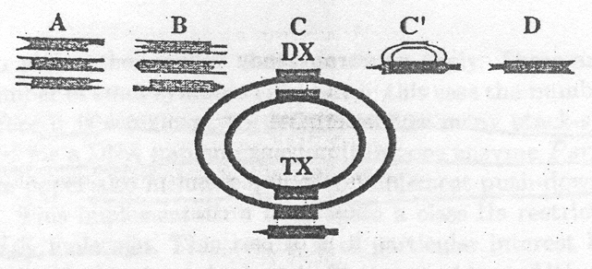
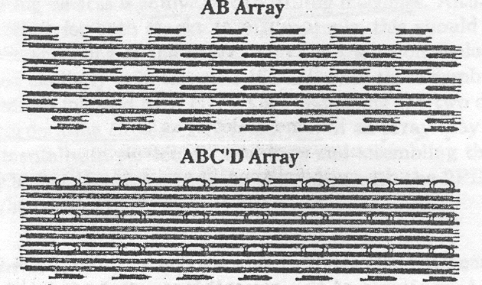
3. 2PDA in an array
By including the 2PDA molecules in an array we can potentially (a) scale up the computational process and (b) avoid mutual interactions between the circular DX molecules.

