Slide 1
DNA starts to Learn Poker
David Harlan Wood
Hong Bi
Steven O.Kimbrough
Dongjun Wu
Junghuei Chen

Slide 2
Game Strategies
Game: a situation in which two or more players make moves(or plays)
  The reward received by a player for its moves depends in part on the moves made by the other player(s)
  Dynamic process of adapting one’s strategies to exploit the mistakes of opponents.

Slide 3
Simplied poker
  Player’s turn
    Dealer deals a single card to player (ace or 2)
    If the card is an ace, player must say “1”
    If the card is a 2, player can say “2” and lose $1
    Or Player can say “1” (bluffing)
  Dealer’s turn (when player says “1”)
    Dealser may fold and lose $1
    Dealer may call and see player’s card
      If the card is 1 player wins and win $2
      If the card is 2 dealer wins and win $2

Slide 4
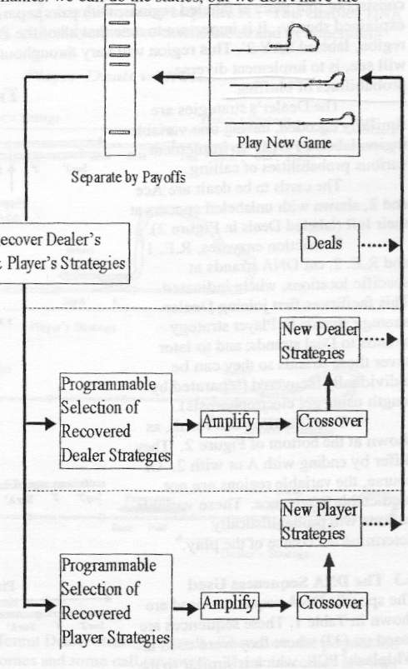
Evolving strategies

Slide 5
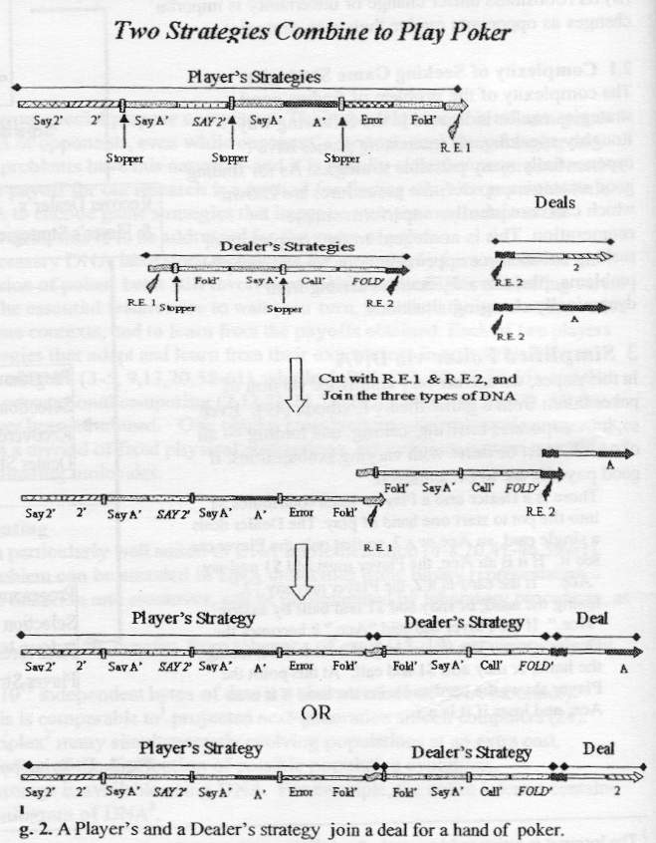
Gene encoding
  Seperated dealer’s strategies, player’s strategies, deal sequence.
  ‘SAY 2’ and ‘FOLD’ are random 15-mers to implement various probabilities.

Slide 6
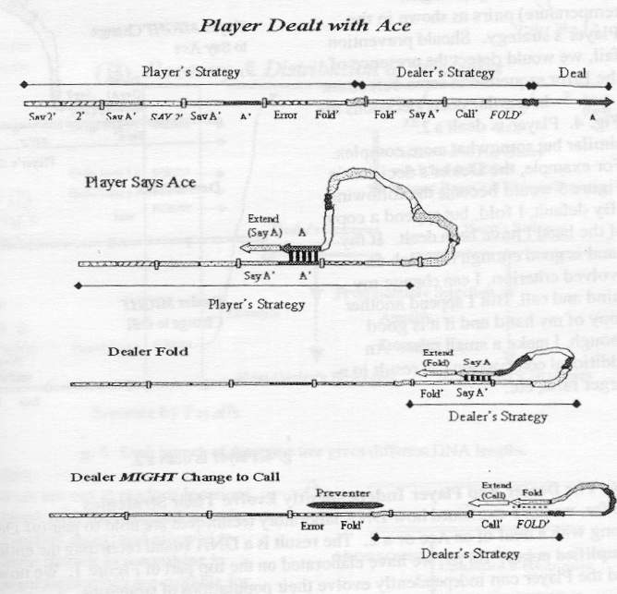
Playing Poker using whiplash PCR
  When player says ‘Ace’
  Dealer chooses call or fold
    Select fold by default
      Extend to make ‘Fold’ sequence
    Success of pairing depends on FOLD’ sequence which varies between each gene.
    If the probability is large enough (Fold-FOLD’ pair) Call is selected
      Extend to make ‘Call’ sequece

Slide 7
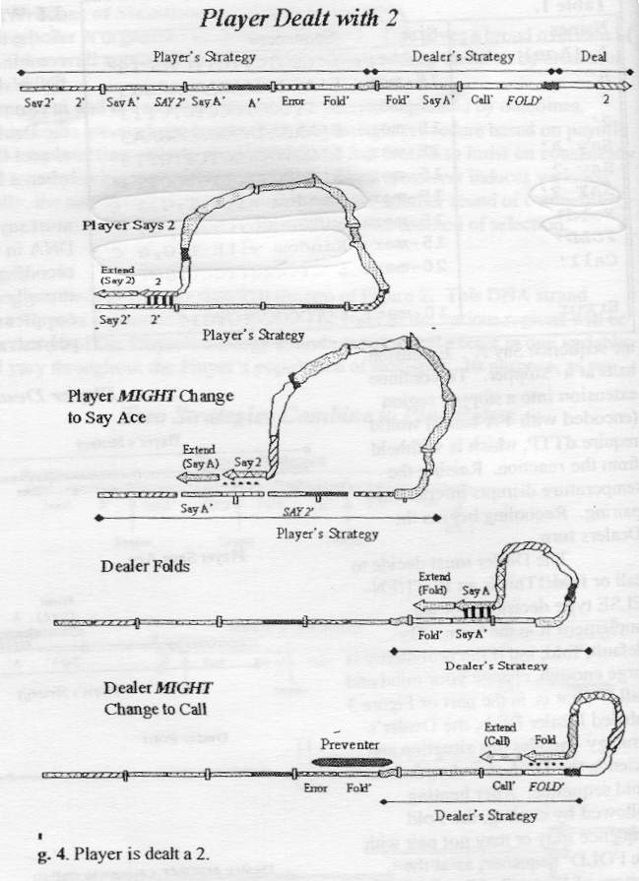
Playing Poker using whiplash PCR
  When player gets 2
  Player chooses to say ace or 2
    Select ‘say 2’ by default
      Extend to make ‘Say 2’ sequence
    Select ‘say ace’ if pairing between Say 2-SAY 2’ success
  Dealer chooses call or fold if player chooses ‘Say 1’

Slide 8
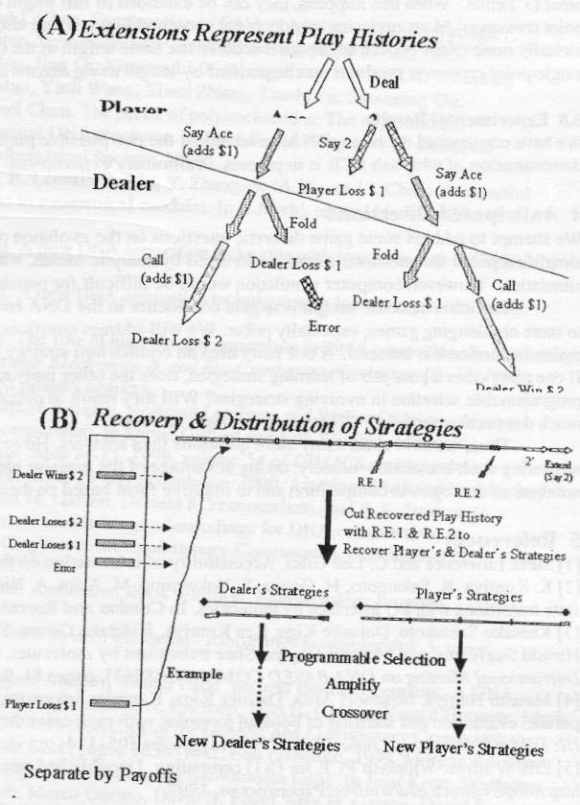
Fitness evaluation/Selection
    All 5 outcomes can be differed with final lengths of the DNA strands.
    Gel electrophoresis can be used to separate game histories by outcomes.
    By Restriction enzyme, DNA strands for player’s strategy, dealer’s strategy can be recovered and used for next generation.

Slide 9
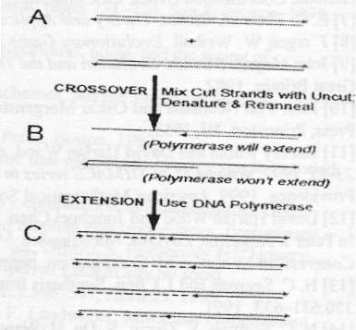
Crossover
Crssover procedure
  Start with double stranded PCR product obtained restoring population size.
  Unreserved DNA strands are cut at random loactions and combined with reserved ones.
  Mixture is melted and cooled down.
  Use DNA polymerase to extend DNA strand to complete 1-point crossover.
  Use denaturing gel electrophoresis to purify crossover products.

